Slide 1
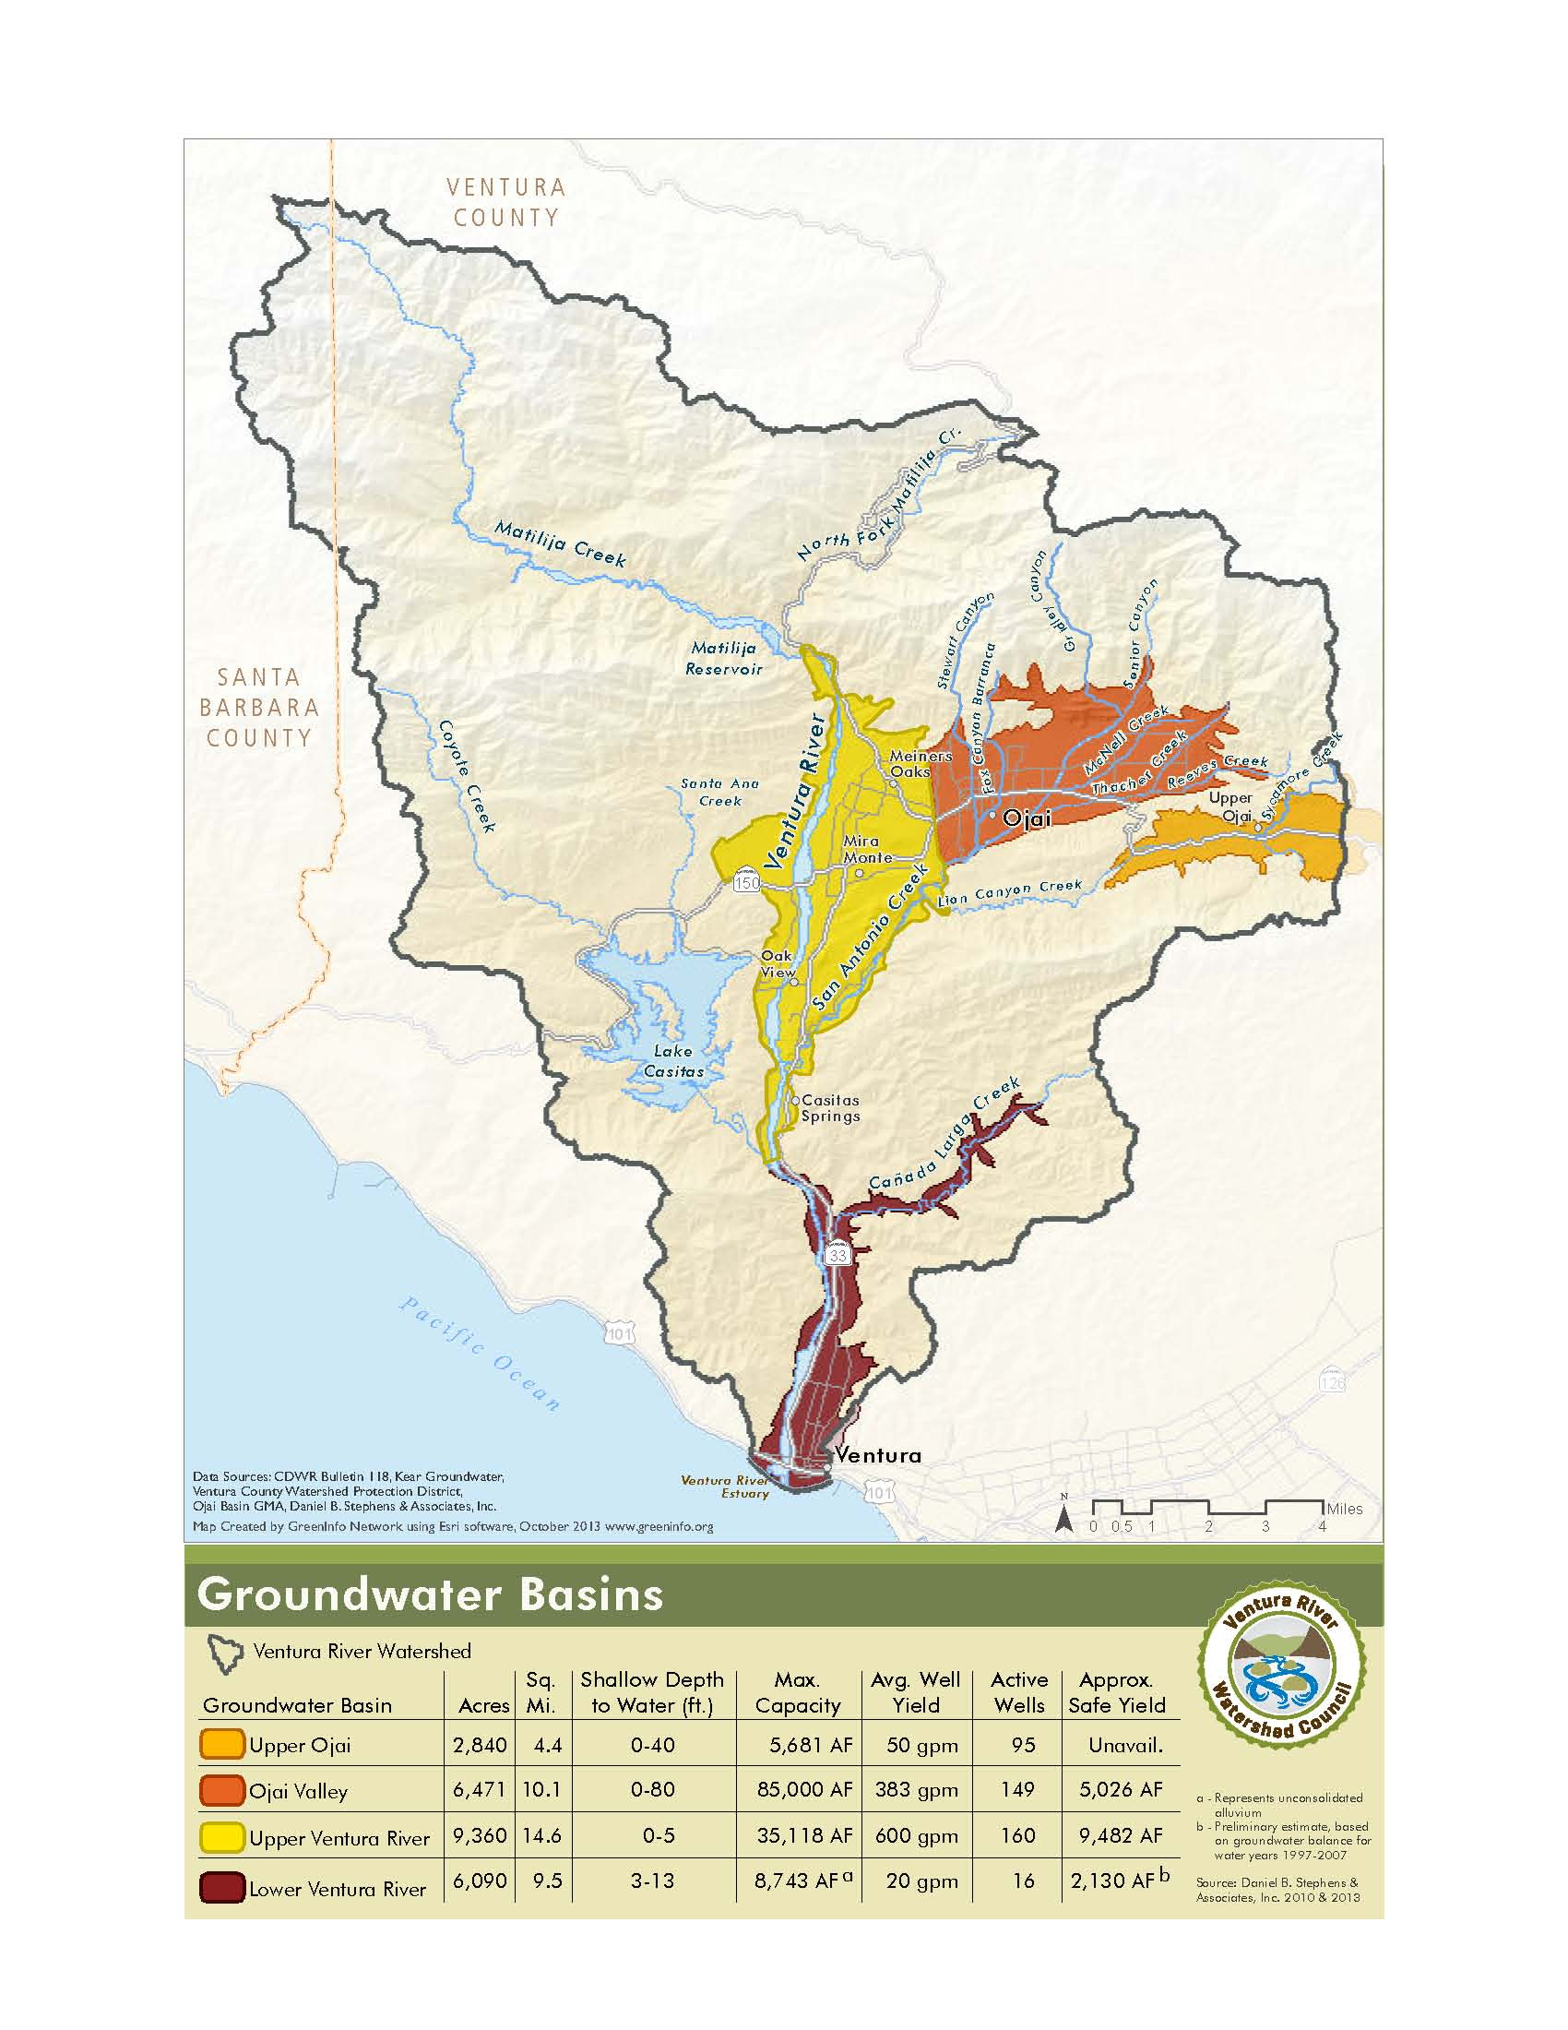
Upper Ventura River Water Sustainability Agency
Update by Bruce Kuebler
Director Ventura River Water District
November 20, 2014

Slide 2
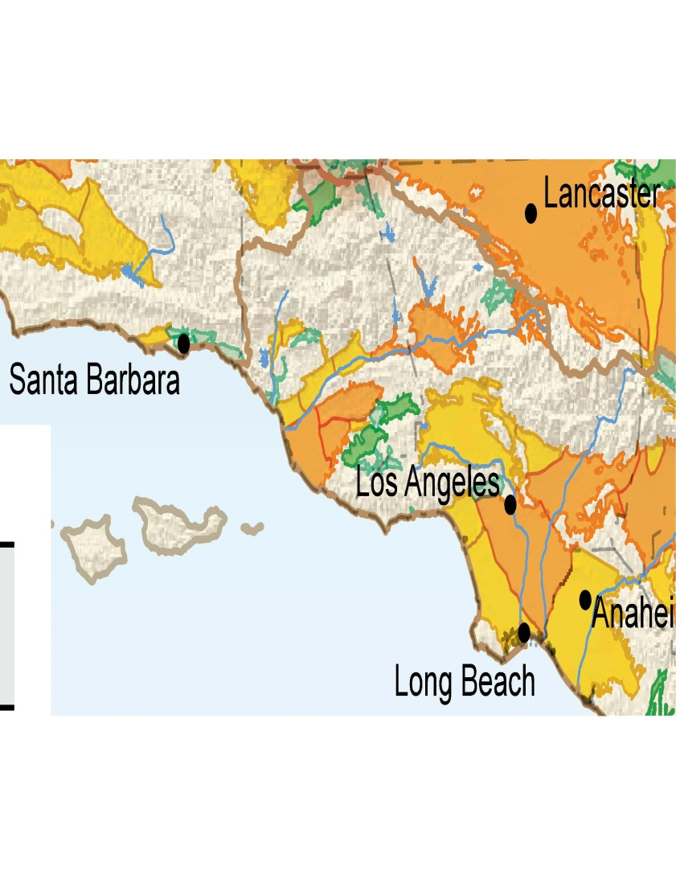
CASGM Ventura County

Slide 3


Slide 4
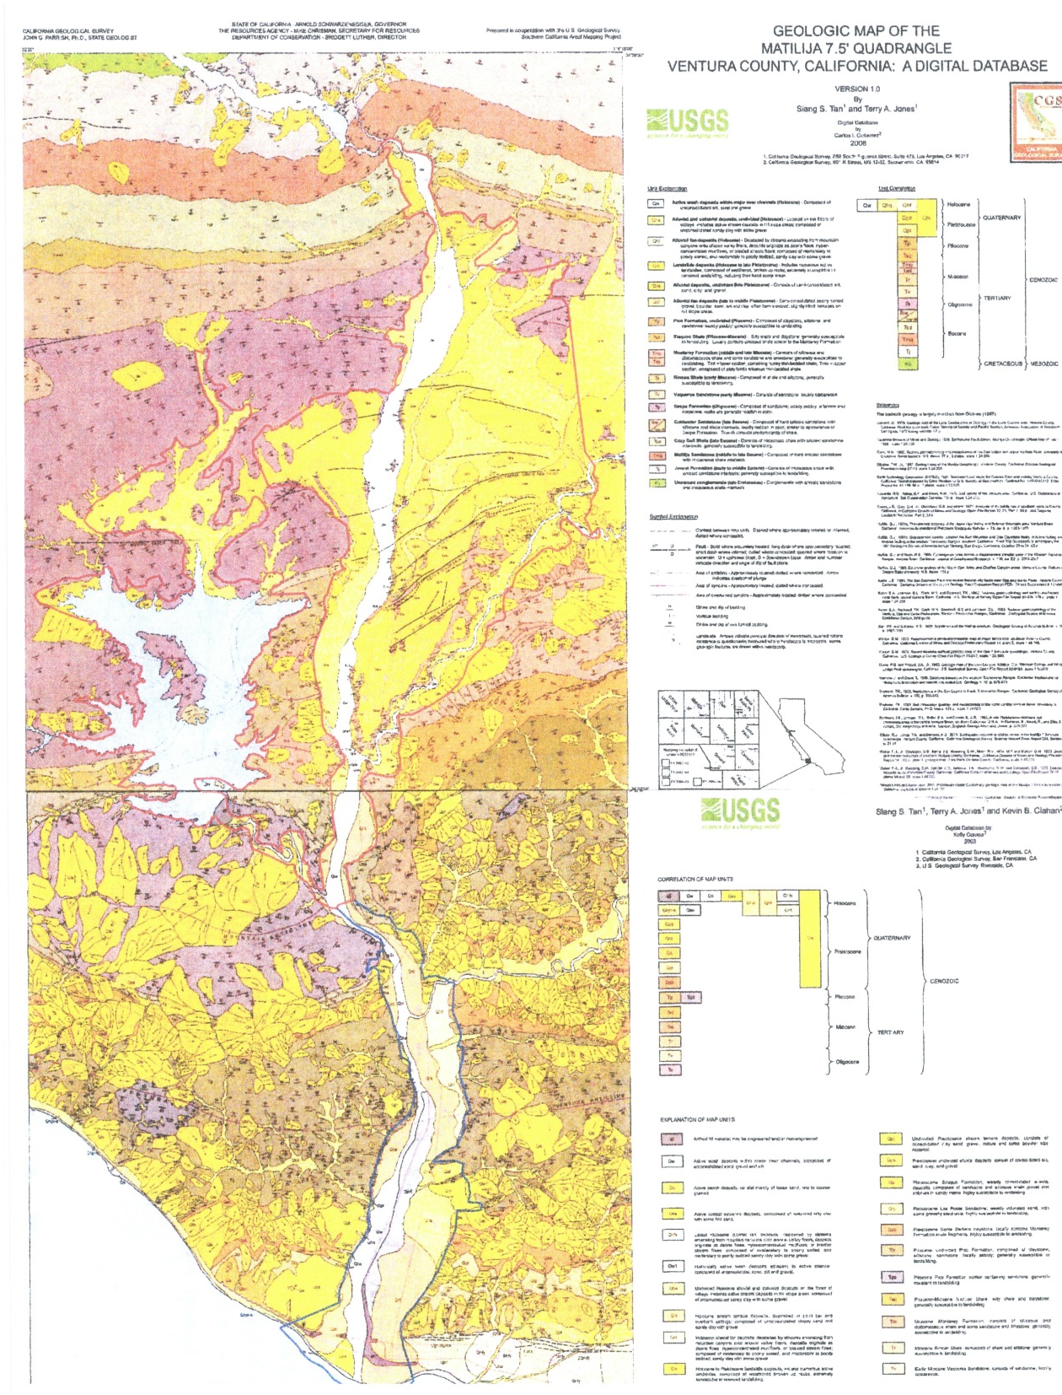

Slide 5
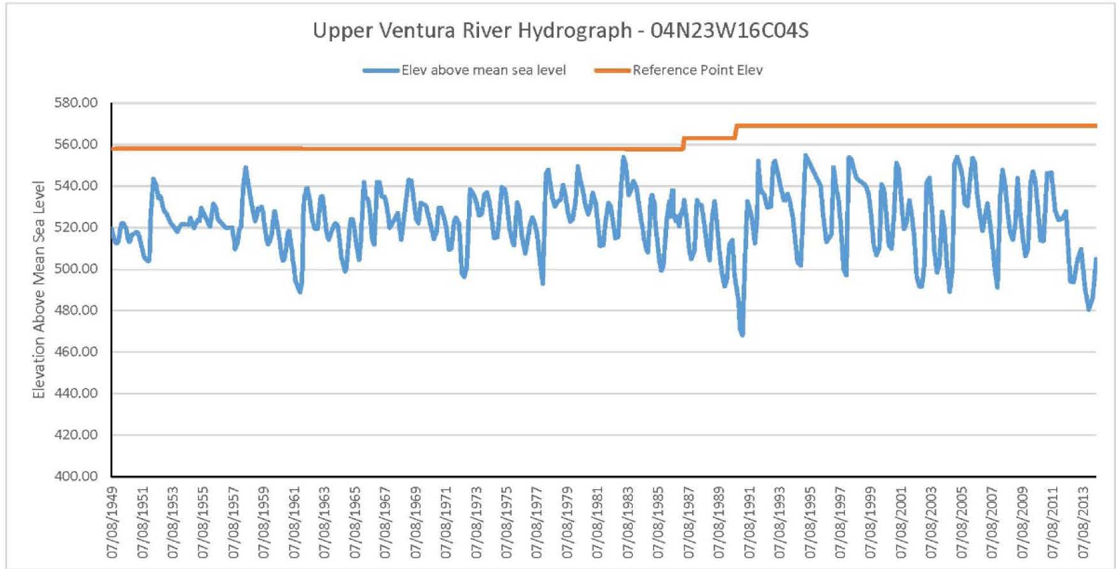
Stable Groundwater Levels for 65 years
1949
2014

Slide 6
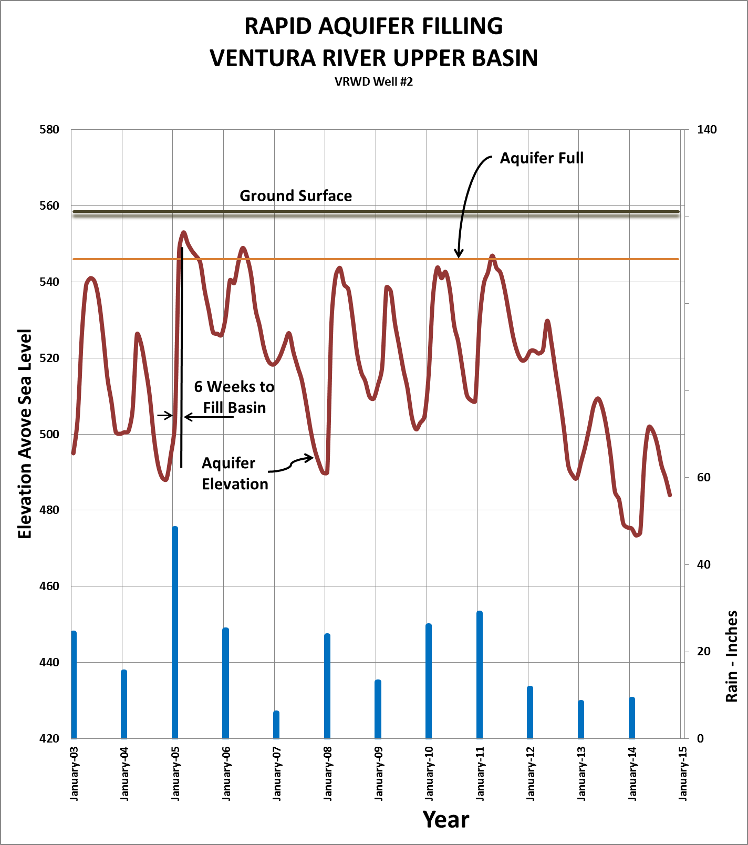

Slide 7
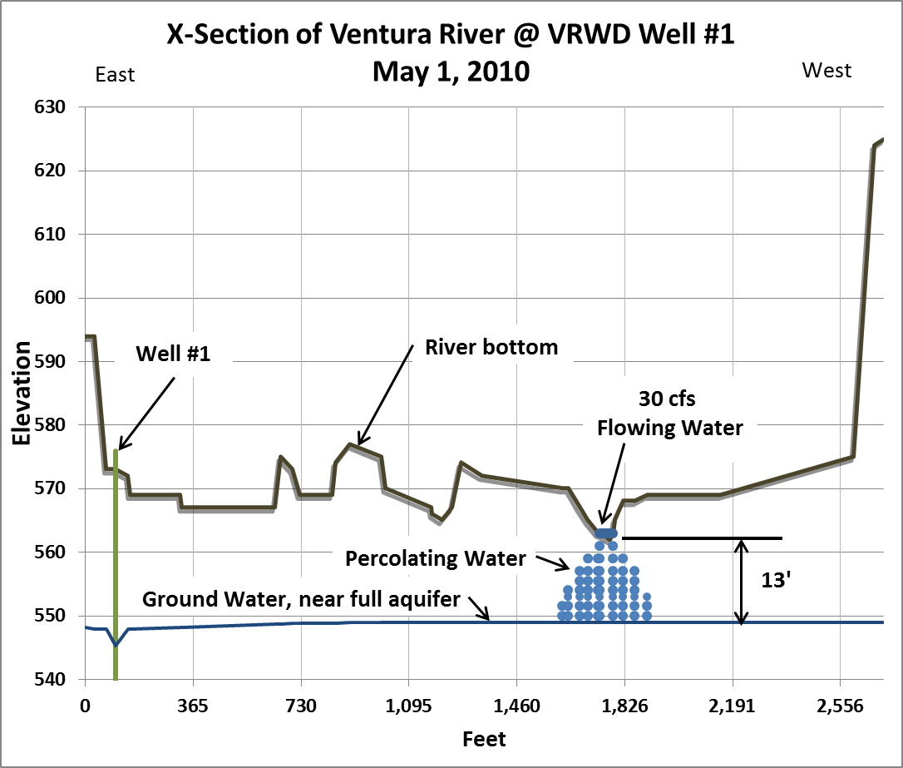

Slide 8
