Slide 1
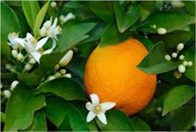
Citrus Drought Strategies

Slide 2
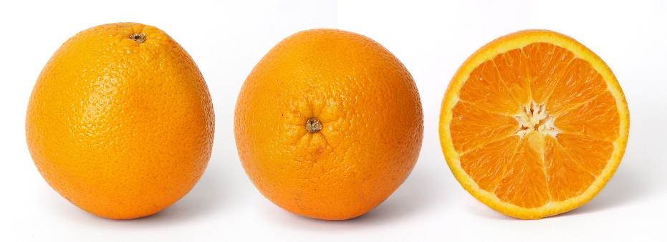
Citrus growth stages
Flower bud induction and initiation mid Nov - Feb
Flowering mid February – May
Stage 1 Fruit Growth (cell division) May - June
Stage 2 Fruit Growth (cell expansion) July - Aug
Fruit maturity June onwards

Slide 3
Flower Bud initiation
Moderate stress can increase flowering

Slide 4
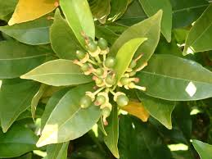
Flowering and Fruit Set – spring
Water stress can cause fruit drop and suppress spring flush
Remaining fruit will size better

Slide 5
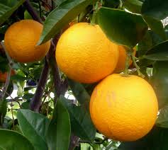
Fruit Growth (cell expansion) July – Oct
Minor water stress can occur without significant effect on fruit size

Slide 6
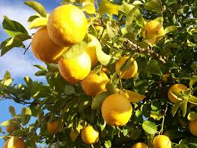
Fruit Maturity
Nov onwards

Slide 7
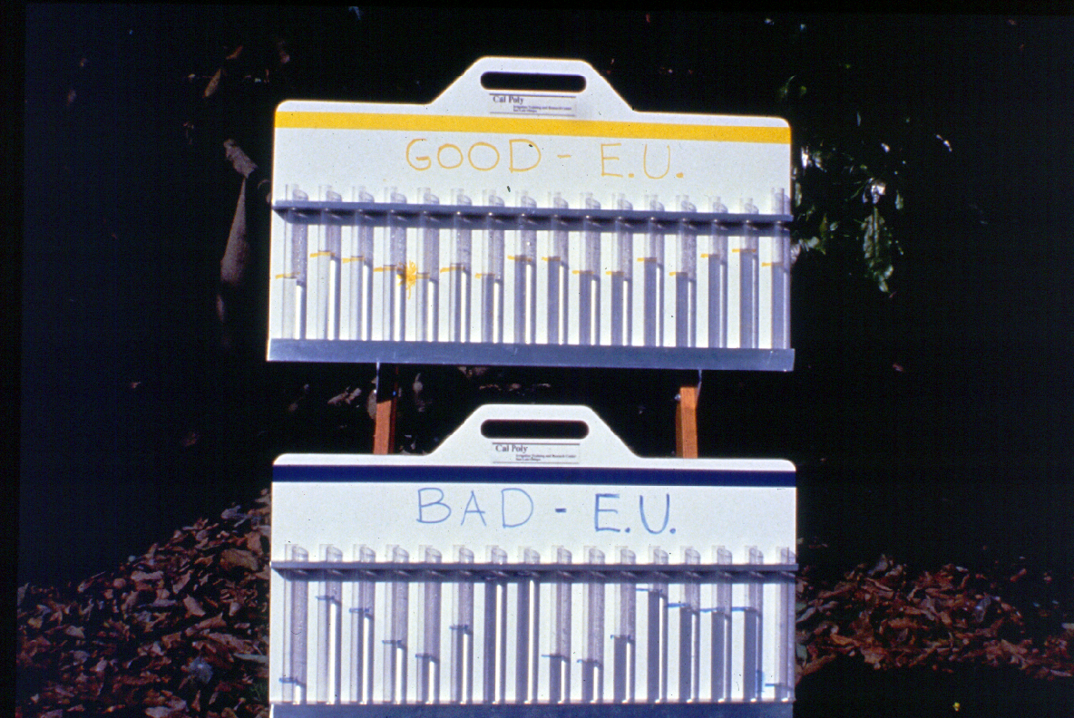
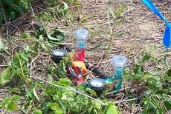
The first step to improving water use is to check the irrigation system
Is the distribution uniformity is as high as possible?
Is deep drainage controlled?
Fix leaks
Clean filters

Slide 8
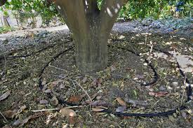
Place emitters under the canopy to reduce evaporative loss

Slide 9
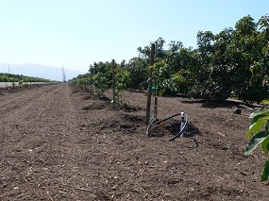
Mulch !!

Slide 10
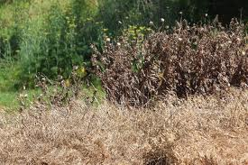
Weed!!!!

Slide 11
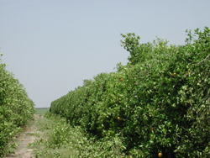
Prune !!
A 30% reduction in tree size reduces water use by 30%

Slide 12
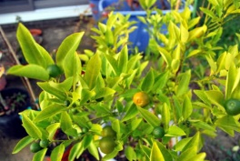
Reduce nitrogen applications

Slide 13
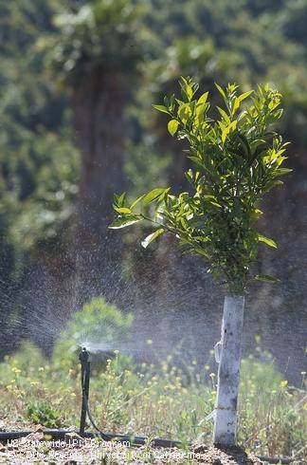
Deficit Irrigation
best applied in summer with least effect on
fruit size and yield

Slide 14
Tree removal – sick trees, poor performing areas

