Slide 1
Sustainable and Fire-SafE Landscapes:
Invasive species and fire recovery
Dr. Sabrina Drill
UC Cooperative Extension-
Natural Resources Program
Los Angeles/Ventura Counties
Notes:
Our program began in 2007 in Los Angeles County, expanded to Ventura in 2008/2009

Slide 2
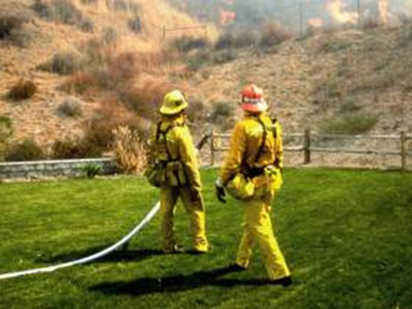
SAFE Landscapes
Sustainable and Firesafe
  Improve fire safety and preparedness in the wildland/urban interface to protect life and property
  Protect the health of neighboring wildlands
Notes:
Wildland urban interface means those areas where homes are very near, often neighboring areas with natural vegetation – like Ojai, Thousand Oaks, Lockwood Valley, Piru, hillsides in Fillmore, Santa Paula, Ventura

Slide 3
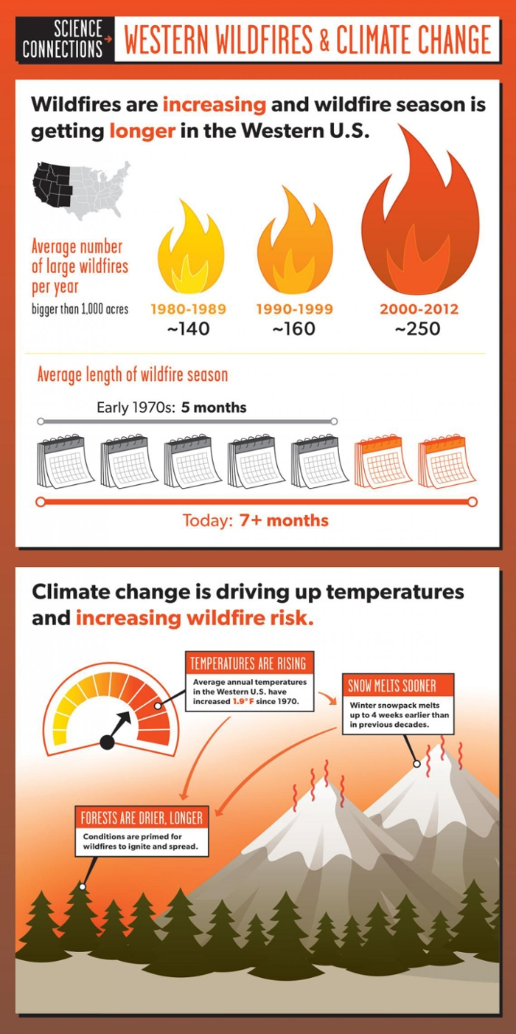
Issues in Wildland Fire
Changes in fire regime
  Human-caused ignition
  Fire suppression
  Climate change
Fuels management
  Selective thinning to protect natural resources
    Changes vegetation – restoration?
  “Brush clearance” encroaching on wildlands
Invasive species
Union of Concerned Scientists, 2016

Slide 4
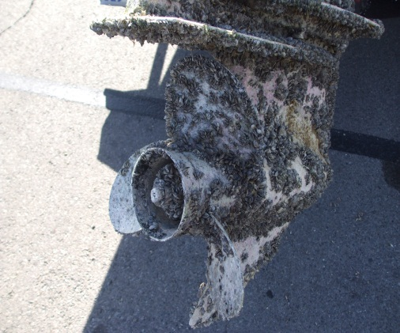
Invasive Species
Non-native to the ecosystem whose introduction causes … economic or environmental harm (USDA NISIC)
  Small subset of exotic species are invasive
  Diseases, predators, competitors
  Damage crops, infrastructure, physical environment
  Similar climate, lack co-evolved controls
  Favored by other ecosystem/climate changes
  Cost ~$120 billion in US in 200 5 (Pimental et al.)
  Contributed directly to decline of 42% of T&E sps (TNC)
Notes:
4
Not all “exotic” or foreign species are invasive. Only those that cause problems.
Invasive species can be plants, but also animals and microbes
Unfortunately, invasive plants are the ones that survive well here – they may be drought tolerant, so in the past, people used them just for this reason. Not all drought tolerant plants are good for Southern California!
Many from the Mediterranean, South Africa, dry south America like Chile, Peru
Even if you don’t care about the environmental problems, you might care about where your tax dollars are going!

Slide 5
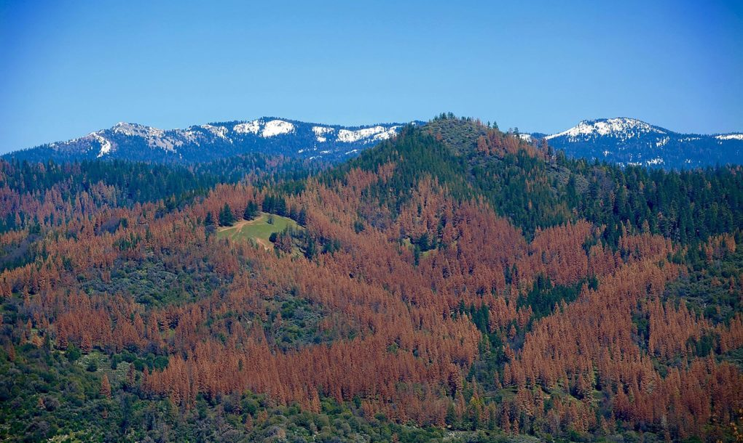
Invasive species and fire
Invasive pests (bark beetles, etc.) causing wide-spread tree mortality
Aquatic invasive species can be spread through fire-fighting (water drops) and inhibit post-fire ecosystem recovery
Invasive plants
Dead trees, Sierra Nevada USFS Region 5, 2016

Slide 6
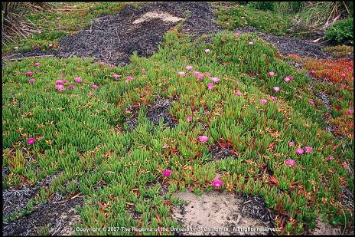
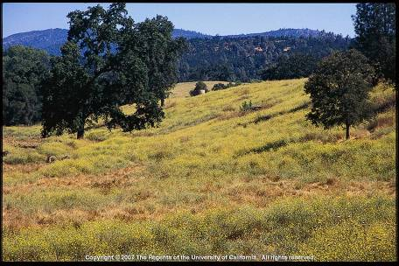
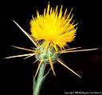
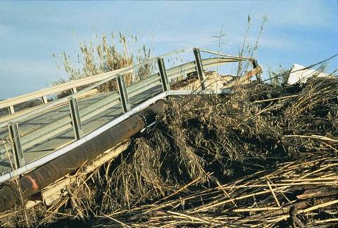
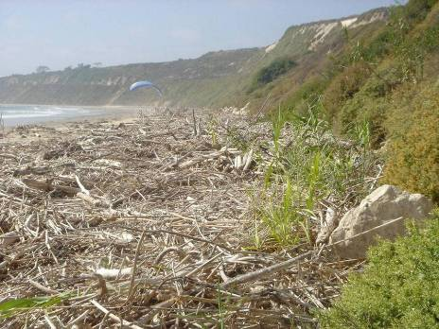
What Problems Do Invasive Plants Cause?
Displace native plants and degrade wildlife habitat
Degrade recreation areas
By simply adding biomass, increase damage from floods and fires
Photo: Bob Case
Notes:
6

Slide 7
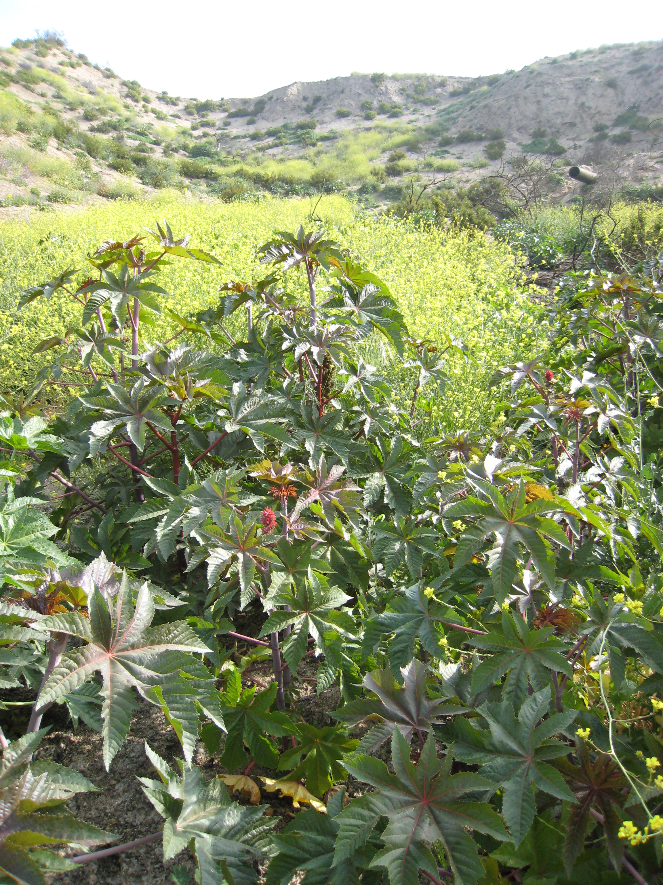
Fire and Invasive Plants
Invasive plants can escape from a “fire safe” landscape
Invasive plants can increase fuel loads
Over-clearance (bare earth) for fire safety can lead to the spread of invasive plants
Post-fire, invasive weeds can lead to type conversion, biodiversity loss
Notes:
Invasive plants may grow at much higher densities than native plants, and may spread a lot in the spring, and die-off, leaving a lot of very flammable stuff in the fall. Grasses and mustard are examples.
Scraping every last bit of vegetation off the ground is NOT the best way to create a fire-safe landscape. We don’t just have fires, we usually have fires followed by floods. With no vegetation, bare earth is prone to erosion, causing all kinds of problems, from mud-slides to water pollution.

Slide 8
Fire and type conversion
Natural fire cycles can be beneficial
  Resources for new growth
  Fire adapted plants
Frequent high intensity fires can break natural cycles
Increase fire frequency and severity
Reduce native seed banks and re-sprouters
High fuel beds
Invasive plants

Slide 9
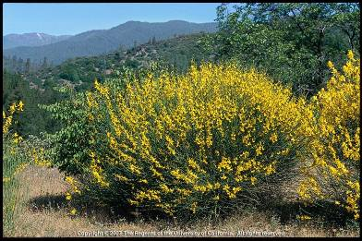
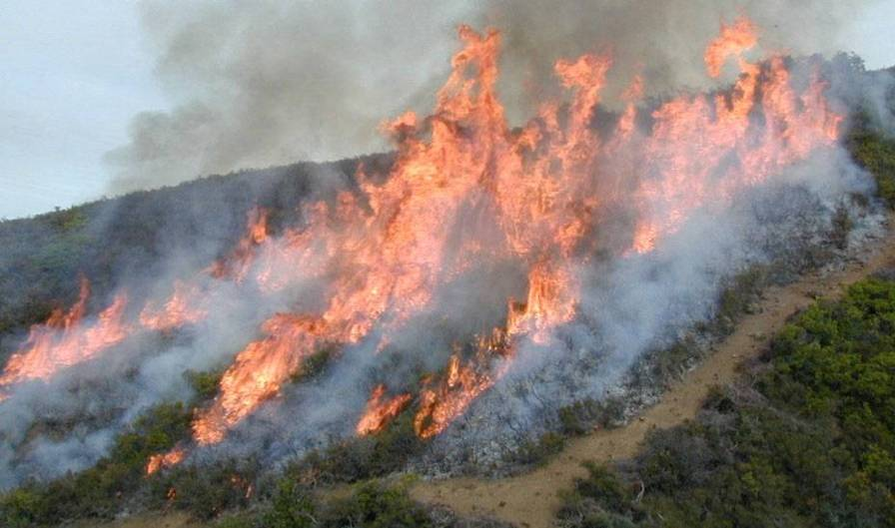
Invasive Plants and Fire Examples
Dense mats of thick groundcovers like iceplant, ivy, and vinca can harbor hotspots
Annual grasses grow in desert areas, increasing fuel load and continuity
Scotch and Spanish broom form dense stands on hillsides where fires can spread quickly
Arundo spreads fire even in stream beds
Photo: Bill Baxter, CDF
Notes:
9
These are just a few examples – brooms were thought to contribute to the recent severe fires on Catalina Island

Slide 10
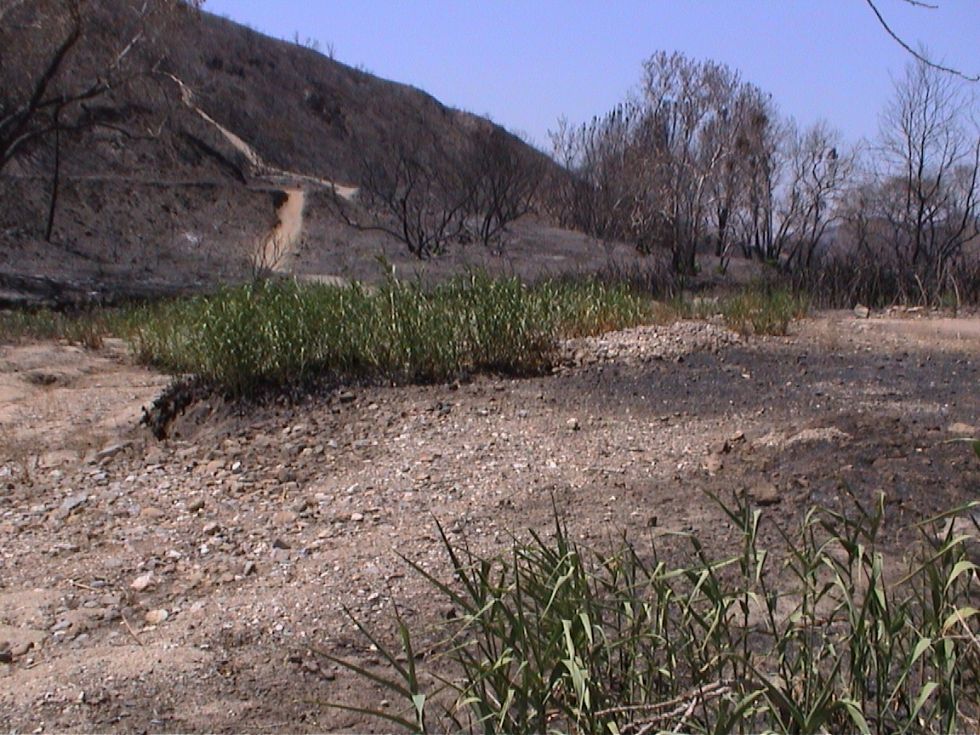
Fire and Invasive Plants
Fires provide an opportunity
  $$$$$ to remove invasive plants
  Treat re-sprouts after fire to control invasives, benefit natives
    Herbicide may be best bet
    Mechanical/hand can be used if slopes are stable
Prescribed fire as a management tool
Notes:
Invasive plants may grow at much higher densities than native plants, and may spread a lot in the spring, and die-off, leaving a lot of very flammable stuff in the fall. Grasses and mustard are examples.
Scraping every last bit of vegetation off the ground is NOT the best way to create a fire-safe landscape. We don’t just have fires, we usually have fires followed by floods. With no vegetation, bare earth is prone to erosion, causing all kinds of problems, from mud-slides to water pollution.

Slide 11
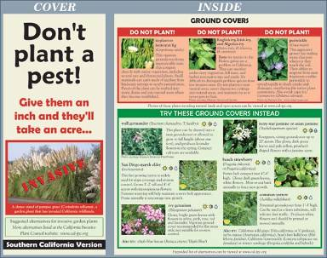


Invasive Plant Alternatives
Cal-IPC Website:
http://cal-ipc.org
PlantRight website: http://plantright.org/
Weed Watch Website:
http://weedwatch.org
Notes:
Don’t Plant-A-Pest Brochure put out by Cal-IPC, LASGRWC, UCCE for homeowners.
PlantRight brochure put out by Cal-HIP for nursery & landscaping industries.
Los Angeles County Fire Dep’t’s. Undesirable and Approved Plants - extensive

Slide 12

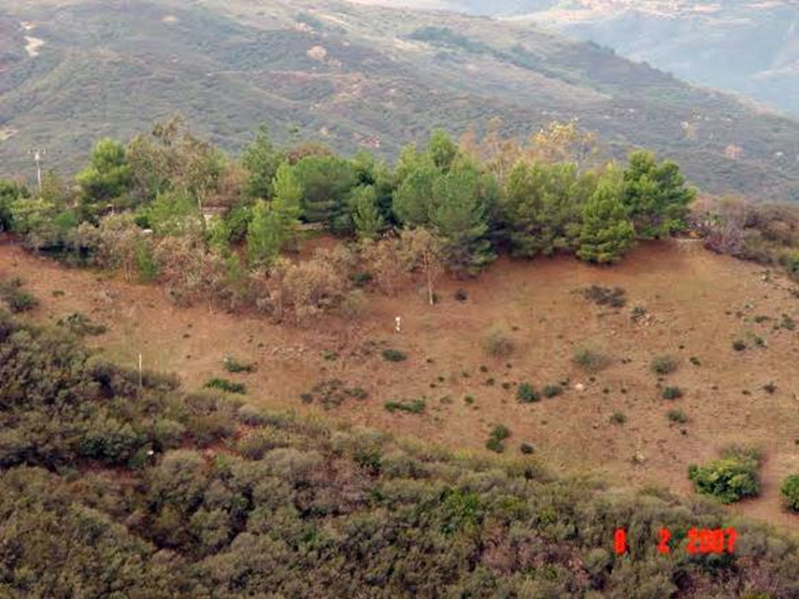

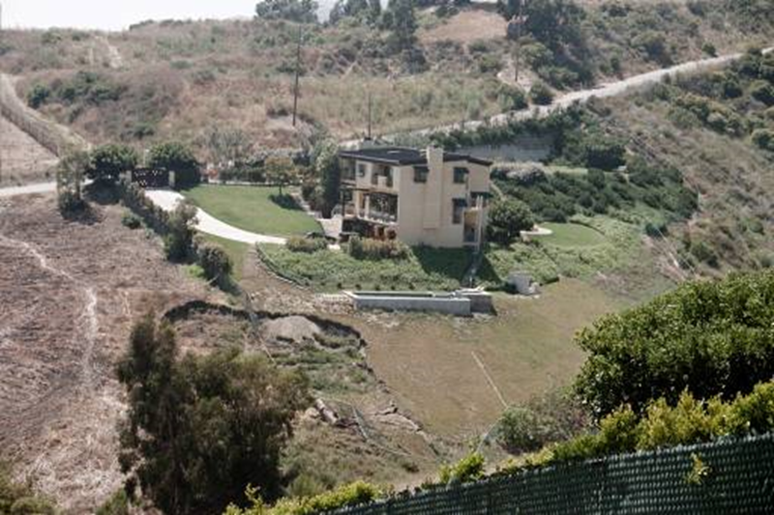
Conduct Reasonable
Fire Hazard Reduction
“Brush clearance” misleading
  Brush ≠ habitat
  Clearance ≠ selective removal and thinning
Bare earth can promote invasion and increase fuel load
  1. Disturbed area invaded by weedy species
  2. Weeds grow fast, produce biomass
  3. Dry-up by fire season
Over-clearing can cause erosion
  Keep plants to hold soil
  Provide environmental and aesthetic benefit
Notes:
12
Often when someone clears a lot to bare earth in June, the whole area fills in with annual grasses and weedy herbs. When these die, the problem is worse than it was before! Leaving appropriate vegetation in place can resist this invasion.

Slide 13
Post-fire land management
Issues
In “natural” fire adapted systems, vegetation will recover
Sometimes do nothing is best
Challenges
What’s natural?
  Loss of connectivity
  Pollution
    nutrient loading
  Invasive species
Socio-political pressure to do SOMETHING

Slide 14
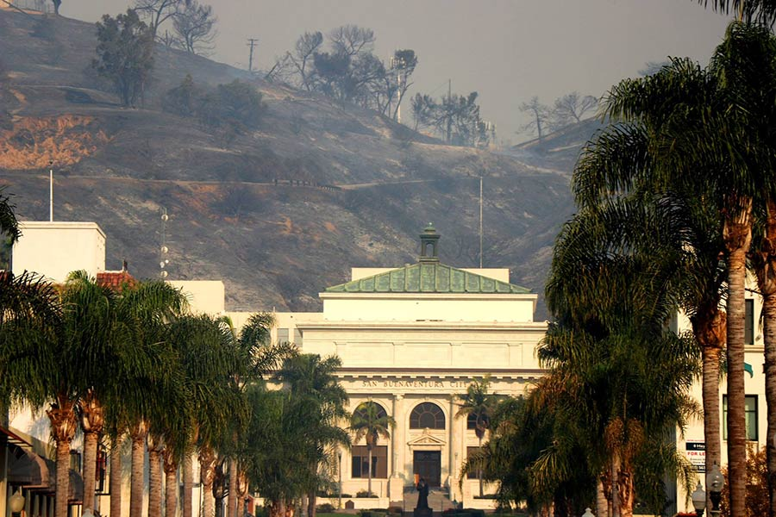
Post-fire land management
Identify values at risk
  Where is mitigation needed needed?
Cost factors
Engineering analysis
  Slope measurement
  Burn severity
  Soil characteristics
Erosion management actions:
Prepare catchment basins
Apply treatments
Nicole Noren, Ventura Museum

Slide 15
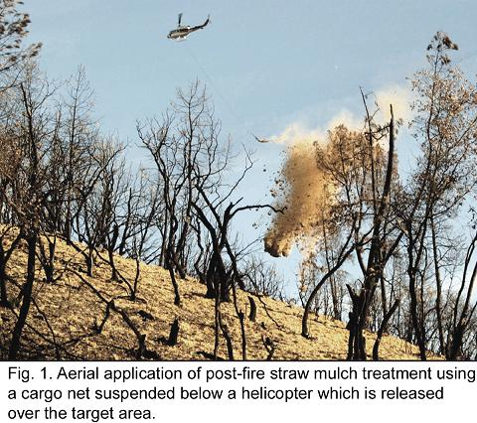
Erosion reduction treatments
Large scale
  Retaining walls and rock revetments
  Terraces
Medium scale
  Fencing
  Logs and contour felling
  Wattles
  Geotextiles
Distributed
  Rice straw
  Distributed mulch
  Hydromulch
  Seeding
USFS RMRS

Slide 16
From USFS Rocky Mountain Research Station
https://forest.moscowfsl.wsu.edu/BAERTOOLS/HillslopeTrt/

Slide 17
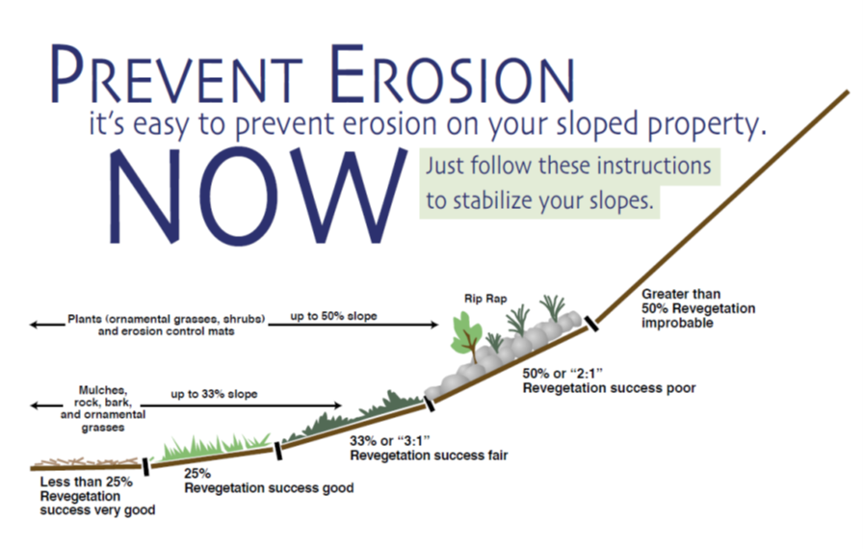
Issues with erosion treatments
Choose treatments based on proximity to values, slope, burn severity, and to the best ability, weather prediction
Determine short vs long term goals
USDA Natural Resources Conservation Service (NRCS)

Slide 18

Seeding
Reasons
  Slope stabilization
  Runoff reduction
  Forage
  Ecological restoration
  Control invasive species (used in sagebrush for cheatgrass)
Types
  Exotic annuals
    Exotic sterile hybrids
  Native – annuals plus perennials
  Trees (where appropriate)

Slide 19
To seed or not to seed
Issues in chaparral/CSS
  Expensive (especially if hydroseed+mulch)
  Native seed supplies limited
  Timing is critical (heavy rains can wash seed away)
  Produces effective cover only ~ 30 to 50% of the time
  Can lead to increased fine fuels for following fire season

Slide 20
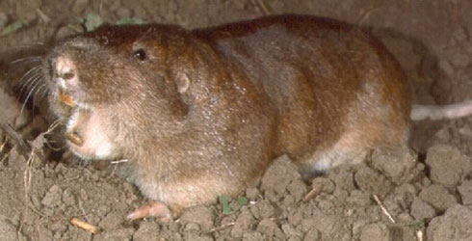
To seed or not to seed
Issues in chaparral/CSS
  To be effective, need to protect from grazing
  Prone to predation, can attract vertebrate pests leading to slope destabilization
  Inhibits medium-long term recovery of native vegetation
    Compete w/native seed bank, inhibit fire followers => type conversion
    Reduces biodiversity of woody species

Slide 21
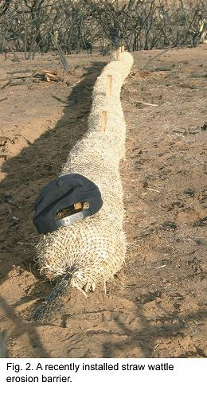
Other approaches
Rice straw wattles and mulch
  Effective for moderate slopes
  Weed free formulation and staging
  Relatively inexpensive
Fencing
  Inexpensive, captures dry ravel before rains
  Needs to be removed
Geotextiles
  Jute or coir textiles of different weave sizes
  Can be used on steep slopes, must be anchored
  Expensive
USFS RMRS

Slide 22
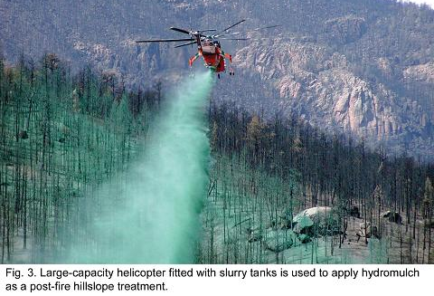
Other approaches
Hydromulch
  Water, an organic fine mulch (paper, etc.), tackifier(s)
  Effective treatment for steep slopes
  Favorable ecological impact
    Increases soil, water, nutrient retention to encourage germination and growth
  Lasts 2-4 months
  Very expensive -$8000 to $10,000/ha
USFS RMRS

Slide 23
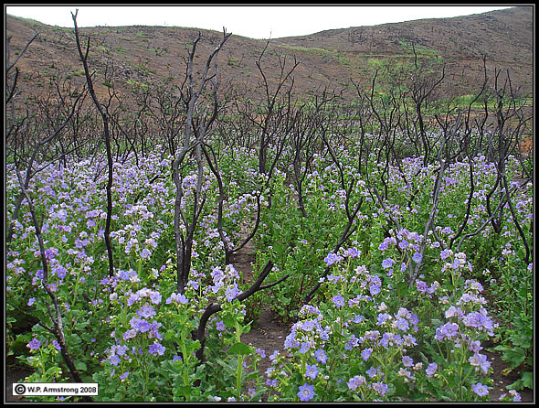

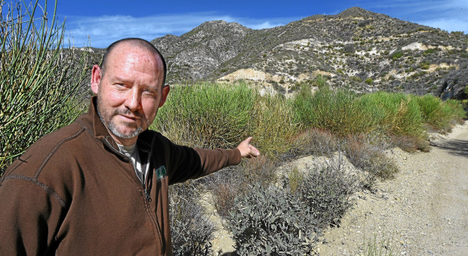
Natural recovery
Many native woody shrubs and oaks will re-sprout from root crowns
Annual and perennial flowers and shrubs may be fire followers
Need to control invasive weeds
Fire followers after the Witch Fire
Robert Skillman, Environmental Director of L.A, Conservation Corps, points Spanish Broom that has multiplied since the Station Fire. By STEVE SCAUZILLO | San Gabriel Valley Tribune

Slide 24
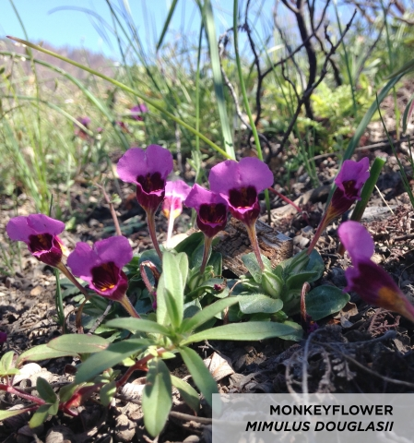
Questions? http://ucanr.edu/sites/SAFELandscapes/
Rim Fire followers – Yosemite Conservancy

Slide 25
Invasive Pests

Slide 26
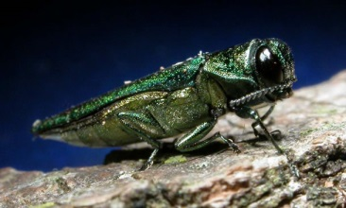
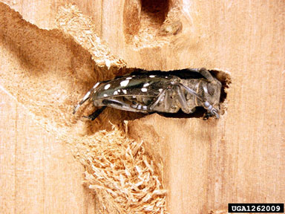
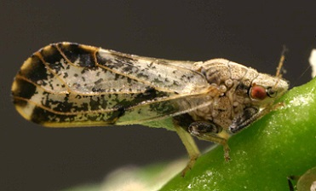
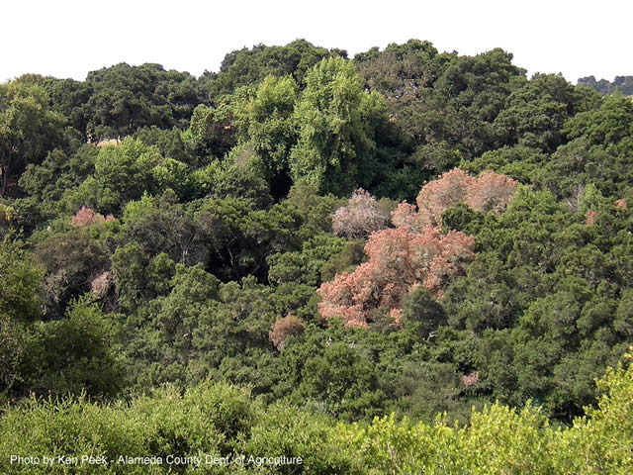
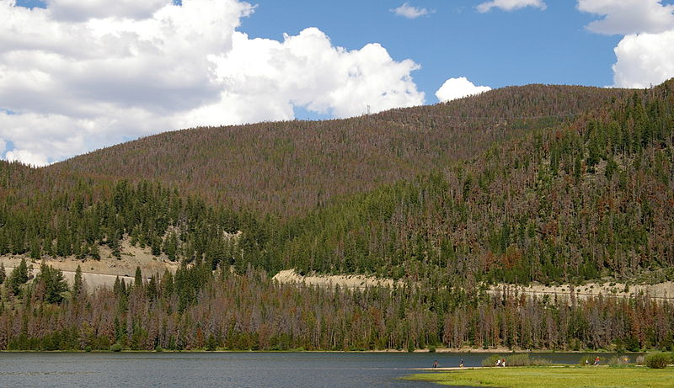
Globally, new pests are threatening trees
  Ash Dieback (Europe)
  Emerald Ash Borer (Northeast US)
  Asian Longhorned Beetle (Northeast US into mid and true West)
  Mountain Pine Beetle (western North America)
    Emerging endemic
  Asian Citrus Psyllid (southern North America)
    pest/disease complex
Possible Causes
  Climate change/drought
  Land use change
  Global transportation

Slide 27
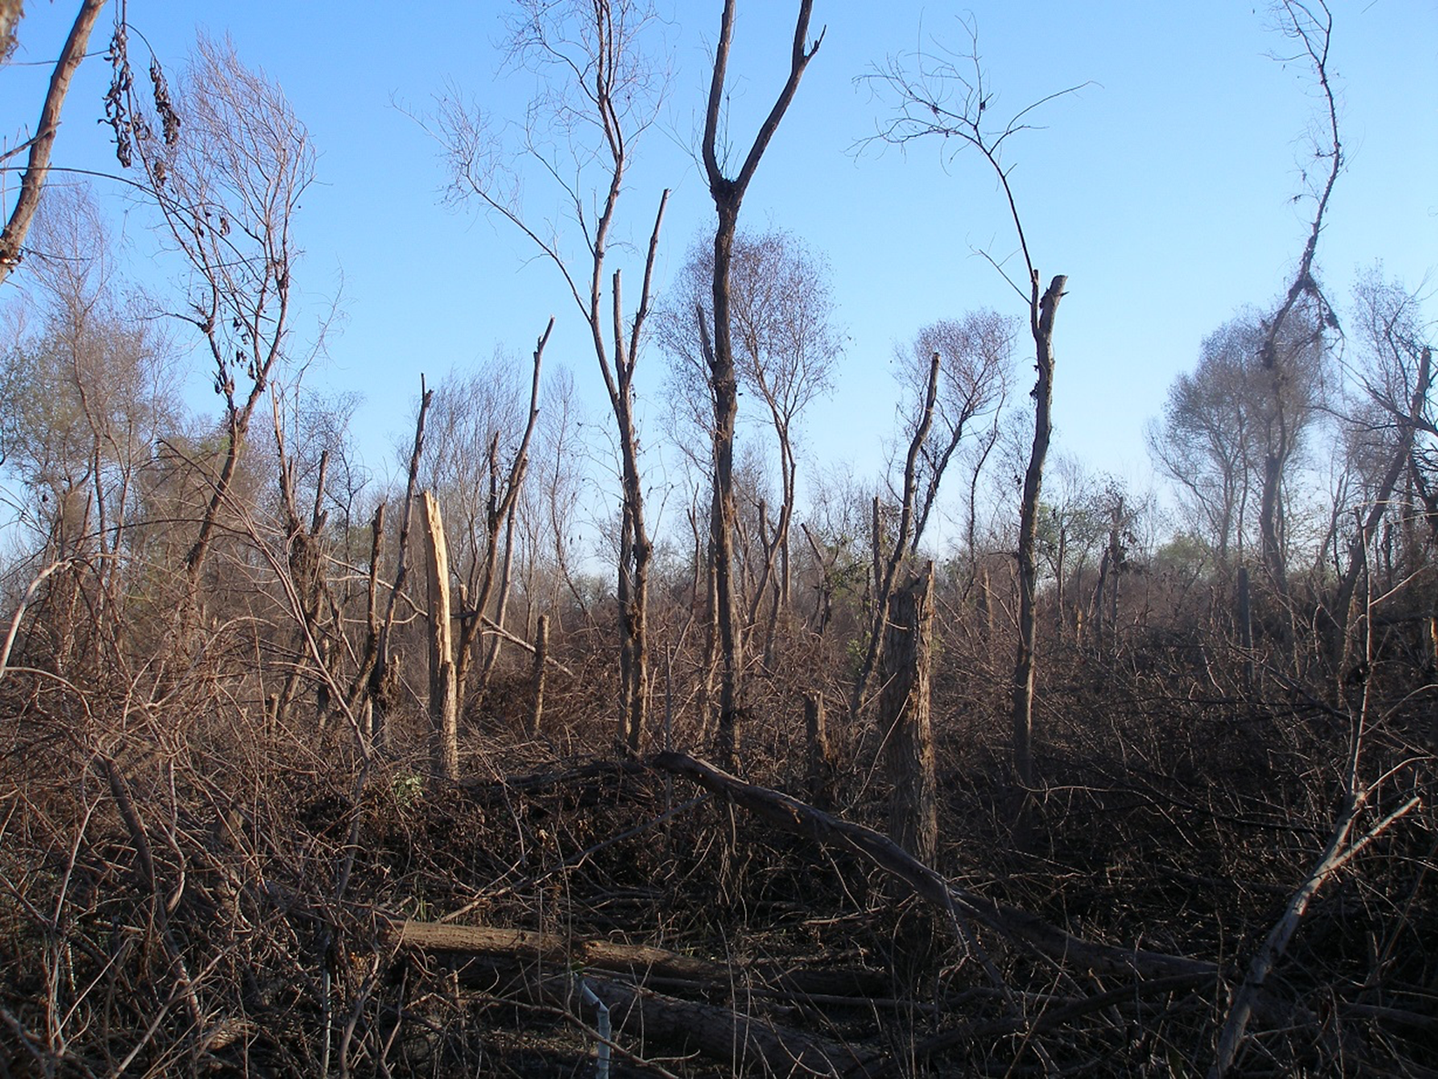
Ecological Impacts of invasive pests
Change in community structure
  Trees and understory
  Change in age structure
Loss of wildlife habitat
  Snags
Loss of physical structure
  Erosion, shade
Loss of amenity/property value
Knock-on weed invasions
Dead willows in Tijuana River, John Boland, 2016

Slide 28
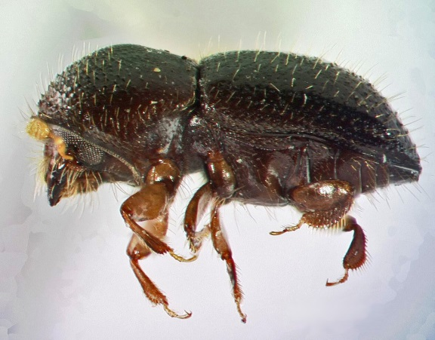
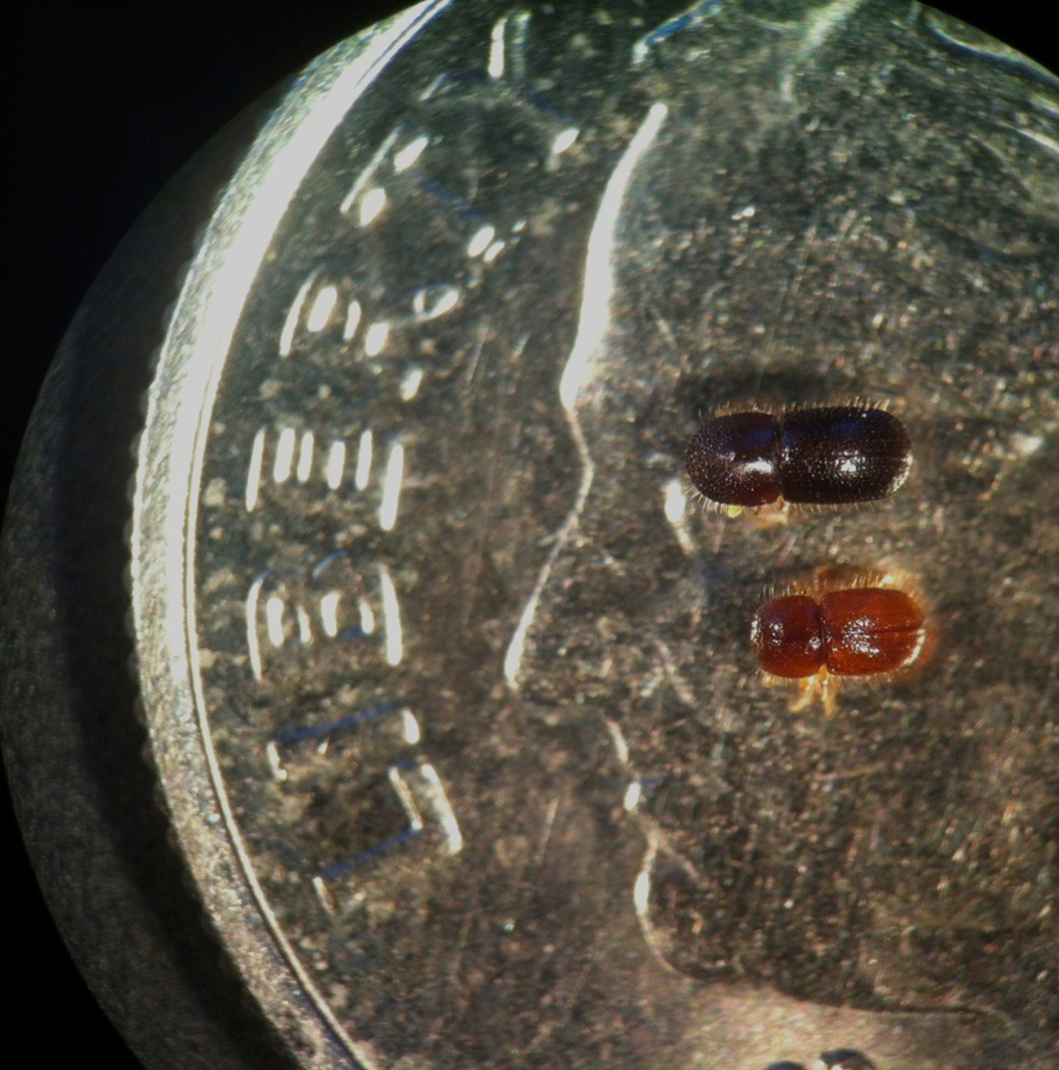
Polyphagous and Kuroshio Shot Hole Borers
Ambrosia beetle insect/disease complex
  Insect carries Fusarium fungus (plus)
  Beetle drills into tree, creates cavities, inoculates with fungus
  Beetle sib-mates and reproduces
  Combination of fungal growth and tree response blocks xylem

Slide 29
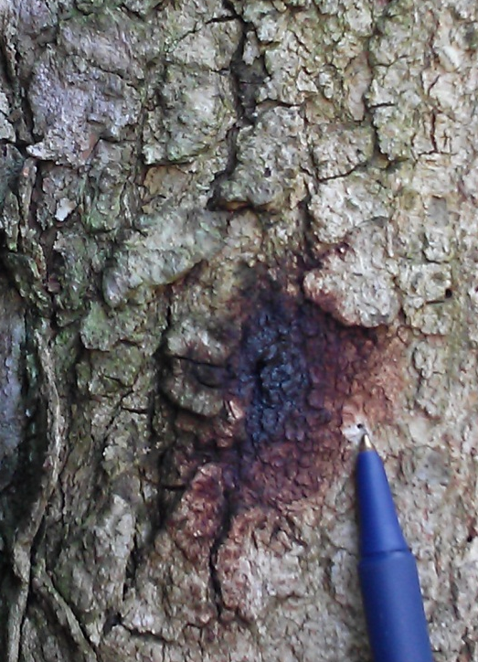
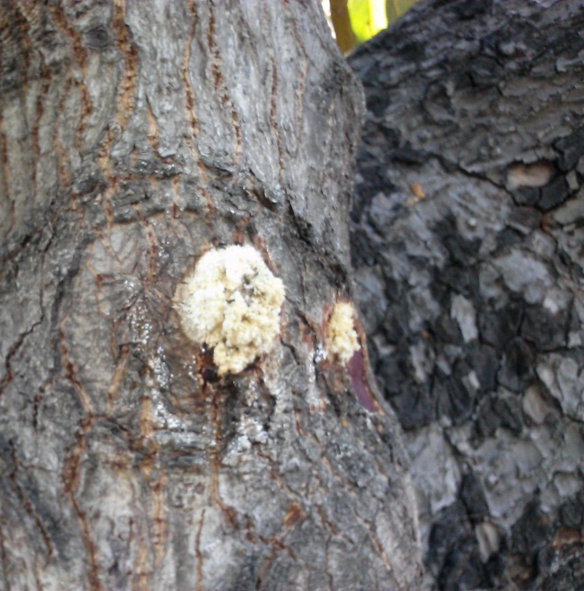
Common signs of ISHB
Very small (< 1mm), perfectly round entry hole
Oily dark stain surrounding entry holes
Discolored wood, leaf discoloration and wilting
Dieback of entire branches
White crusty sugar ring found in avocado and box elder

Slide 30
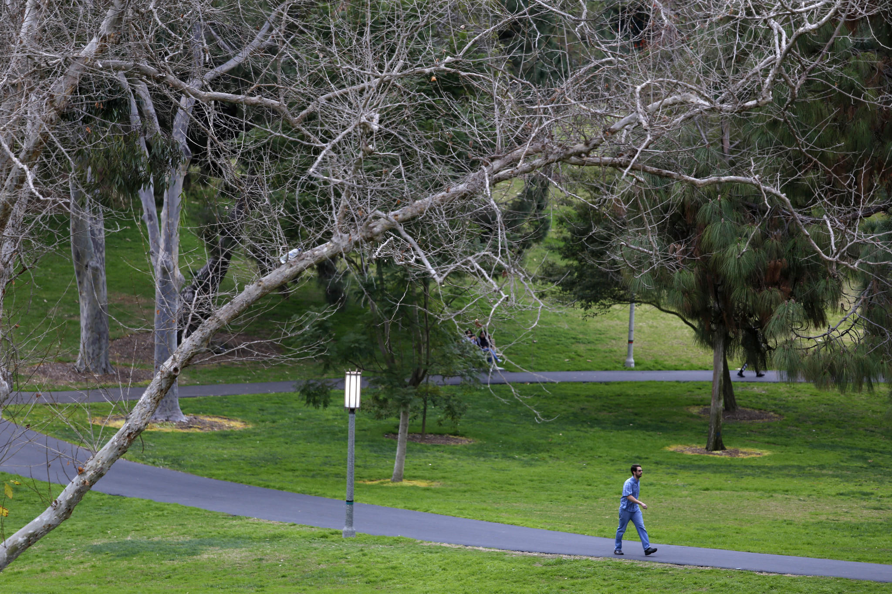
PSHB in California
2003 - Whittier Narrows, wrong ID
2010 - killed street of box elders in Long Beach
2012 - backyard avocado in South Gate; several botanical gardens
2013 - KSHB in El Cajon, PSHB in Riverside and San Bernardino
2014 – KSHB in avocado on San Diego
2015 - KSHB wipes out willow forest in Tijuana River
2016 – PSHB in Ventura – Santa Paula avocado groves
2016 - KSHB in Montecito and SLO
2017 – KSHB in Tijuana
2017 – PSHB in riparian forests Santa Paula, oaks in TO

Slide 31


Reproductive hosts of ISHB and Fusarium dieback (June 2017)

Slide 32
ISHB Native hosts
Box elder (Acer negundo)*
Big leaf maple (Acer macrophyllum)*
California sycamore (Platanus racemosa)*
Red willow (Salix laevigata)*
Coast live oak (Quercus agrifolia)*
Fremont cottonwood (Populus fremontii)*
Black cottonwood (Populus trichocarpa)*
White alder (Alnus rhombifolia)*
Engelmann oak (Quercus engelmannii)*
Valley oak (Quercus lobata)*
Blue palo verde (Cercidium floridum)*
Mesquite (Prosopis articulata)*
Goodding's black willow (Salix gooddingii)*
Mule Fat (Baccharis salicifolia)*
California buckeye (Aesculus californica)*
Canyon Live oak (Quercus chrysolepis)*
Black poplar (Populus nigra)

Slide 33
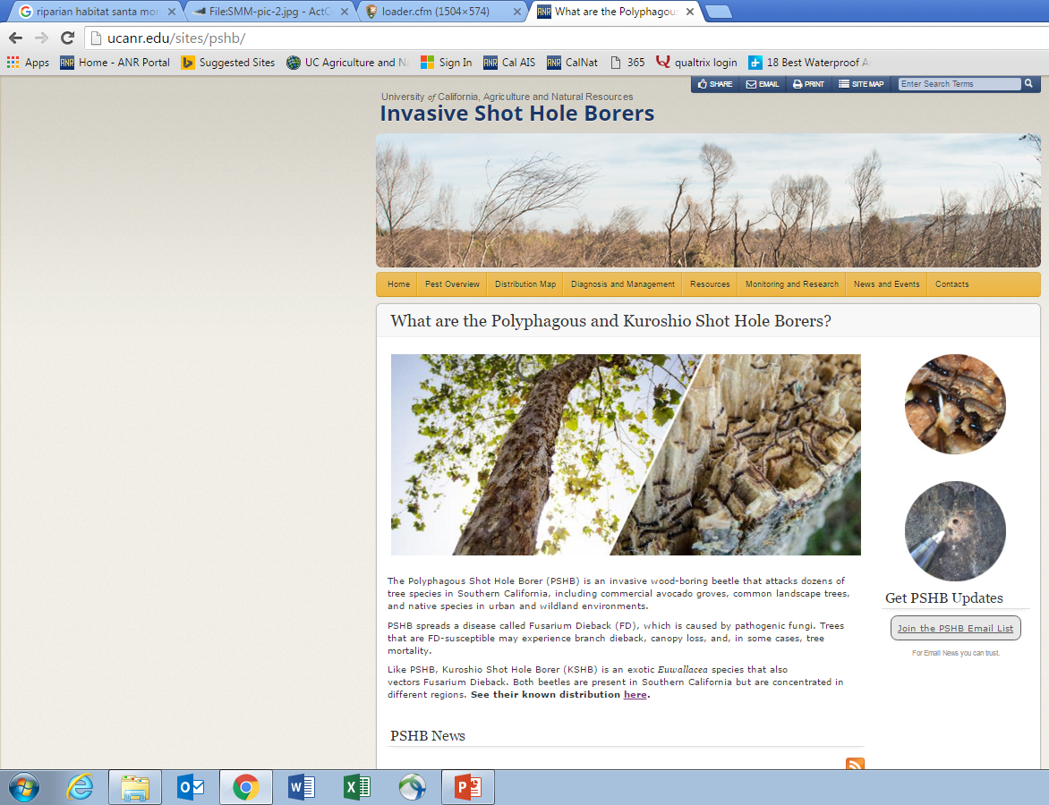
www.pshb.org
Or
Ucanr.edu/sites/pshb

