Slide 1

Groundwater and Drought
Ventura River Watershed Council
01 March 2018
Jordan Kear, PG, CHG

Slide 2
Questions…
Where are we with respect to rainfall in a historic context?
How has the groundwater responded to the rainfall we have had in recent years and this year in particular?
How have the fires and debris flows impacted our surface water and groundwater resources?
What (really cool!) projects are local agencies working on now, in 2018, in two years, and in five years to battle the chronic drought and climate change in the Ventura River watershed?

Slide 3
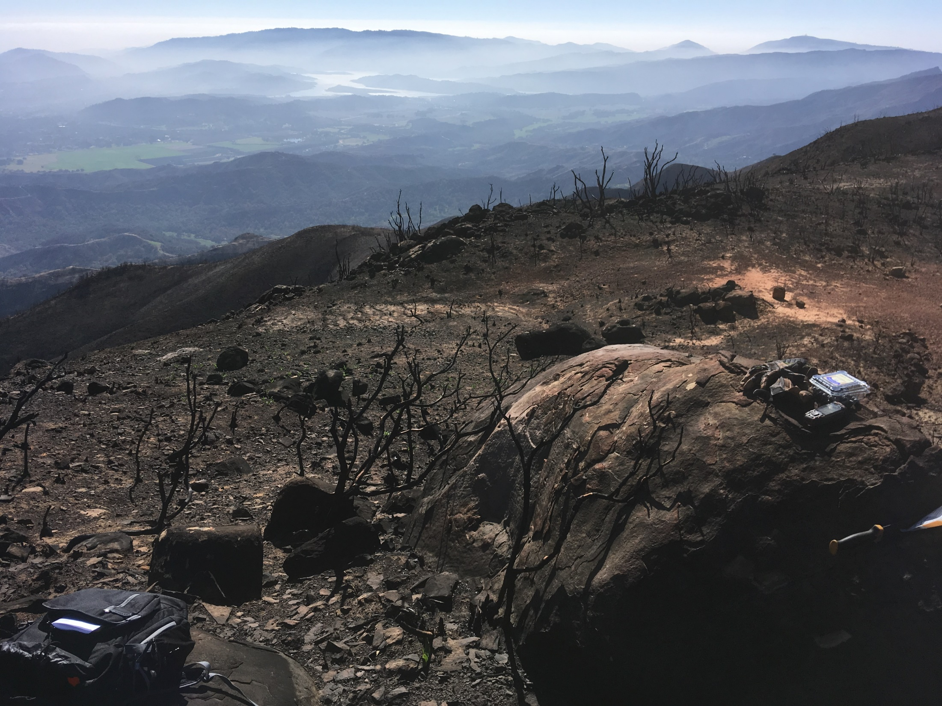

Slide 4
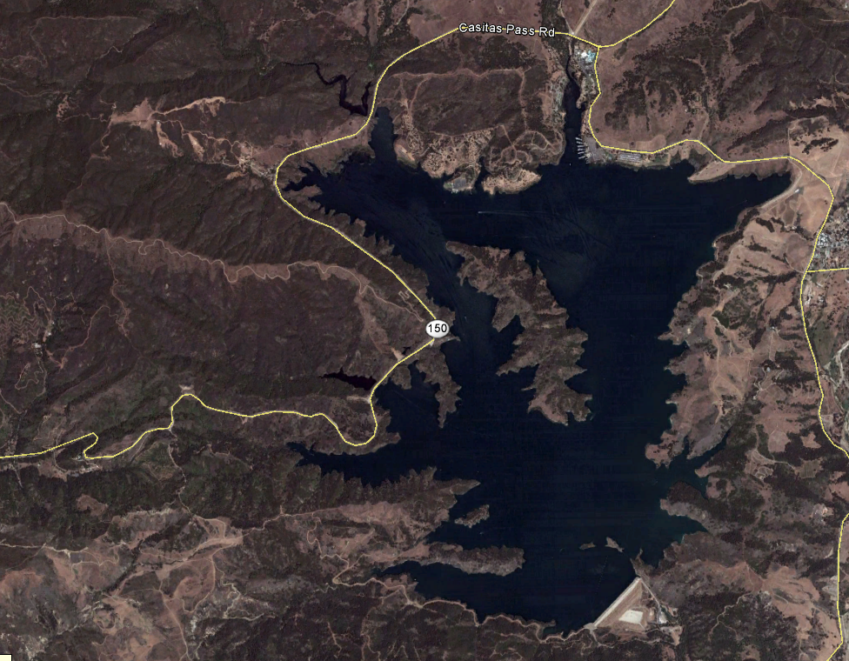

Slide 5
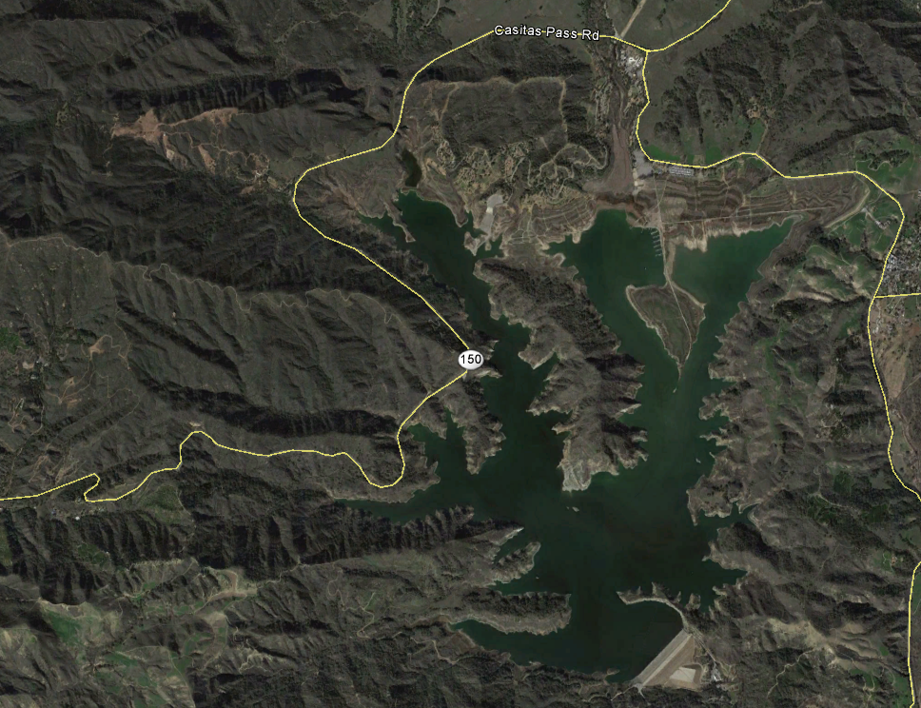

Slide 6
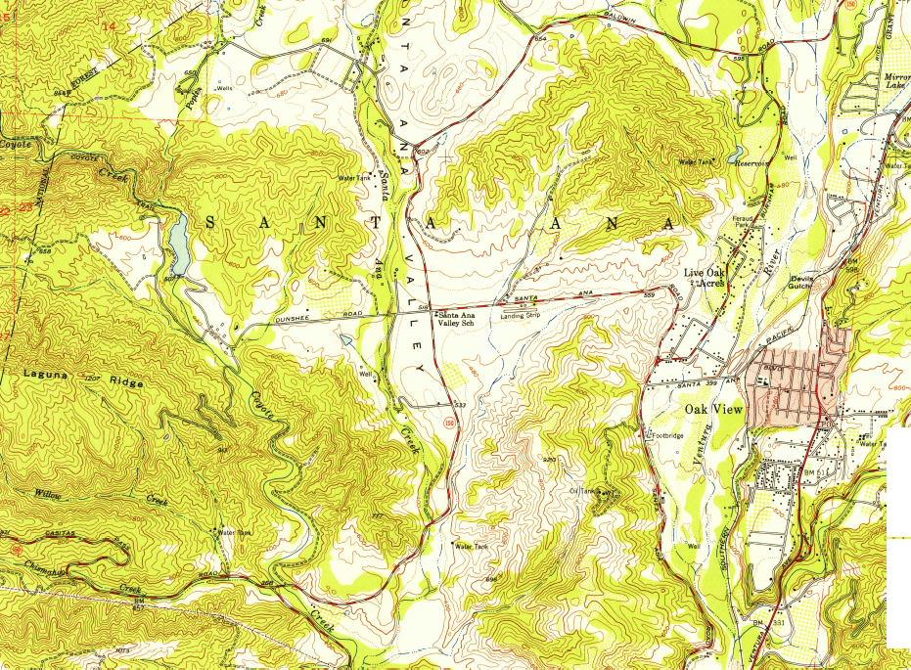



Slide 7
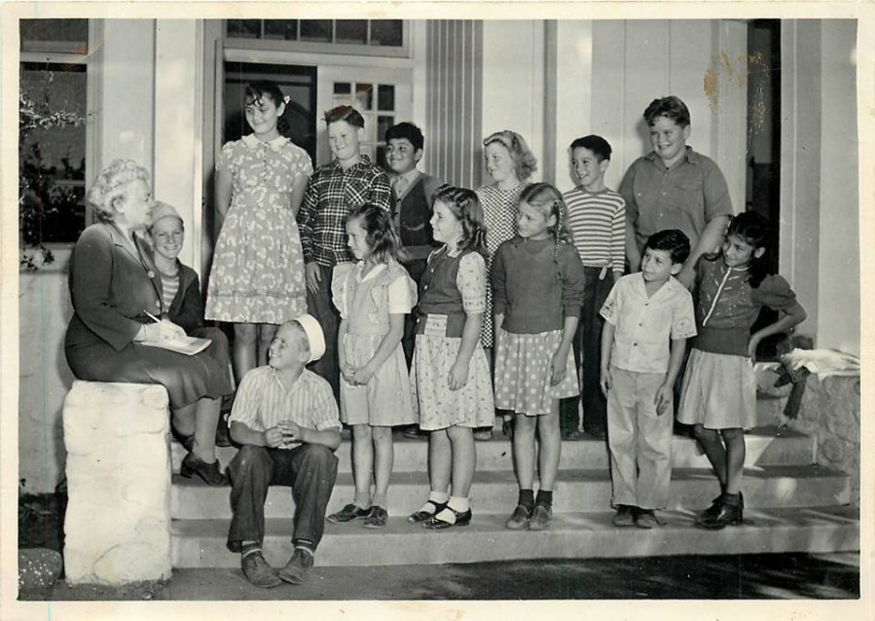

Slide 8
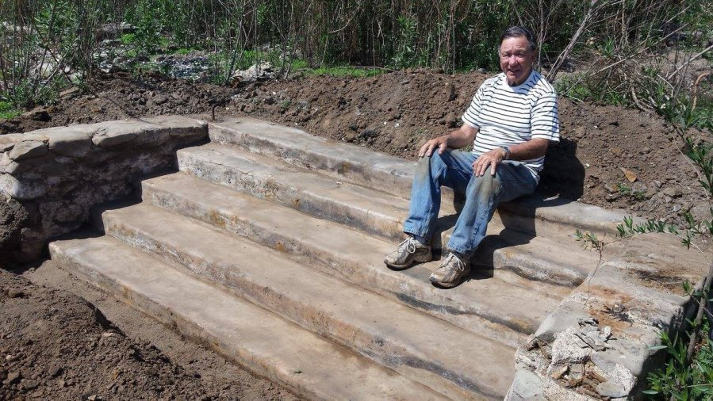

Slide 9
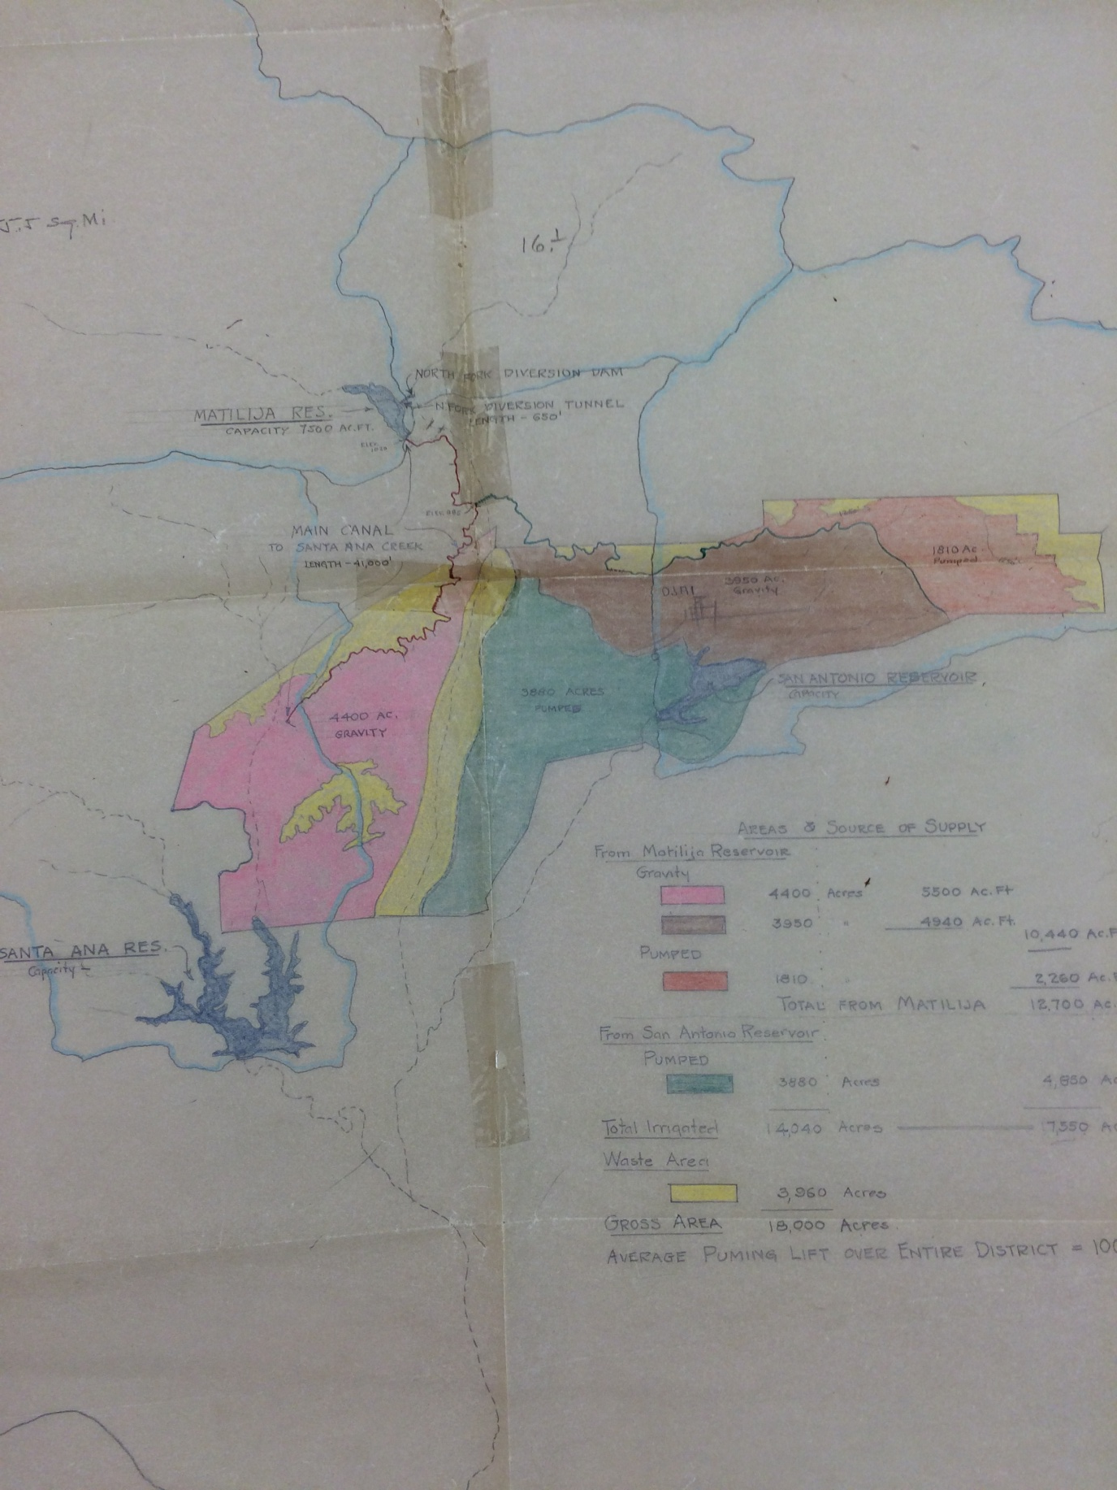

Slide 10
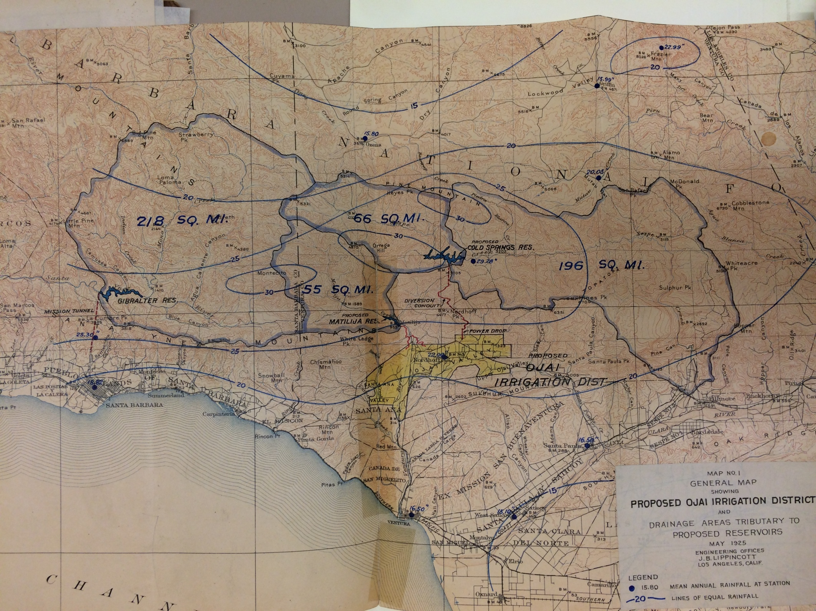
Planned Utilization of Water Resources In Ventura County
Two separate basins
Includes portion of Lake Casitas
San Antonio Creek
Most limits of alluvium
Includes “Islands”

Slide 11
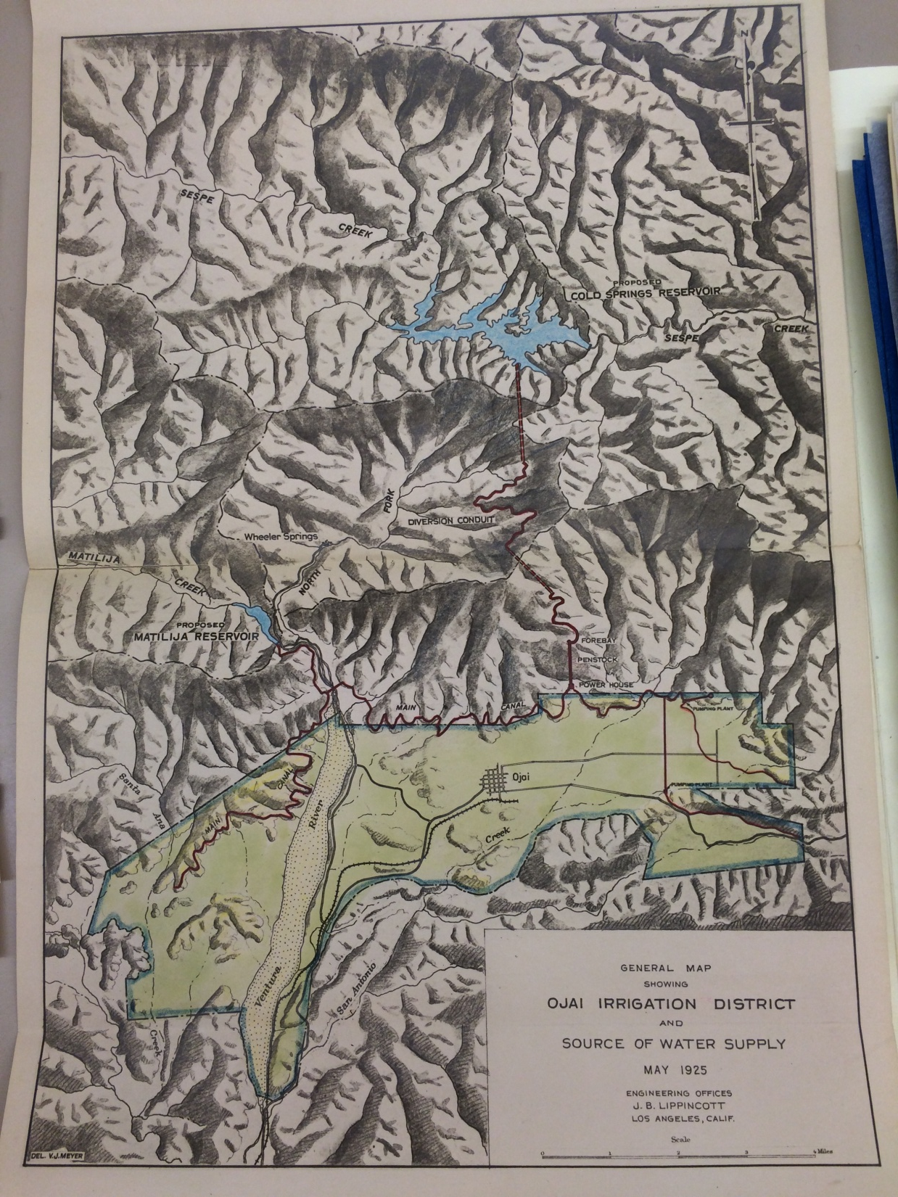

Slide 13
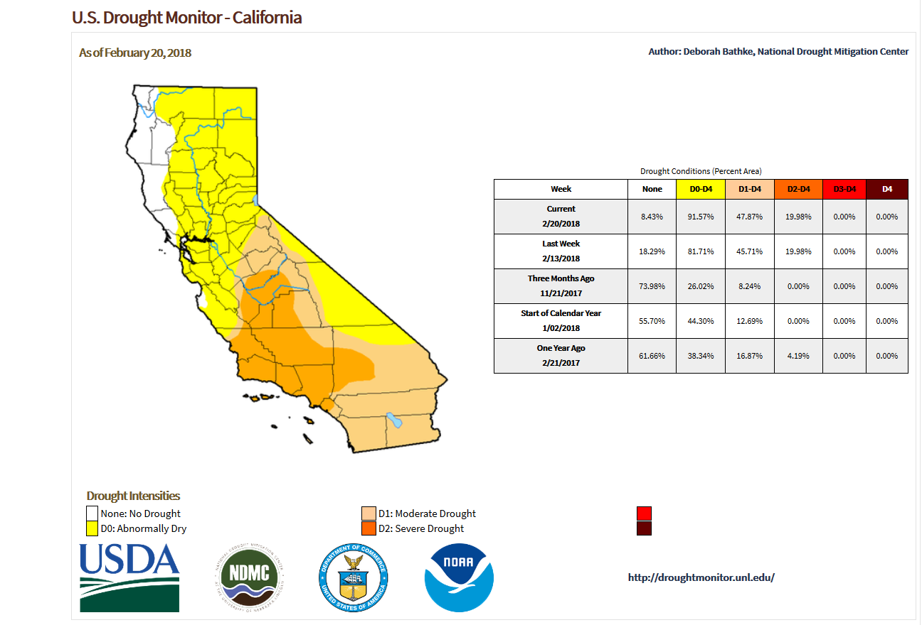

Slide 15
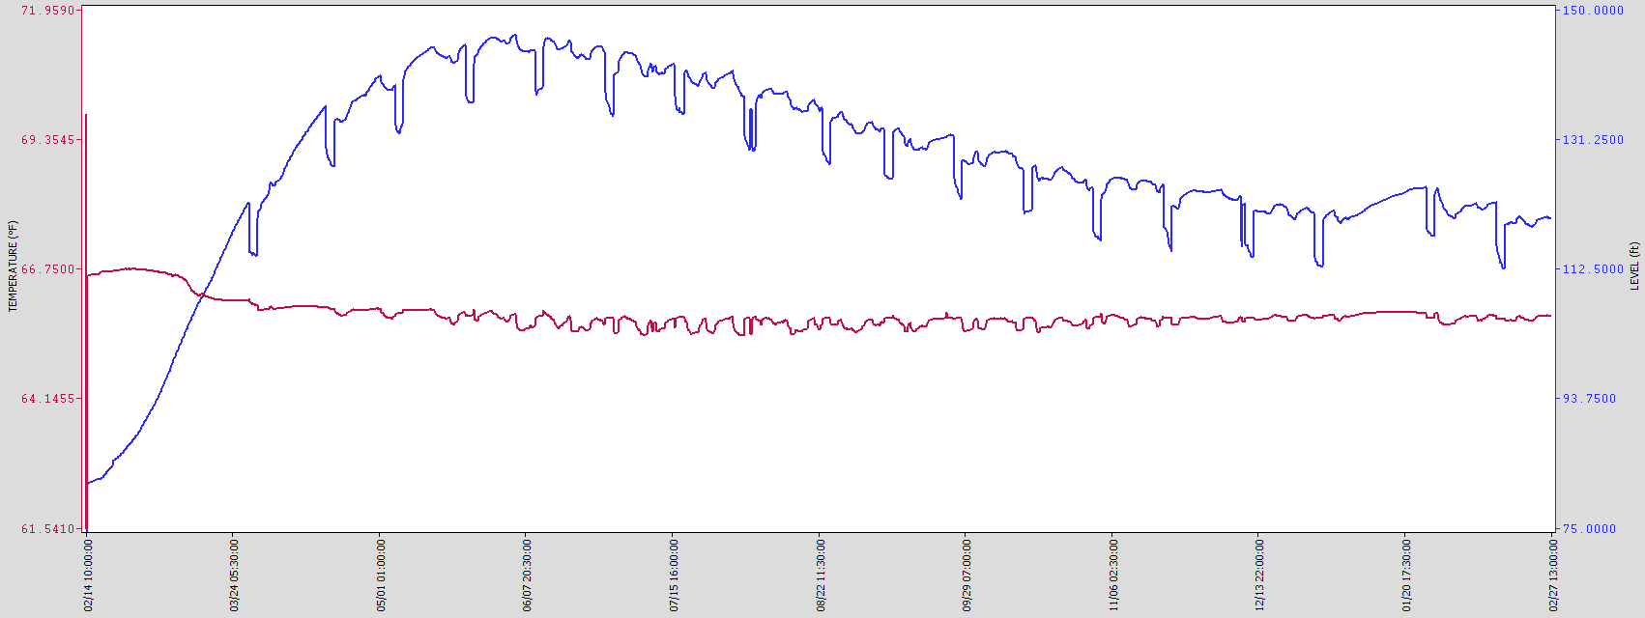
January 9, 2018 storm
Fire
Surface Flow
Limited recharge
Recedes ~25 ft during summer and fall
Rise in water levels from 2016-17 winter rains
Peak in June 2017

Slide 16
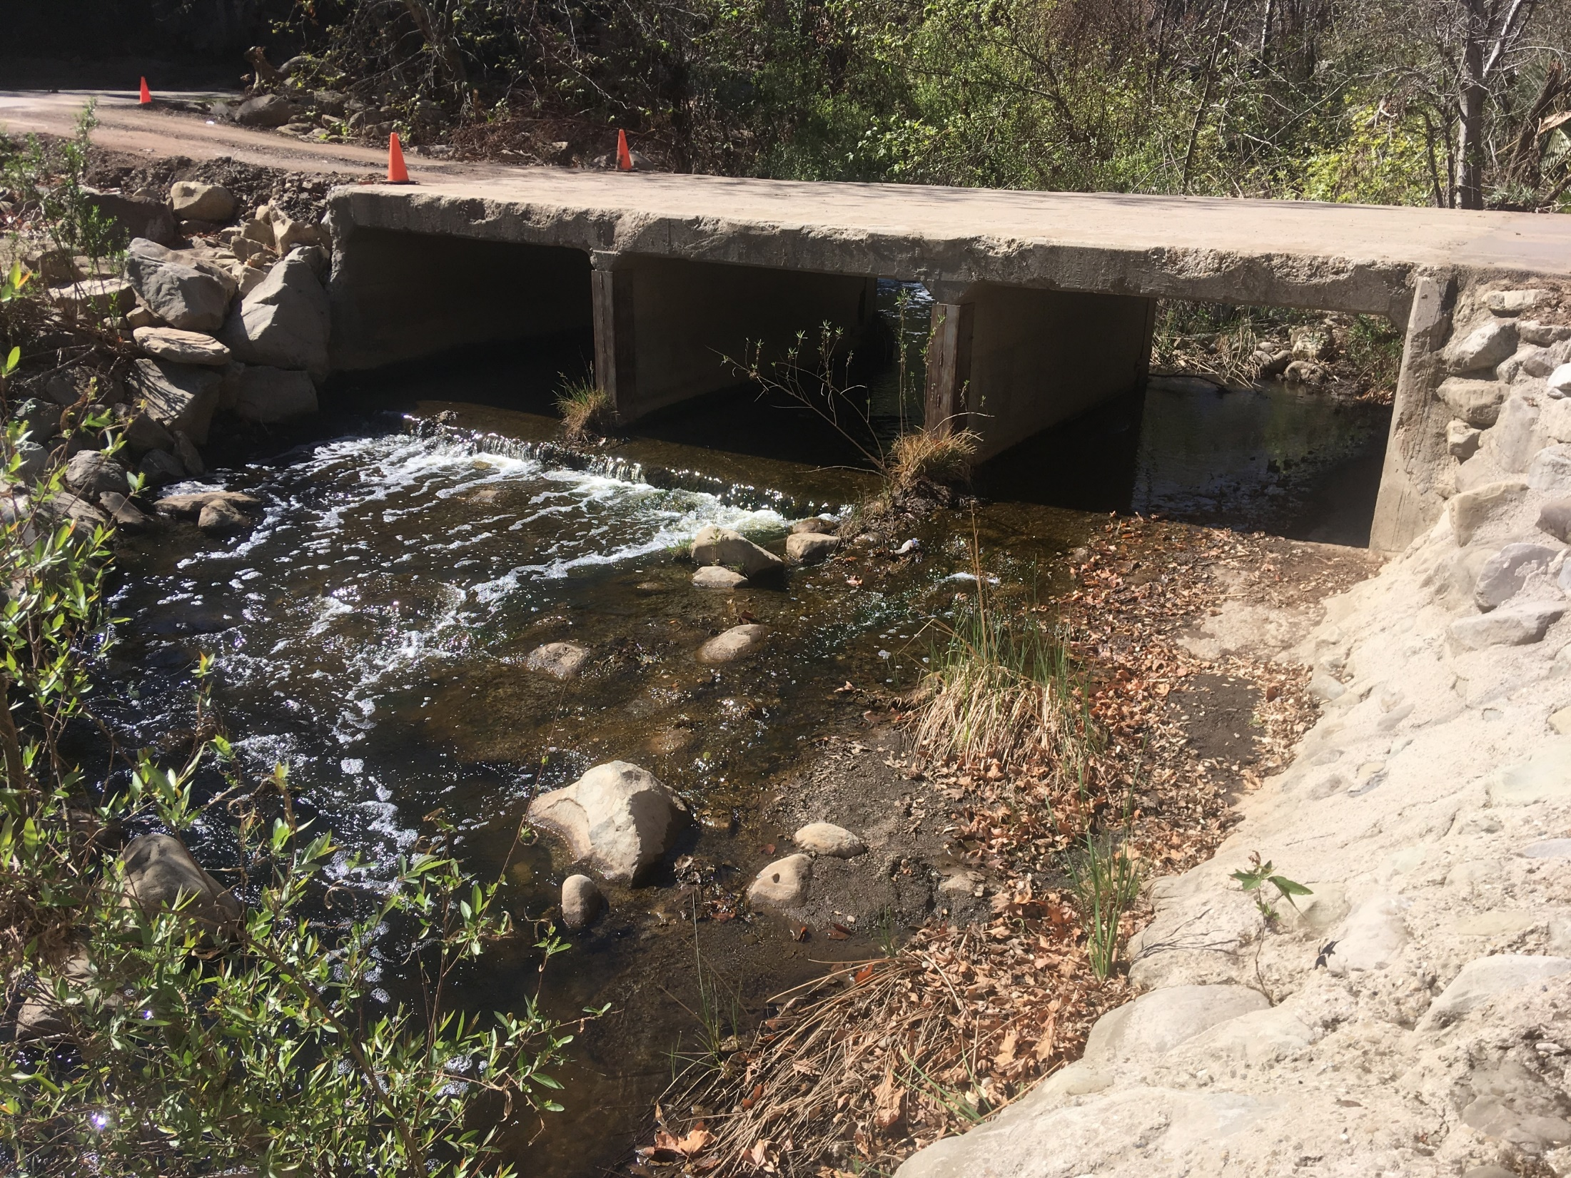
6.2 cfs
28 February 2018

Slide 17
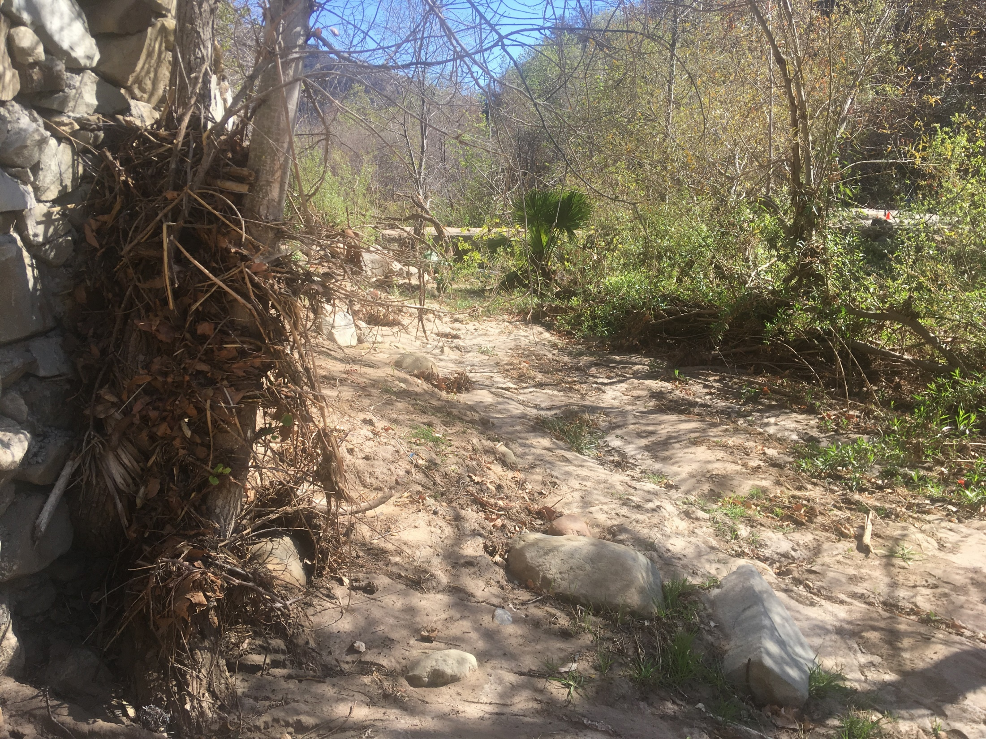

Slide 18
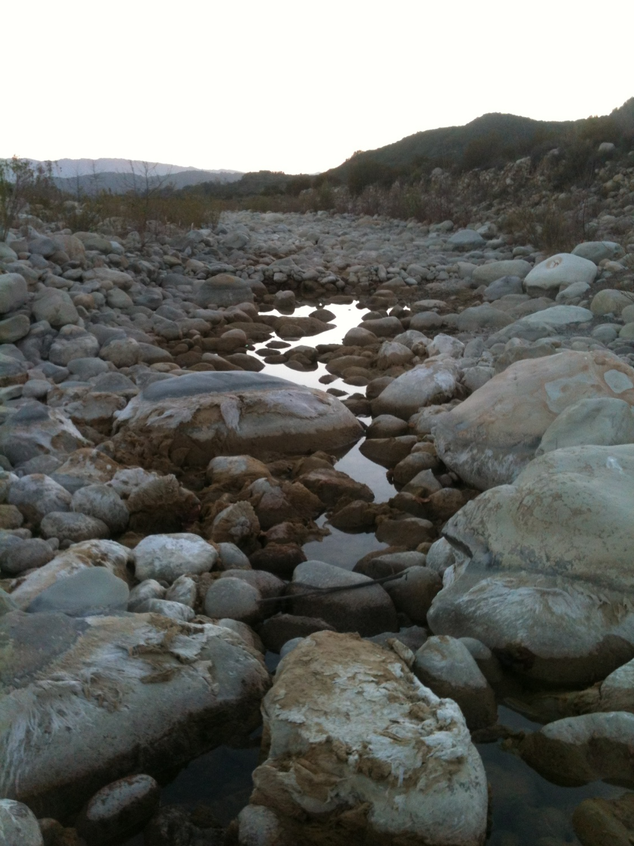
Southern Wet Edge Of Surface Flow
Moves constantly
-Advances southward with:
increase surface water
or increased groundwater
storage
-Recedes northward with:
decreased surface water and loss
or decreased groundwater
in storage in balance with surface
water
Ash component:
-decreases infiltration capacity of river bottom sediments
-River flows to ocean without infiltration
-Groundwater does not respond as rapidly or consistently
-Available aquifer storage capacity unused
-less water available for natural discharge over summer and fall in live reach

Slide 19
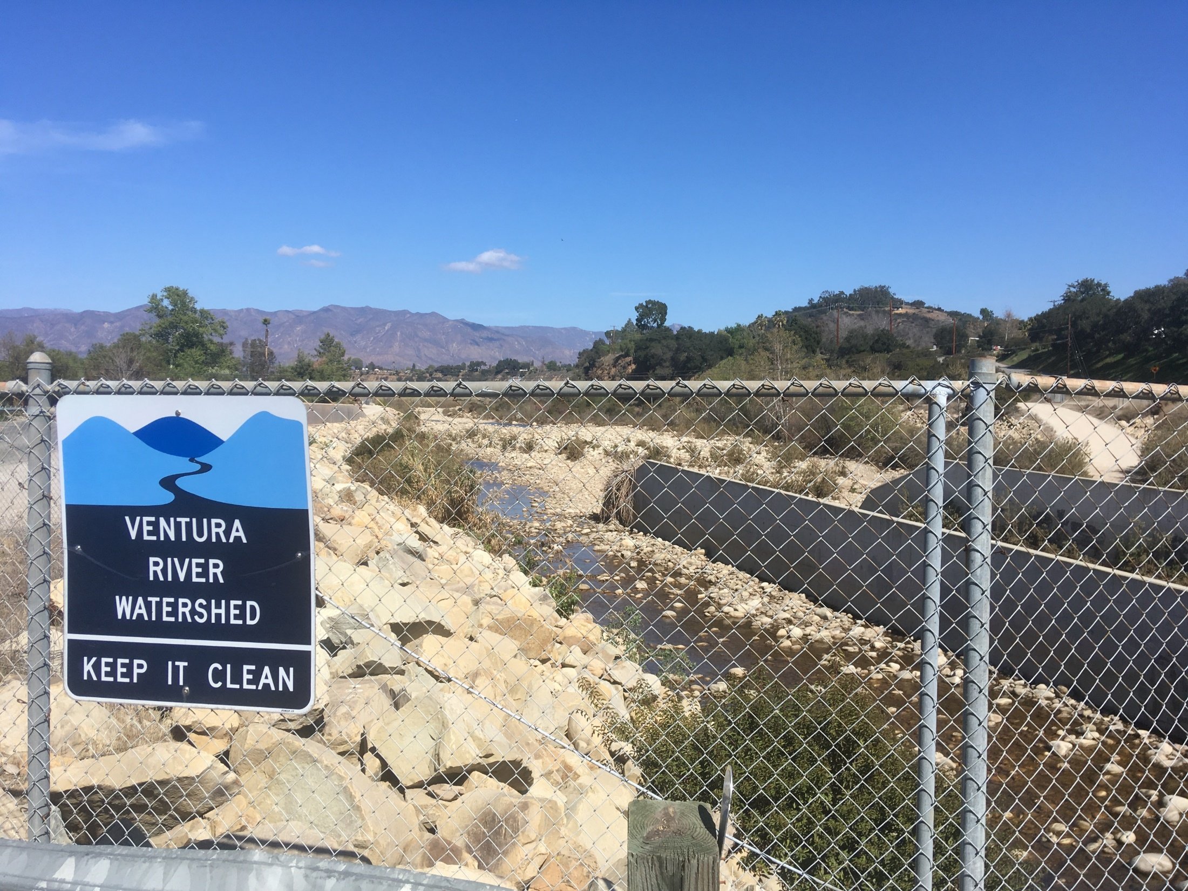
Water escapes watershed

Slide 20
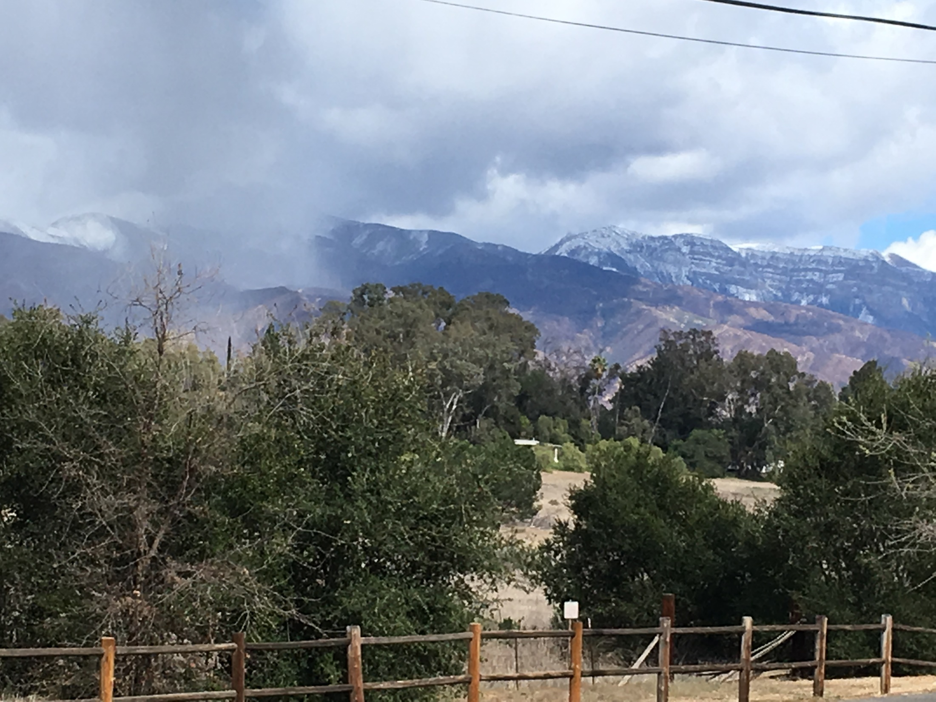
HOPE

Slide 21
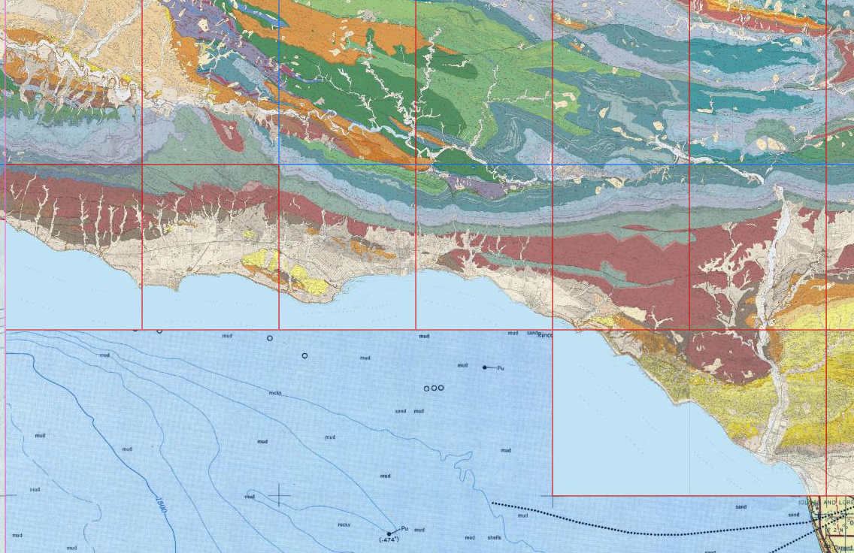
Matilija Horizontal Bores
Tecolote
Mission
Cold Spring
Doulton
HoBos

Slide 22
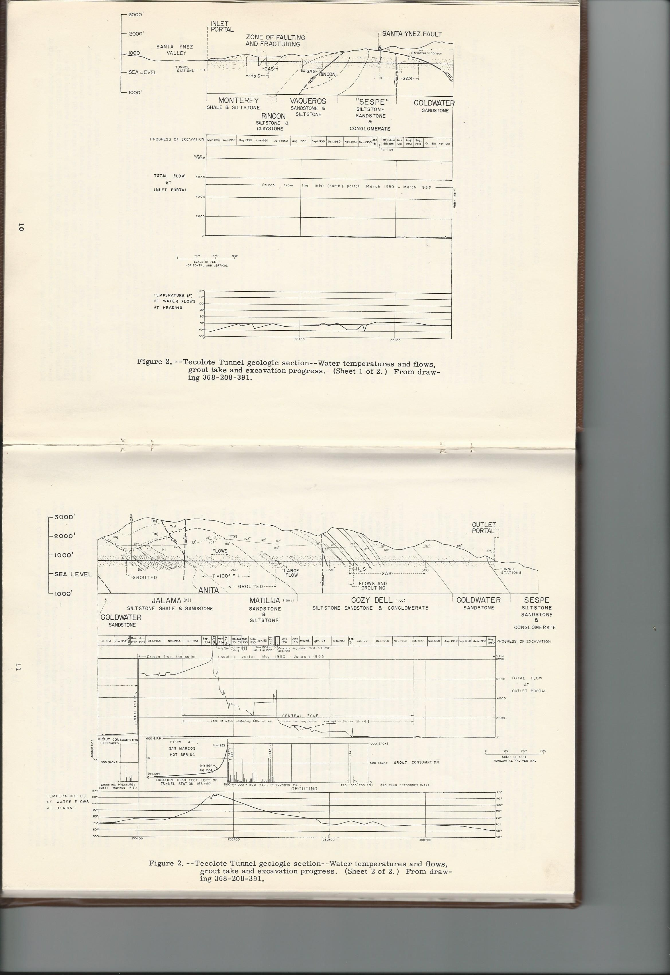
Tecolote Tunnel
8,000 gpm
1,000 gpm

Slide 23
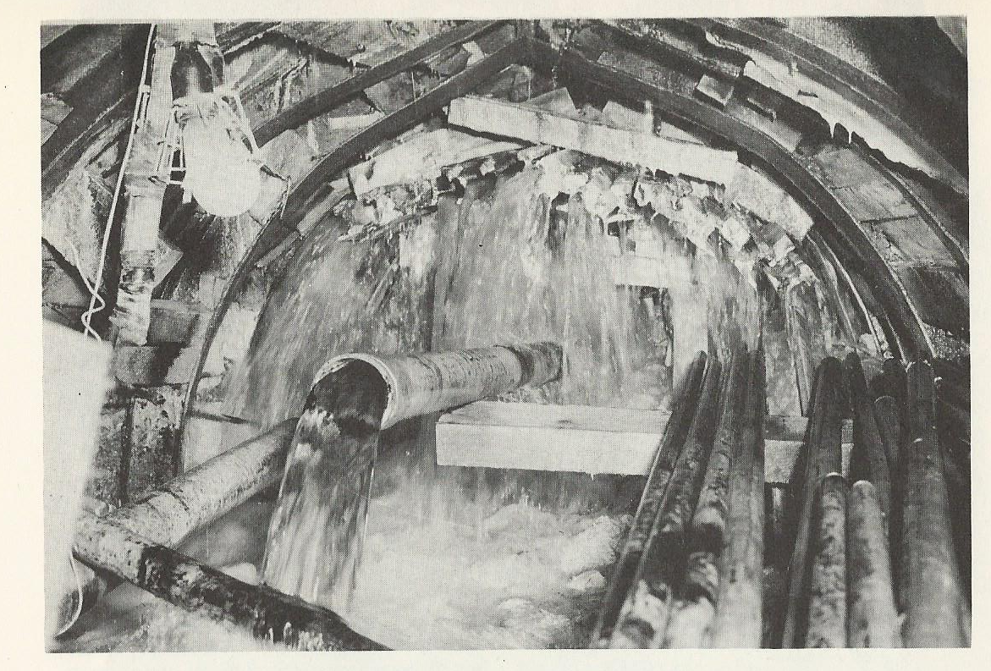
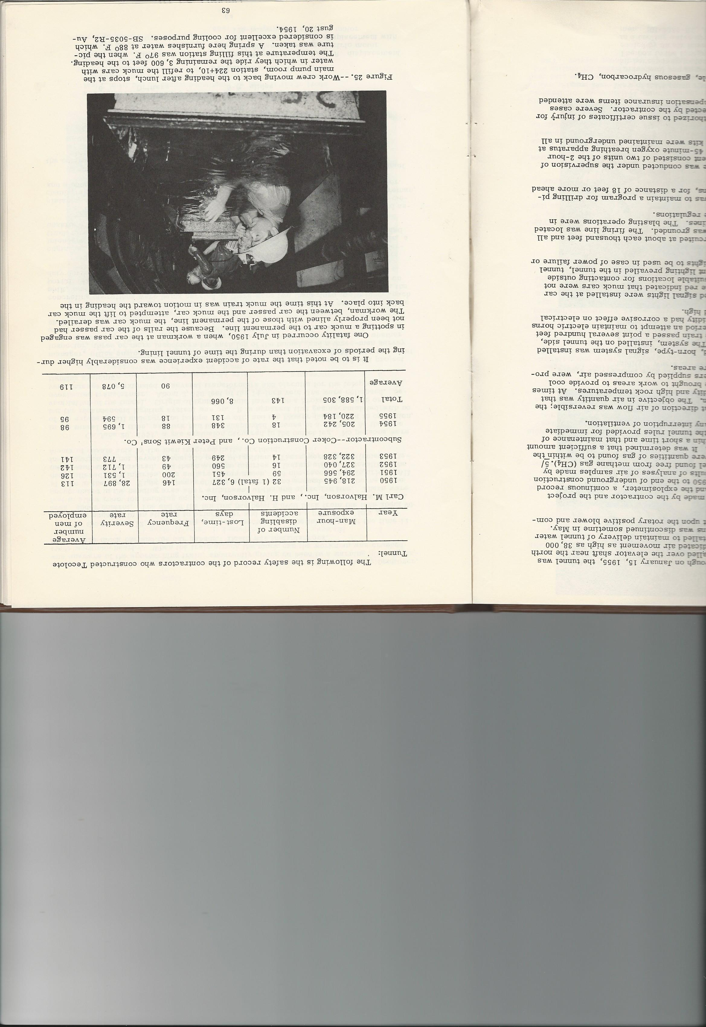
Tecolote Tunnel

Slide 24
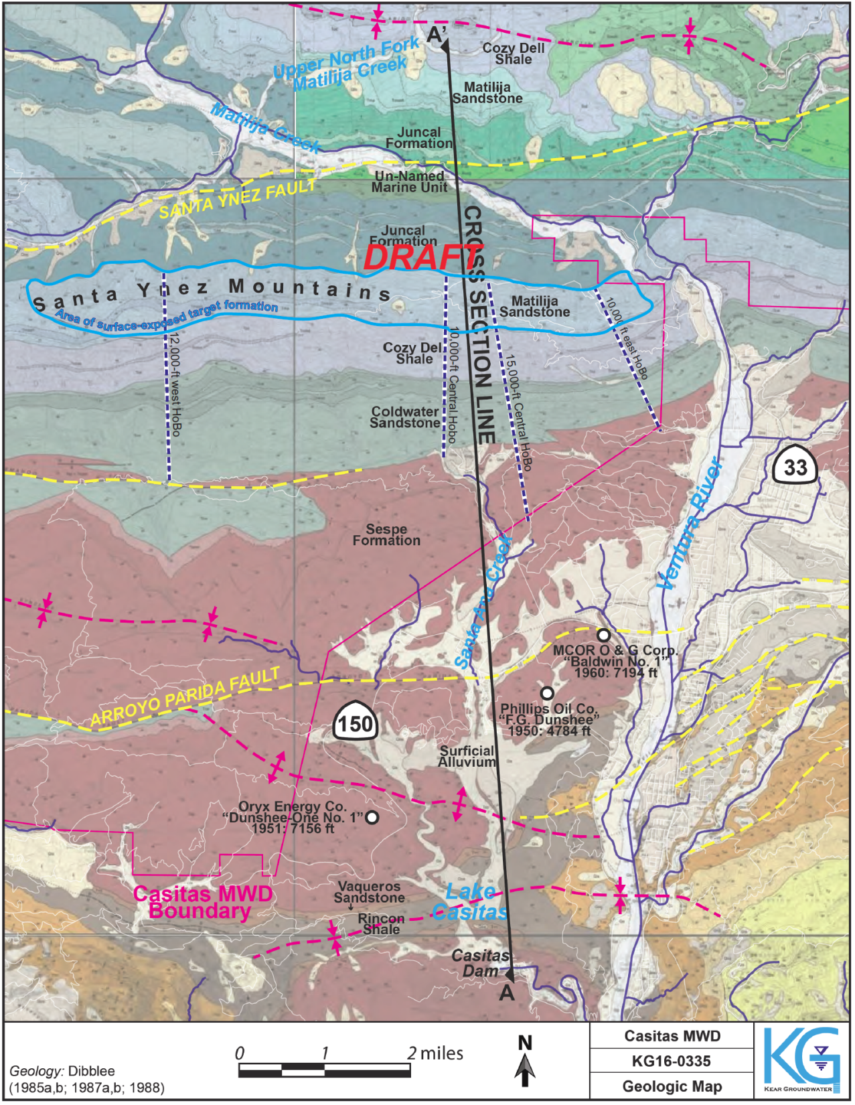

Slide 25

6 miles
2000 ft
2000 ft
3000 ft
Specific Yield ~1%
31680 ft X 2000 ft X 2000 ft X 0.01 = 1.26 x 10⁹ cubic feet
1.26 x 10⁹ cubic feet / 43560 cf/af = 29,000 AF
Specific Yield ~5%
31680 ft X 2000 ft X 3000 ft X 0.01 = 9.50 x 10⁹ cubic feet
9.50 x 10⁹ cubic feet / 43560 cf/af = 218,000 AF

Slide 26
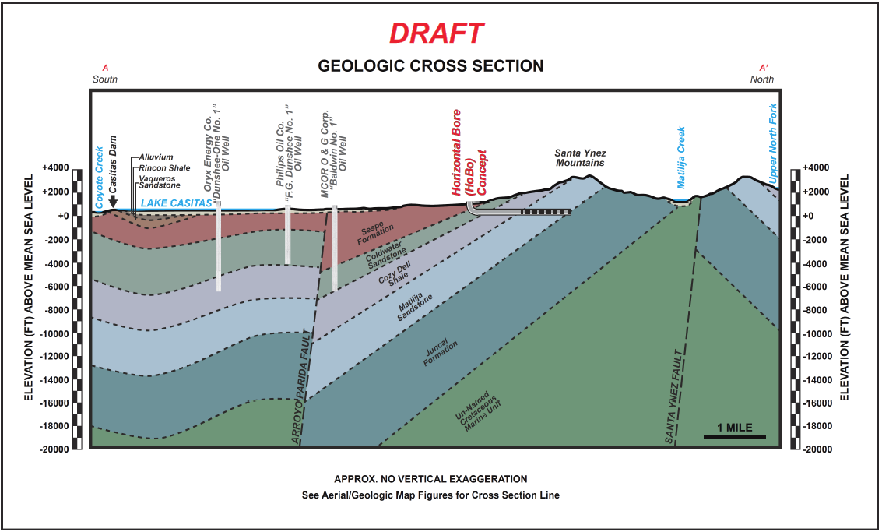

Slide 27
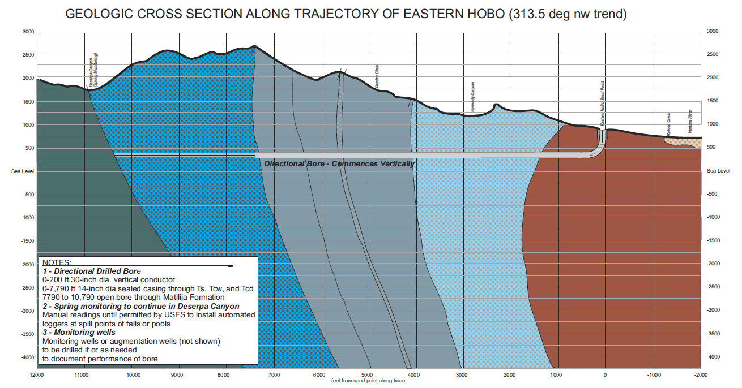

Slide 28
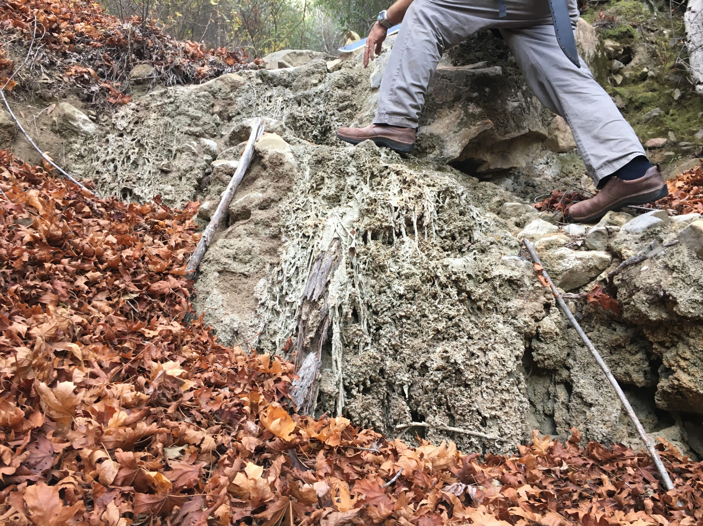

Slide 29
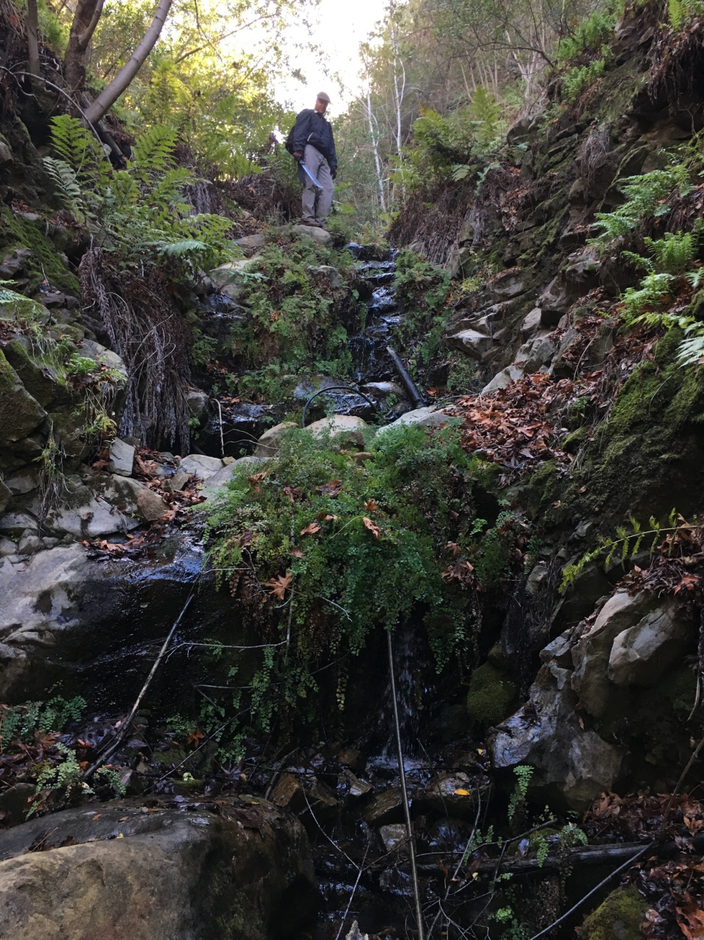

Slide 30
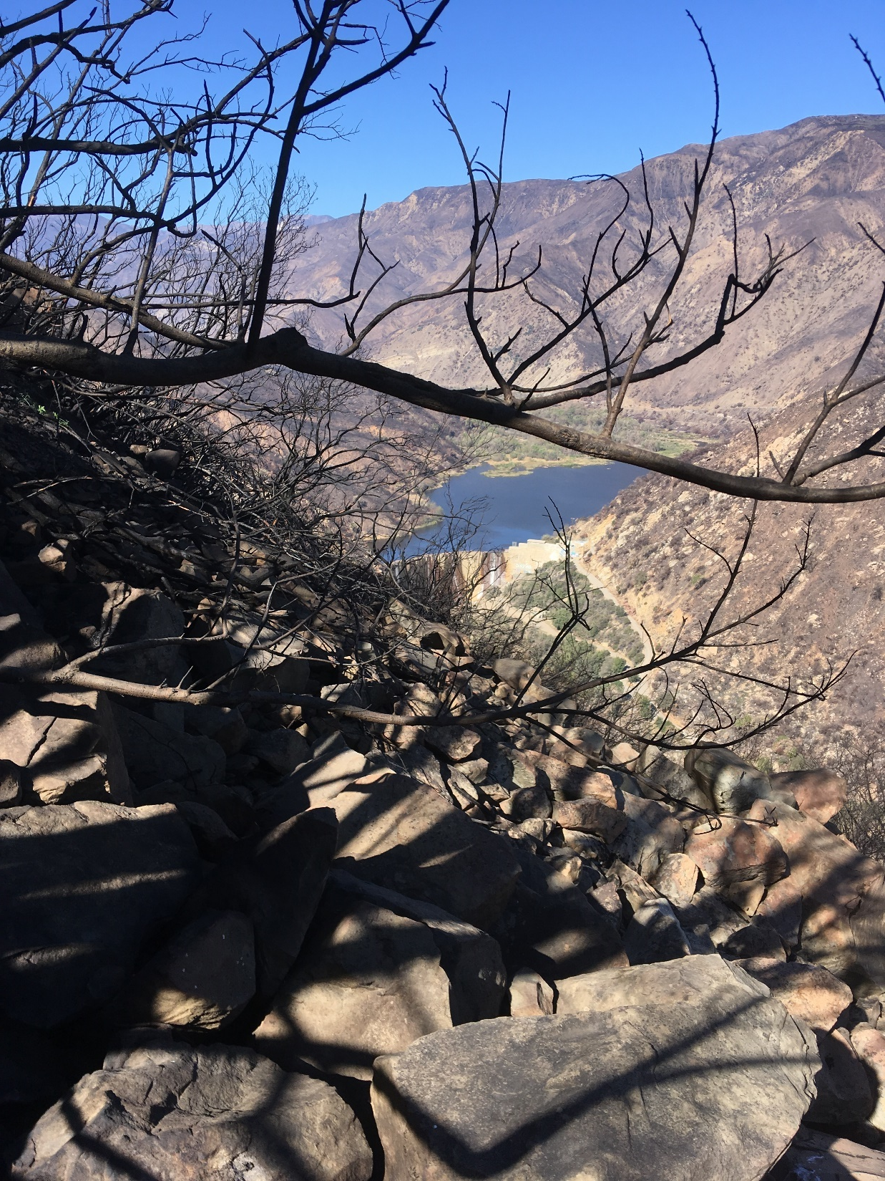

Slide 31
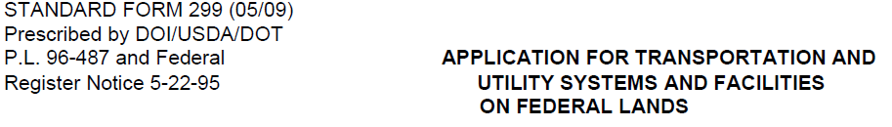
Matilija Horizontal Bores
Preliminary estimates of up to 8,000 AF per year
Used only when triggers of drought are met
Recharged during wet periods
Wells shut-in during wet periods to allow for replenishment
Pilot Project
USDA FS 299 permit
ES/EIR/CEQA/NEPA compliance
Intensive study to inform
Water Rights

Slide 32
State Water Project Intertie
City of Ventura
Calleguas MWD
Reliable …
5000 AFY
3 to 5 year time frame
Offset lake demand

Slide 33
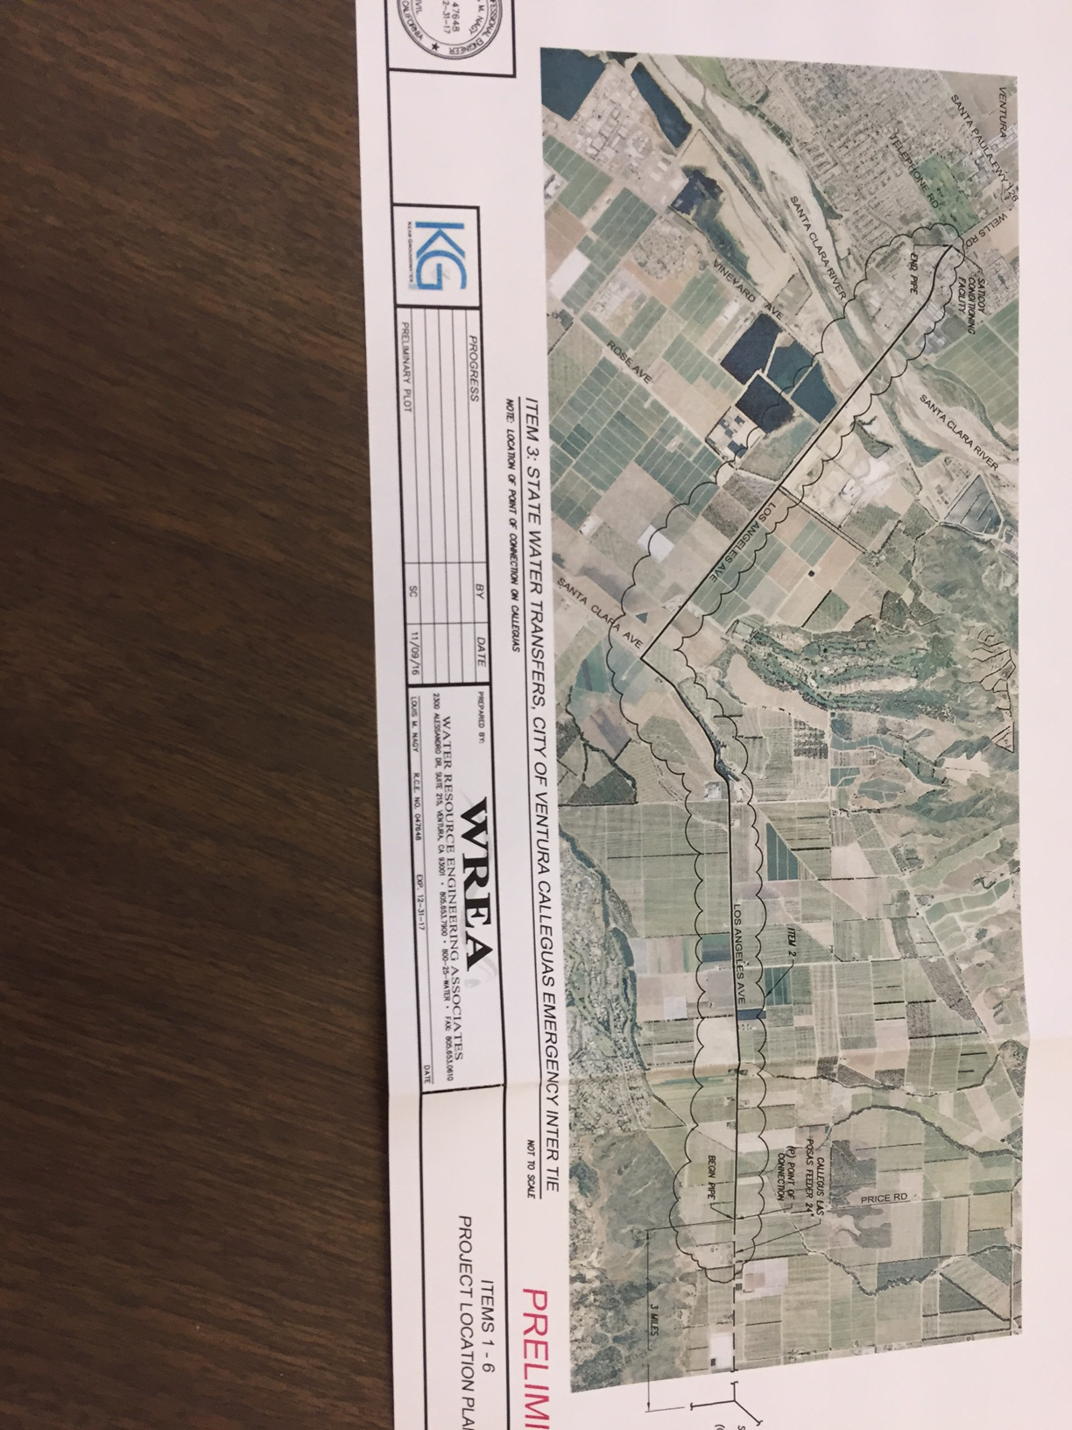
State Water Project Intertie

Slide 34
Ojai Desalter

Slide 35
Ojai Desalter
Strives to make additional water usable to the District
Offsets potential “Undesirable results” of groundwater extraction during drought
May use existing infrastructure
350 AF Y
Treated water put into municipal system
Concentrated byproduct put into OVSD system, joins with treated waters downstream before plant
Limited net change
Improve basin WQ

Slide 36
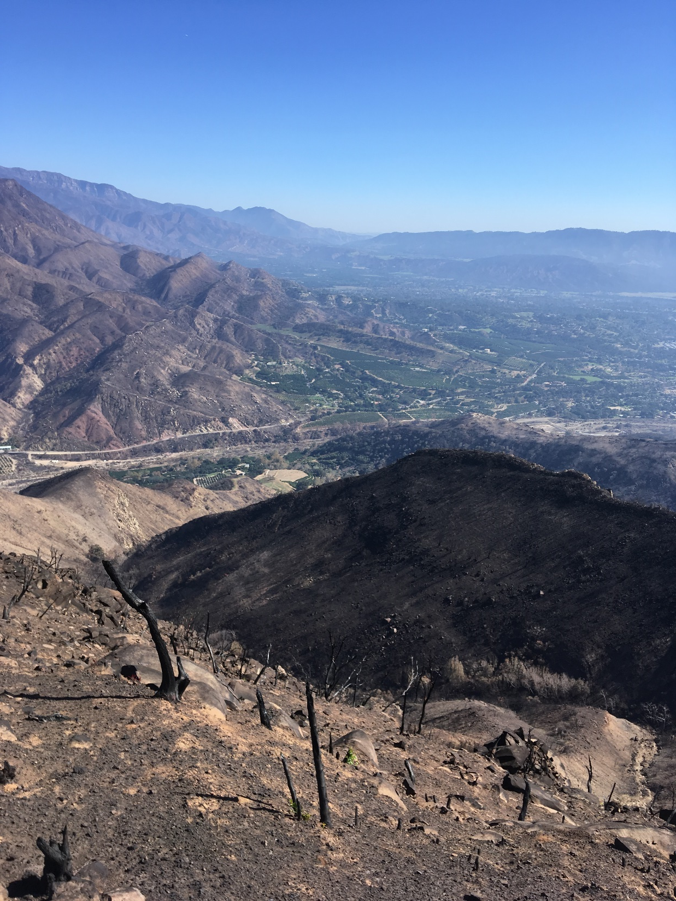
Let us use
The knowledge
And resources
At hand
To bridge
to future Generations
Whose knowledge
And capacity
will surpass ours
by leaps and bounds

