Slide 1
Thomas Fire Ventura River Watershed
Lloyd Simpson
USFS

Slide 2
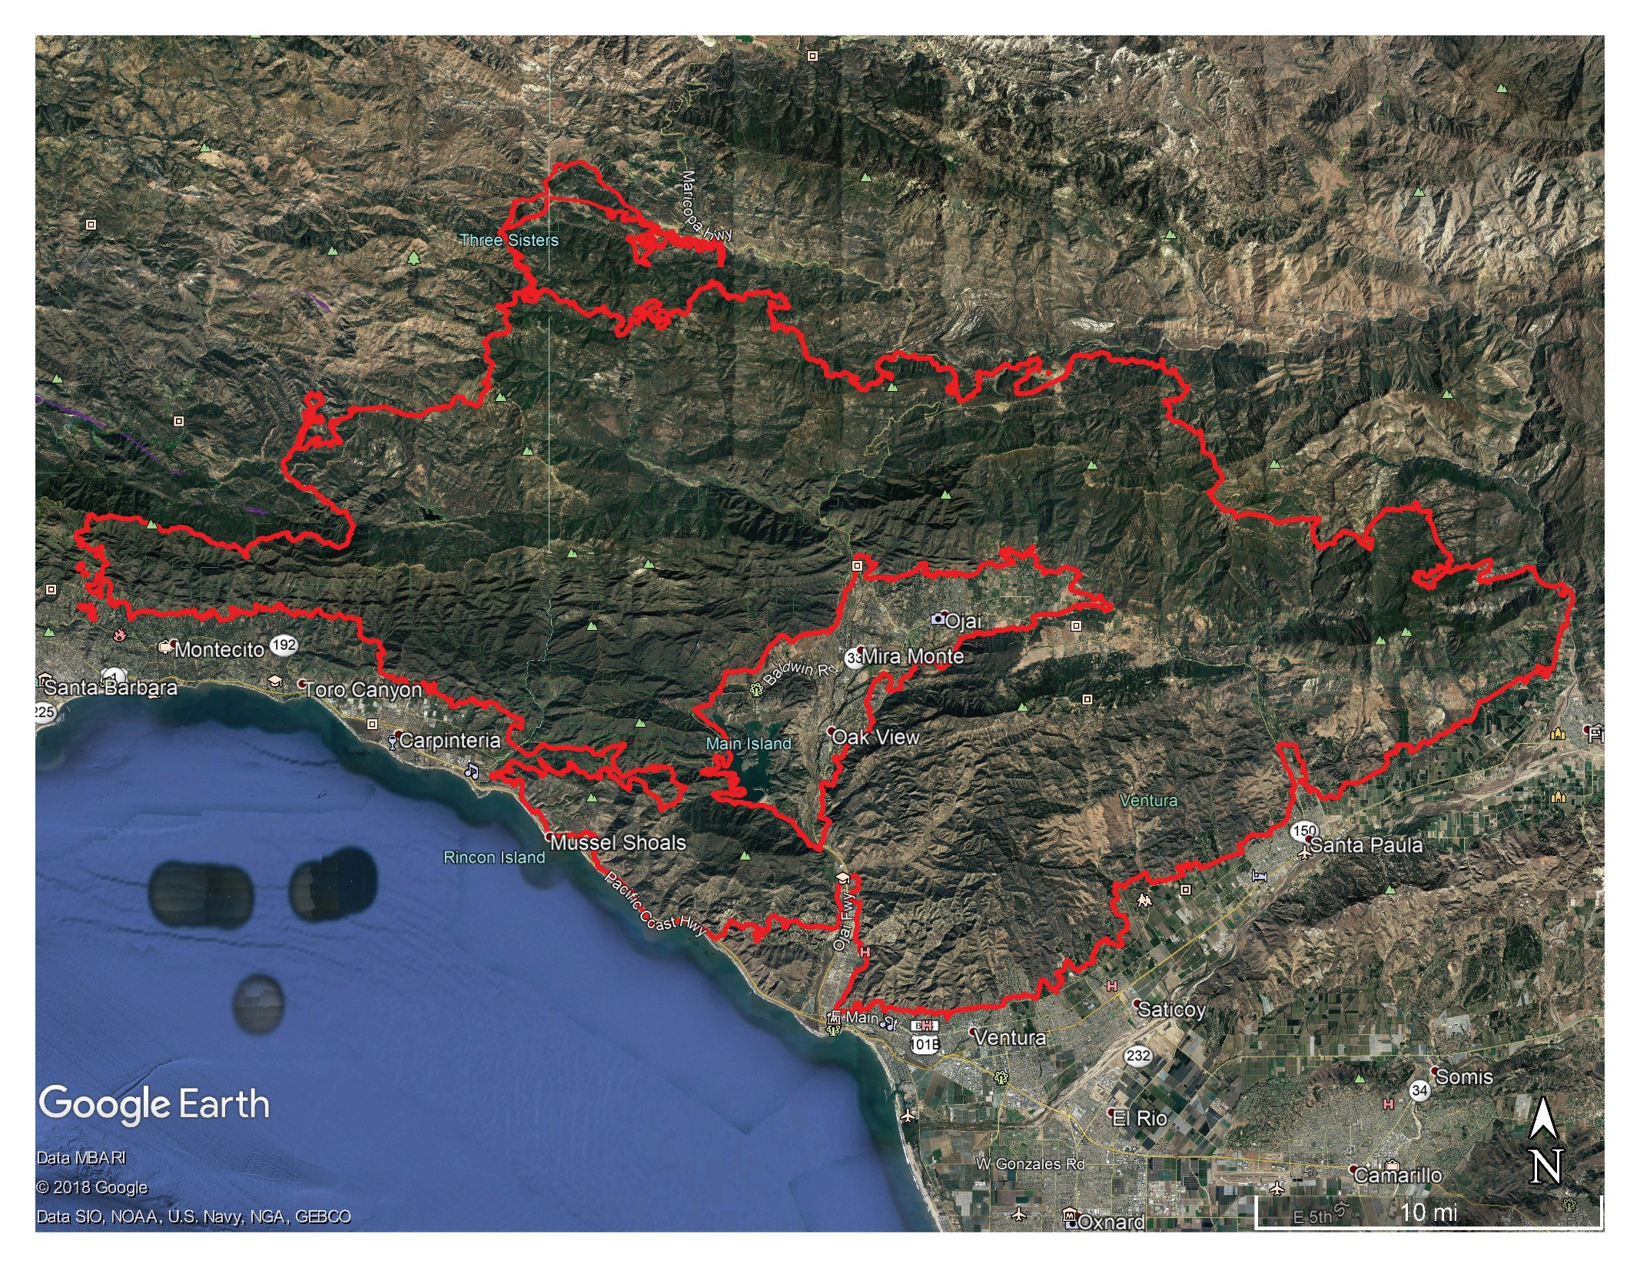
Thomas Fire Perimeter – 272,760 Acres

Slide 3
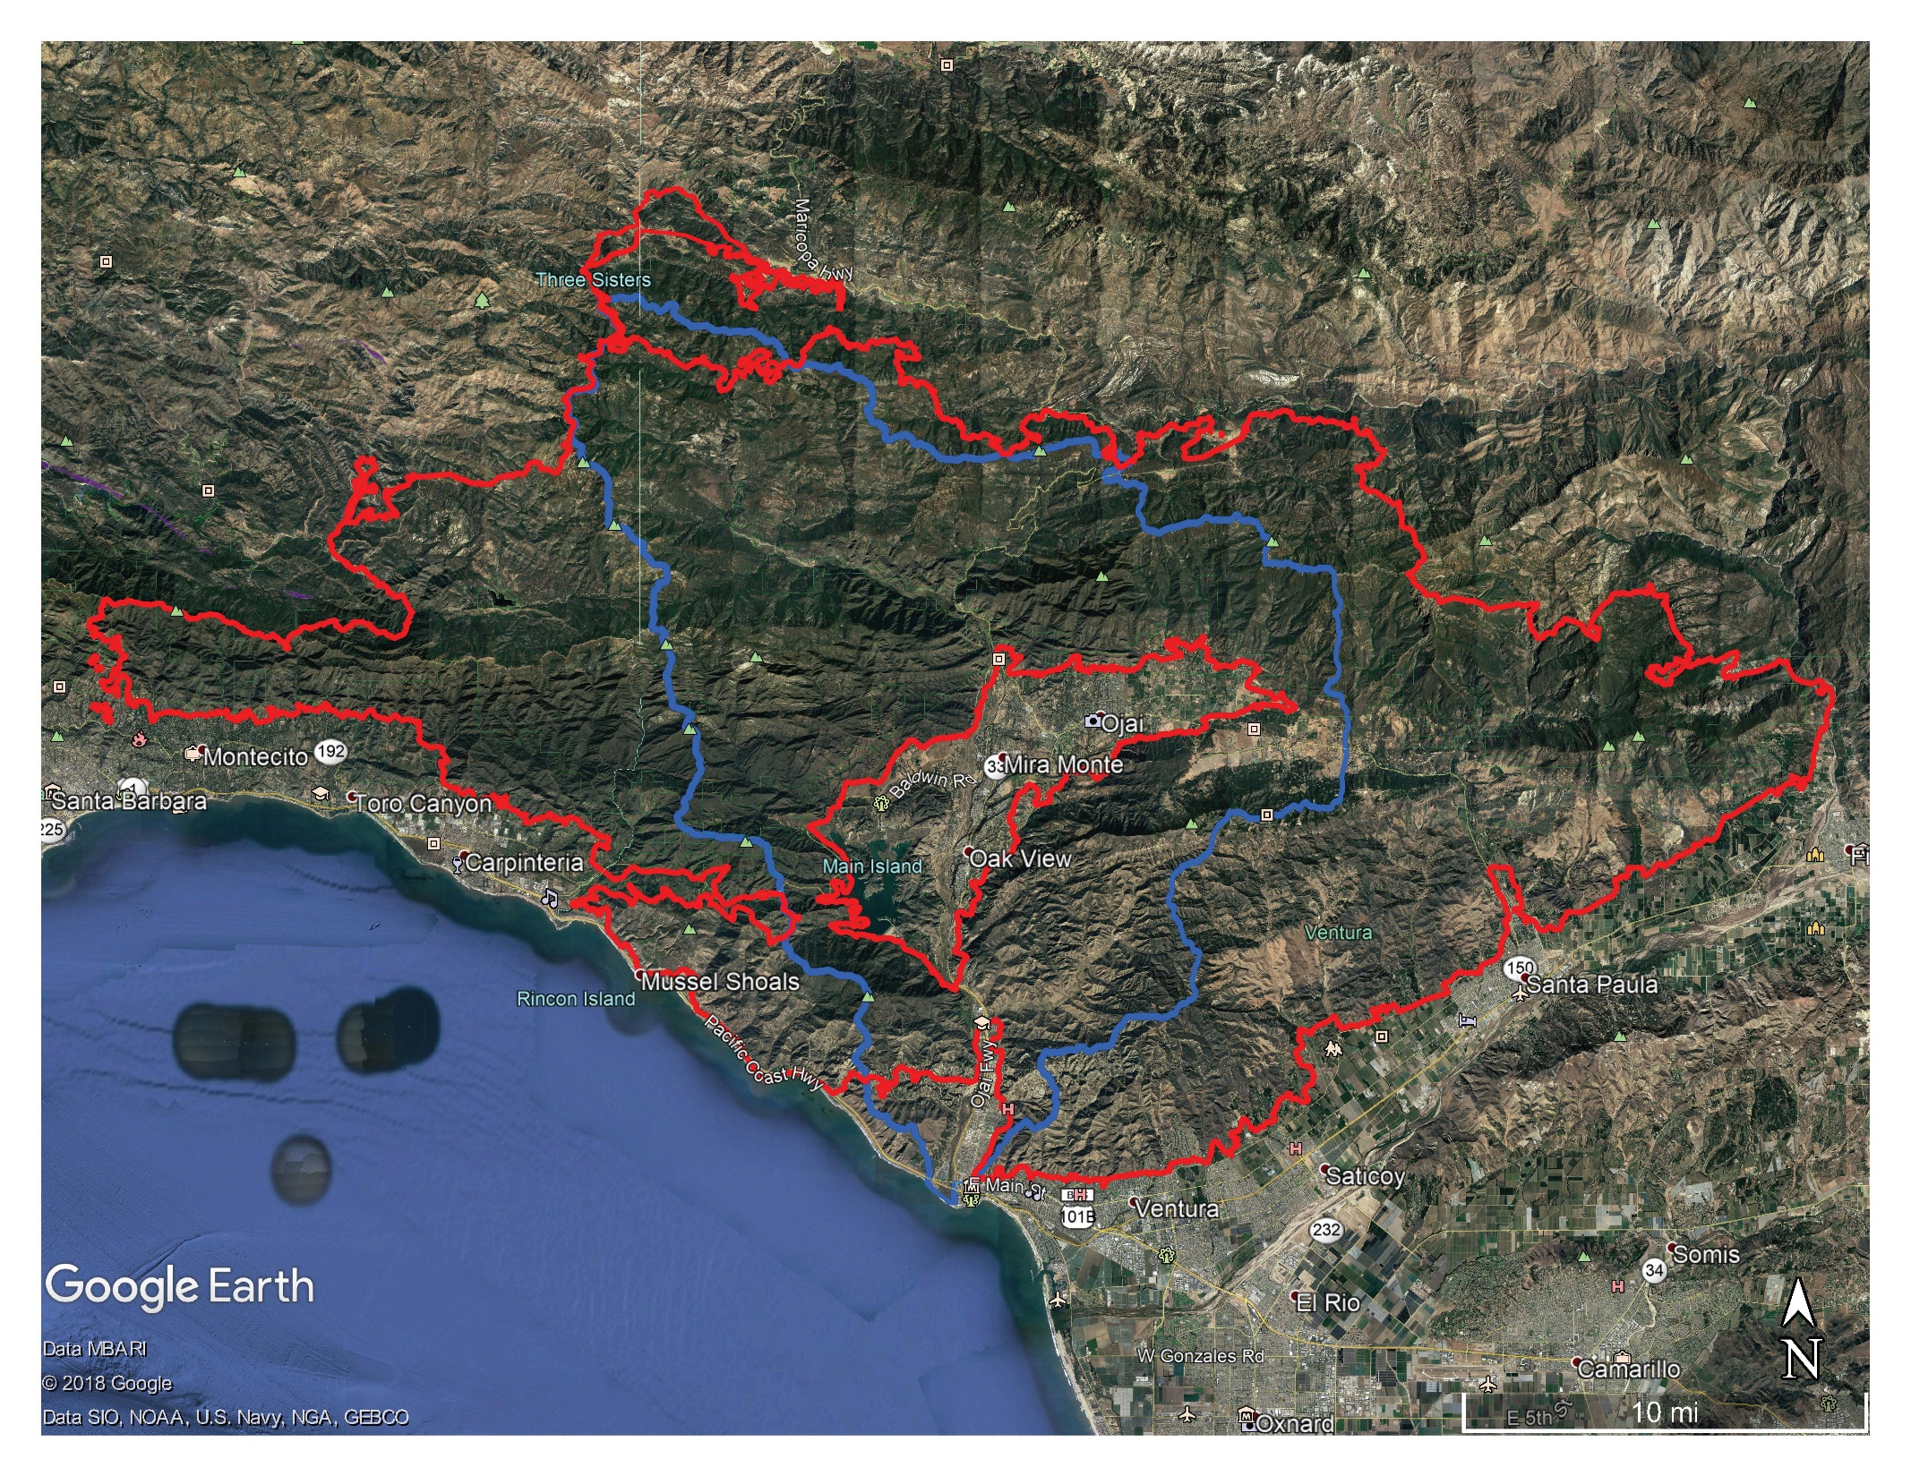
Ventura River Watershed – 144,833 Acres
➤
Data MBARI
© 2018 Google
Data SIO, NOAA, U.S. Navy, NGA, GEBCO
N
10 mi

Slide 4
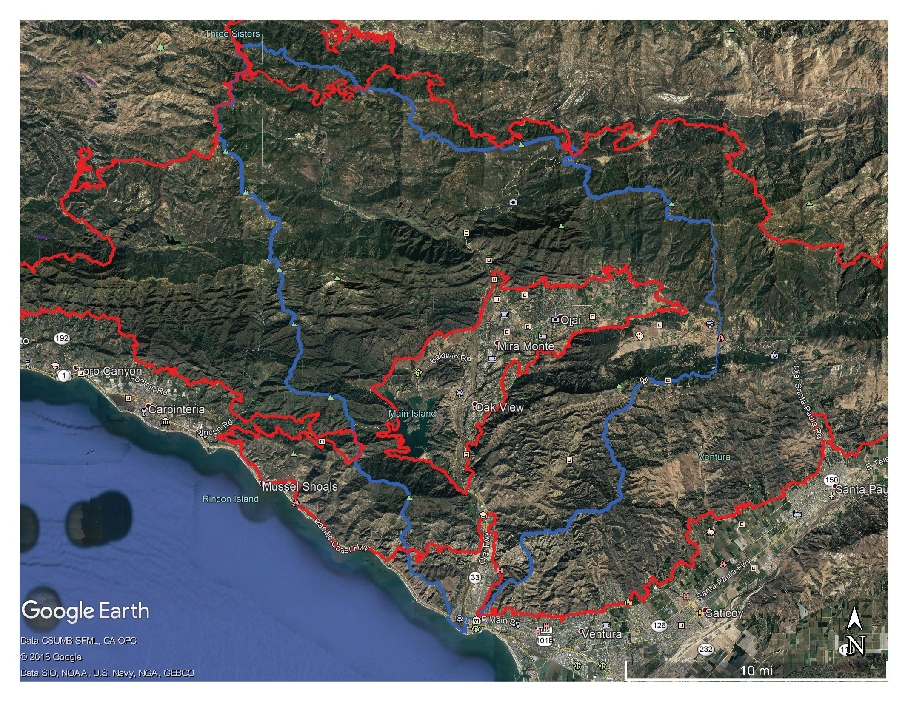
Ventura River Watershed – 144,833 Acres

Slide 5
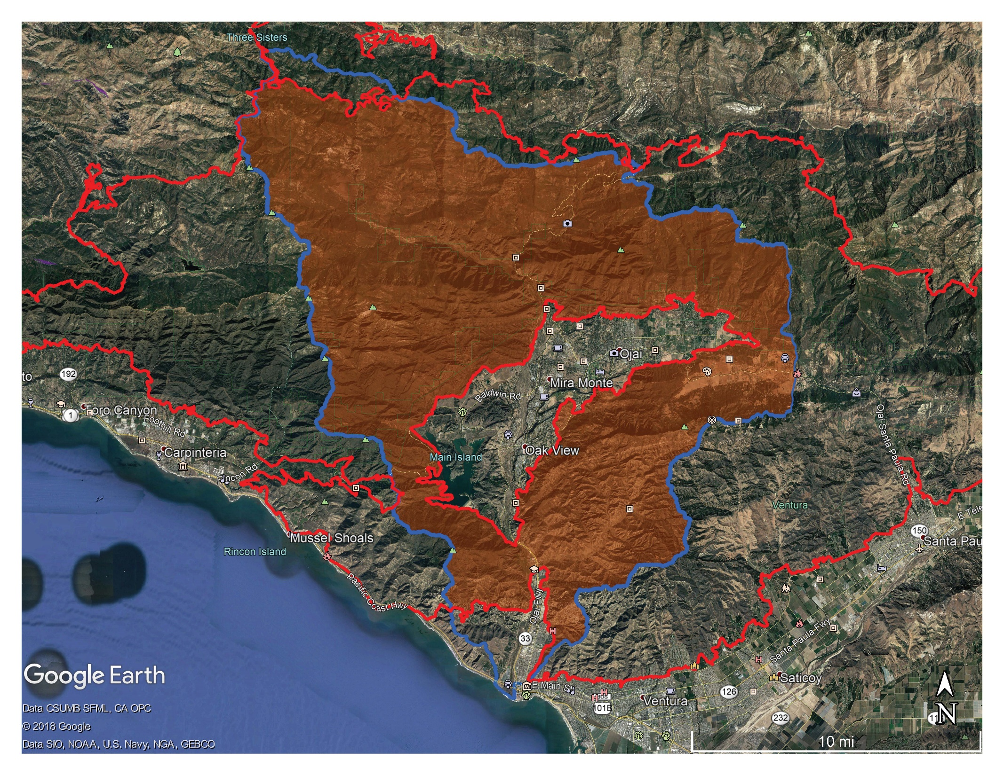
VRW Burned – 116,094 Acres – 80%

Slide 6
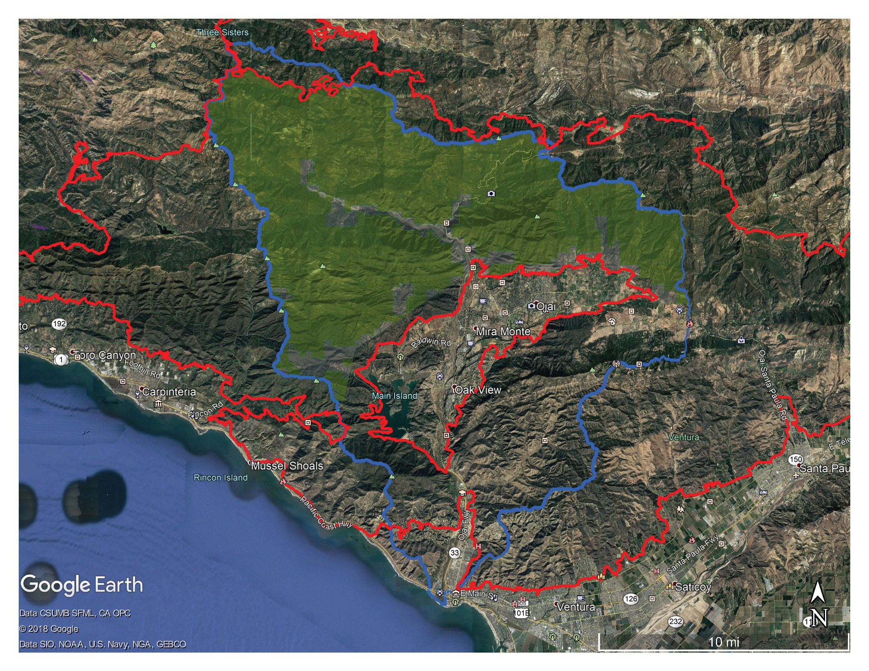
Los Padres NF Burned 96% of 70,063 Acres

Slide 7
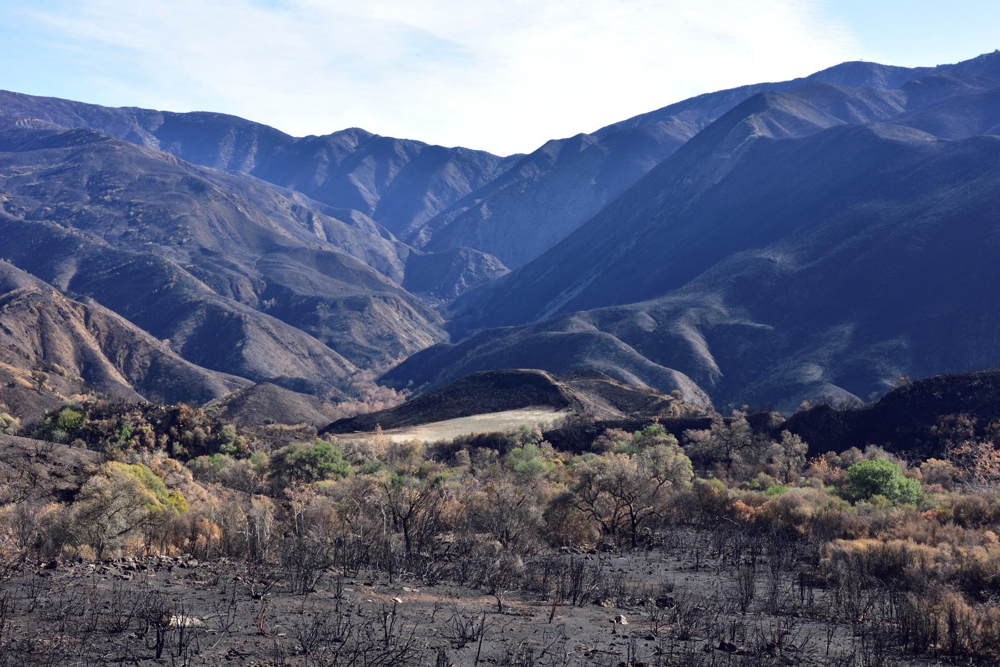

Slide 8
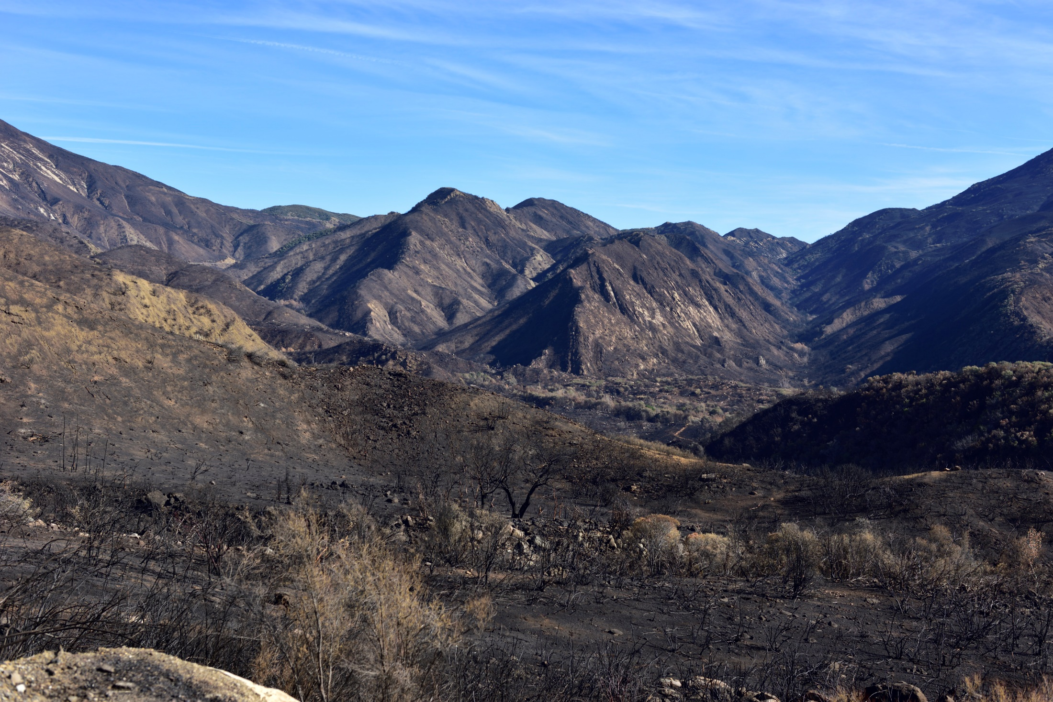

Slide 9
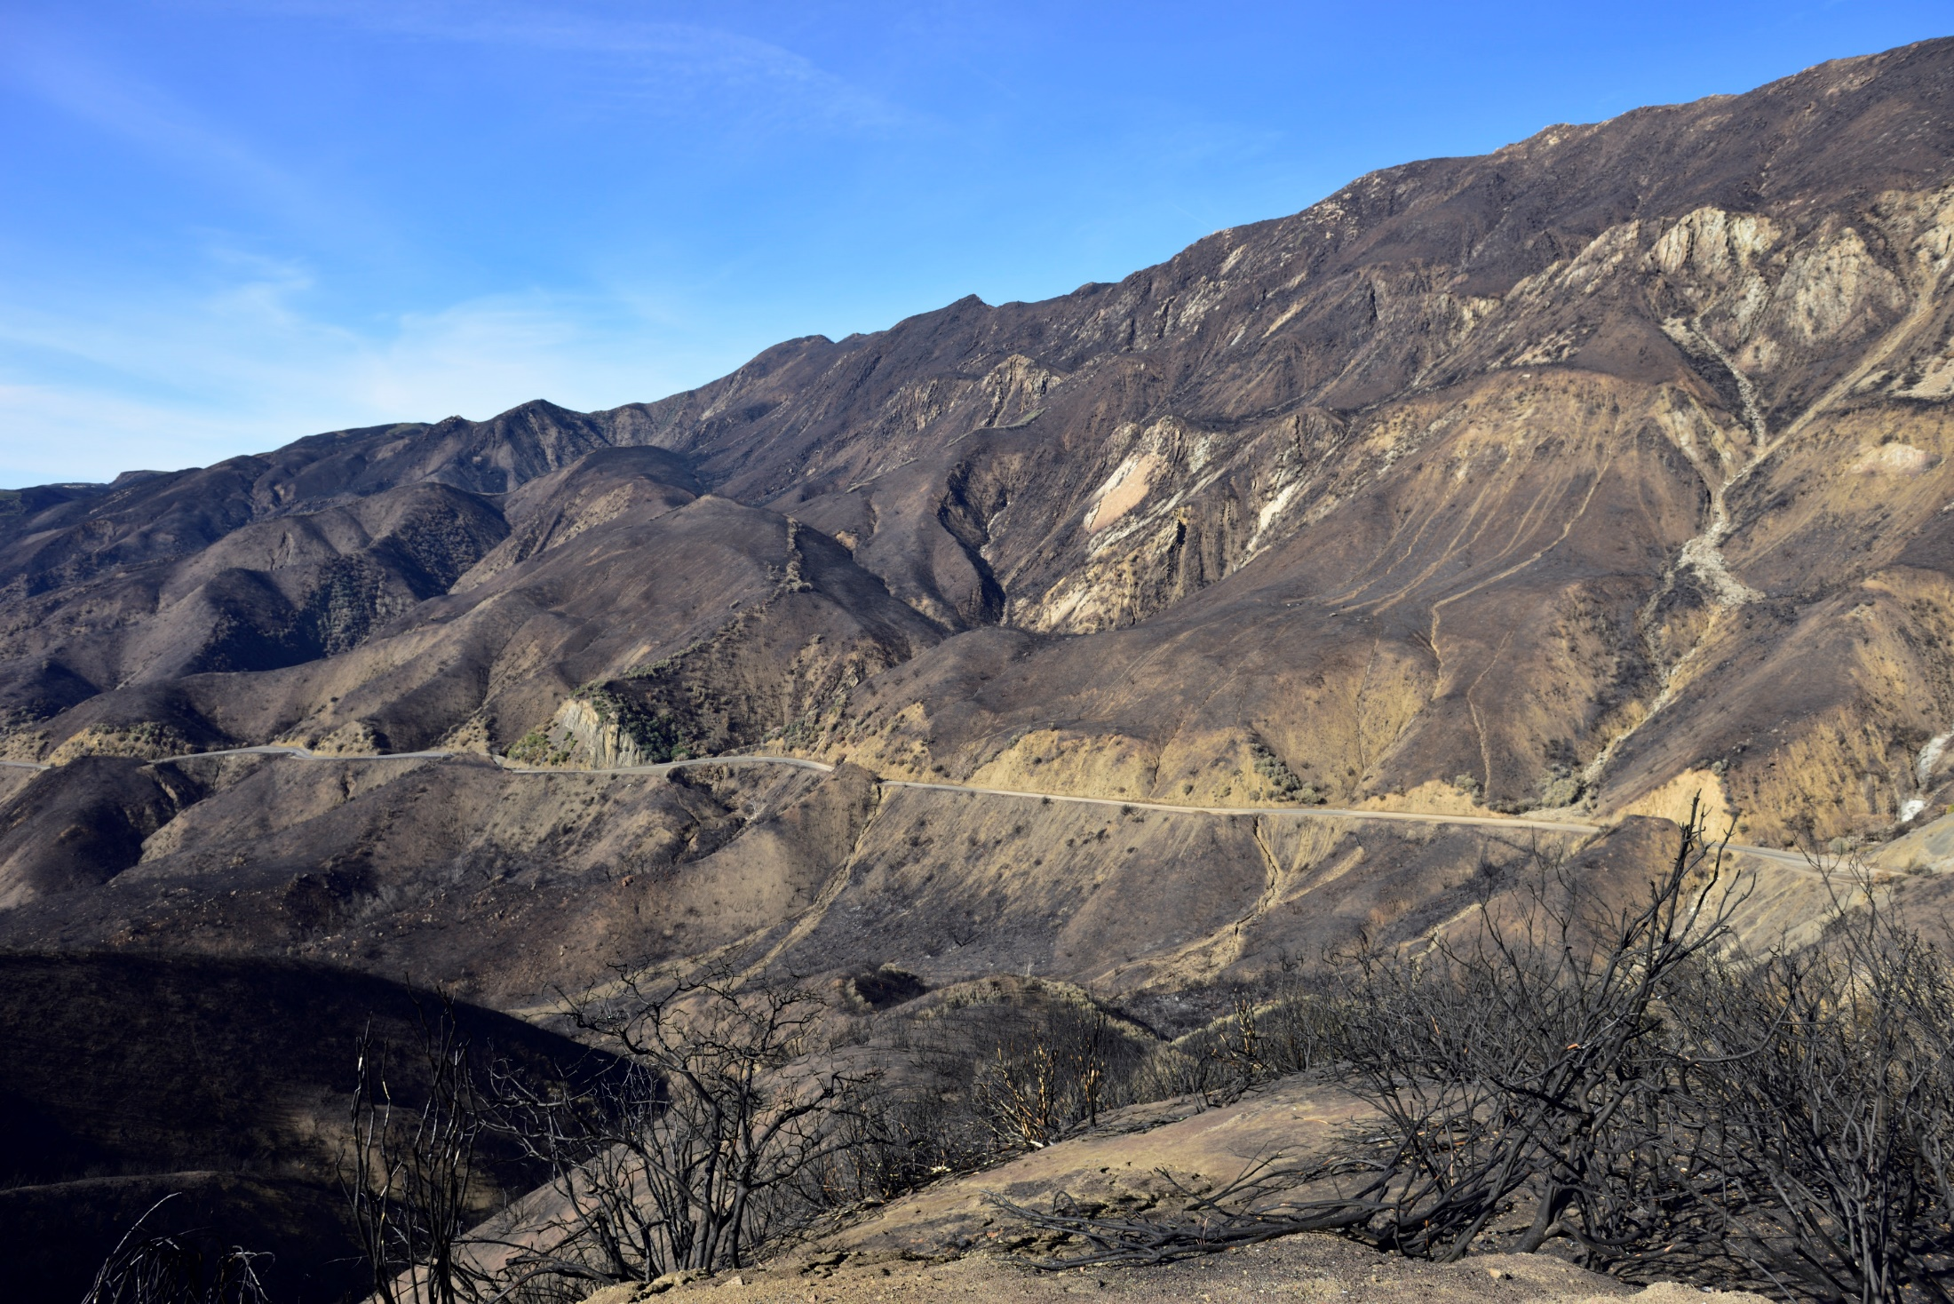

Slide 10
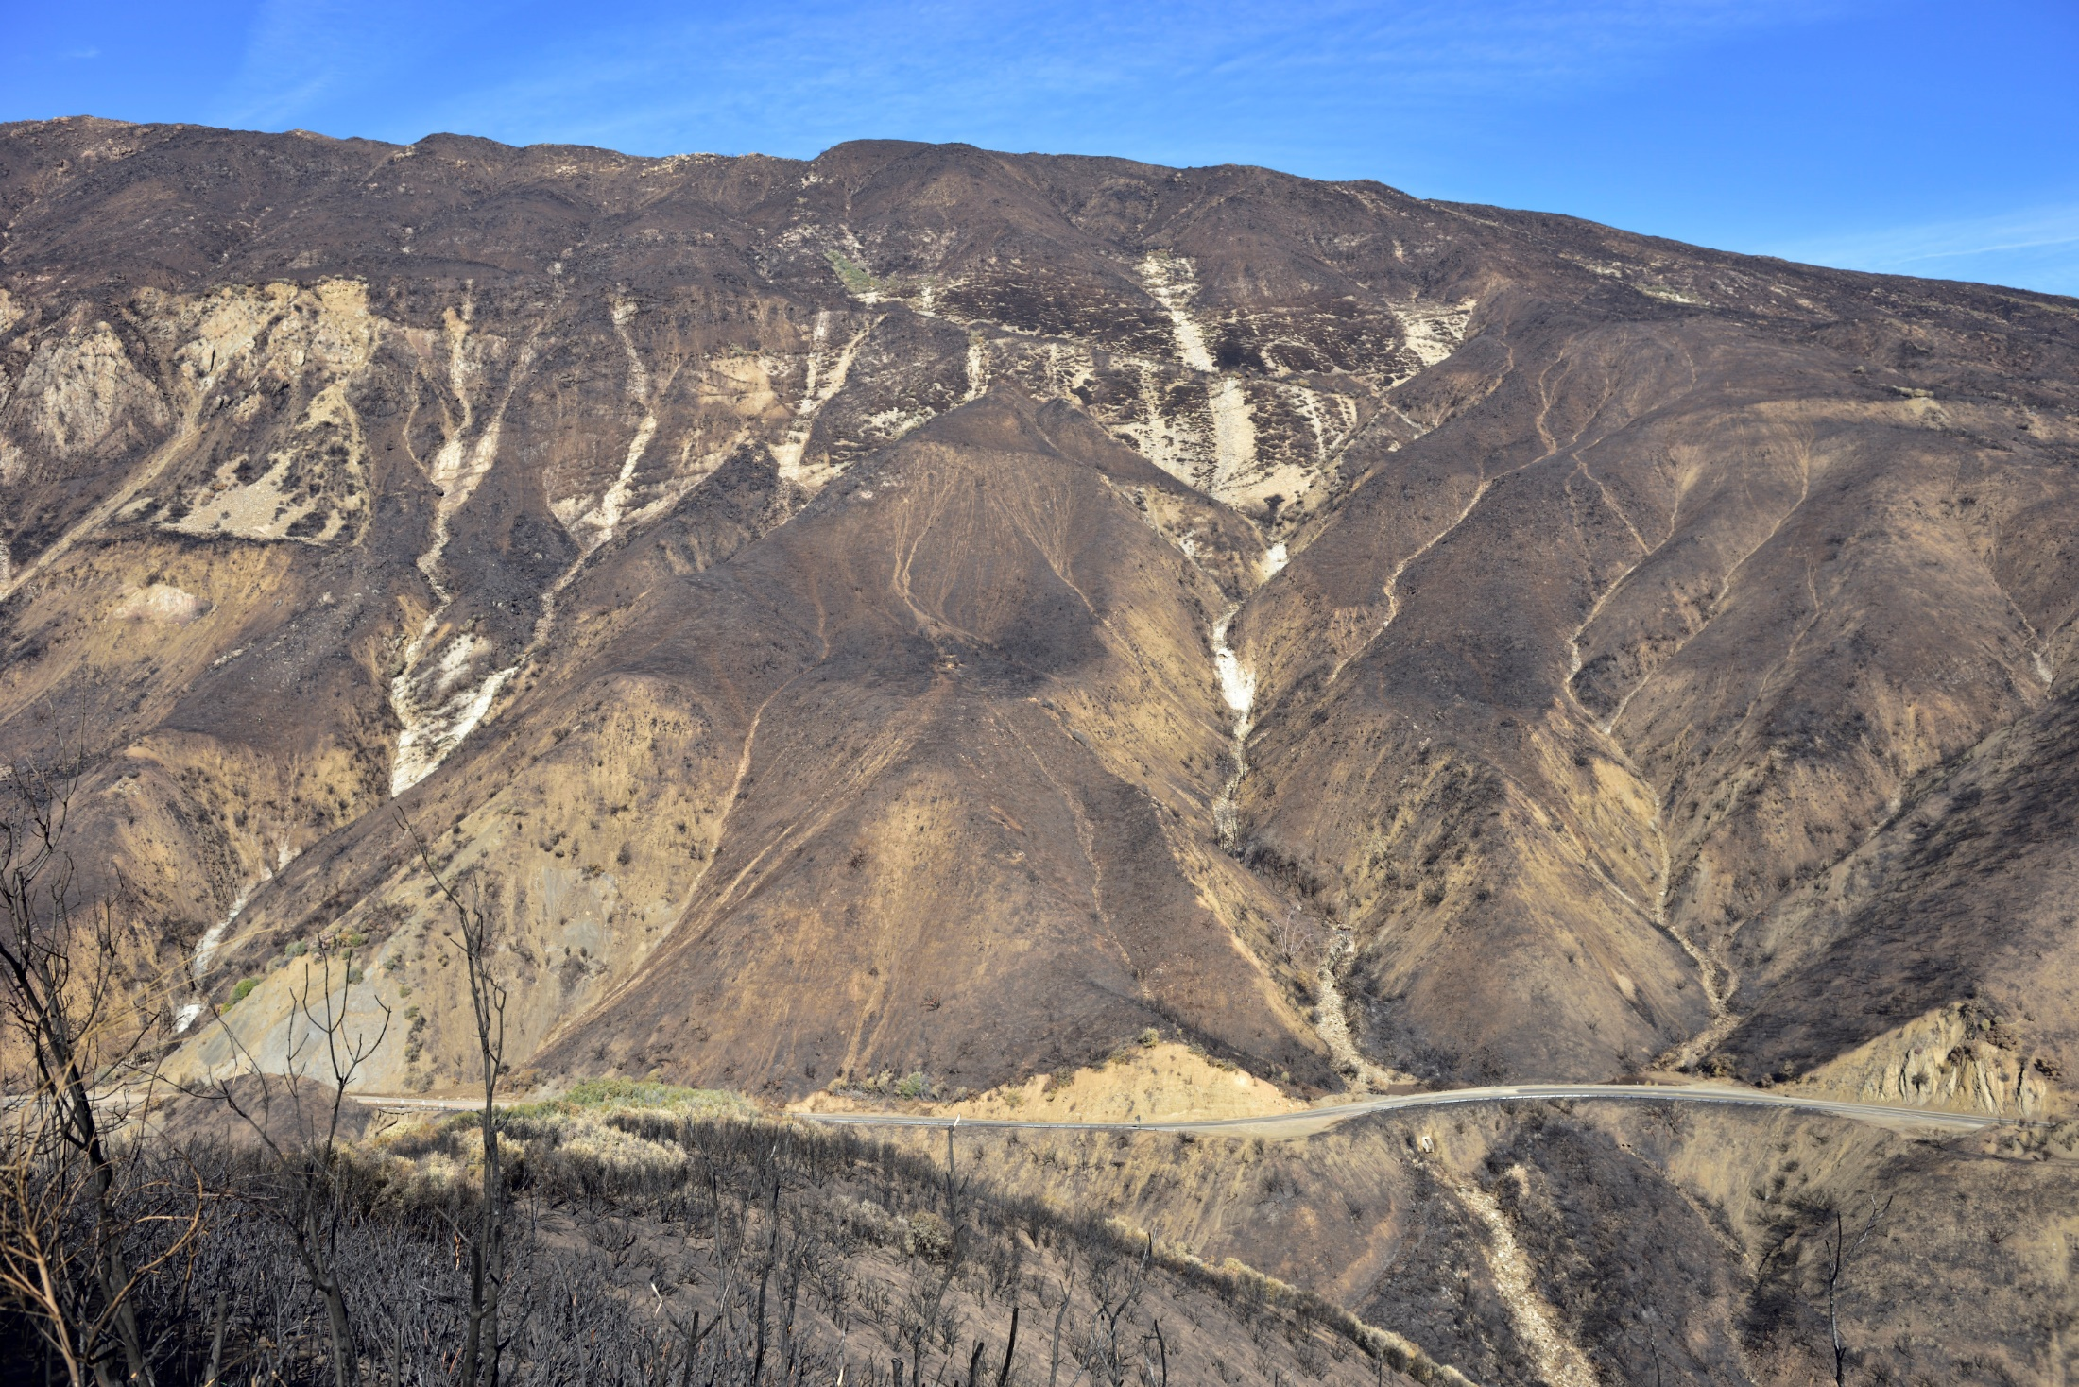

Slide 11
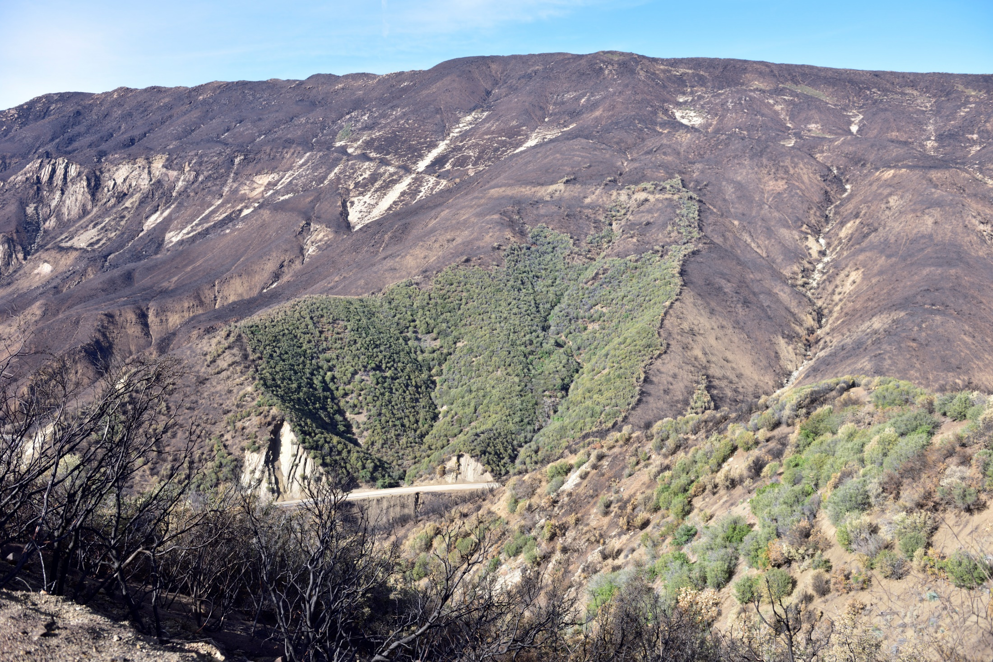

Slide 12
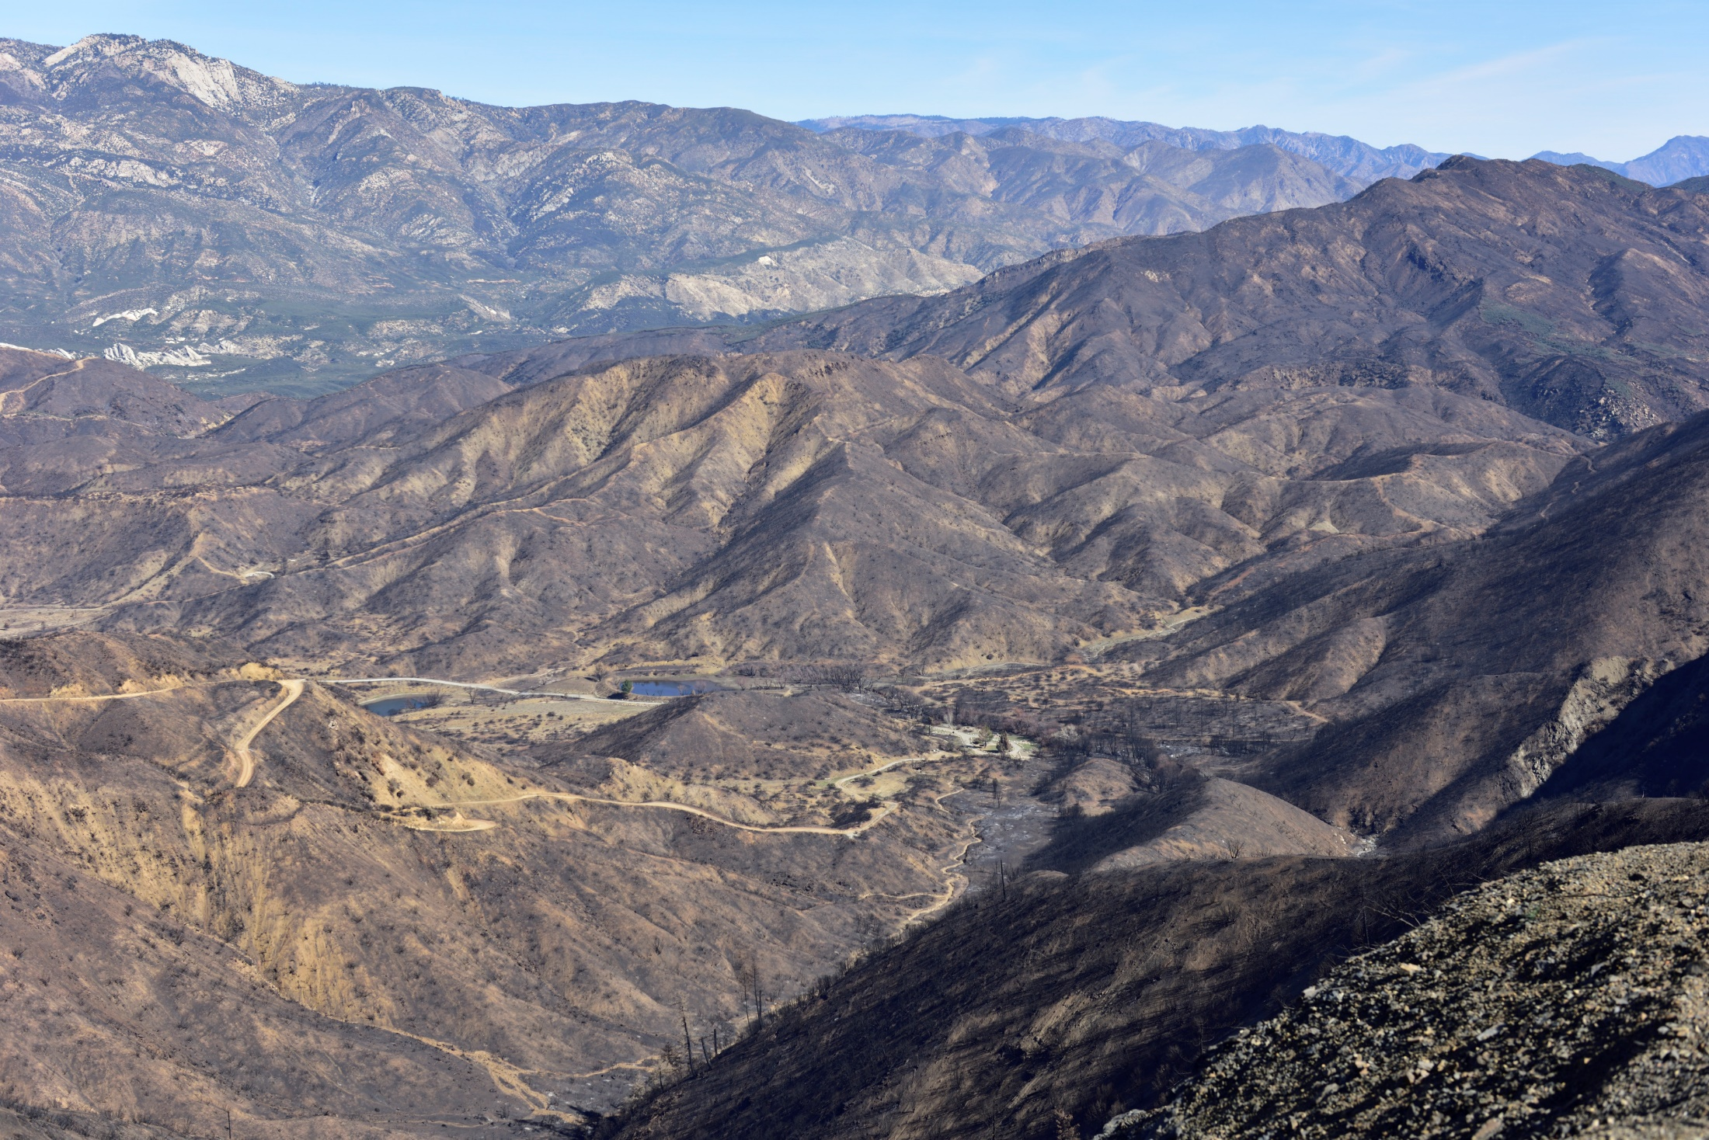

Slide 13
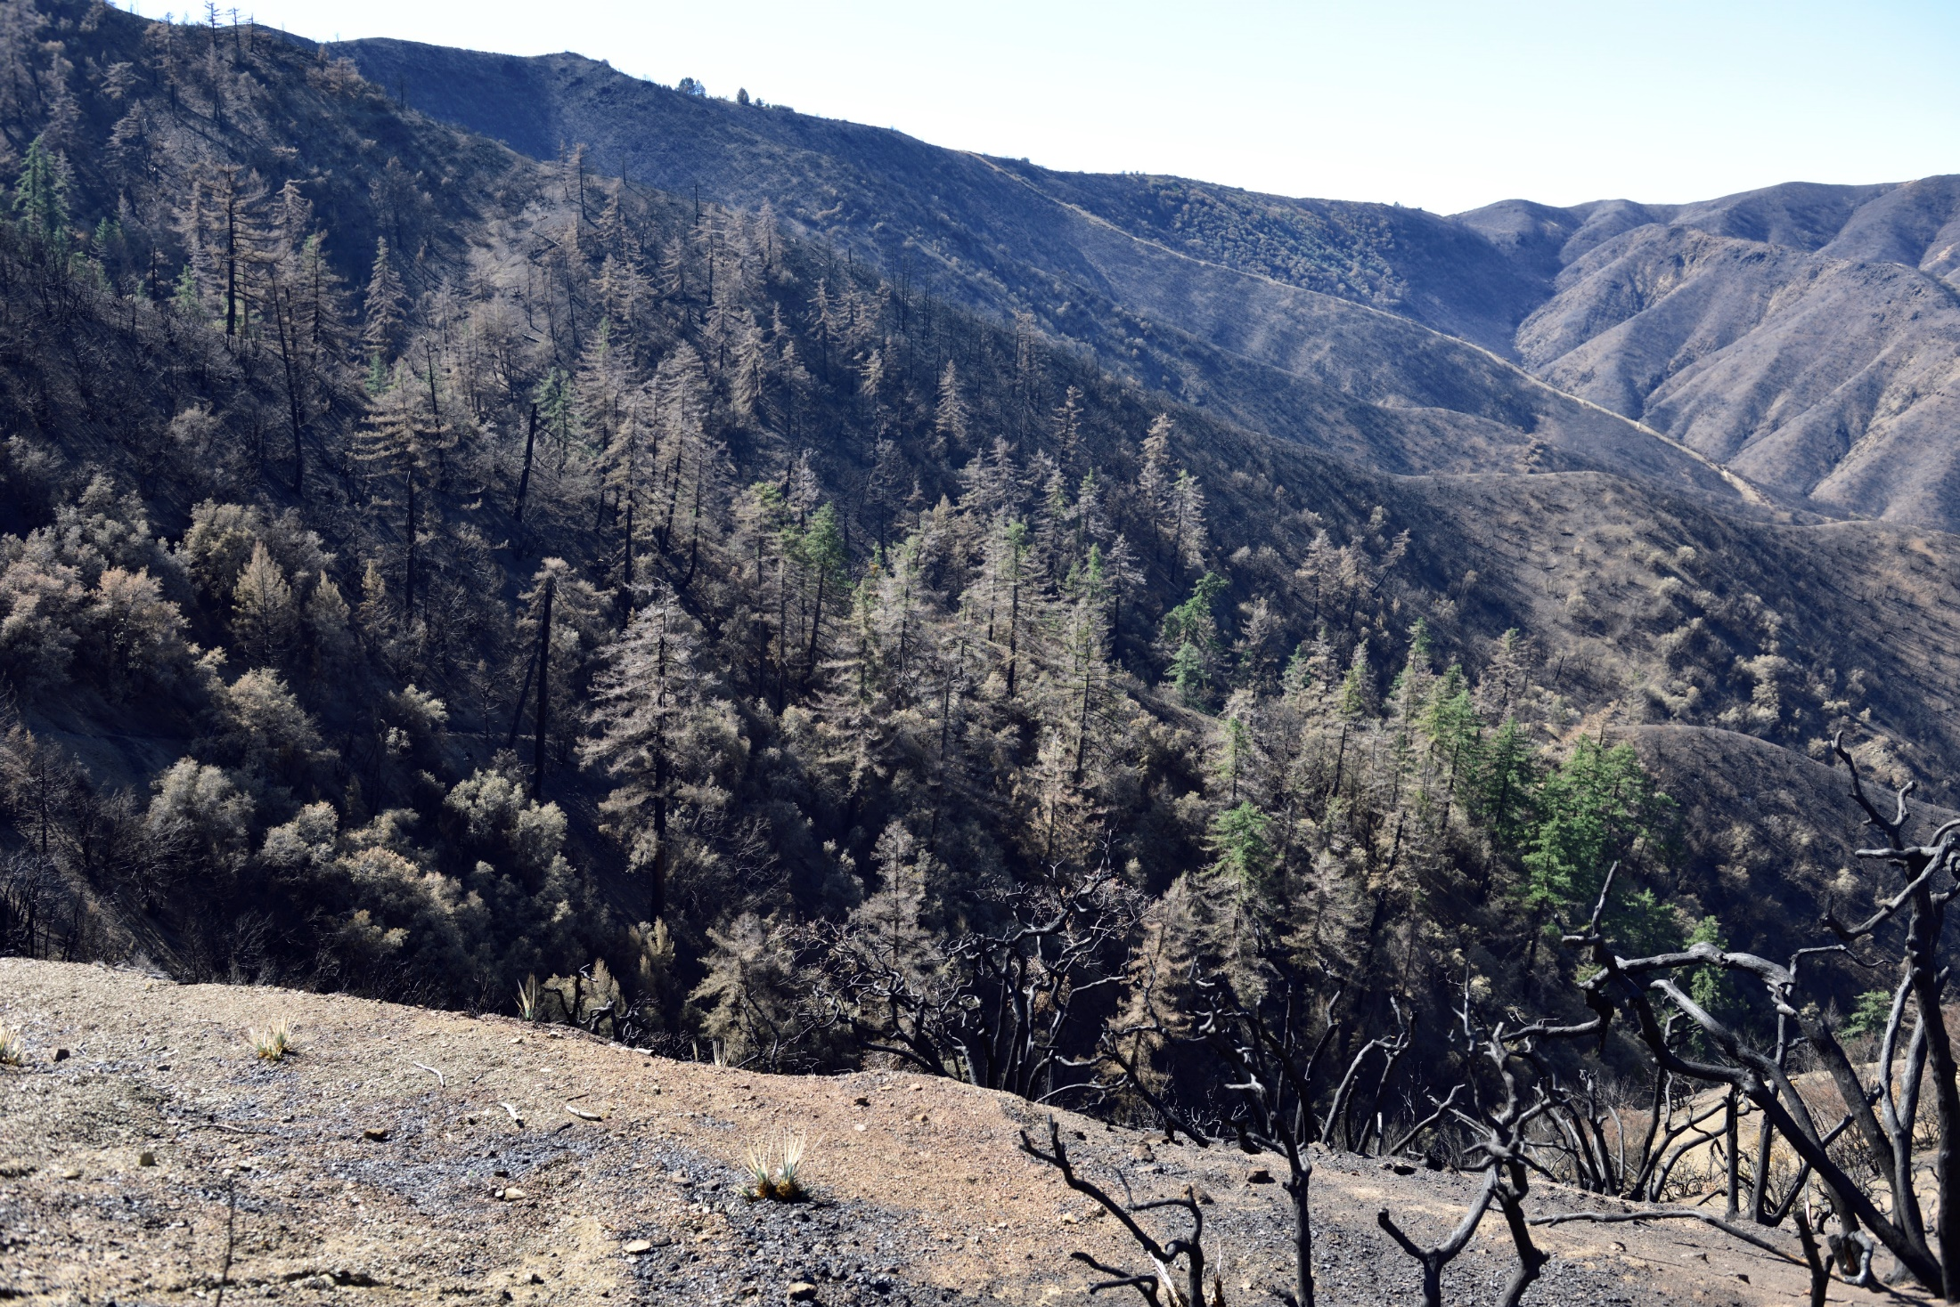

Slide 14
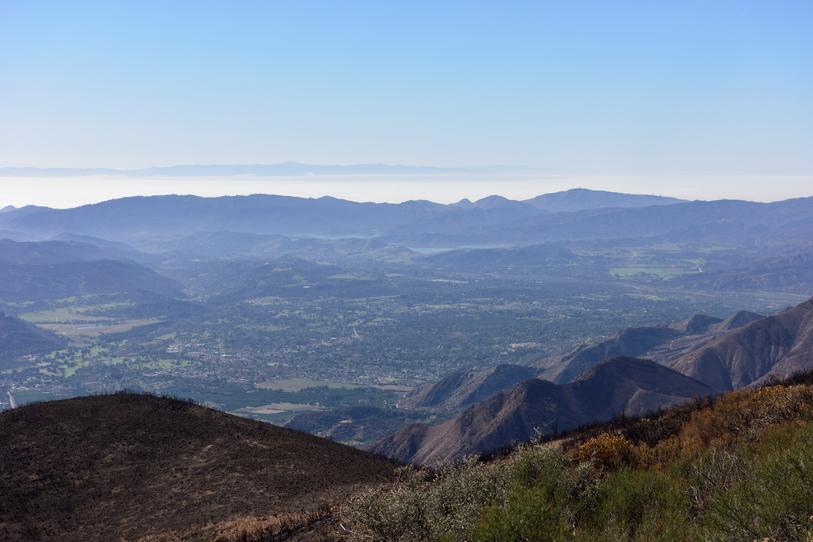

Slide 15
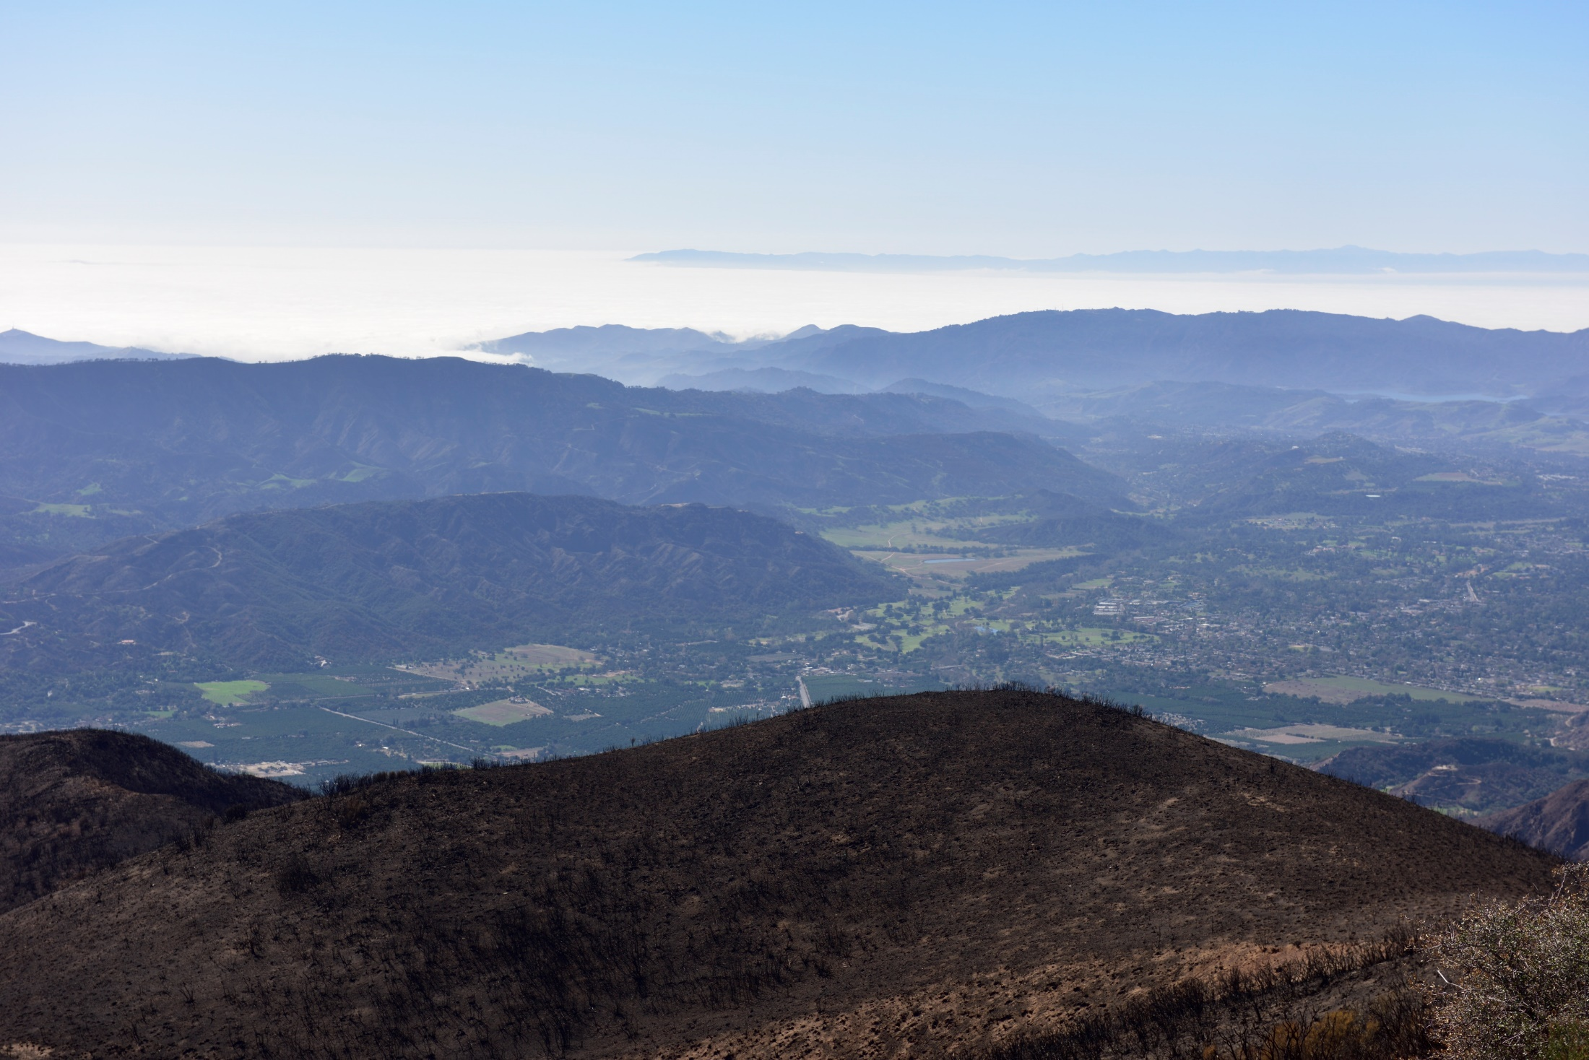

Slide 16
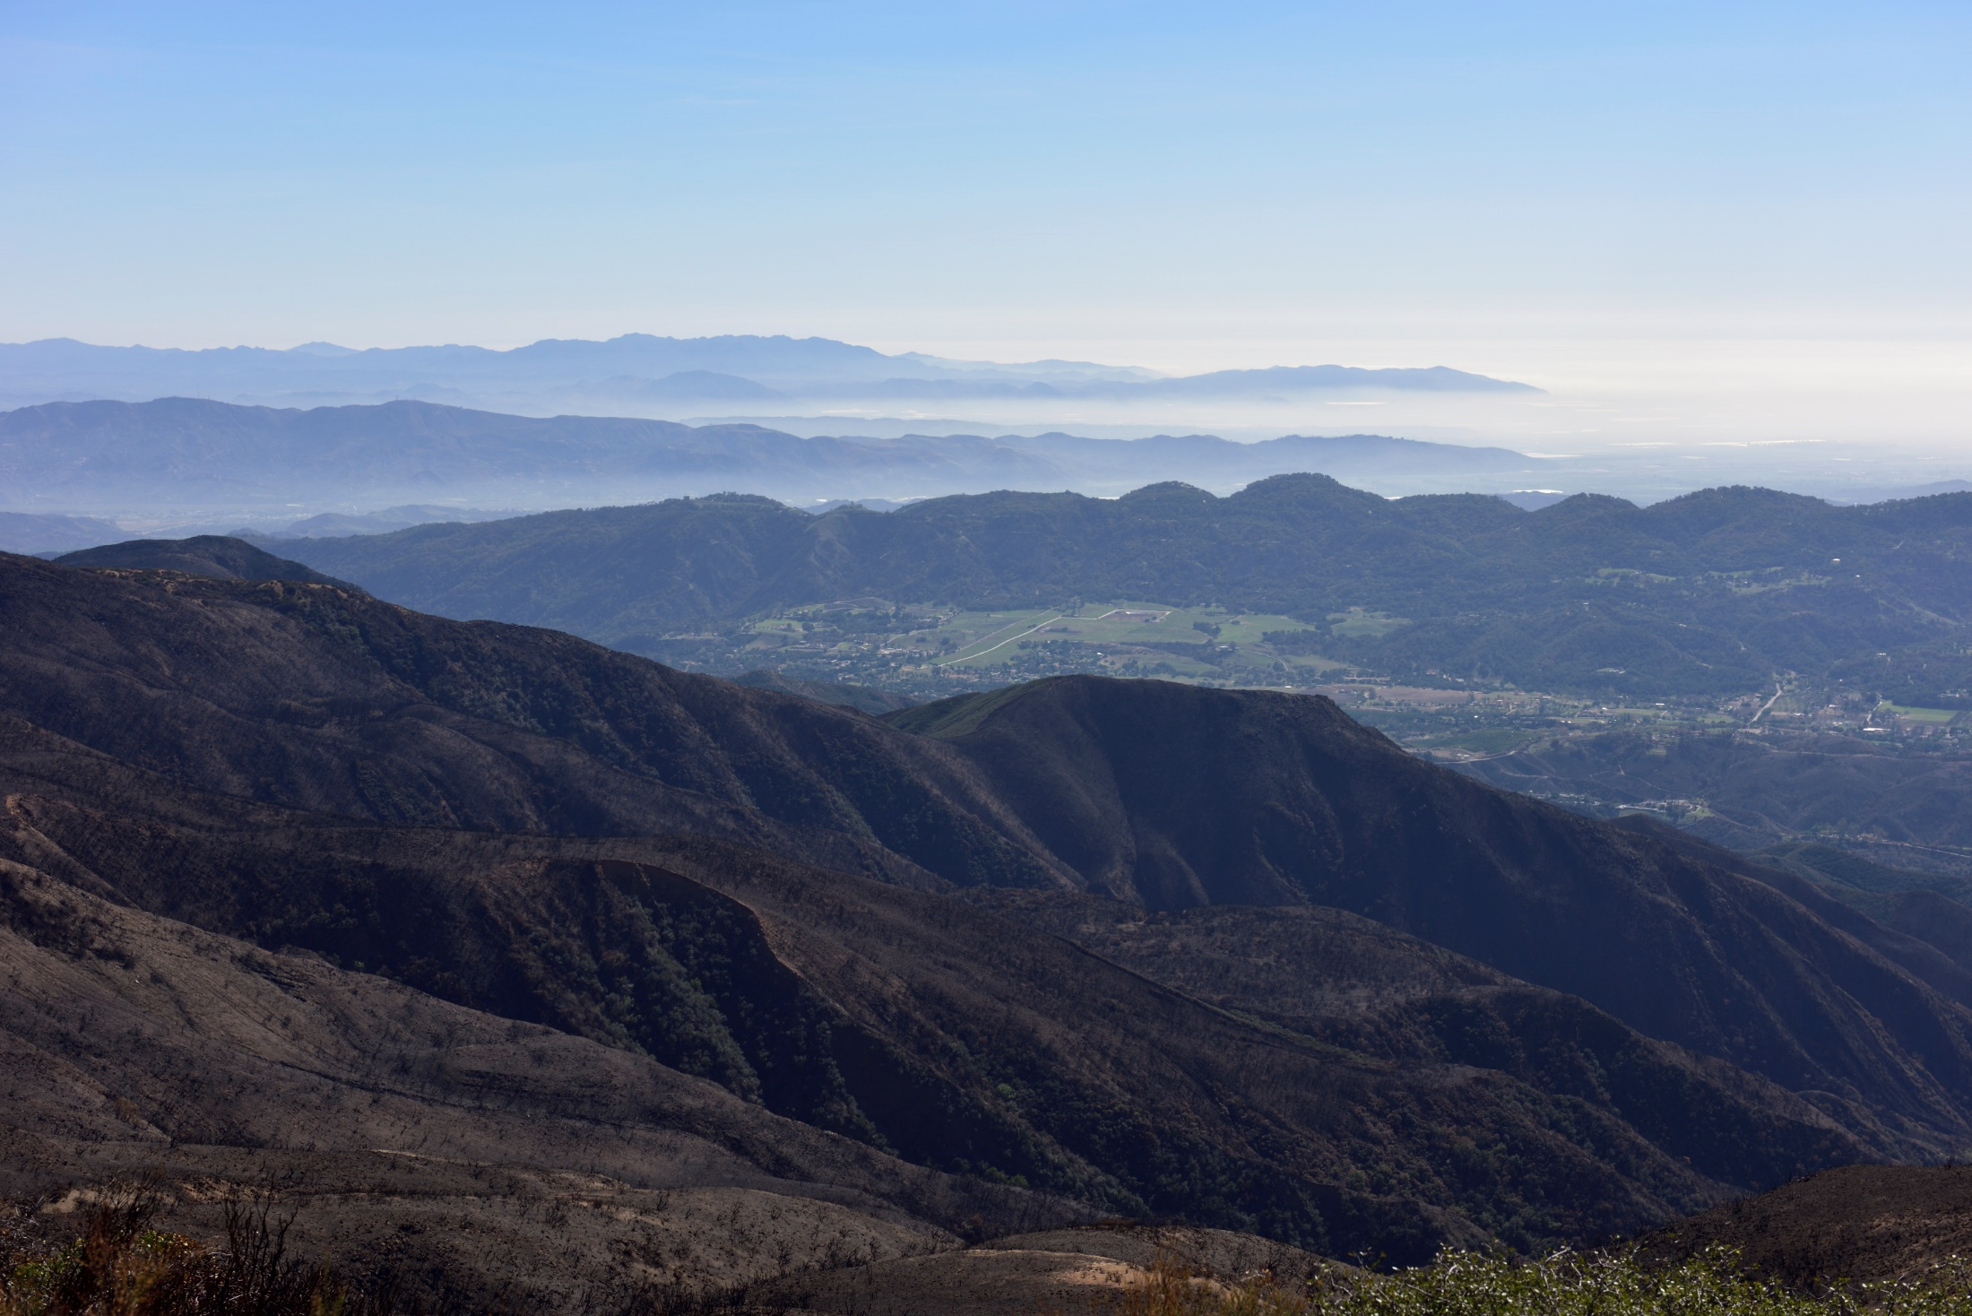

Slide 17
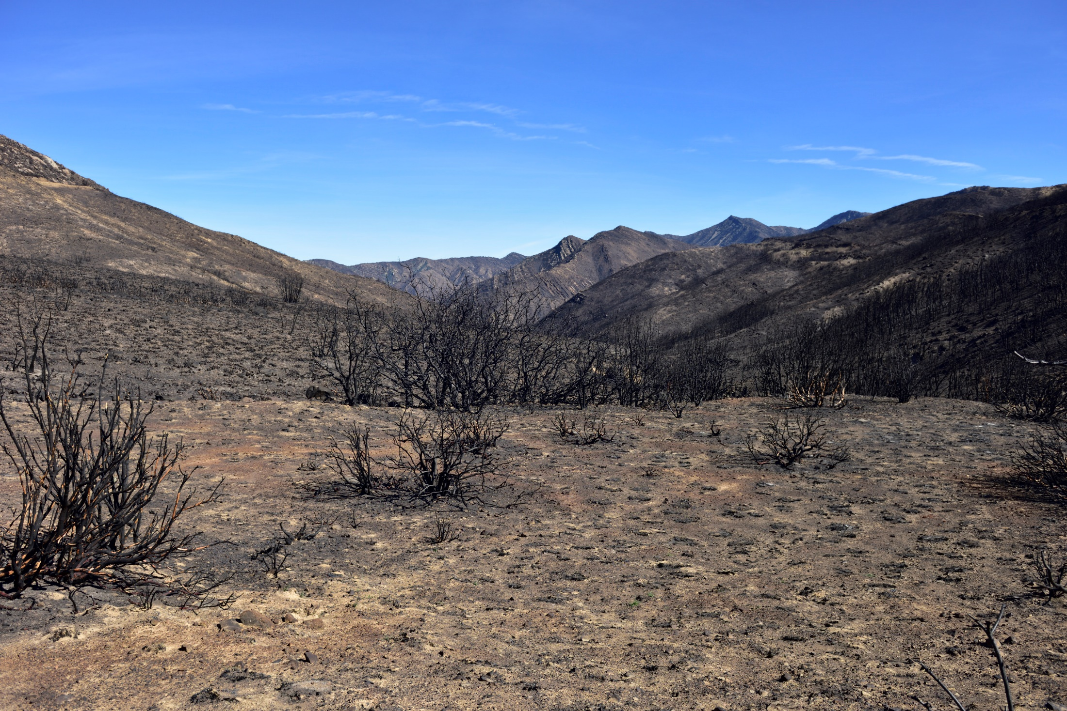

Slide 18
