Slide 1
Presentation to Ventura Watershed Council
Richard Atmore Jr.
Co-Founder of Rancho Ventura Conservation Trust
President, R.A. Atmore and Sons, Inc.
President, RA Cattle Company
03/01/2018

Slide 3
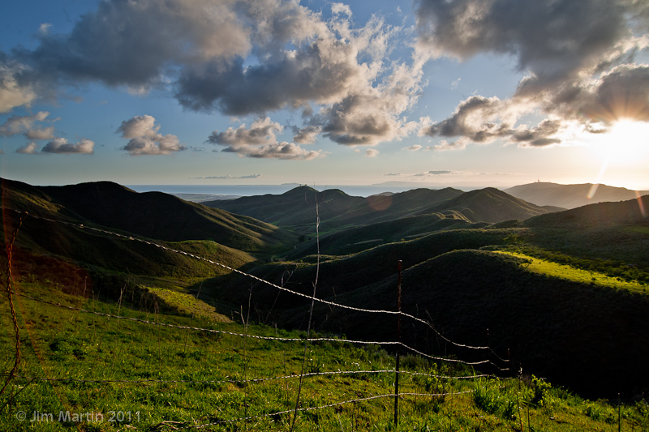

Slide 4
Grazing Operation
R.A. Cattle Co., division of R.A. Atmore & Sons, Inc.
275 head Cow/Calf Operation
6800 acres currently under lease
Current grazing capacity = 1 animal unit (1000 lbs.) per 35 acres
Current grazing methods: High Intensity – Short Duration / Rotational – Rest.

Slide 5
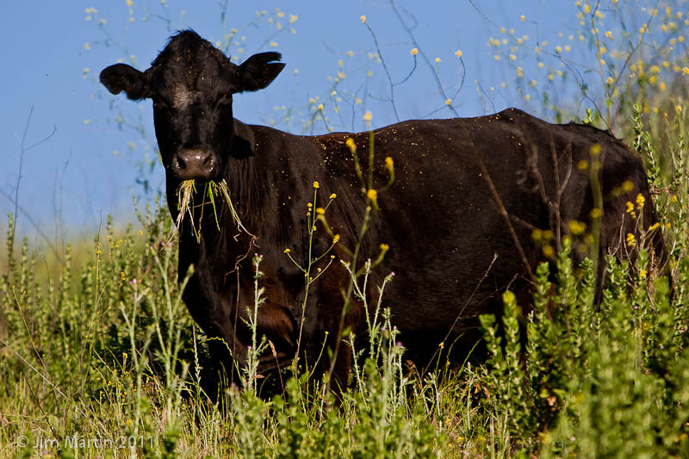

Slide 6
Grazing Benefits
Invasive Weed Control
Valuable Protein Source
Wildfire Protection
Enhanced Viewshed
Security & Management for Open Space
TNC, USFWS & others utilize grazing to enhance habitat on their properties.

Slide 7
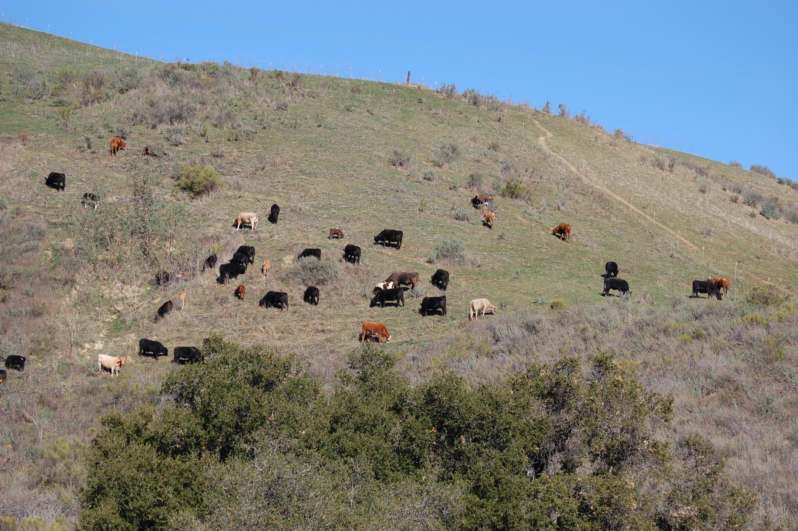

Slide 8
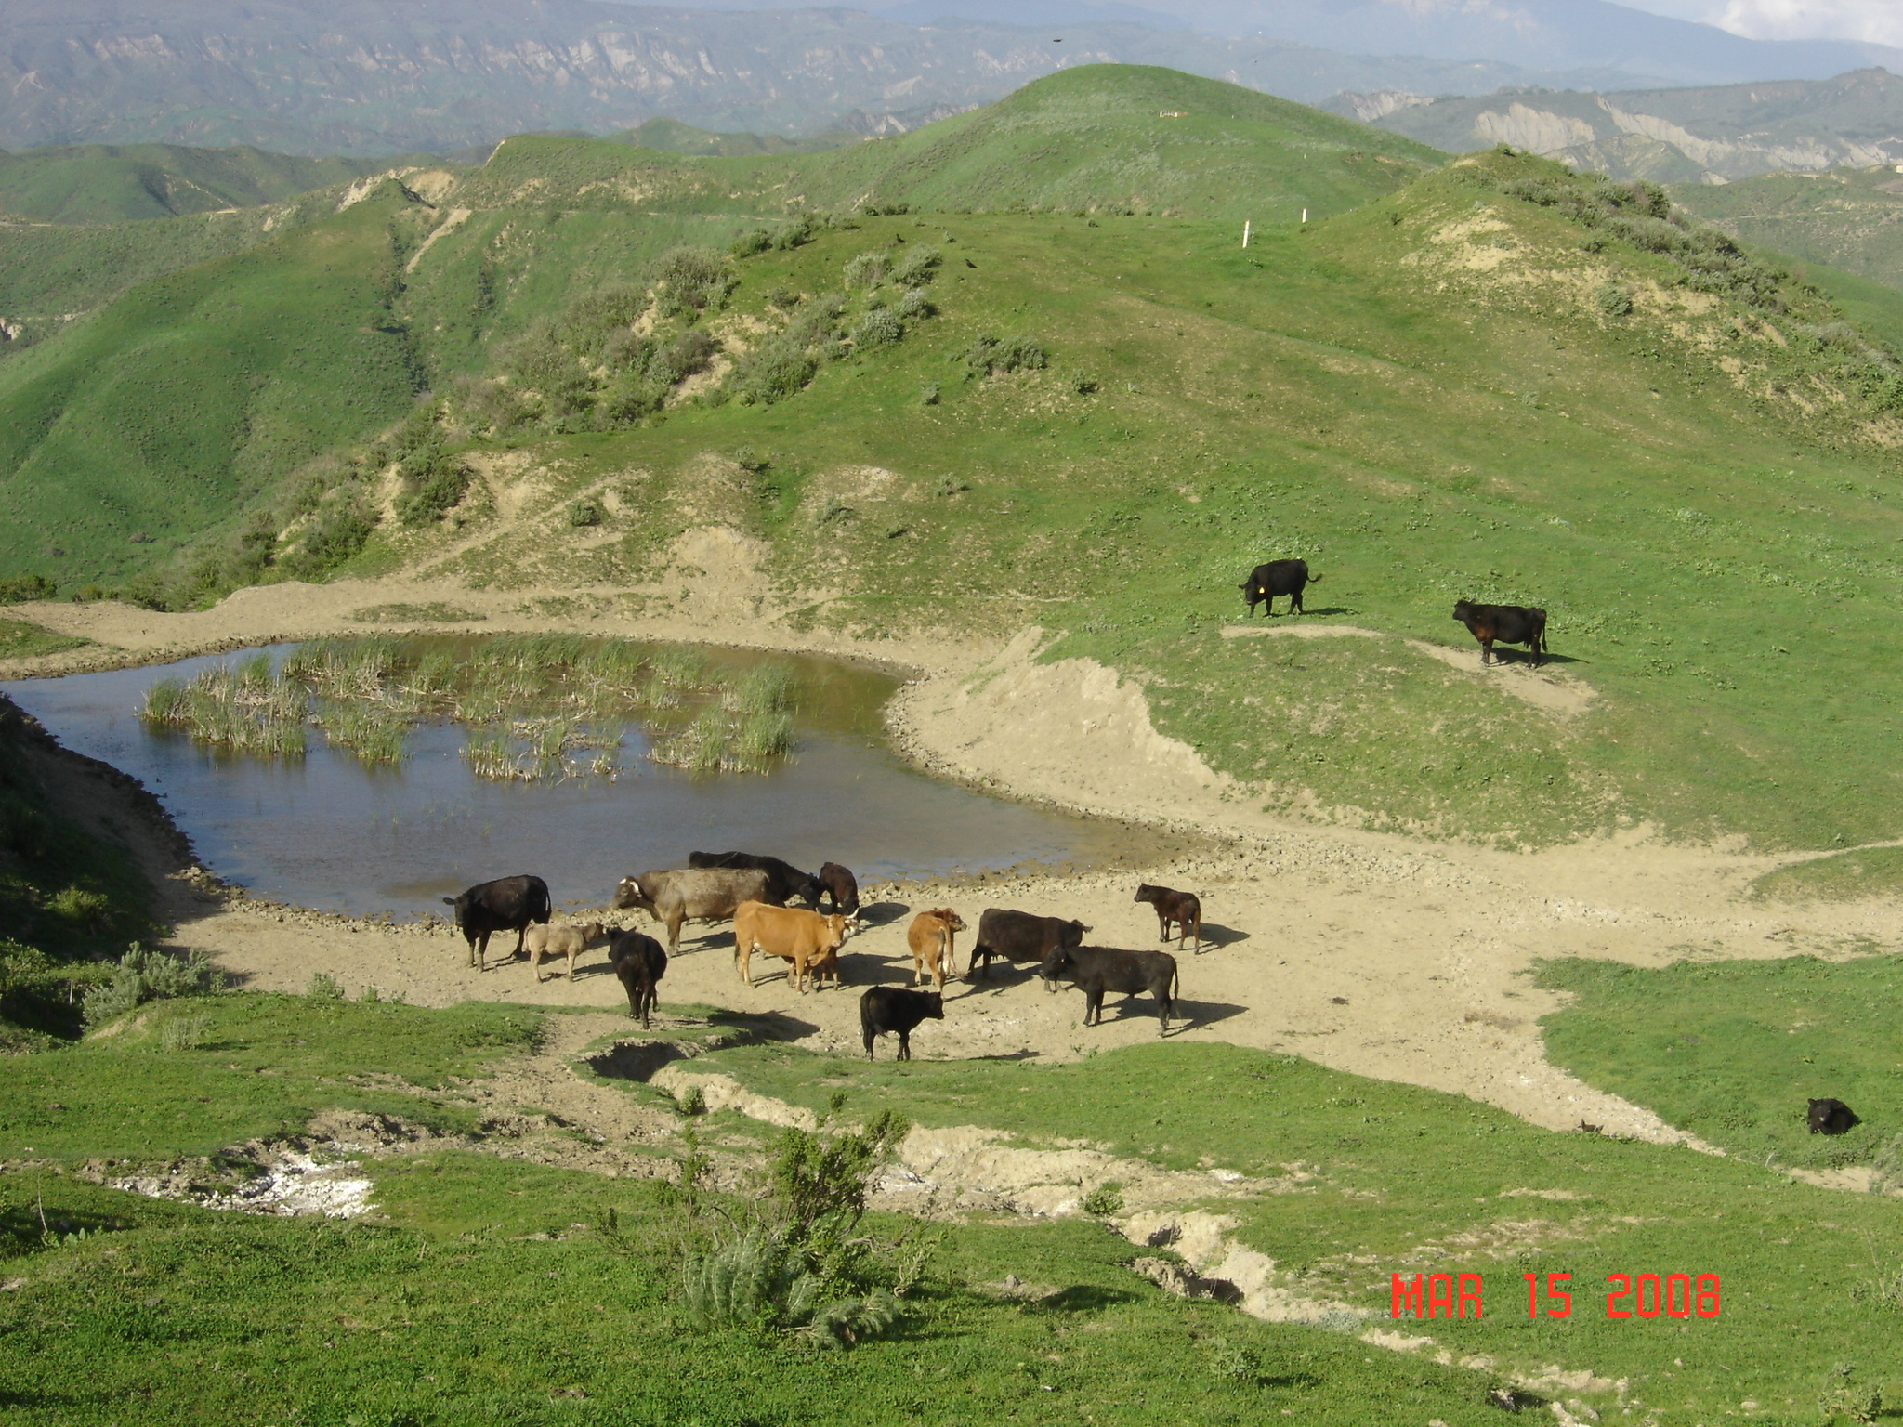

Slide 9
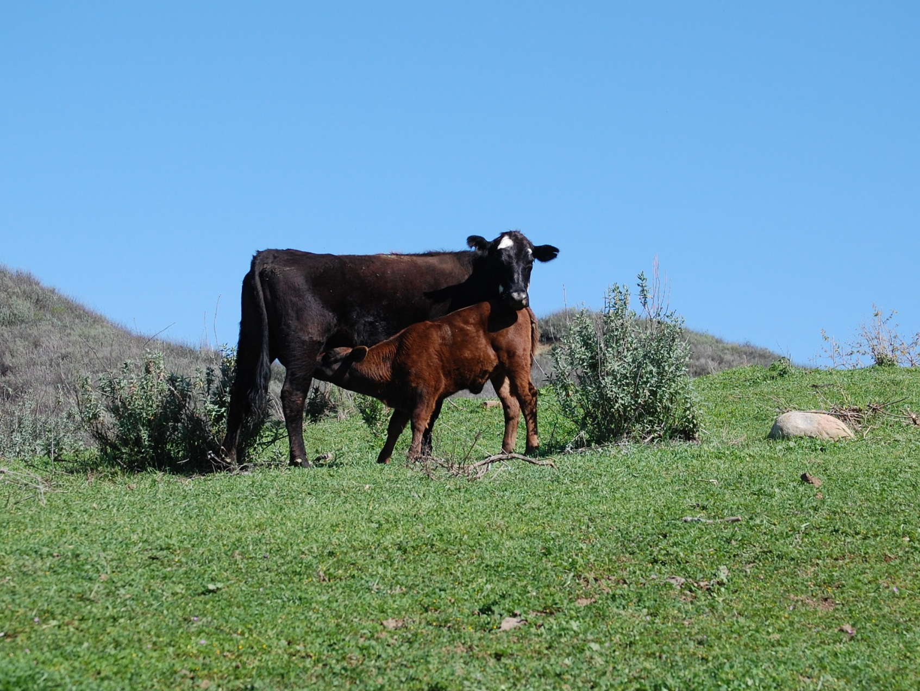

Slide 10
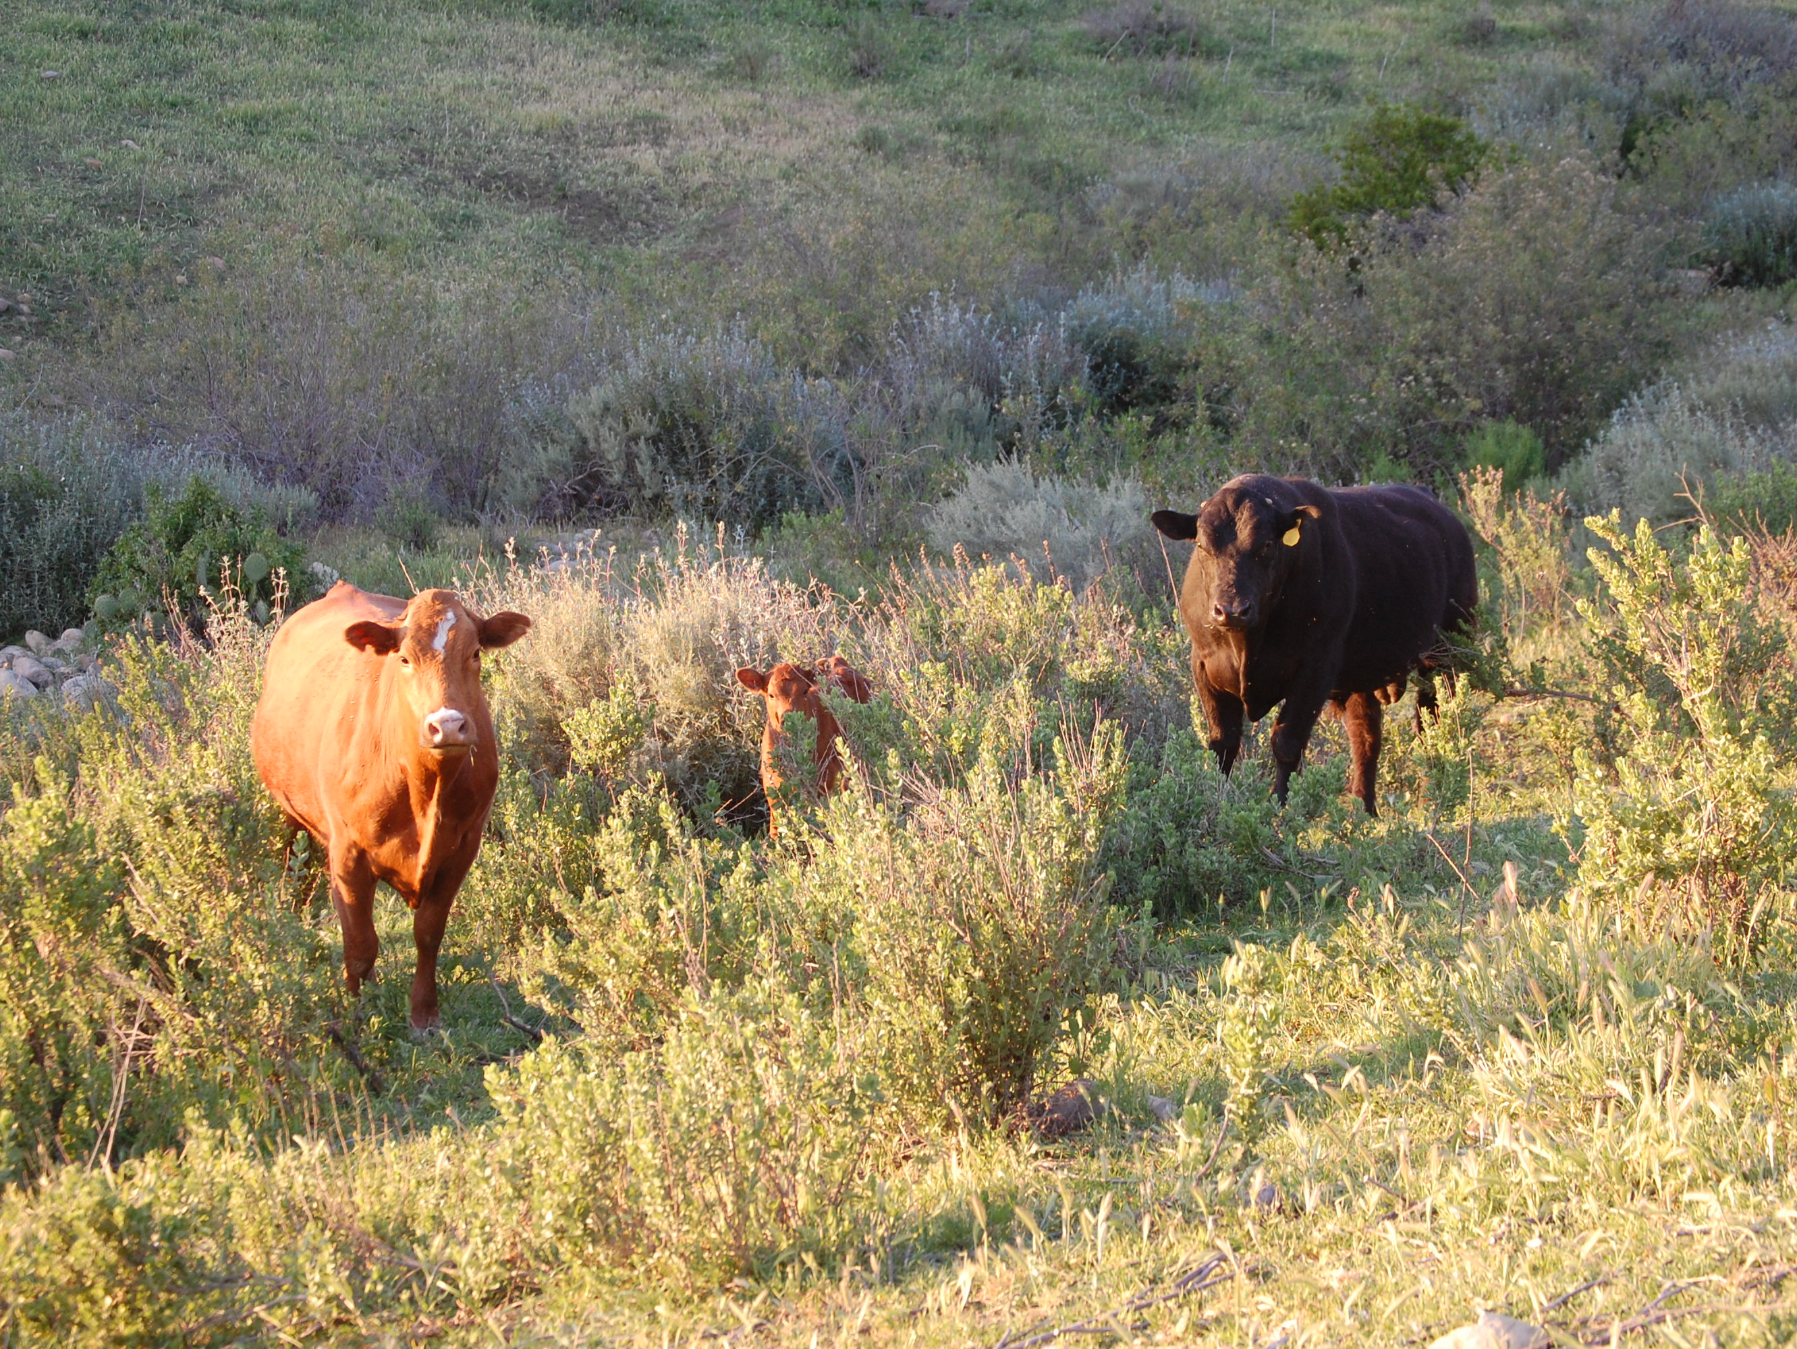

Slide 11
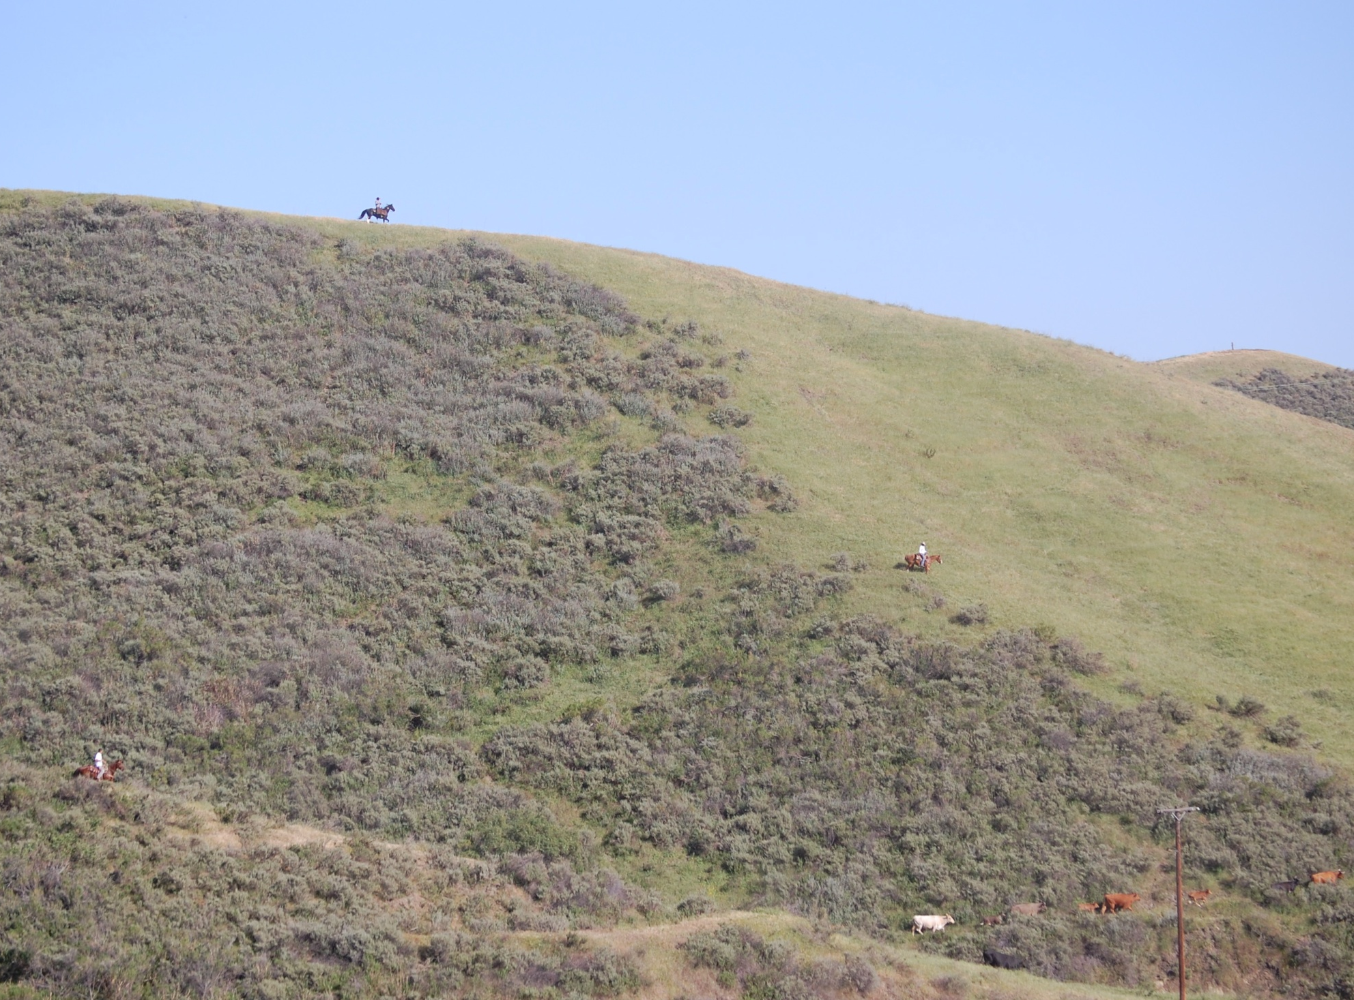

Slide 13
Historic Land Stewards

Slide 14
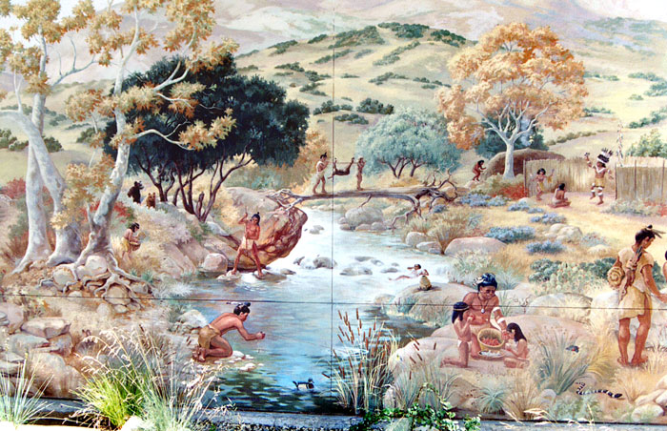
American Indians: The First Land Managers
The Chumash burned brush for over 10,000 years to:  Increase Food Resources  Reduce Fire Hazard  Increase Water Resources  Increase Game Animals

Slide 15
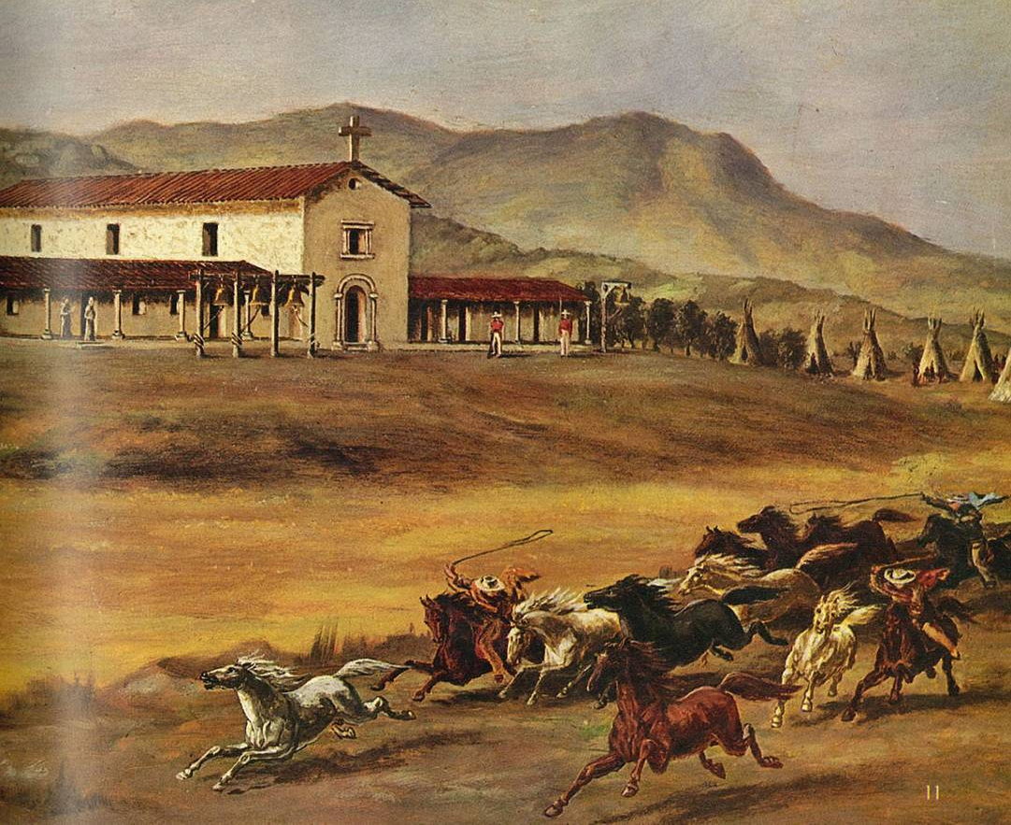
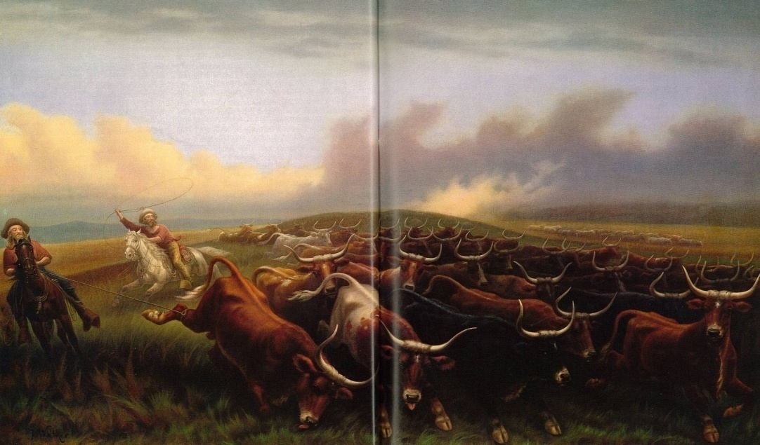
Spanish Colonization
When the Spanish arrived in 1770:  The California landscape was primed for the introduction of agriculture & animal husbandry  Cattle were California’s first agricultural product  Hides & tallow were shipped to Europe  Meat was a useless by-product
Copyright © 1977 Time-Life Books, Inc.
Copyright © 1977 Time-Life Books, Inc.

Slide 16
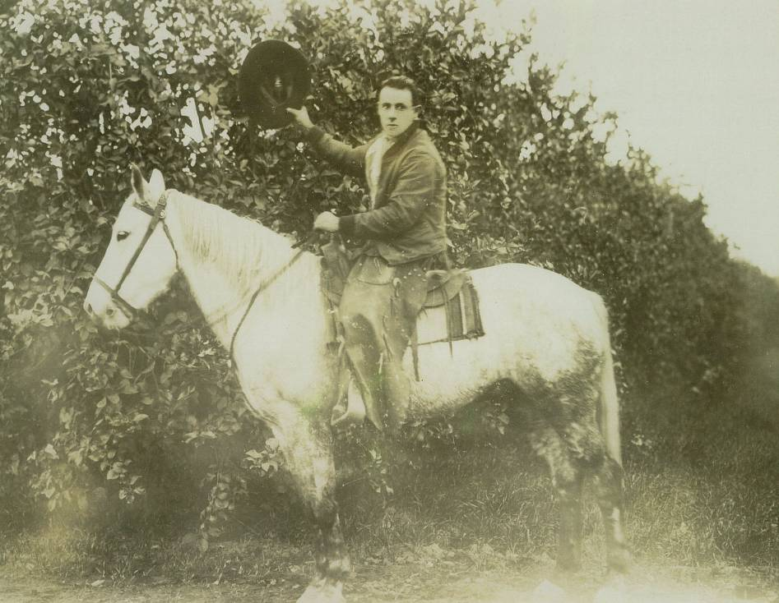
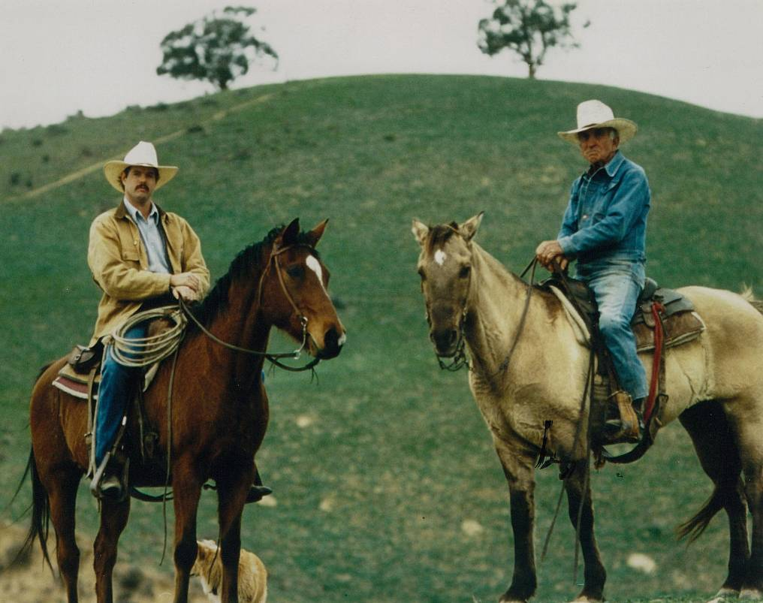
Cattle Ranchers
● 5 Generations of Stewardship

Slide 17
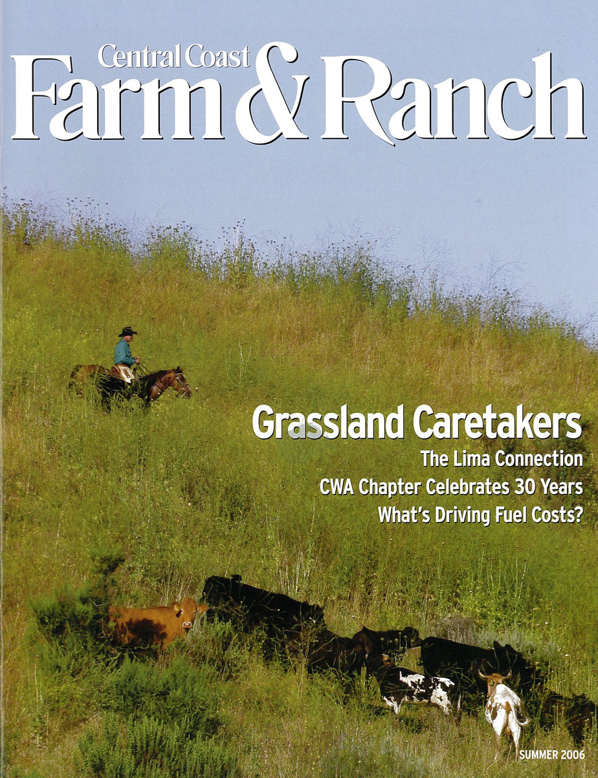

Slide 18
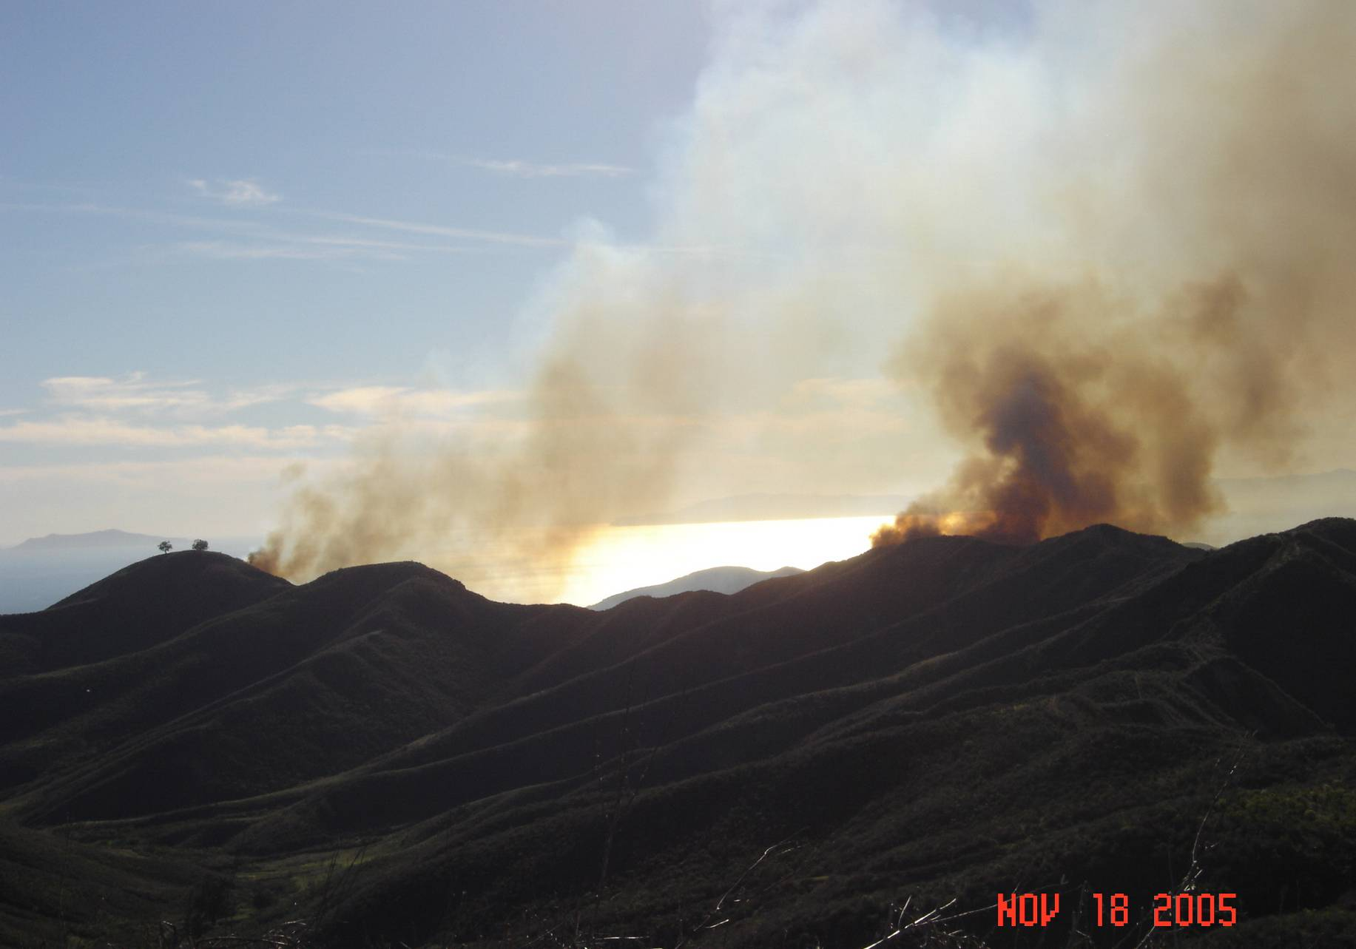
Management of Venturan Coastal Sage Scrub

Slide 19
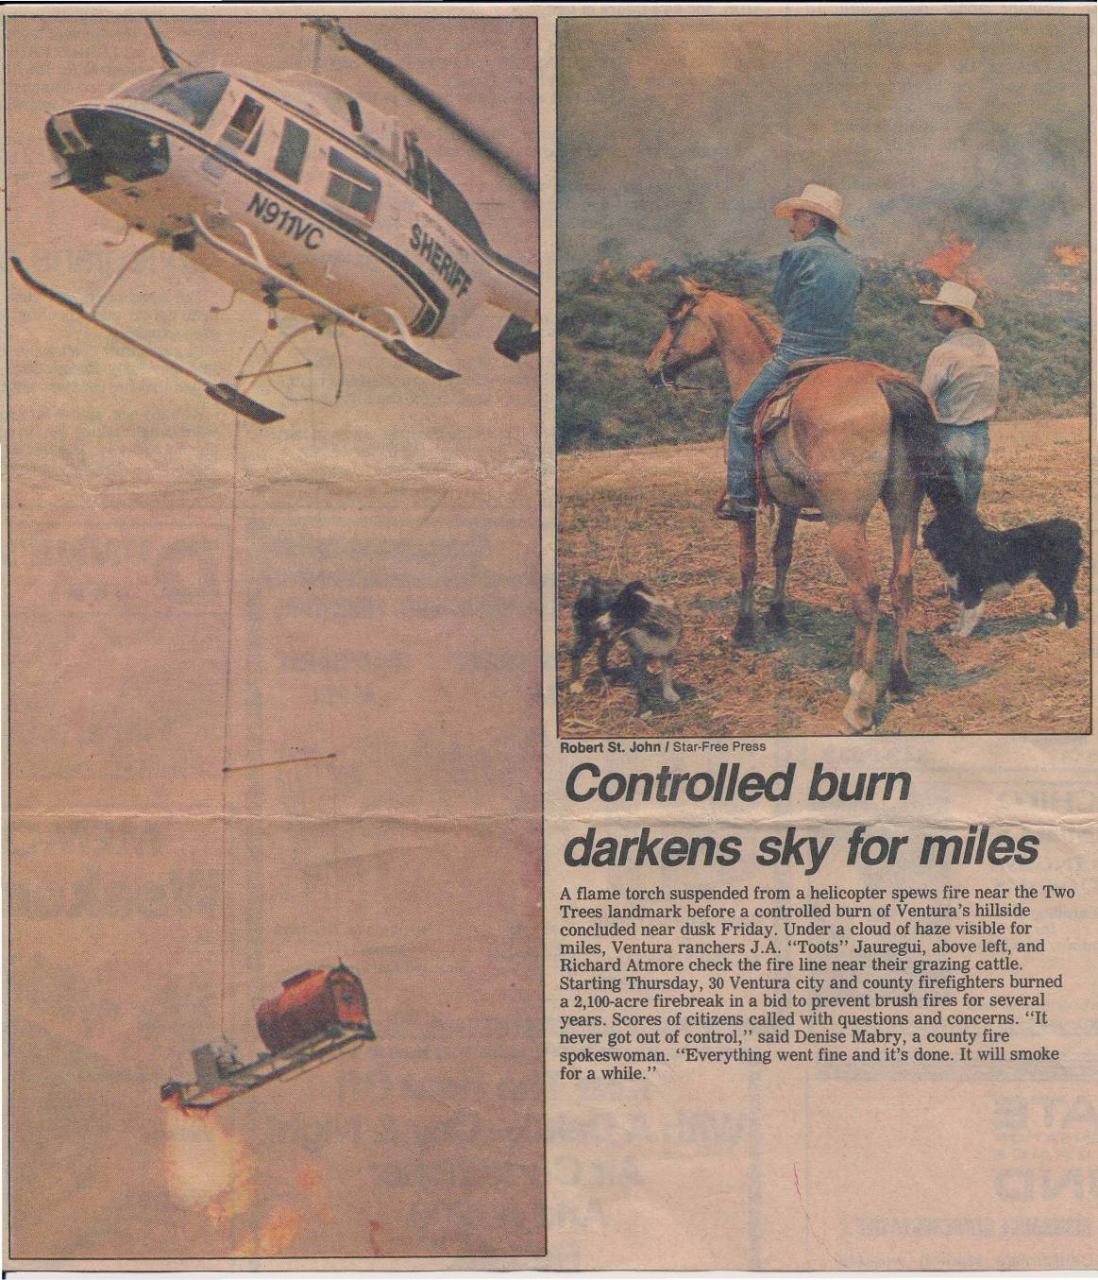
Prescribed Burning
● Produces rangeland conversions  Reduces fuel hazards  Creates habitat diversity  Increases water resources  Provides habitat more favorable to wildlife  Increases livestock carrying capacity

Slide 20
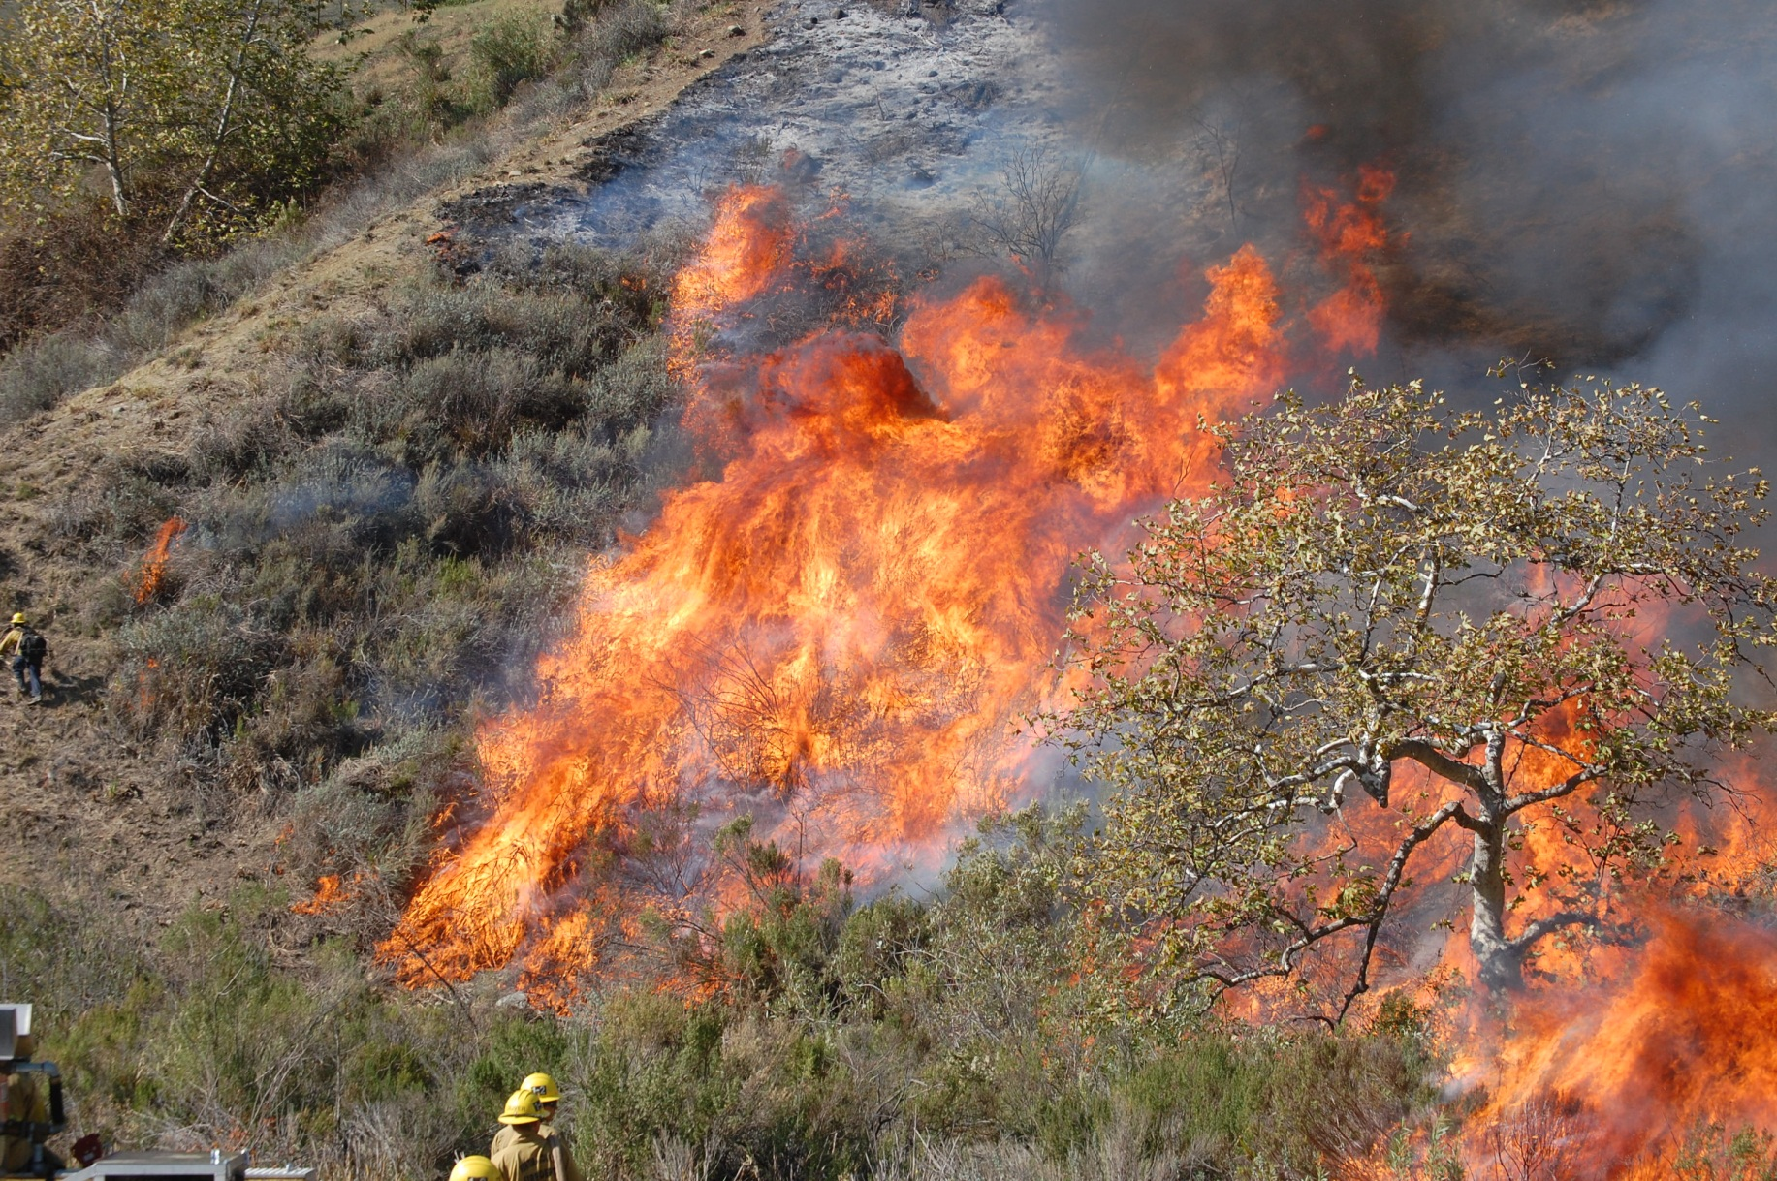
Prescribed Burning

Slide 21
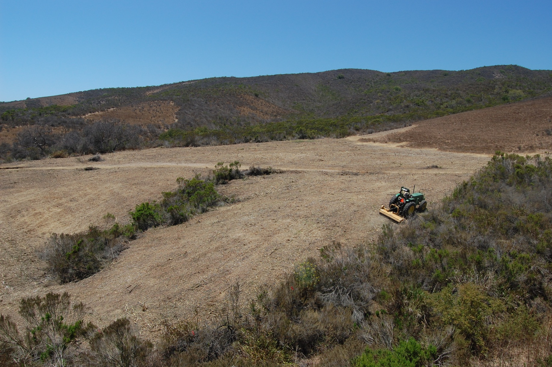
Mastication

Slide 22
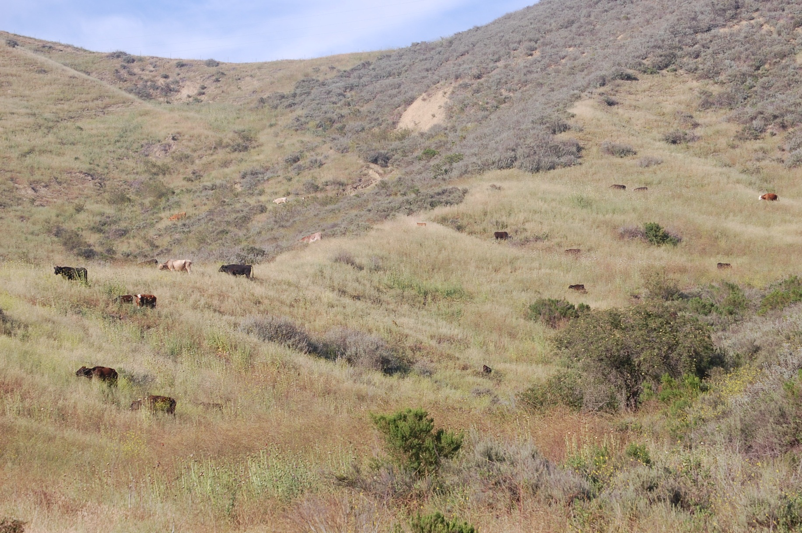
Prescribed Grazing

Slide 23
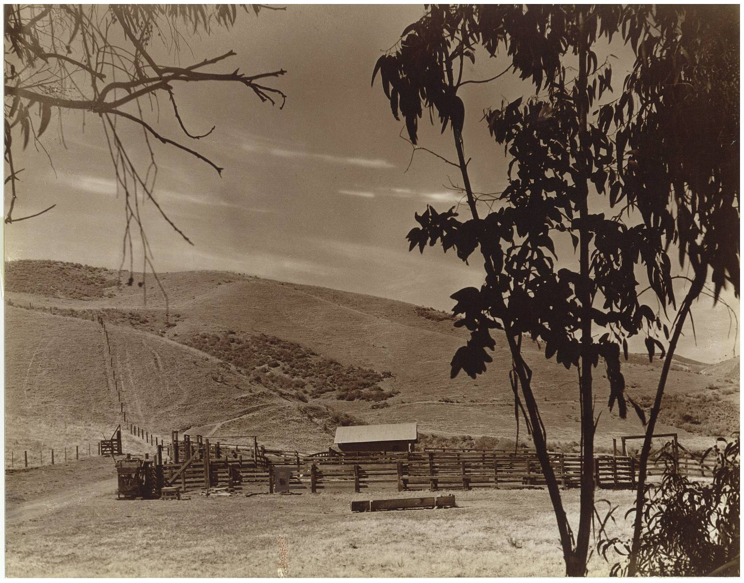
Barlow Canyon 1955
● Photos dating back to 1850 depict similar viewsheds  Photo depicts thousands of years of sage scrub management  By 1955 95% of grasses were introduced species

Slide 24
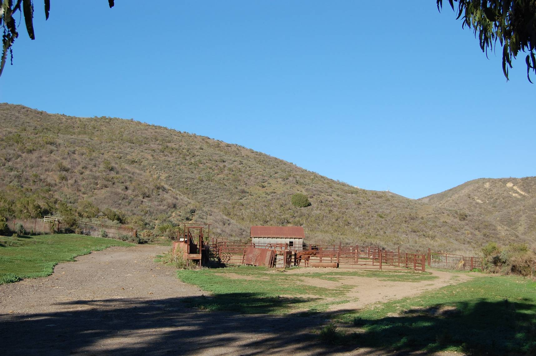
Barlow Canyon 2009
● 1960 – 1988: No prescribed burning  Coastal sage scrub demonstrates dominance over annual grasses

Slide 25
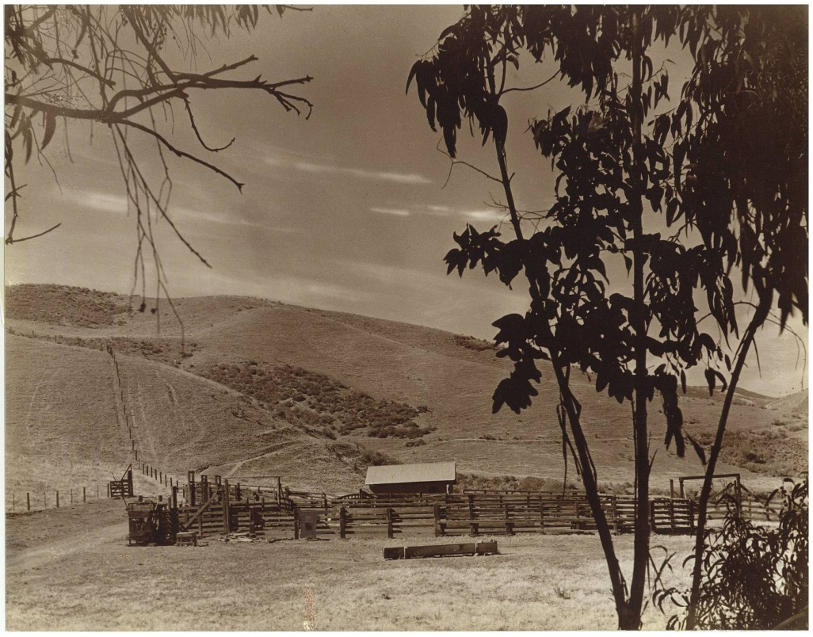
1955: Livestock carrying capacity of 1 animal unit per 10 acres
2009: Livestock carrying capacity of 1 animal unit per 35 acres

Slide 28
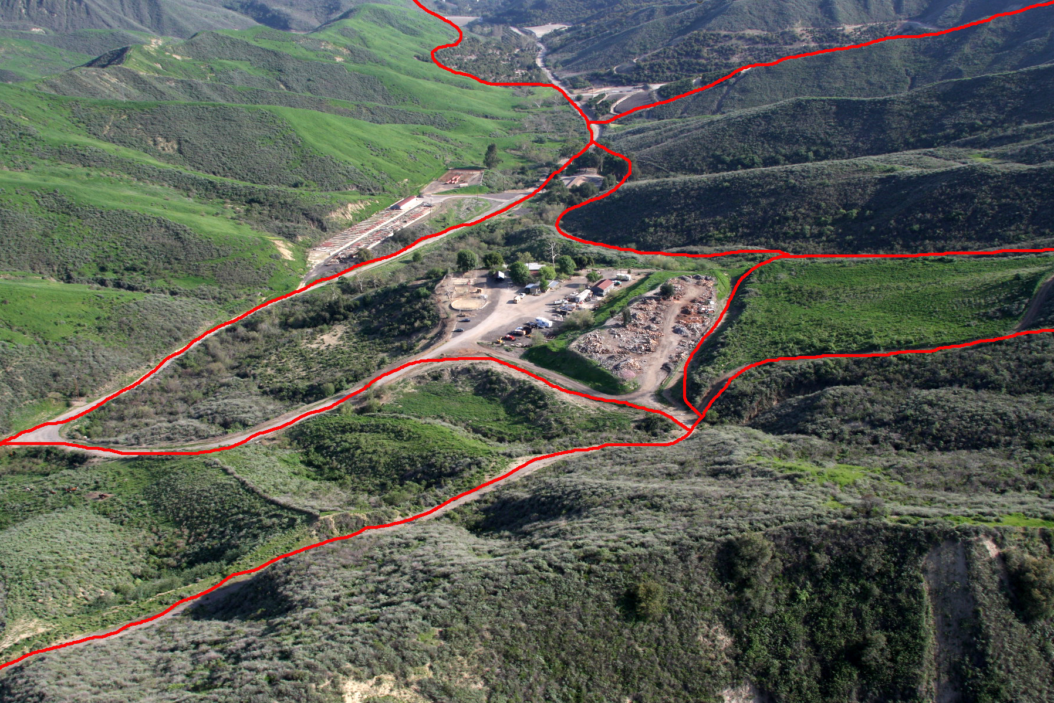

Slide 29
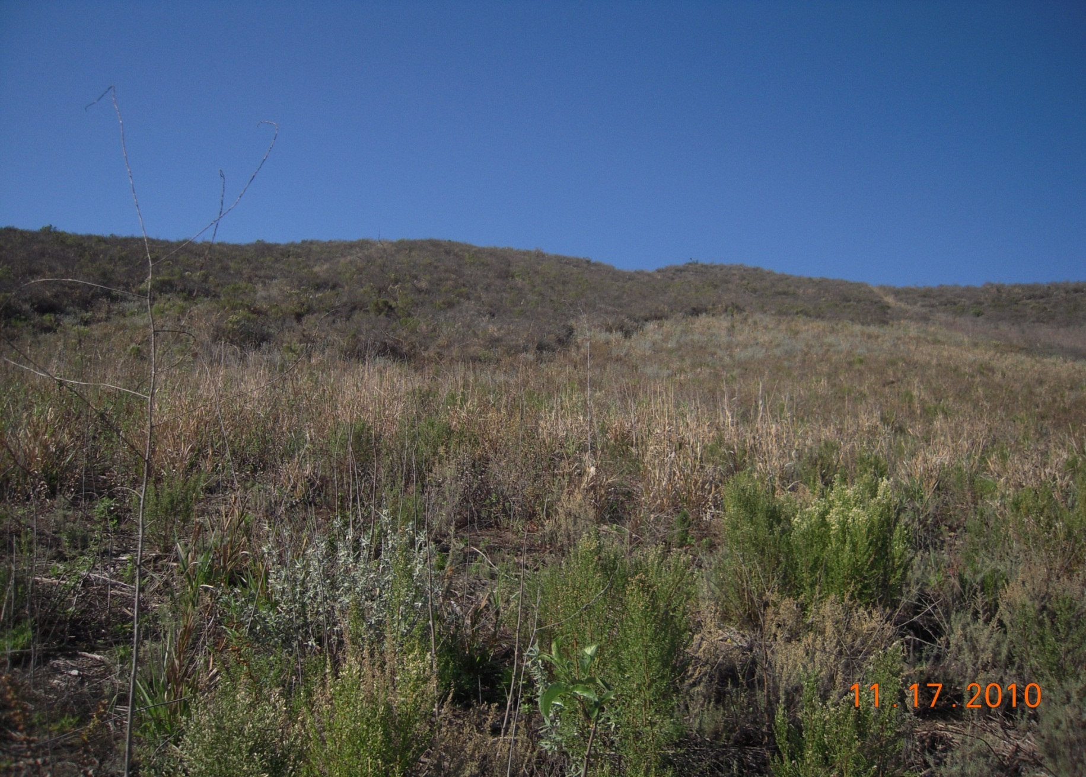
Masticated Area

Slide 30
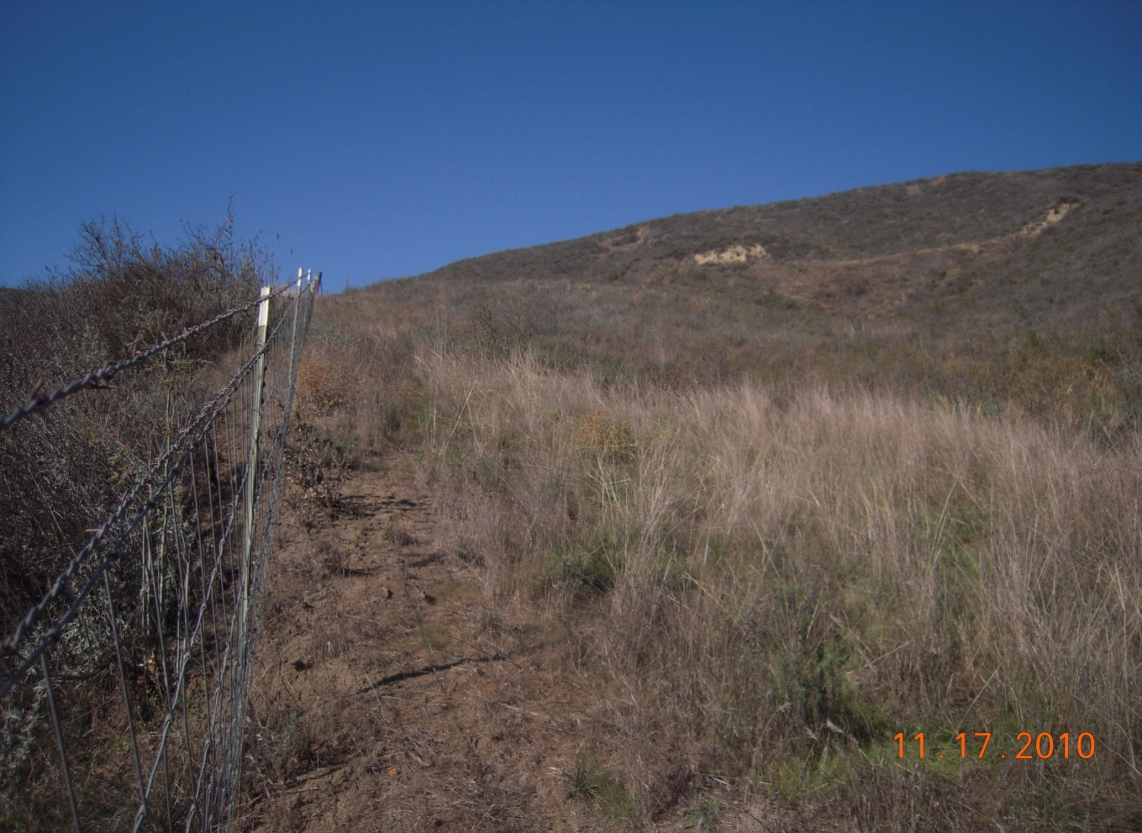
Push, Pile and Burn Area

Slide 31
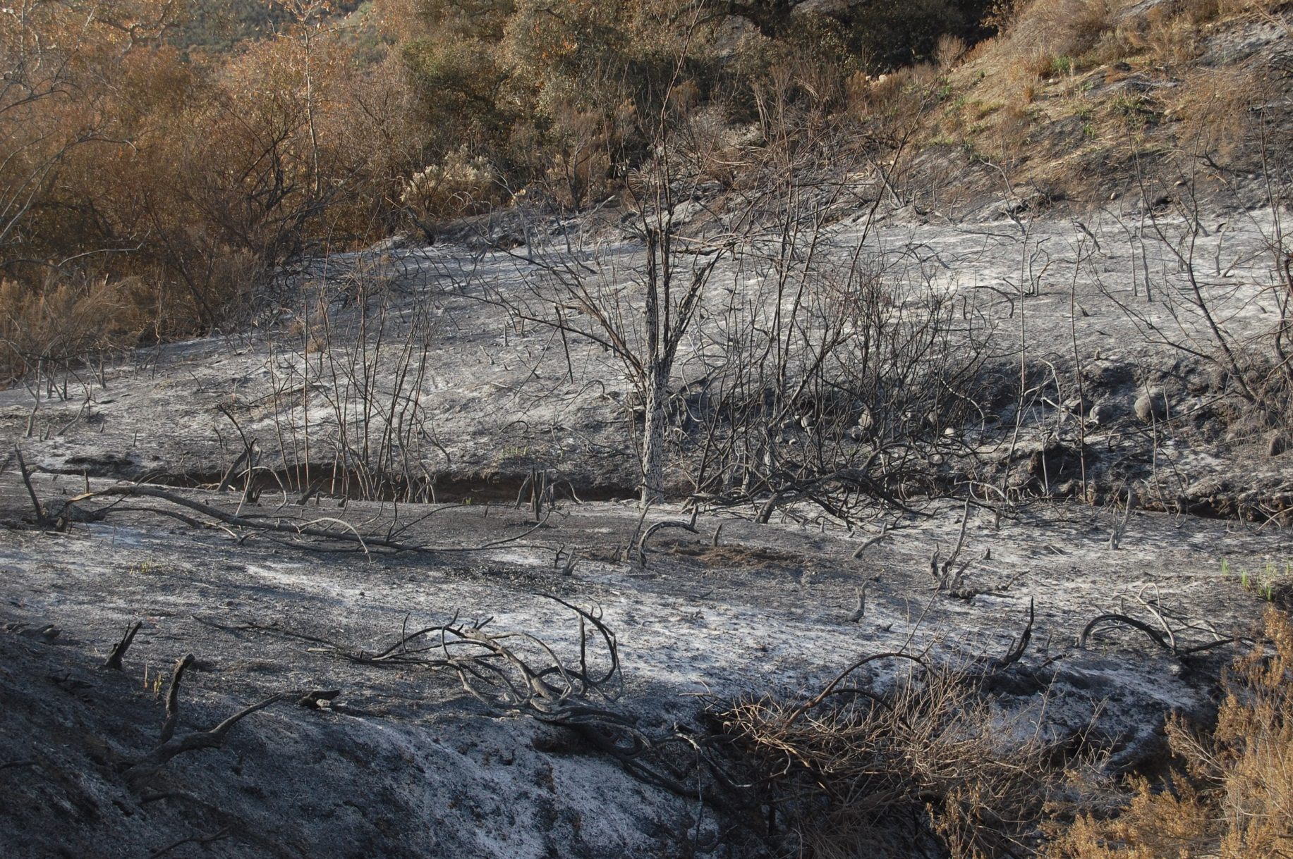
Post-prescribed burn

Slide 32
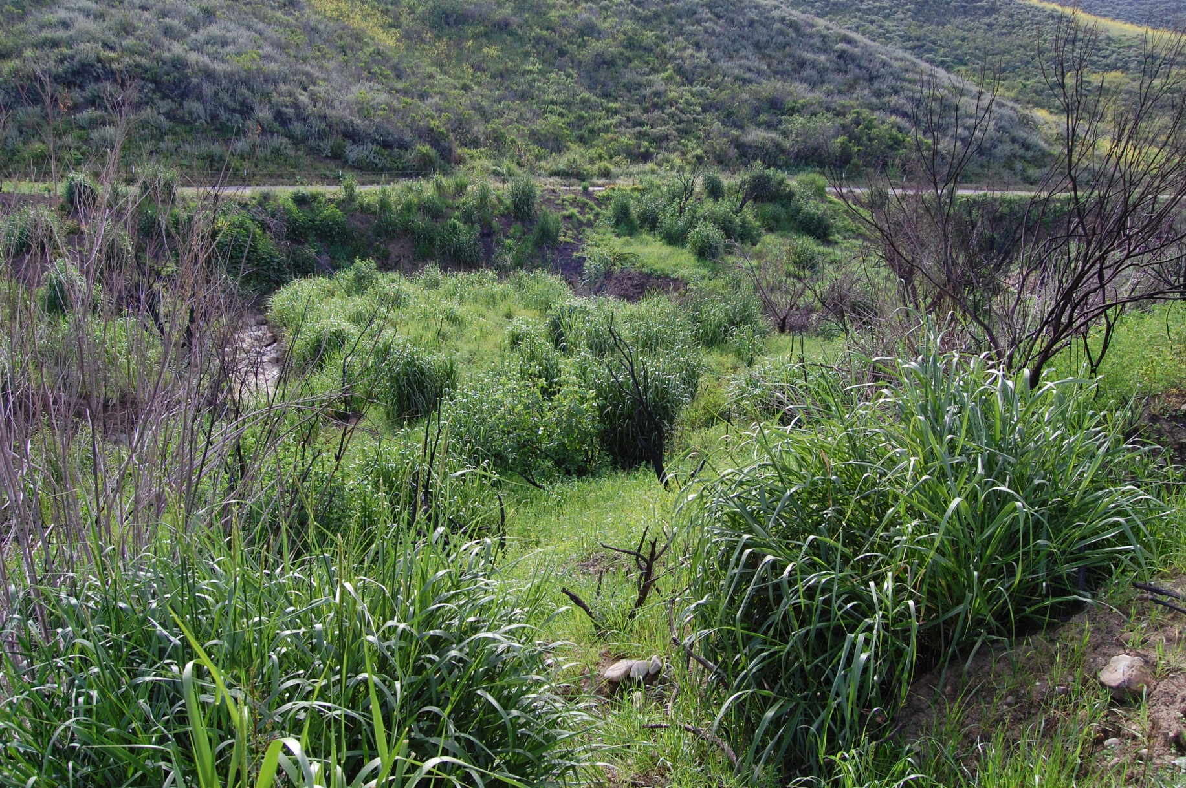
Controlled Burn Area

Slide 33
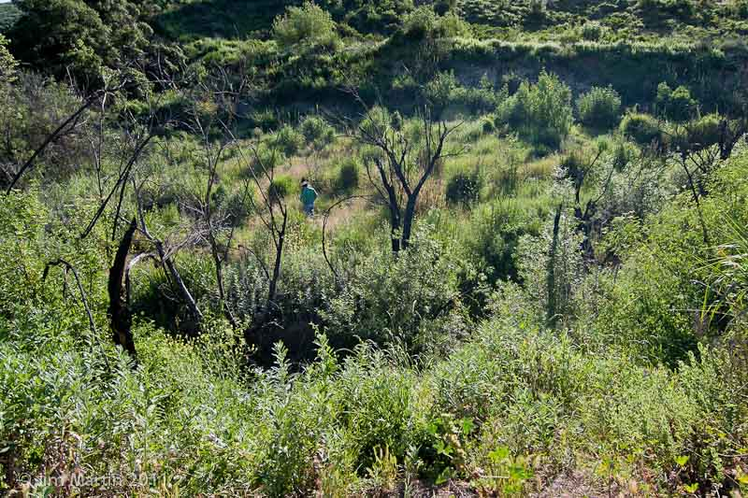
Controlled Burn Area

Slide 34
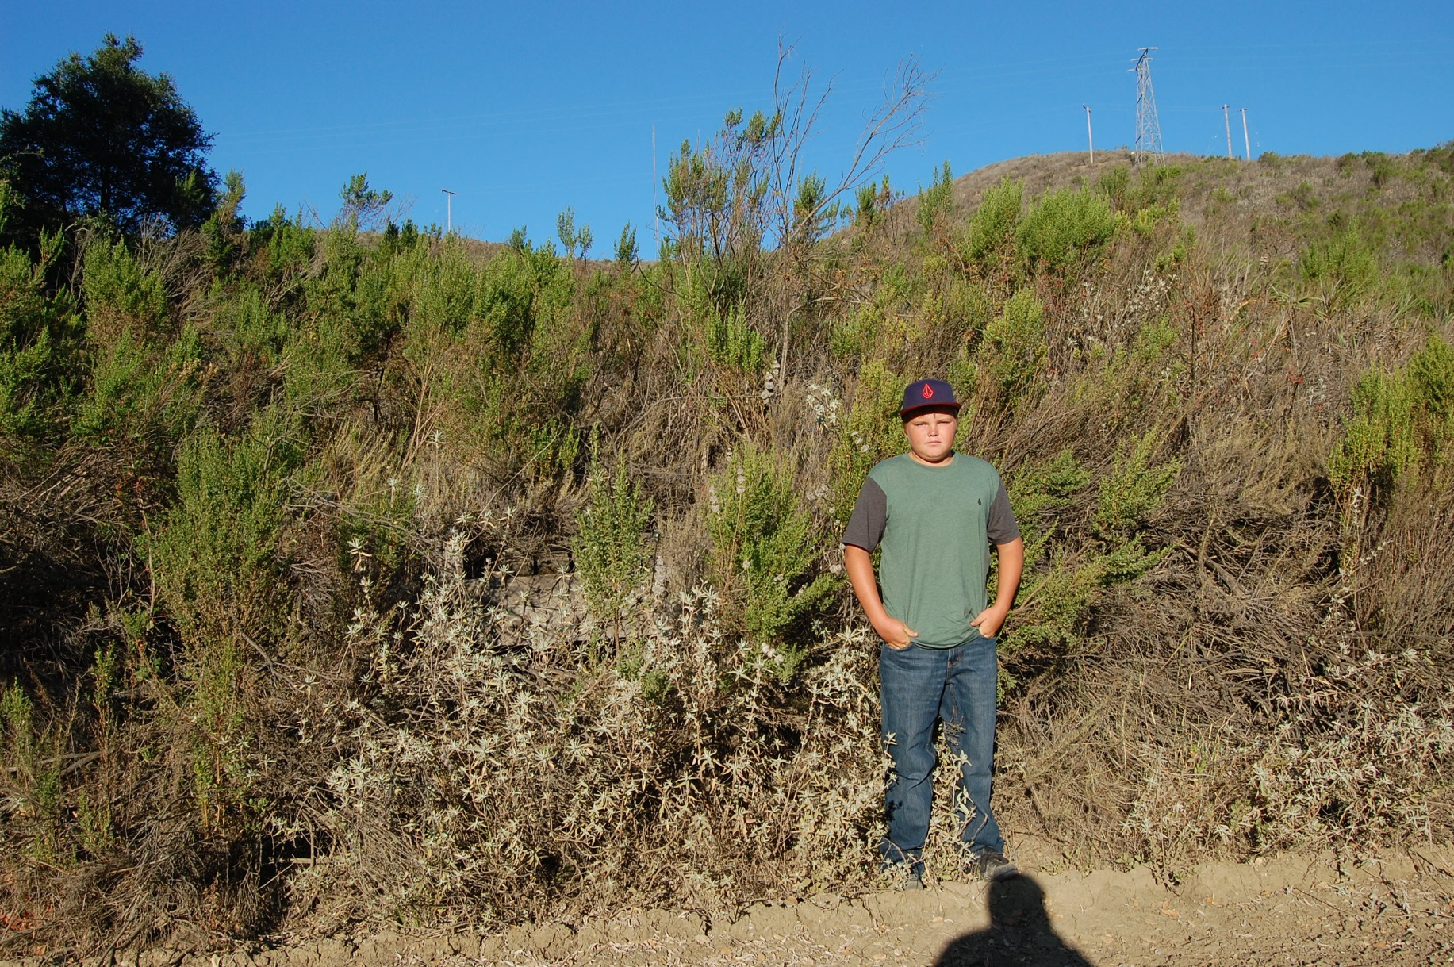
Control Area

Slide 35
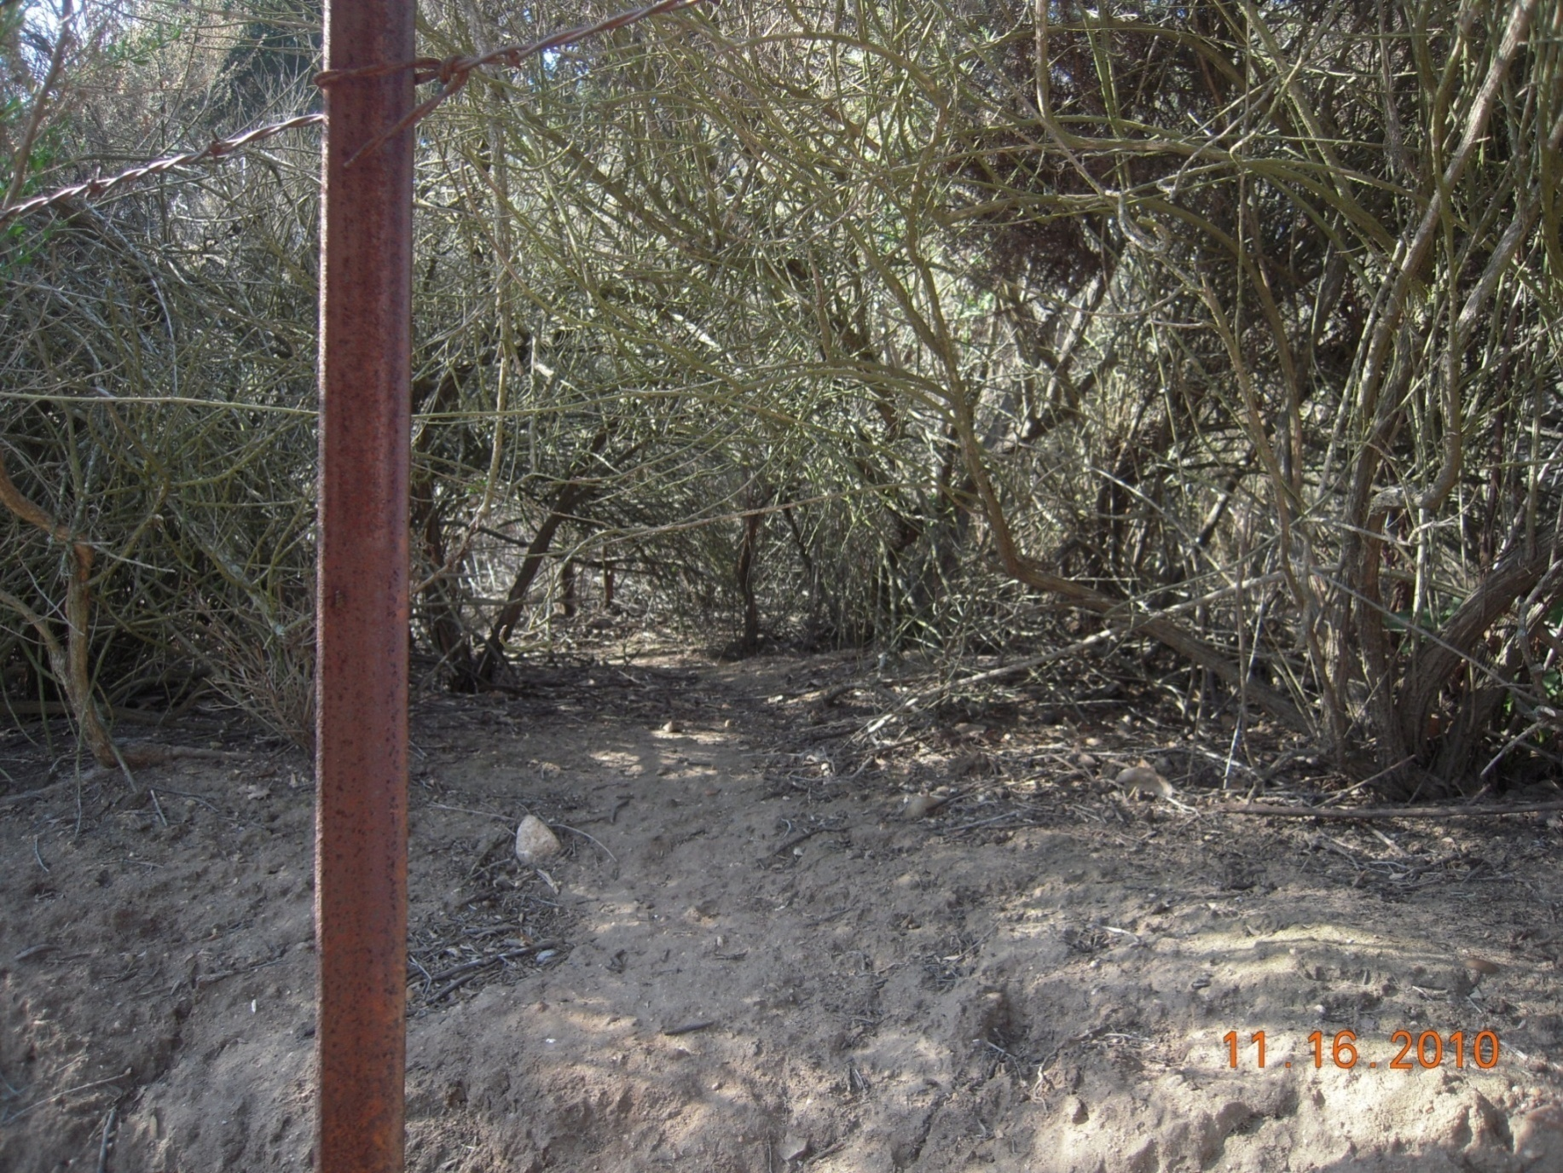
Control Area

Slide 36
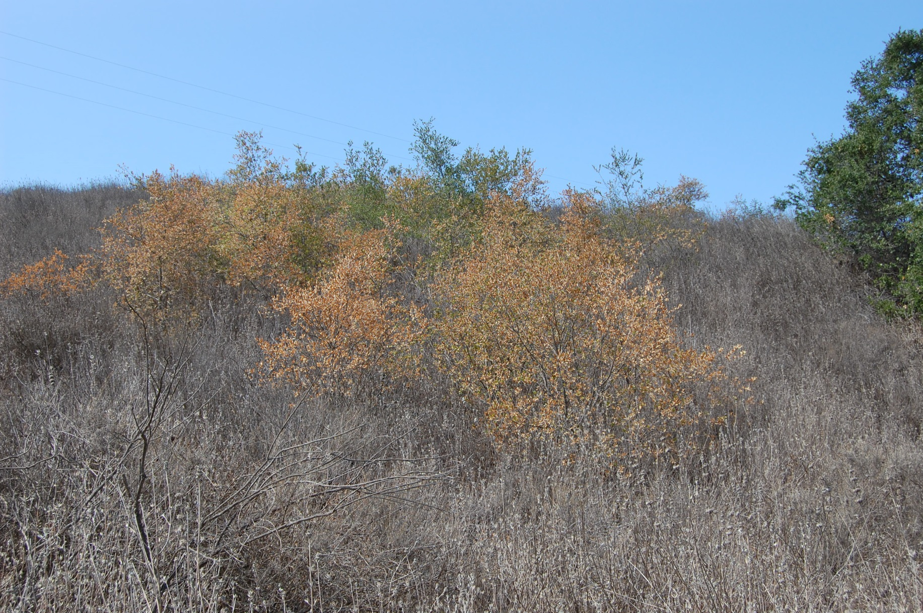

Slide 37
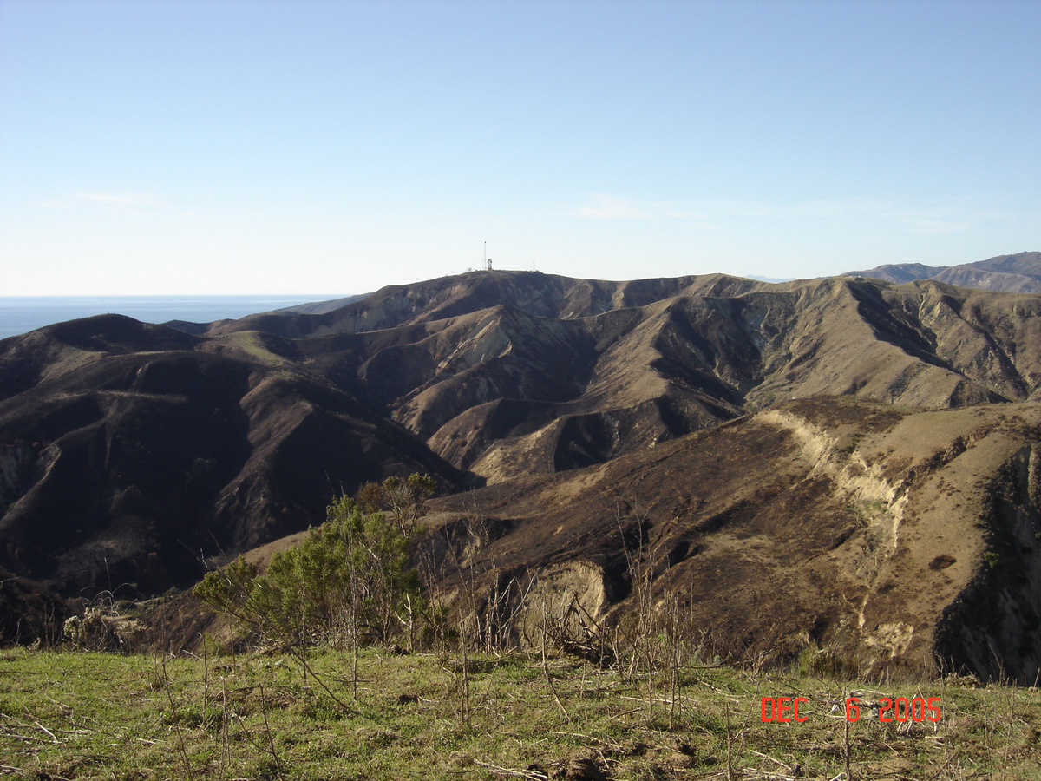
Proper management of grassland controls invasive plants and reduces wildfire risks.

Slide 38
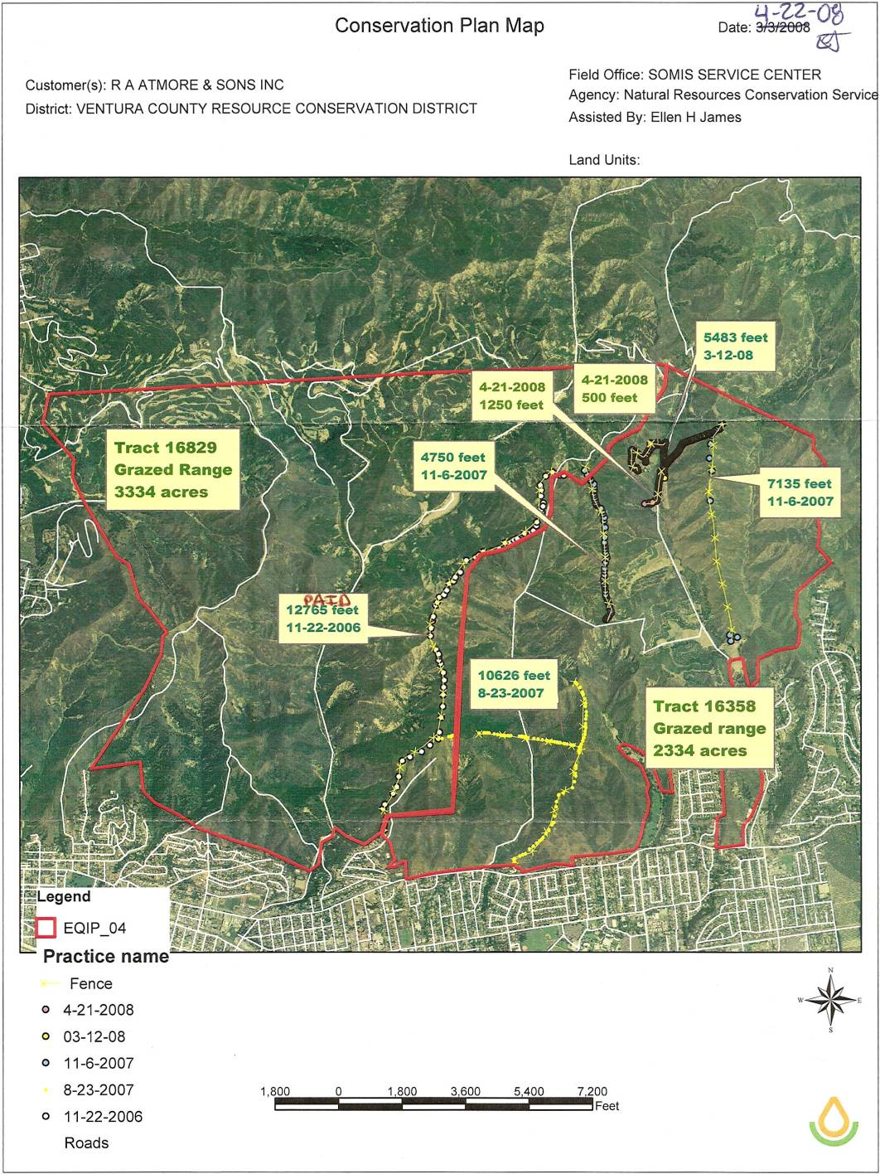
● Fencing facilitates rotational grazing practices  Since 1995, have installed over 120,000 feet of fence  Divided 5 pastures into 16  Graze 2 years, rest 1 year

Slide 39
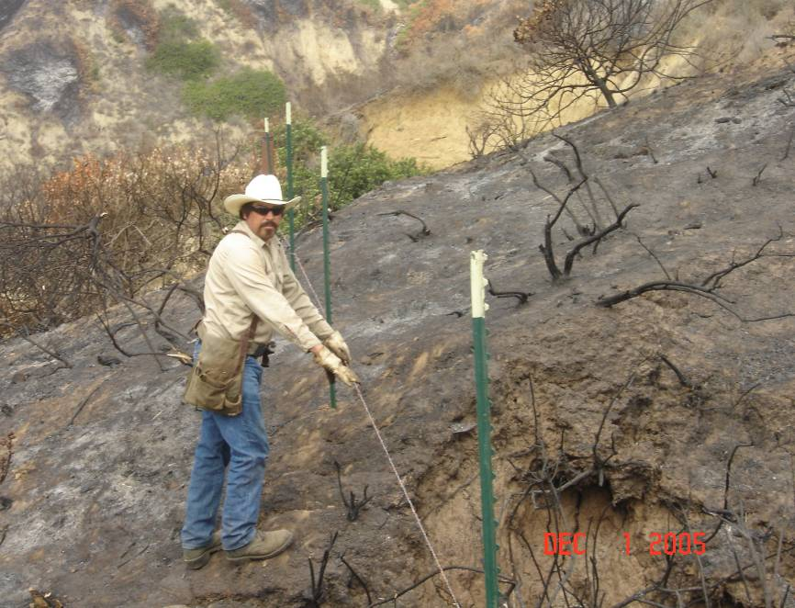
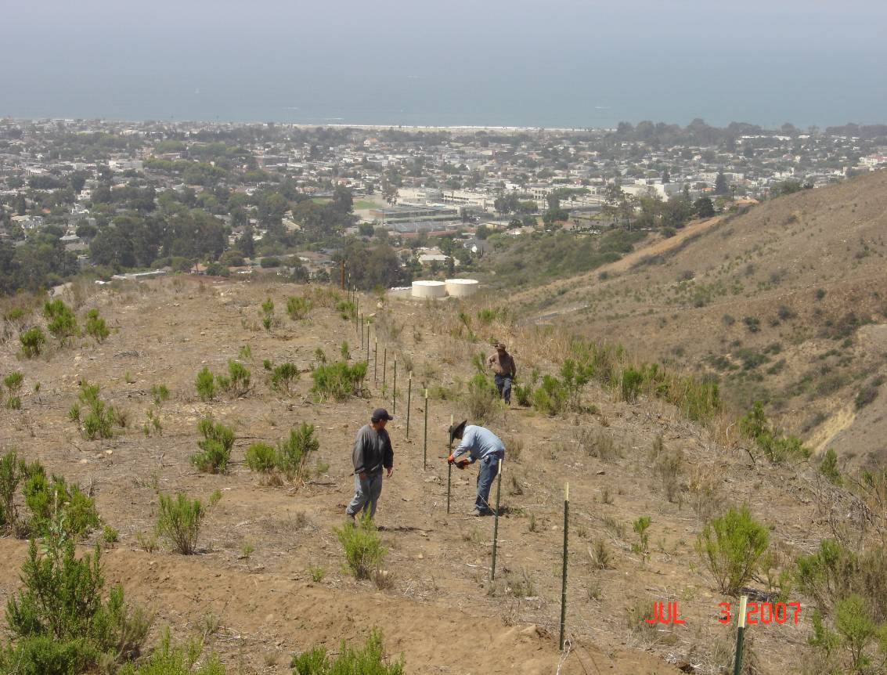

Slide 40
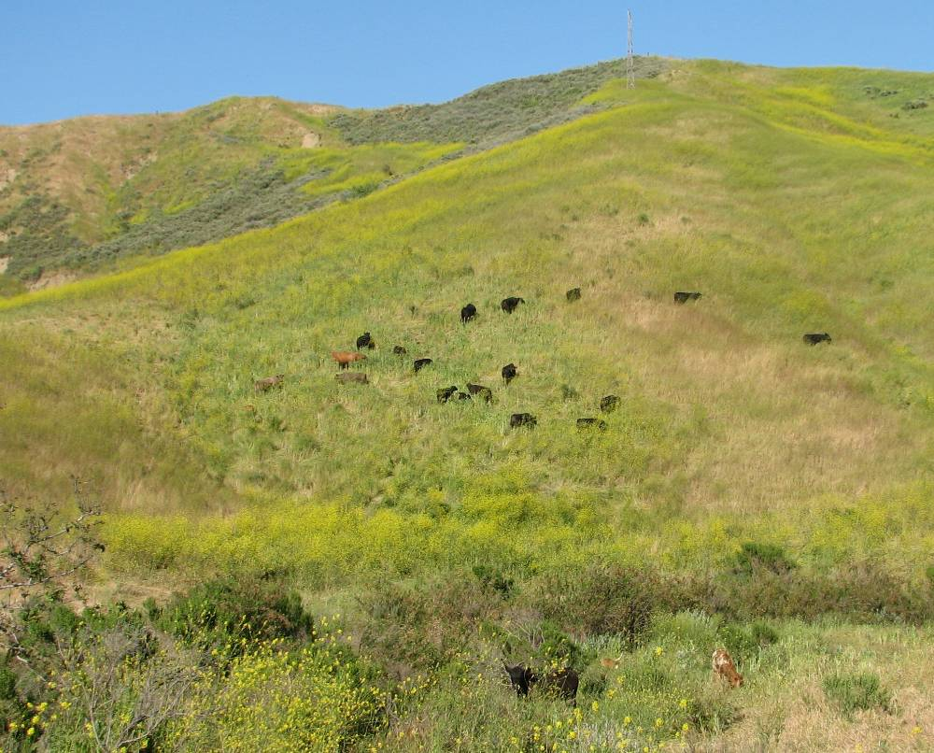
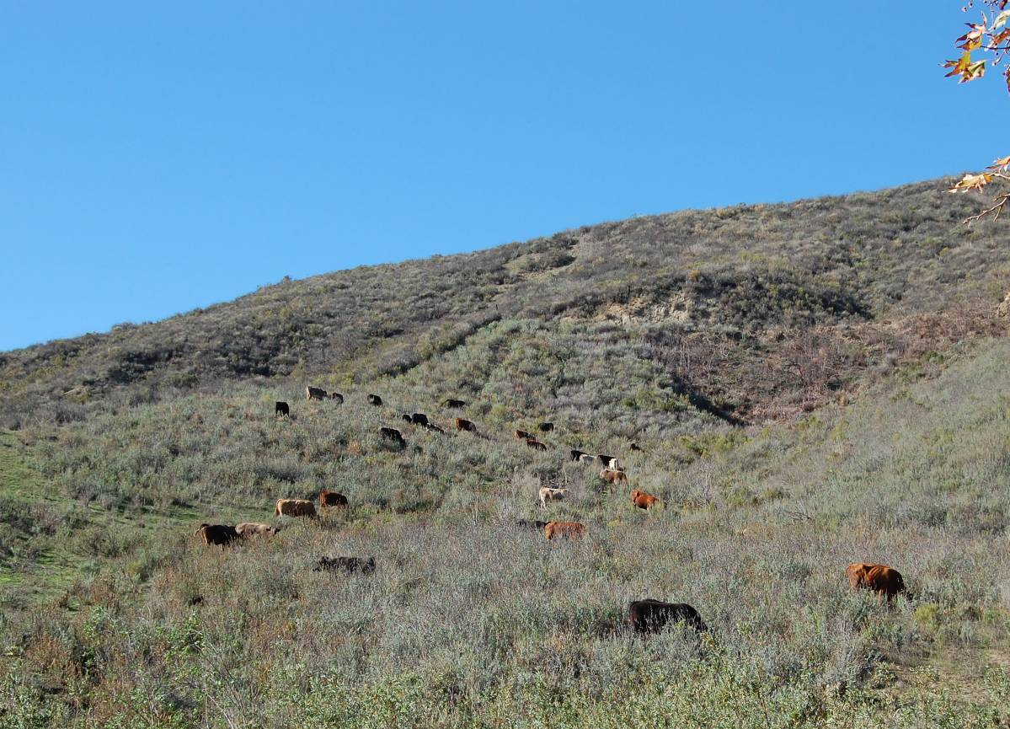
Timing and intensity of grazing controls non-native plants.

Slide 41
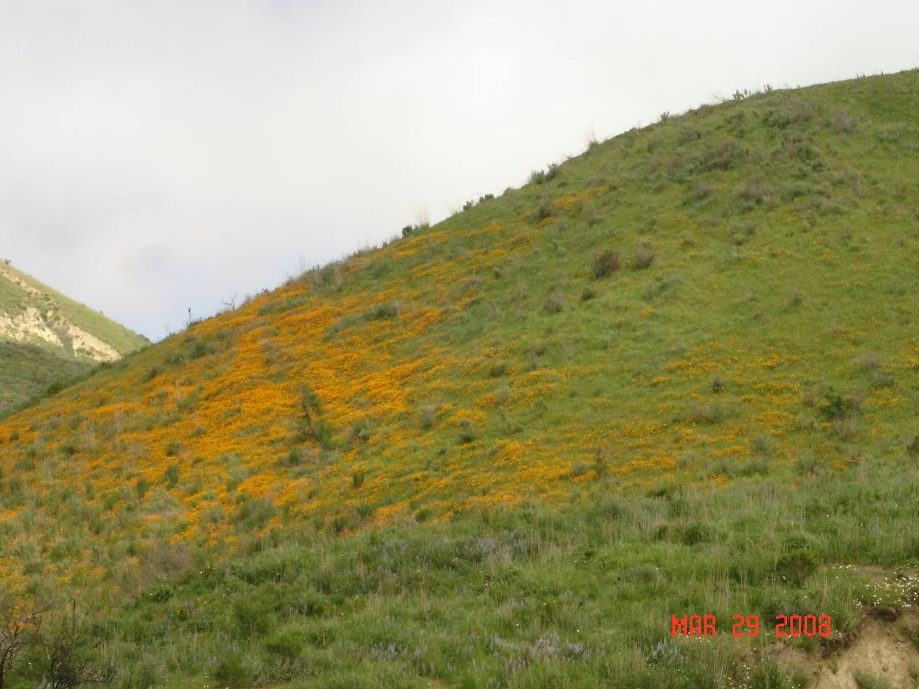
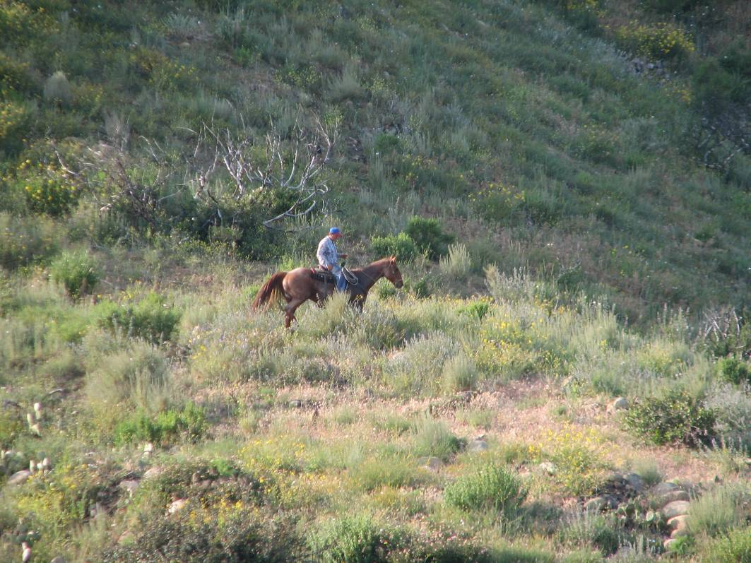
California coastal flora evolved under the influence of man and grazing animals, both which have been part of the eco-system for thousands of years.

Slide 42
Invasive Plant Control
Early detection & eradication of non-established, noxious invasive species
Control vs. eradication of established non-native plants
Invasive plants cattle cannot control are detrimental to existing habitat

Slide 43
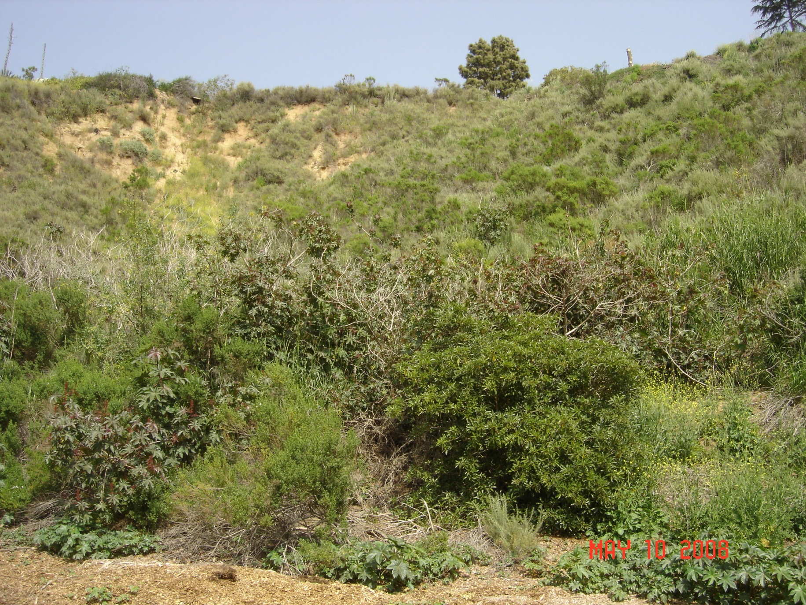
Herbivory
Castor Bean

Slide 44
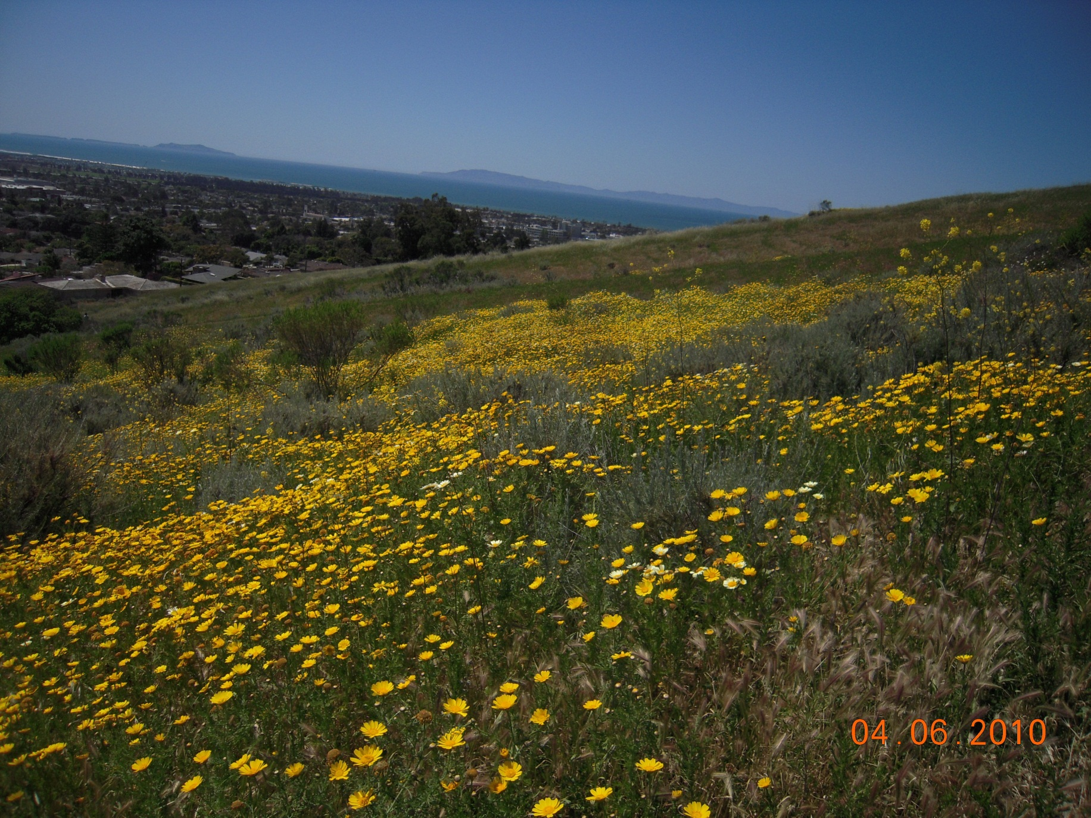
May Weeds

Slide 45
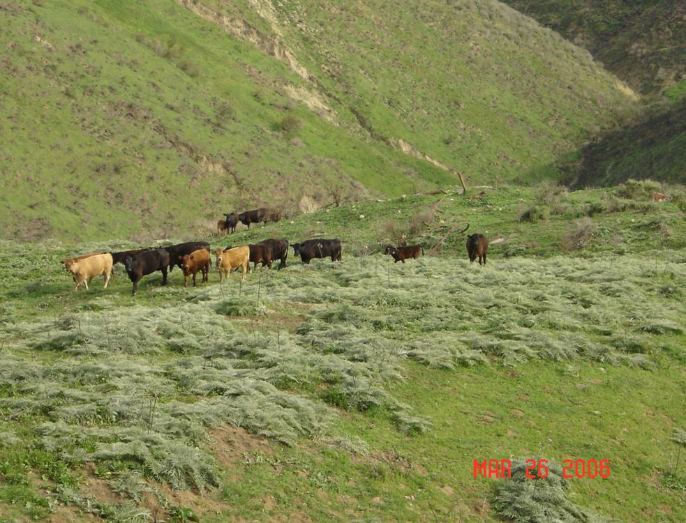
Artichoke Thistle

Slide 46
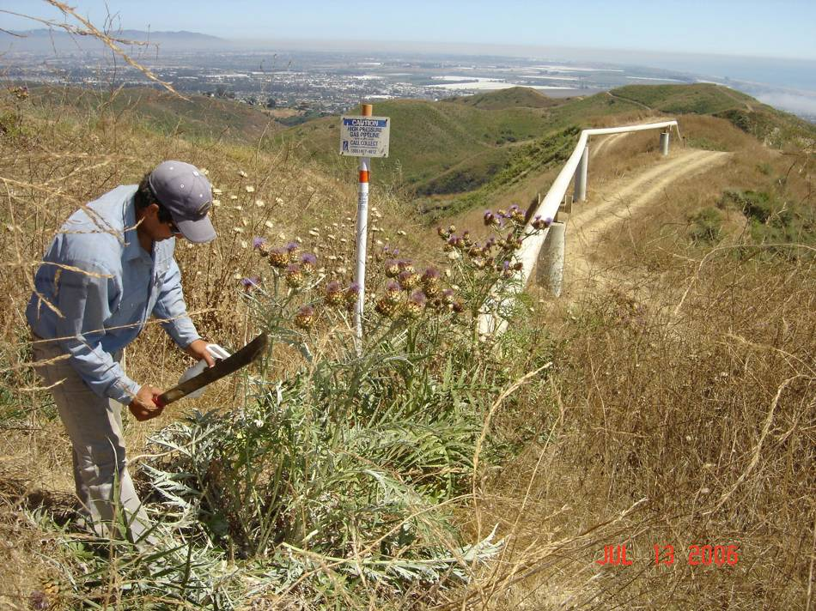
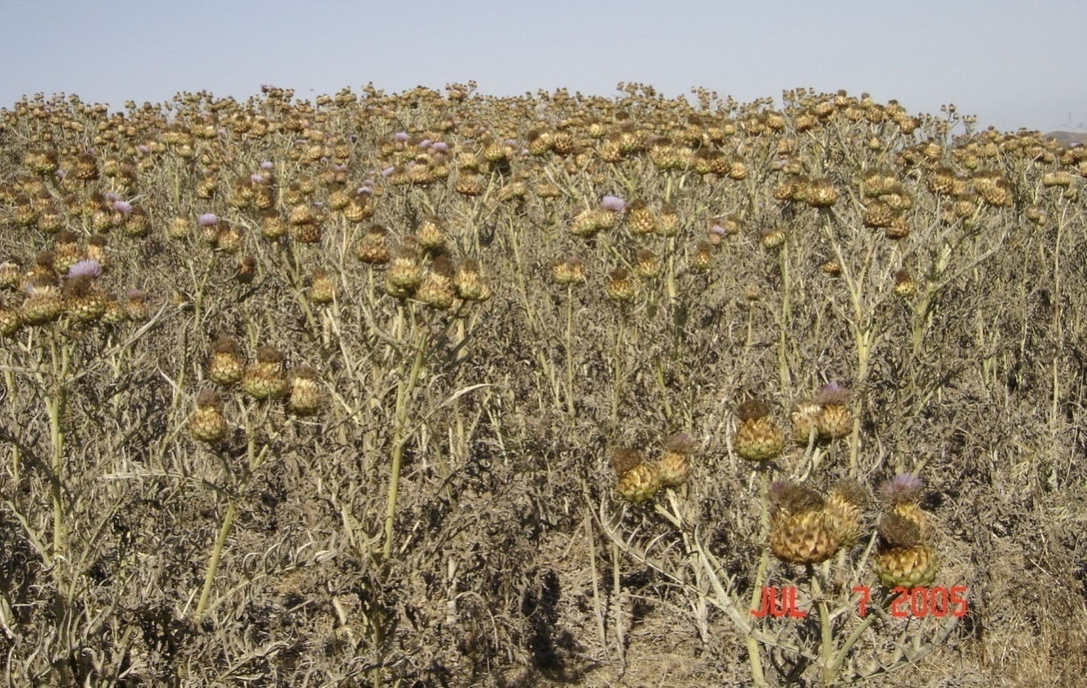
Early Detection & Eradication
Artichoke Thistle

Slide 47
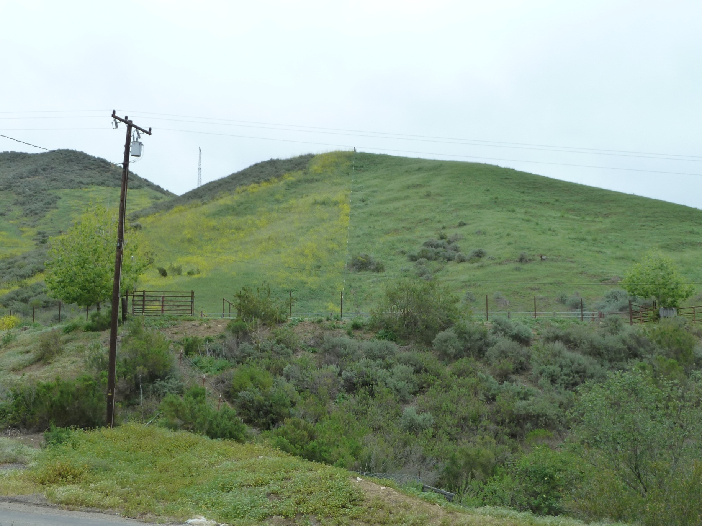
Black Mustard

Slide 48
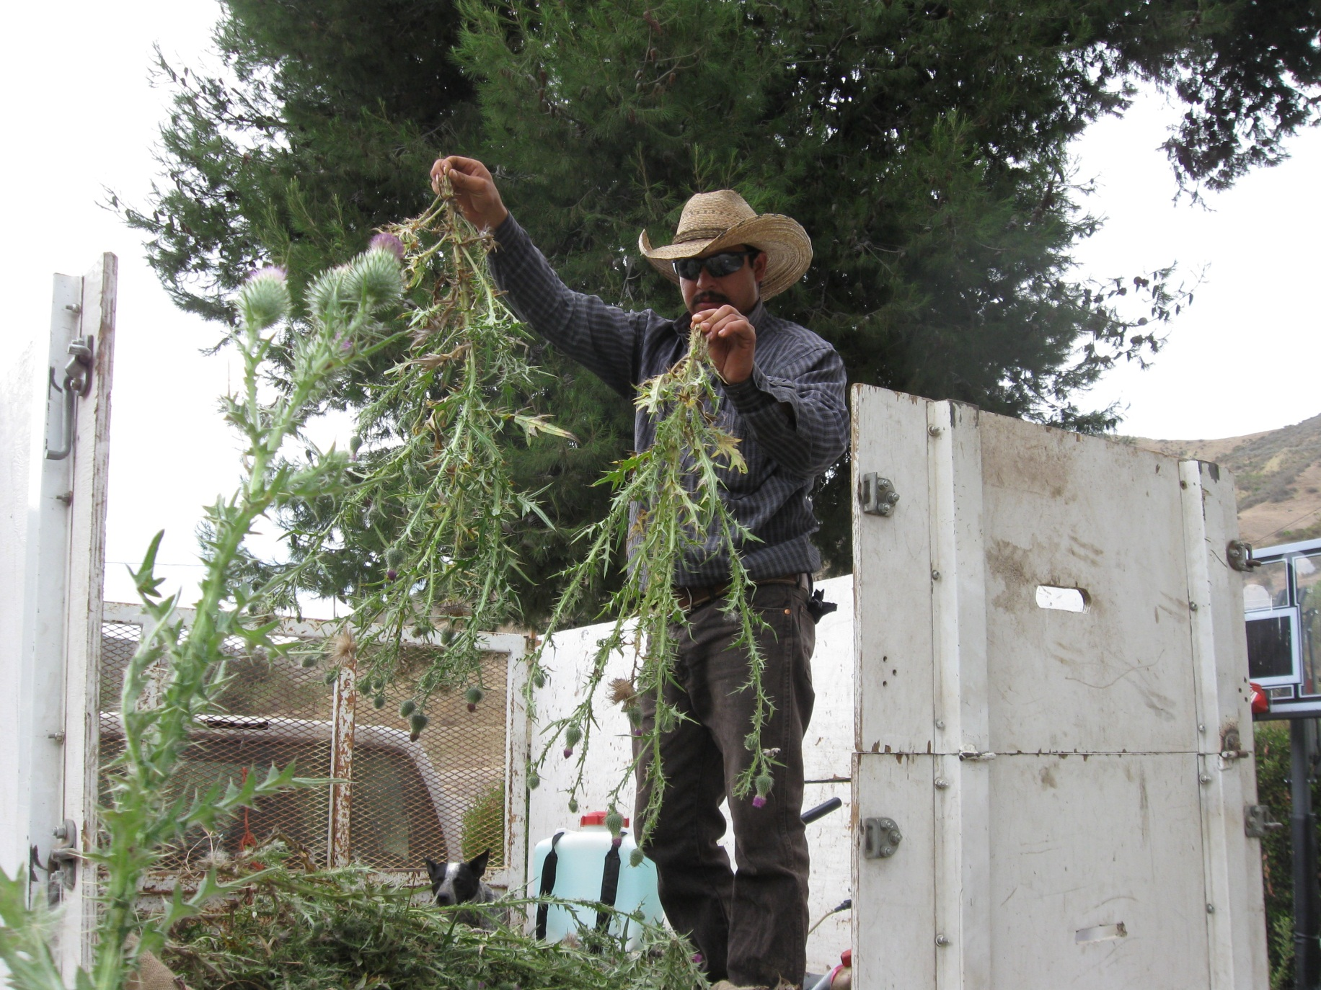
Bull Thistle

Slide 49
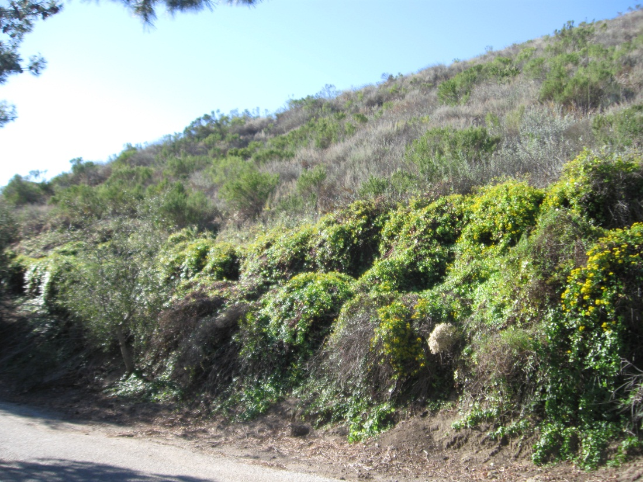
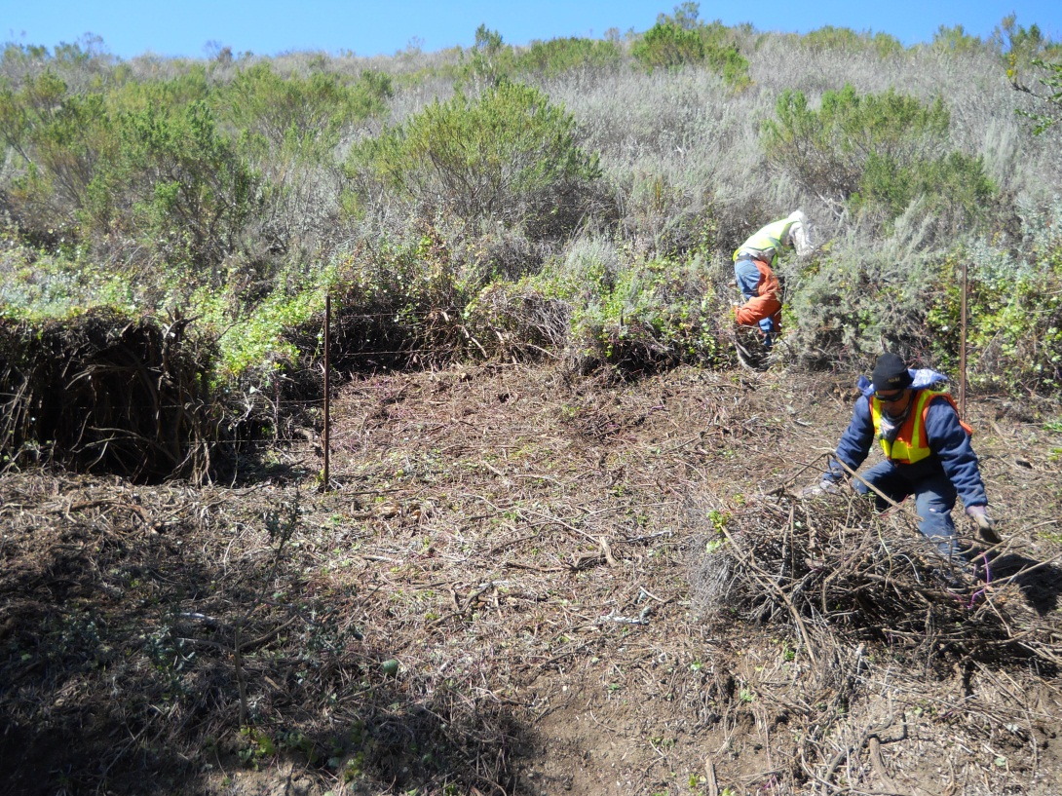
Cape Ivy

Slide 50
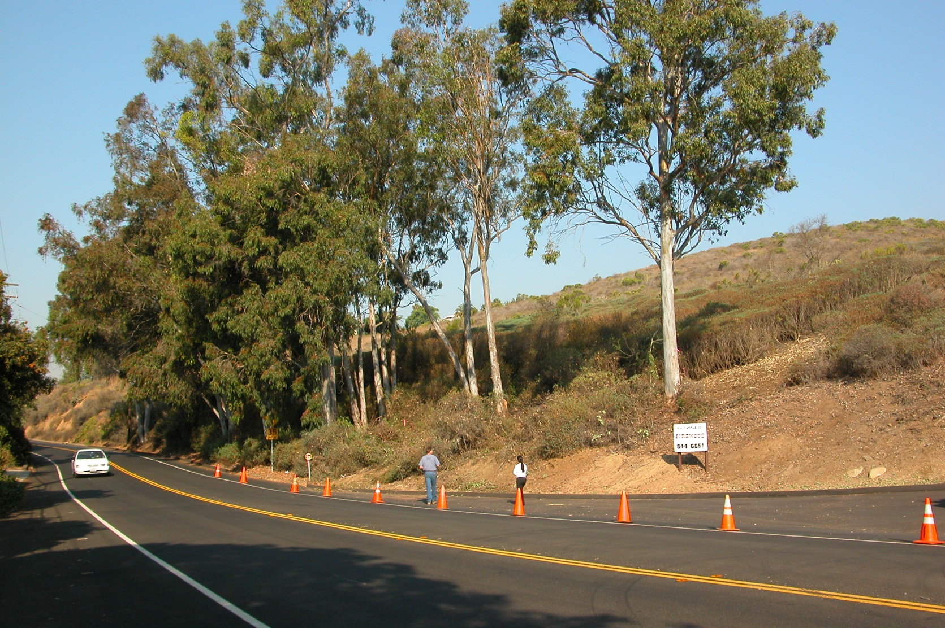
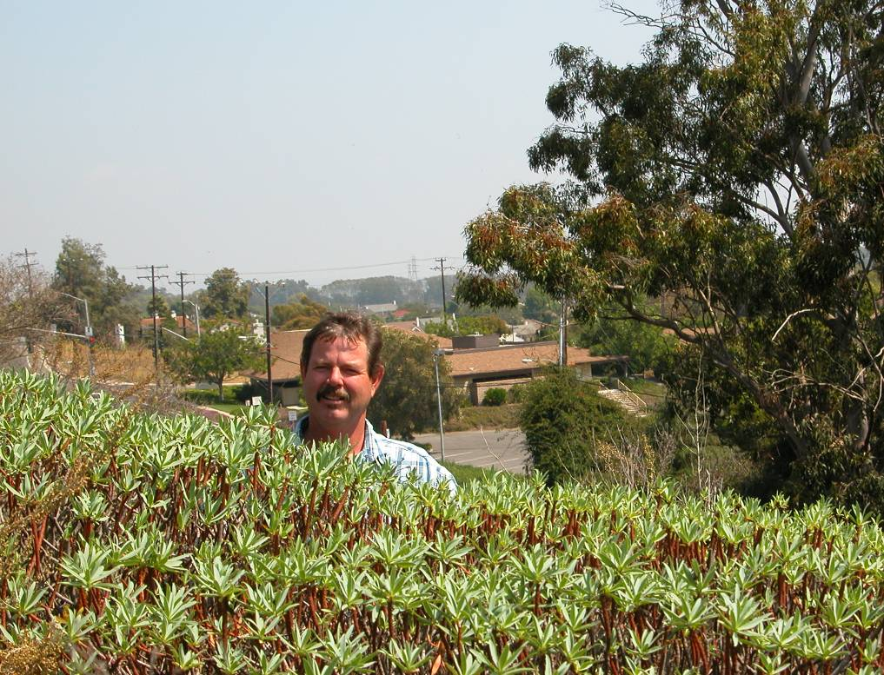
Tree Spurge (Euphorbia dendroides)

Slide 51
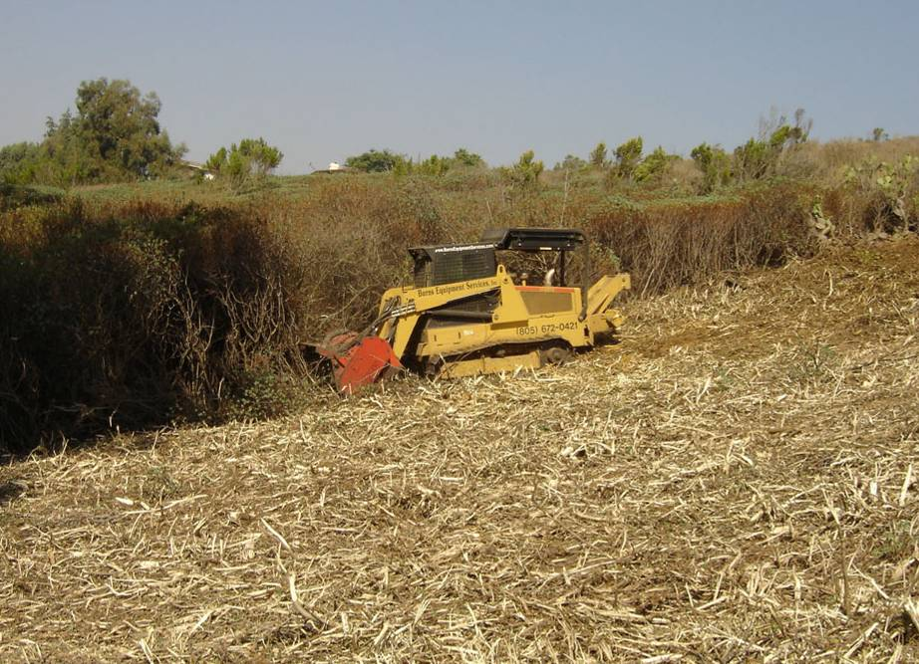

Slide 55
Sexton Canyon Creek Rehabilitation

Slide 57
Rangeland & Wildlife Habitat Enhancement

Slide 70
Wildfire

Slide 76
Responsible urban interface rangeland & open space managers work to:  Protect the environment  Provide managed habitat diversity  Work with evolved existing ecosystems to achieve realistic goals  Reduce wildfire risks

Slide 77
80% of all home losses from wildfires are preventable

Slide 79
The End

