Slide 1
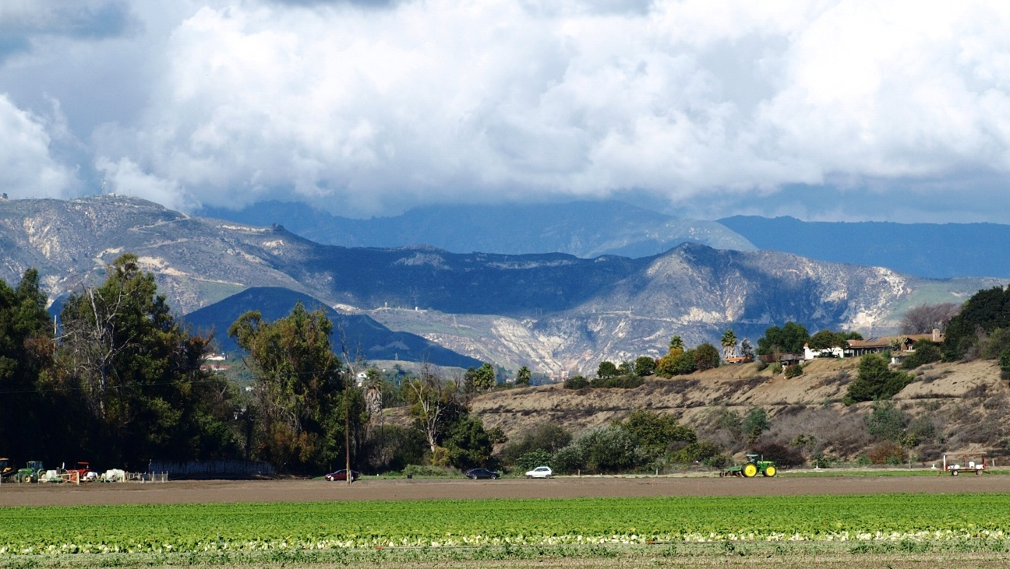
RESOURCE CONSERVATION DISTRICT
VENTURA COUNTY
Your partner in local conservation and agriculture
Lexi Ballinger
Environmental & Land Management Specialist

Slide 2
They are special districts of the State of California, set up to be locally governed agencies with their own locally appointed or elected, independent boards of directors
Public Resources Code Division 9 establishes Resource Conservation Districts (RCDs) to conserve soil and water, control runoff, prevent and control soil erosion, manage watersheds, protect water quality, and develop water storage and distribution
California RCDs implement projects on public and private lands, and educate landowners and the public about resource conservation
RCDs are a vital link between federal, state, and local programs, helping these agencies meet their conservation goals
What is a Resource Conservation District?
Notes:
Other examples of Special Districts:
Cemetery & Memorial Districts
Community Services Improvement & Health Districts
Port and Harbor Districts
Recreation & Park Districts
Resource Conservation Districts
Wastewater Treatment and Reclamation Districts
Water Storage, Distribution, Collection & Disposal Districts

Slide 3
What is a Resource Conservation District?
California has 97 RCDs statewide – Generally, one per county, but sometimes two
To the west, Cachuma RCD in Santa Barbara County and east, Antelope Valley and Santa Monica Mountains RCDs represent LA County
Notes:
The concept of RCDs was established early 1930s due to much concern over soil erosion, floods and dust storms.
Some RCDs partner or even cohabitate with USDA-NRCS. It was found that federal standards could be better implemented by RCDs at the local level.
RCDs = Resource Conservation Districts (only in CA)
Conservation districts can be found throughout U.S
Trade organization: CARCD = California Association of Resource Conservation Districts
Typical projects include water conservation, watershed protection, habitat improvement, native plantings, fire prevention projects and education, etc.
Some RCDs are totally grant funded, some receive an annual tax base, some receive support from donors, some are all three!

Slide 4
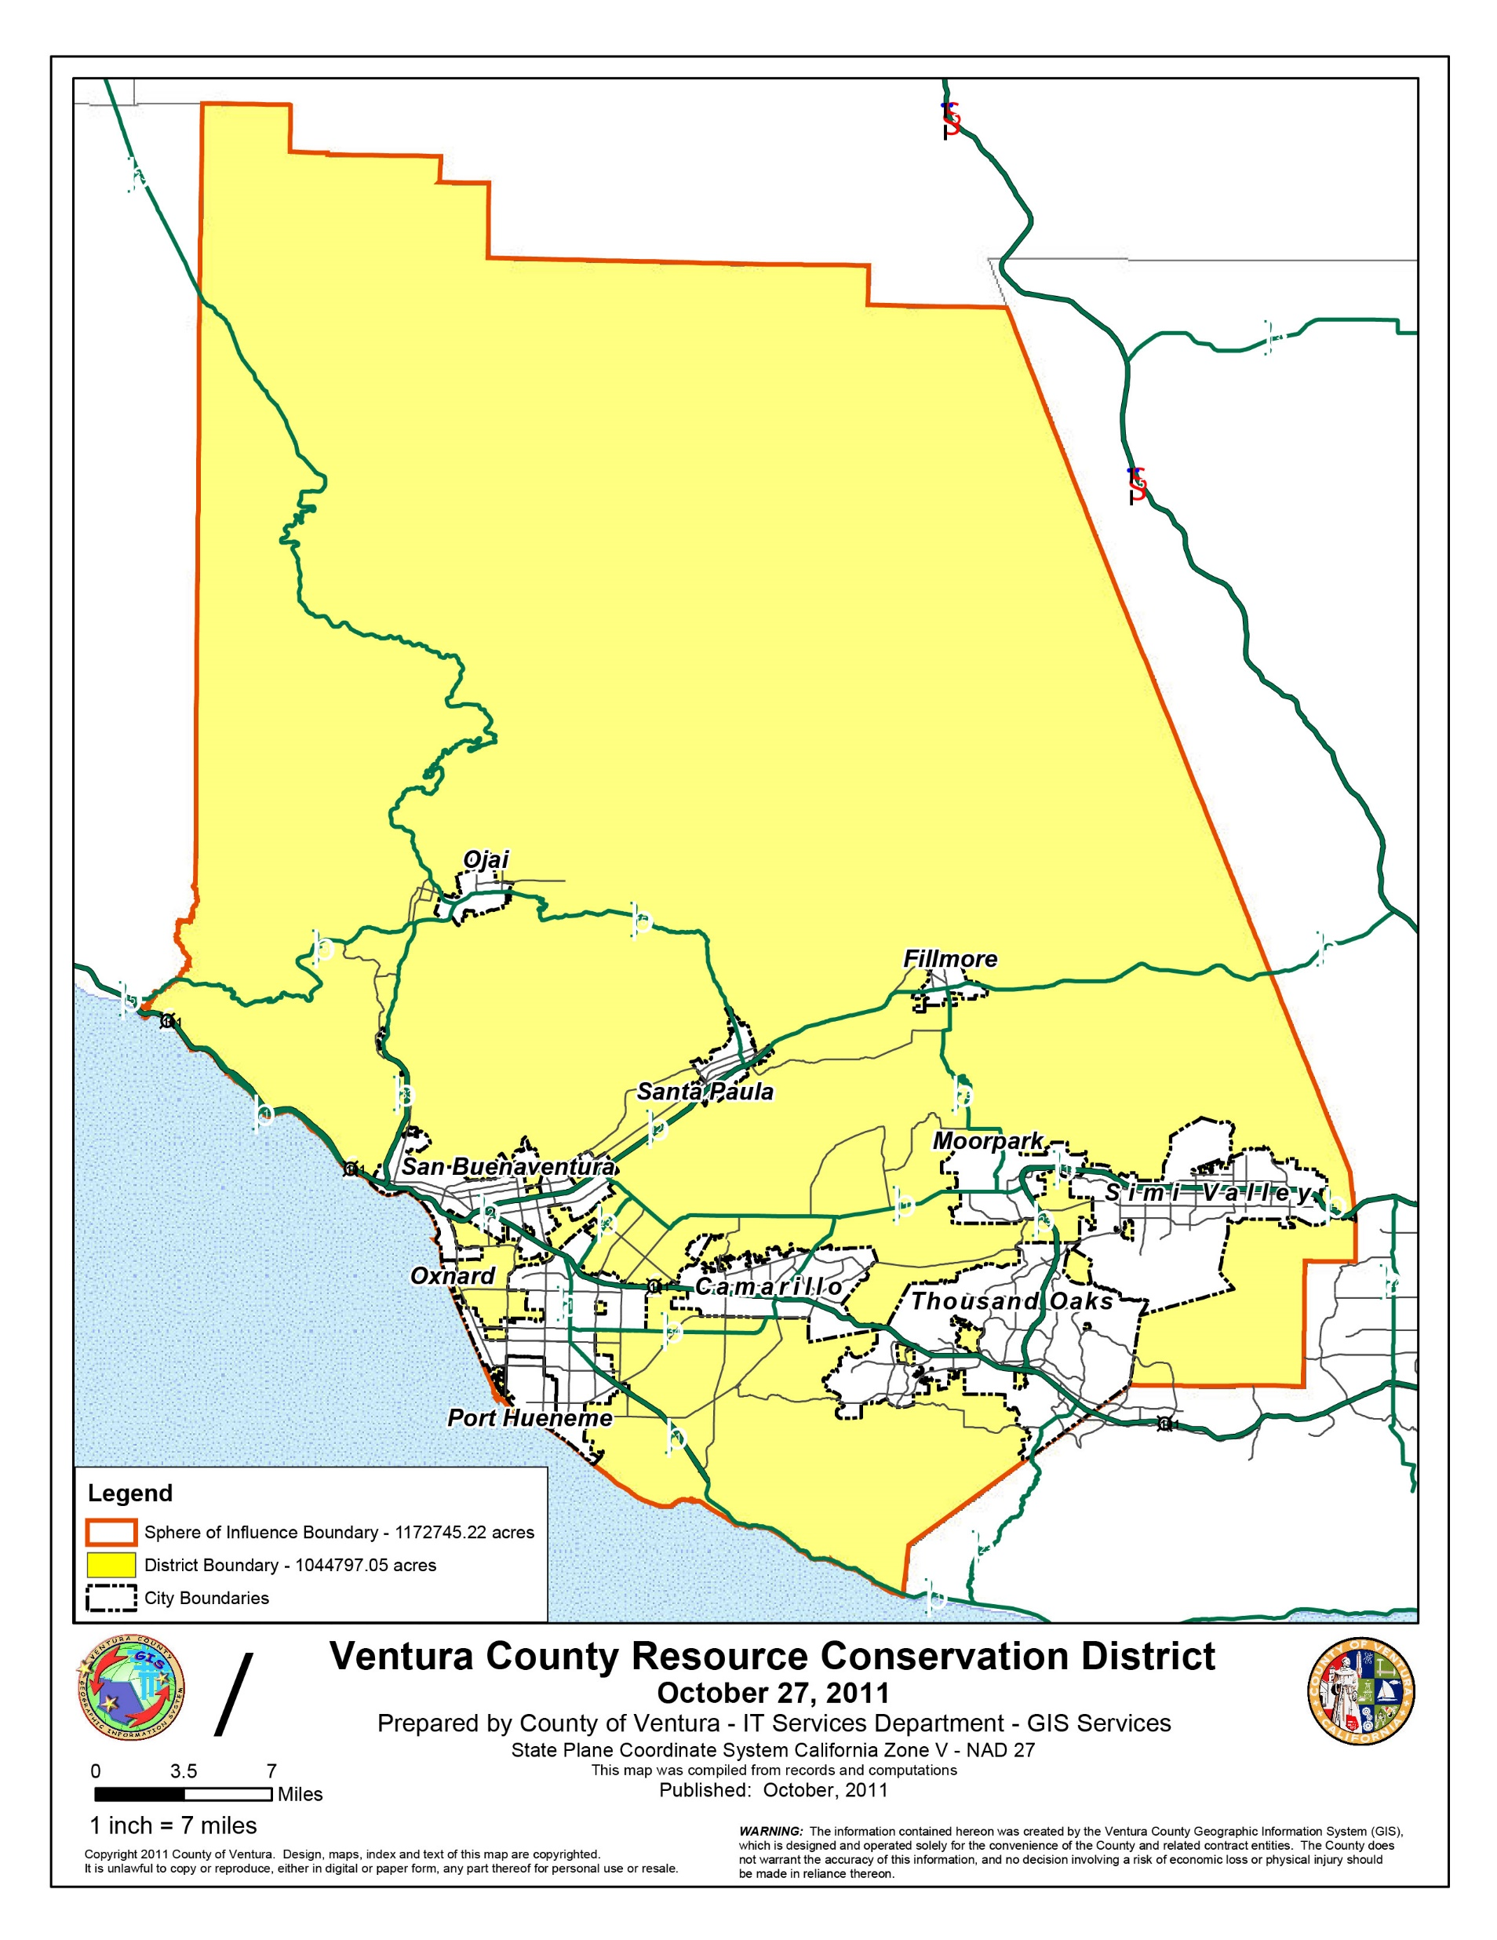
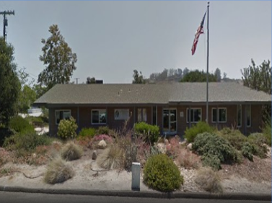
All About VCRCD
RCD of Ventura County
3380 Somis Road, PO Box 147
Somis, CA 93066
*Vcrcd.org*
(805) 764-5130
Notes:
*In the midst of updating/upgrading our website. Please be aware that some info is out of date!
VCRCD does not receive a tax base... We are almost entirely grant funded. We receive donations from time to time.

Slide 5
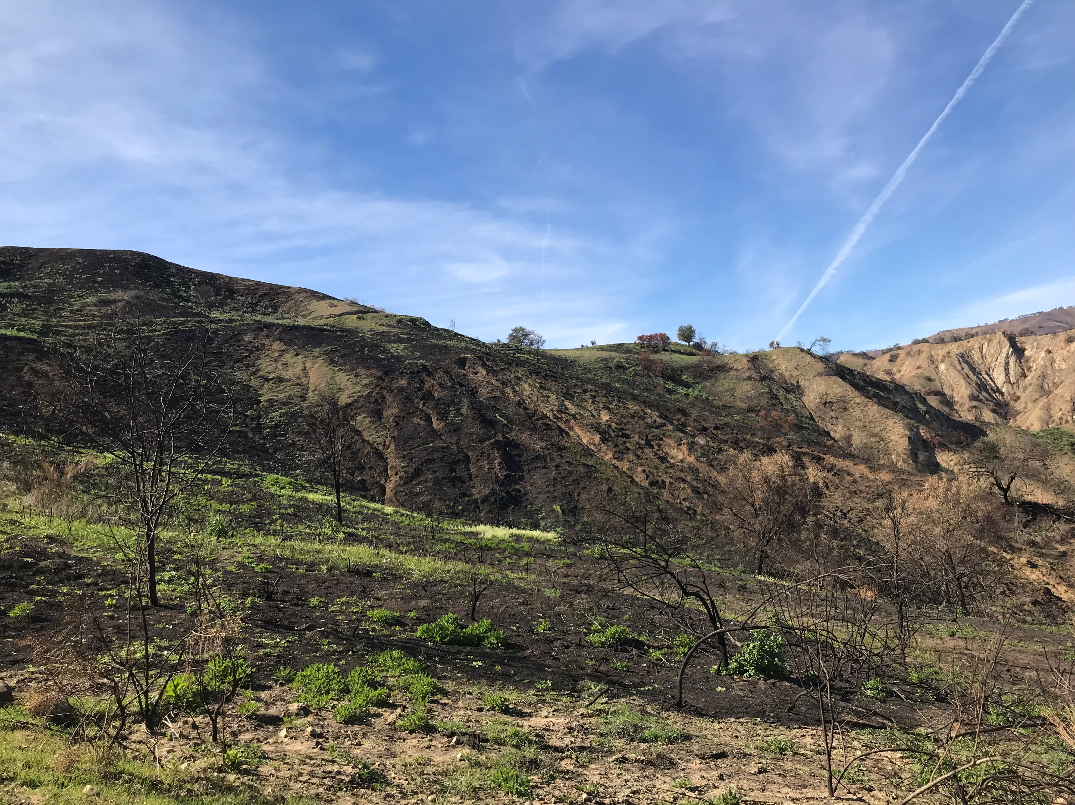
Our mission is to collaborate with landowners, government agencies, and other willing partners to facilitate the conservation and restoration of Ventura County’s natural resources.
All About VCRCD
Board of Directors
Aubrey E. Sloan, President
Mike Mobley, Vice President/Treasurer
Kevin Cannon, Director
Tom Crocker, Director
Bill Morris, Director
Merrill Berge, Director
Peggy Ludington, Director
Directors must be landowners or agents of landowners residing within the District
Regular Directors Meetings are held at 8:30 AM on the third Wednesday of the month except August and December, which have no meetings
Notes:
RCDs are organizations made up of landowners FOR landowners.

Slide 6
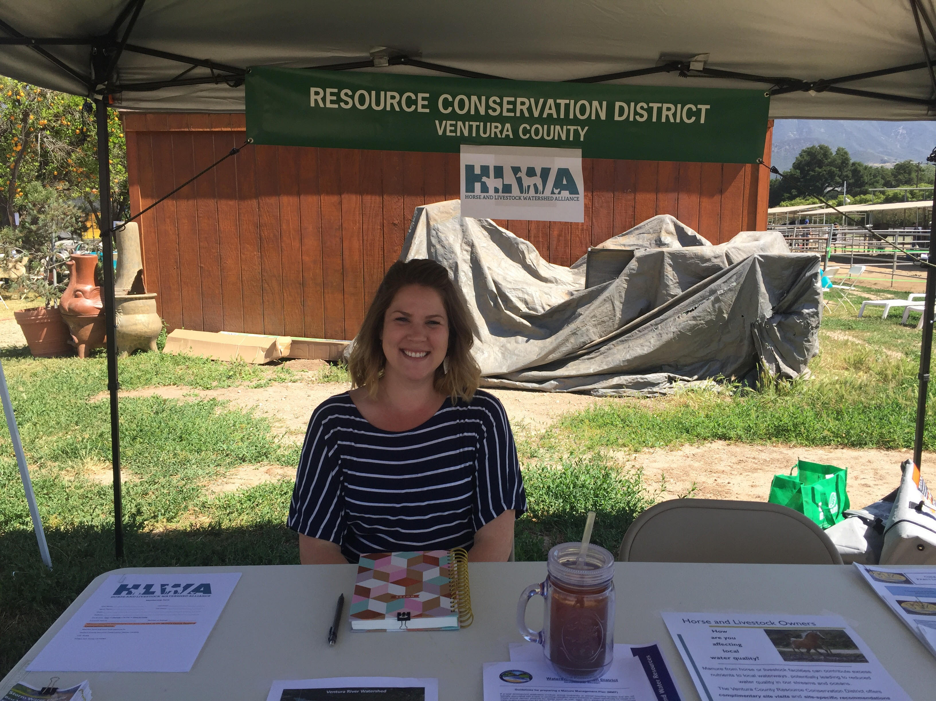
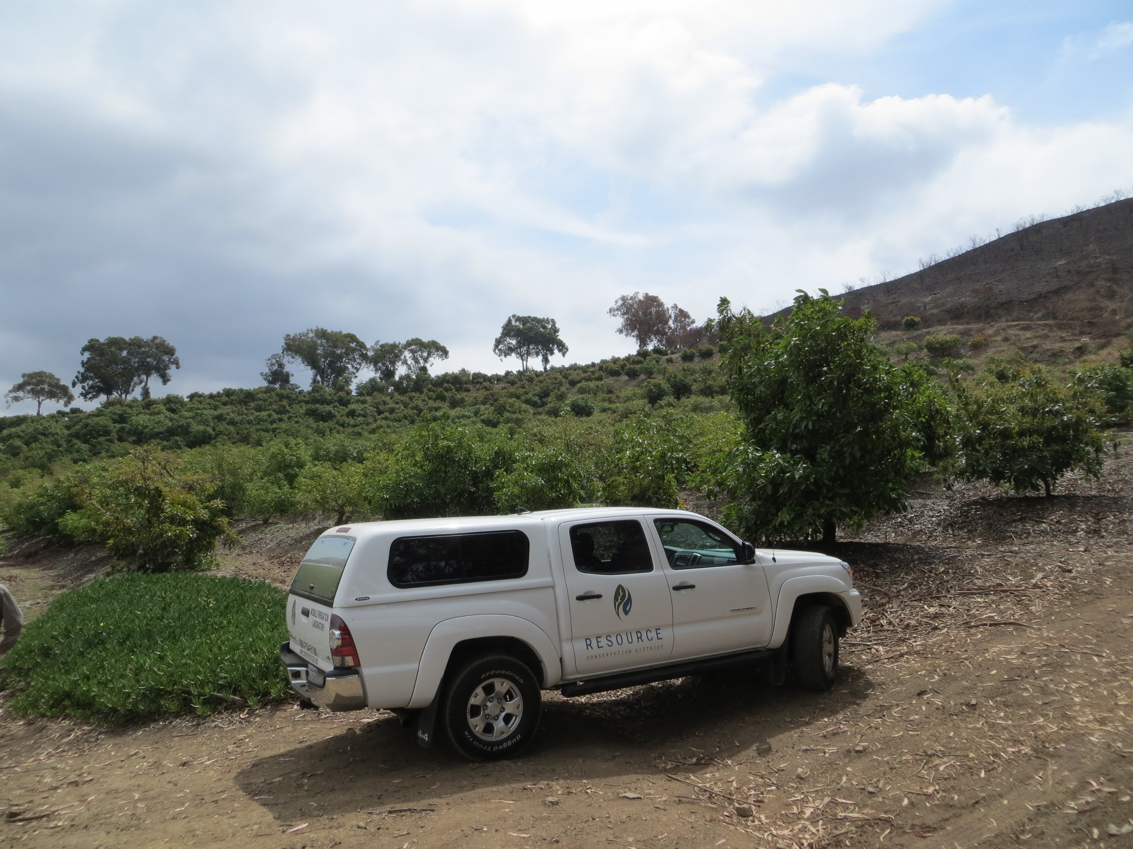
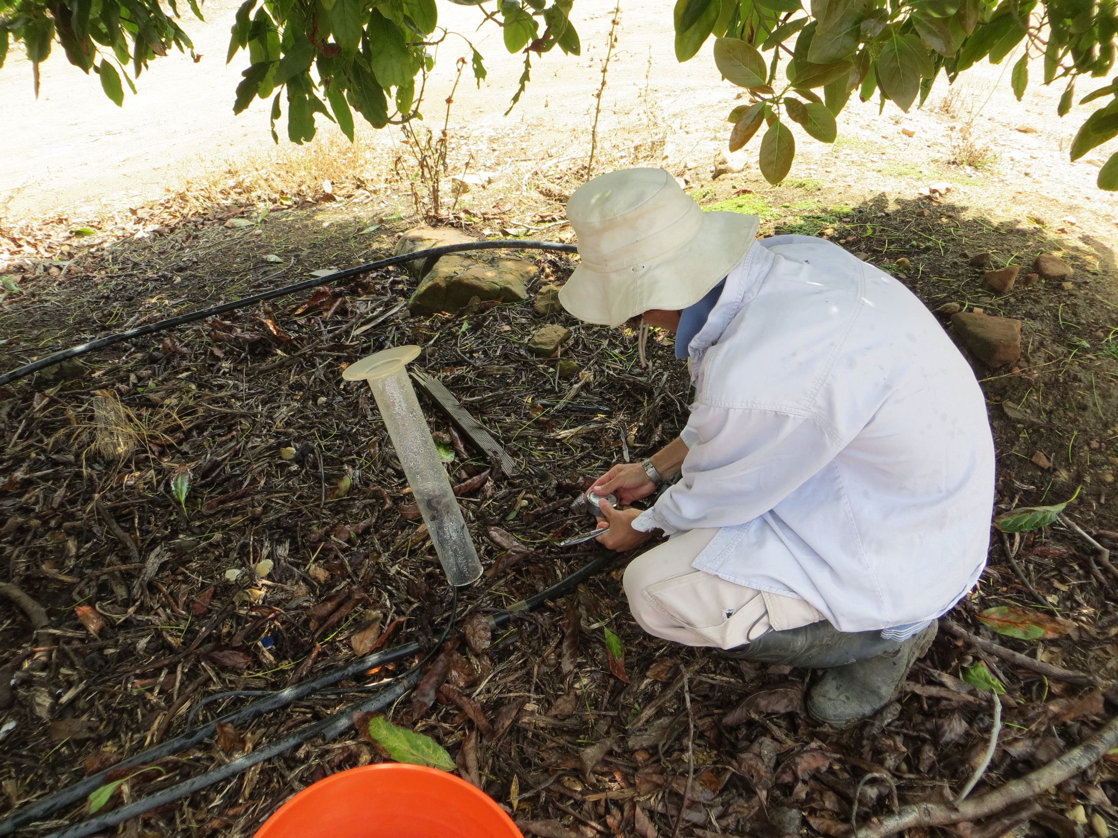
Staff
Debra Gillis - Director of Finance/Executive Director
Vic Akundzadeh - Irrigation Specialist
Dr. Jamie Whiteford - District Scientist
Lexi Ballinger - Environmental and Land Management Specialist
Dawn Whiteford – Field/Administrative Assistant
All About VCRCD
Notes:
Staff take direction from the Board and implement, or put ideas into action.
First 4 staff are full time, Dawn is part-part time and assists when needed.
Jamie and Lexi handle grant writing, project development, etc.

Slide 7
Past
Present
Future
Thomas Fire Recovery BMPs Program – LA Regional Water Quality Control Board
Hoophouse Stormwater Quality Study – CA Department of Food and Agriculture
Irrigation Efficiency Testing and Upgrades – CA DWR
Site Visits and Recommendation Reports at Horse Properties – VC WPD
Reconciling CIMIS Station Data in Canyon Areas in Ventura County – USDA-NRCS
Calleguas Creek Watershed Agricultural Management Measures Program (CCWAMMP) – LA Regional Water Quality Control Board
Agricultural Water Use Efficiency (AWUE) Program – CA DWR
Nutrient Mgmt Development for Horse Properties in VRW – LA Regional Water Quality Control Board
Programmatic permit program to facilitate the removal of Arundo and Tamarisk from Santa Clara River Watershed
Chipping, Weed Abatement, and Education Program in Ojai Valley
VRT bike path project
VRW instream flow framework
Implementation $ for horse properties in VRW
Backyard citrus tree removal program to control Asian Citrus Psyllid
Technical assistance to horse owners in Hidden Valley
All About VCRCD
Programs, Projects,
Efforts, etc.
Etc..

Slide 8
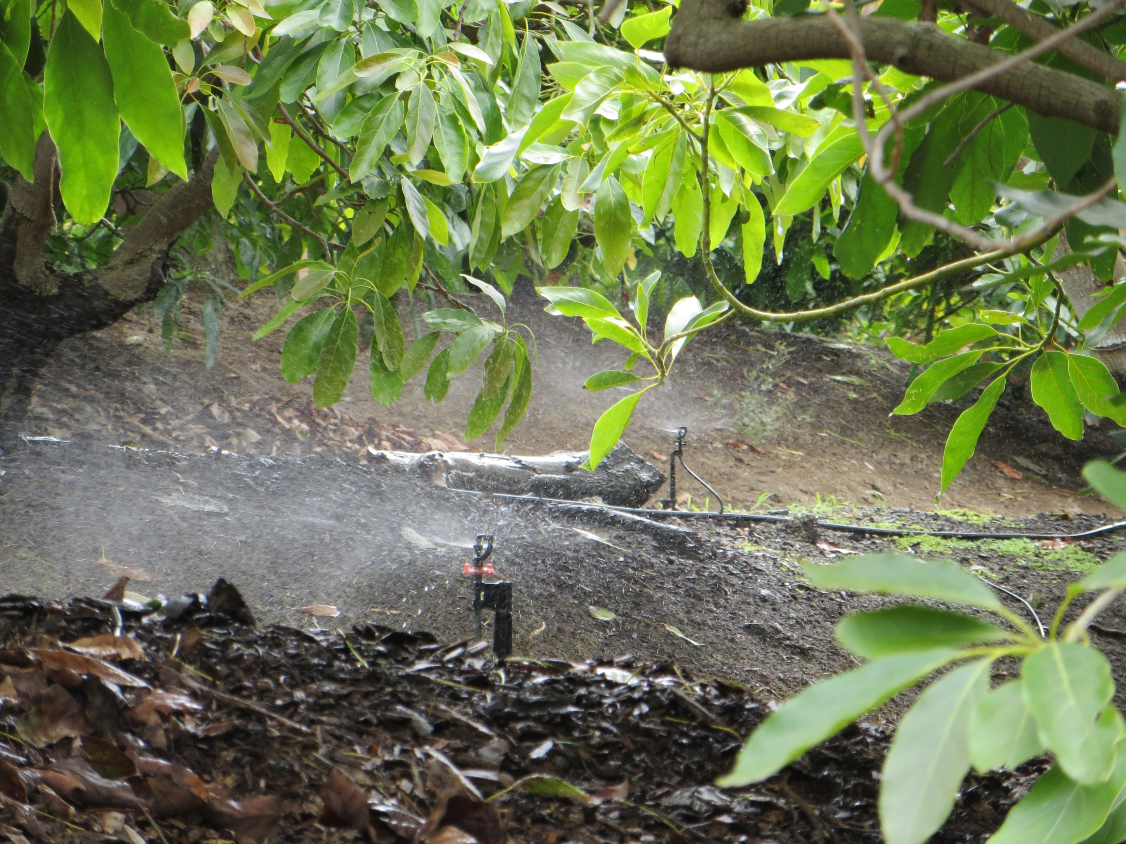
Agricultural Water Use Efficiency (AWUE) Program
All About VCRCD
Partnership with Farm Bureau and USDA-NRCS to conduct irrigation evaluations and cost-share (up to 60%) for equipment upgrades for Ventura County growers
Funded by Prop 84
Notes:
The VCRCD’s Mobile Irrigation Lab (MIL) has been our bread and butter for a while now... We serve both Ventura and Santa Barbara Counties in this programmatic capacity, providing Cachuma RCD with staff. Drought is an ongoing resource concern in CA, but we need to diversify our program so that it meets other resource concerns, too.

Slide 9
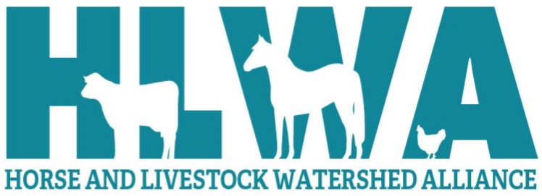
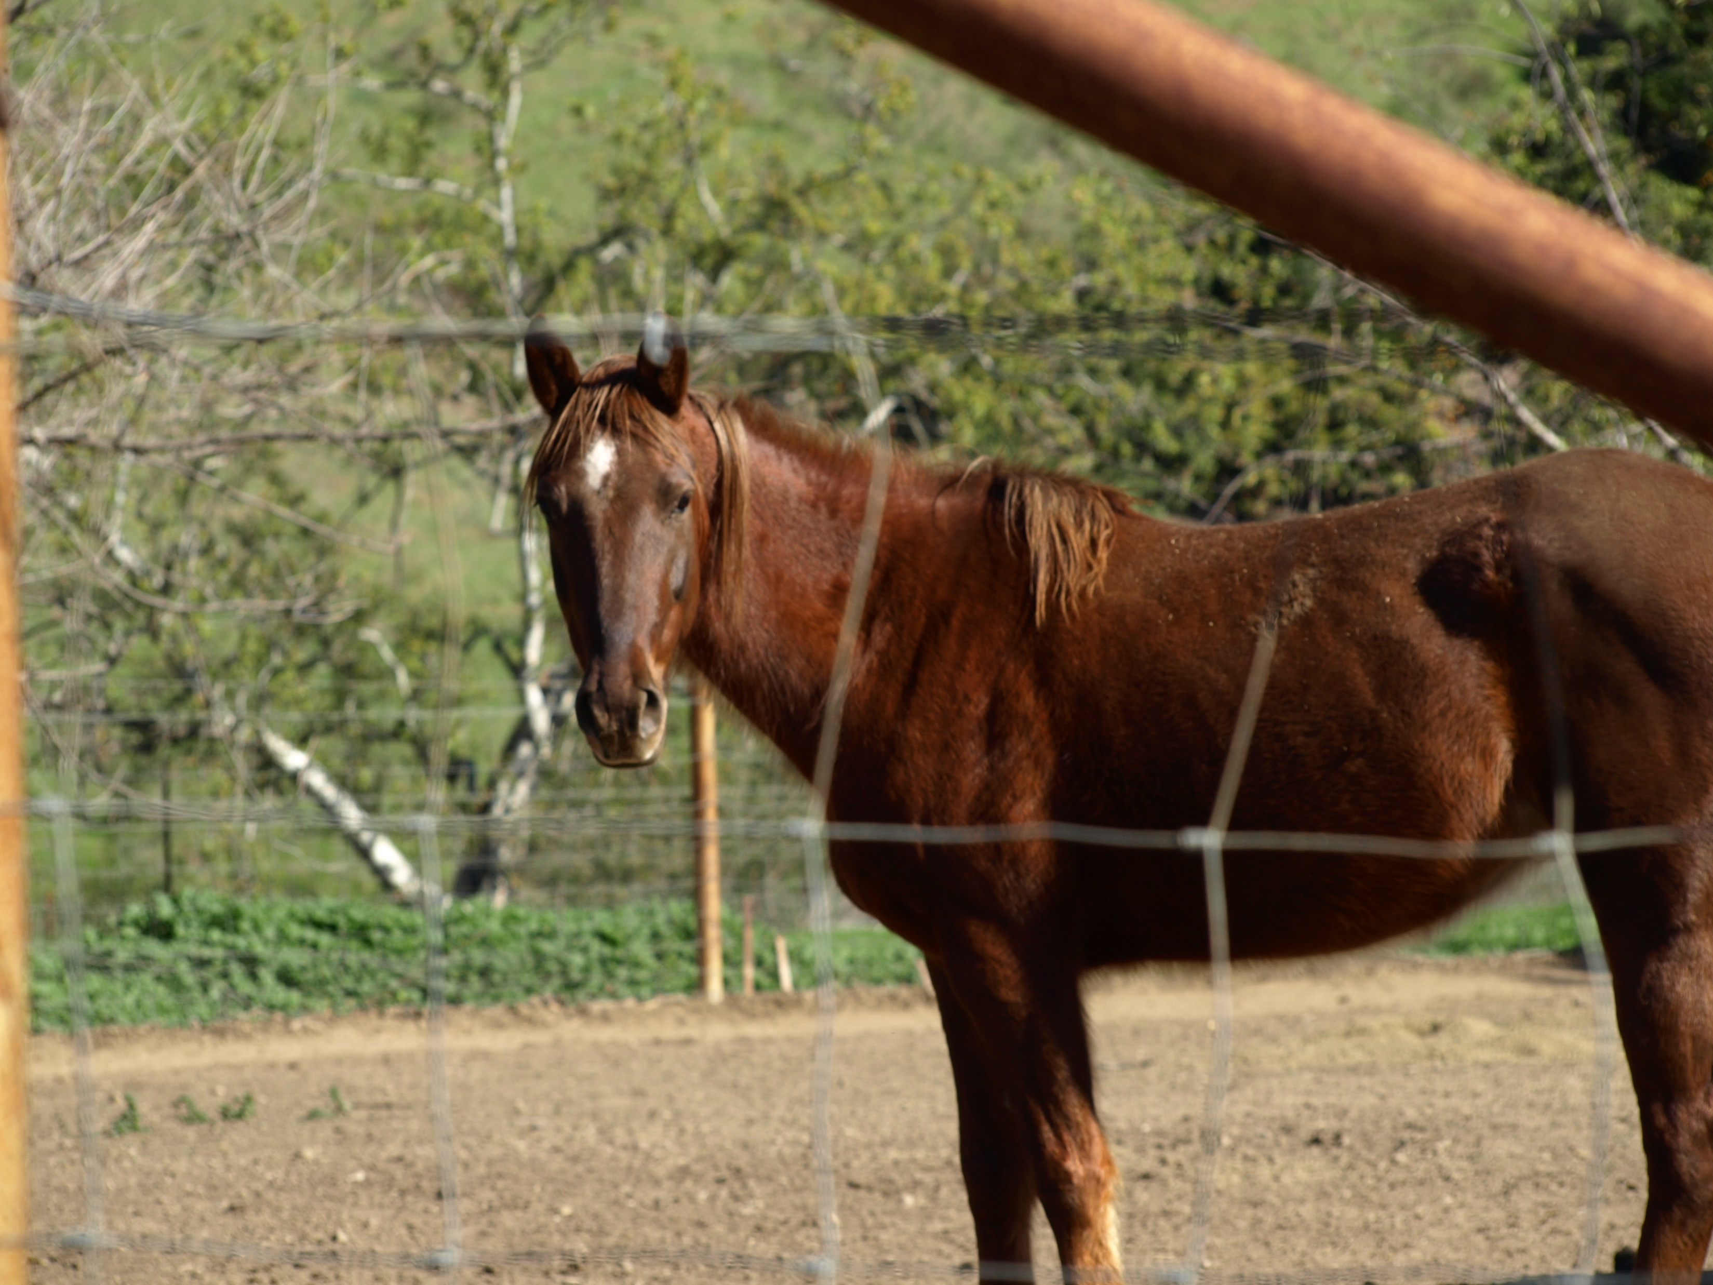
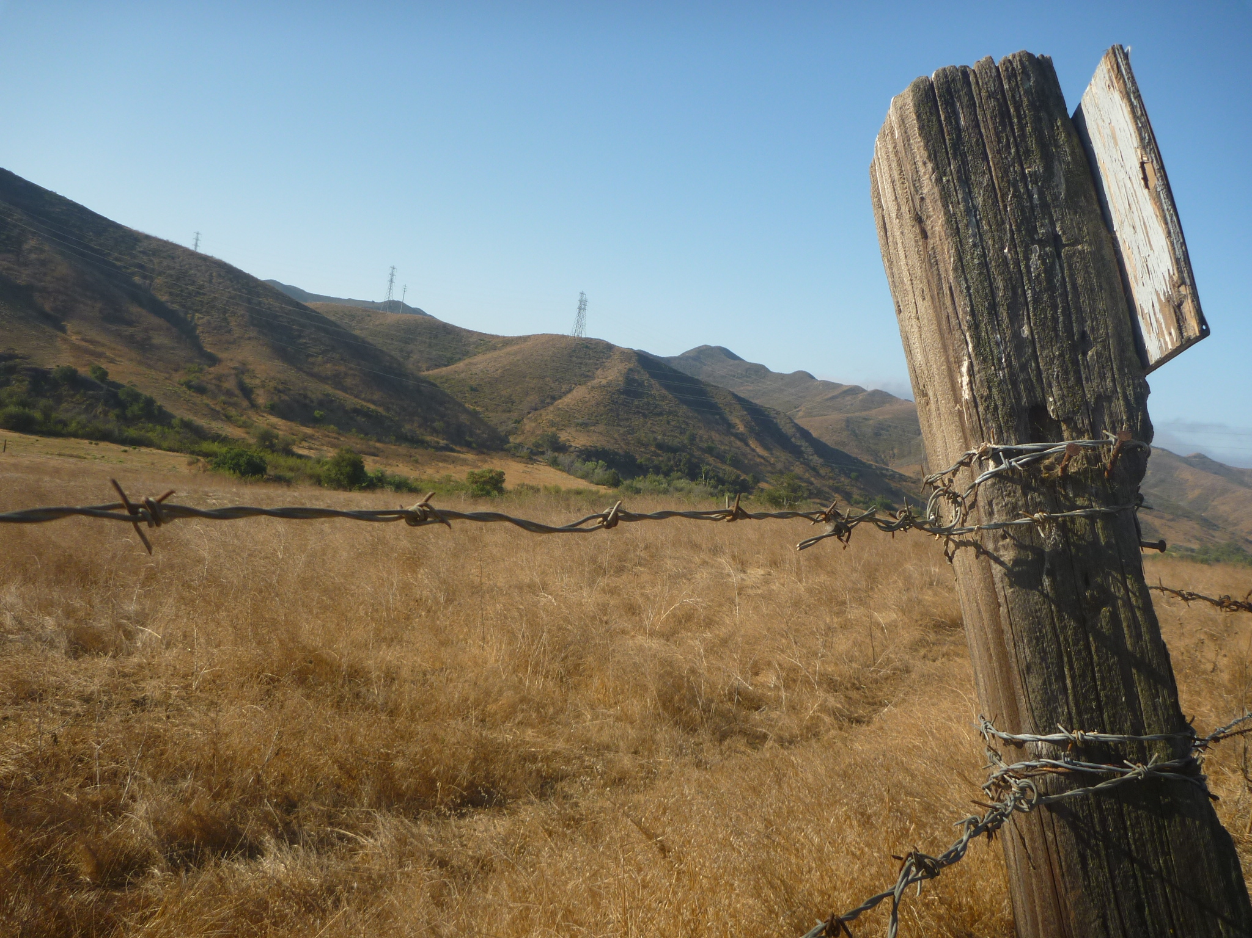
Stormwater Quality
BMPs Program
All About VCRCD
Provide technical assistance to horse and intensive livestock owners in the Ventura River Watershed by:
1. Conducting property walk-throughs (evaluations) and subsequently developing Nutrient Management Plans
2. Providing some cost-share funds to Demonstration Sites for BMP implementation
3. Conducting a variety of outreach and education
Notes:
Give update on how program is going -
- Project funded by the State Water Resources Control Board and administered by the LA Regional Water Quality Control Board
Ends in December
Visited a total of 12 properties and almost finished with developing NMPs
Working with Oak Ranch Estates HOA and CA Coastal Horse Rescue as Demo Sites – manure bunker at HOA and looking to construct O2 Compost structure at CCHR
Still outstanding – finish BMP implementation at demo sites, host field trips at demo sites, send out final brochure mailer, host an HLWA meeting, final reporting
Planning on applying for 319(h) funding this year for implementation $

Slide 10
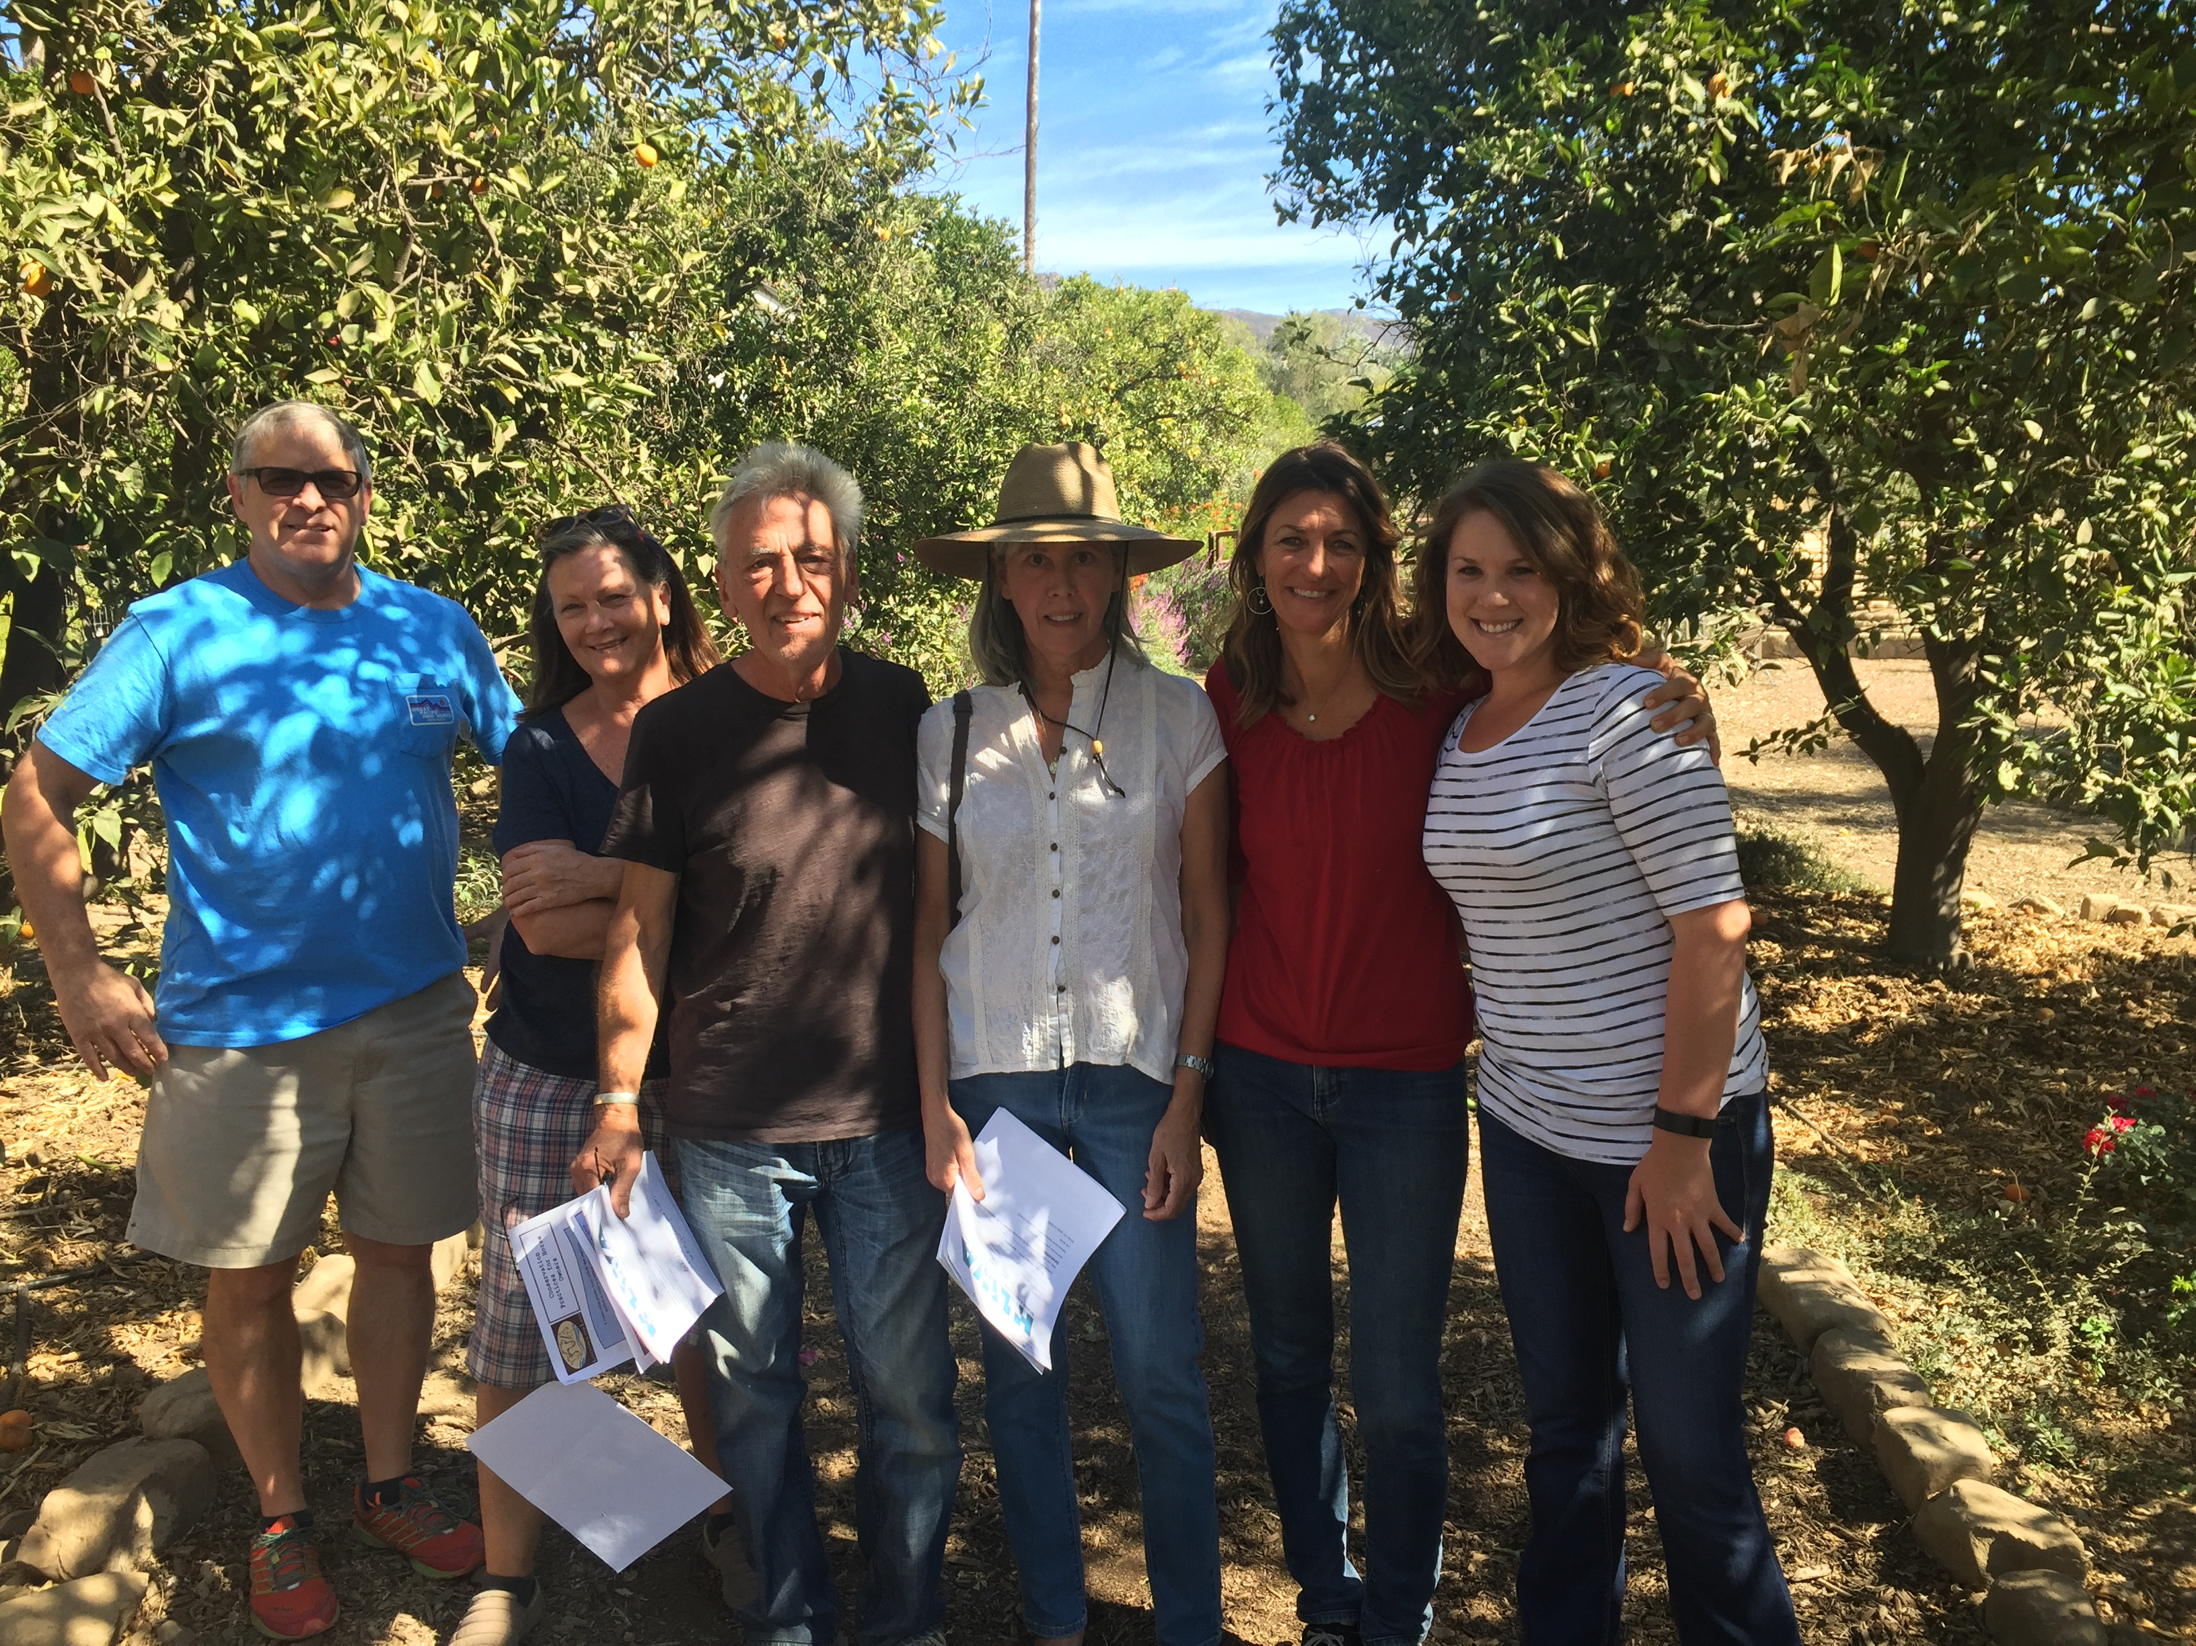
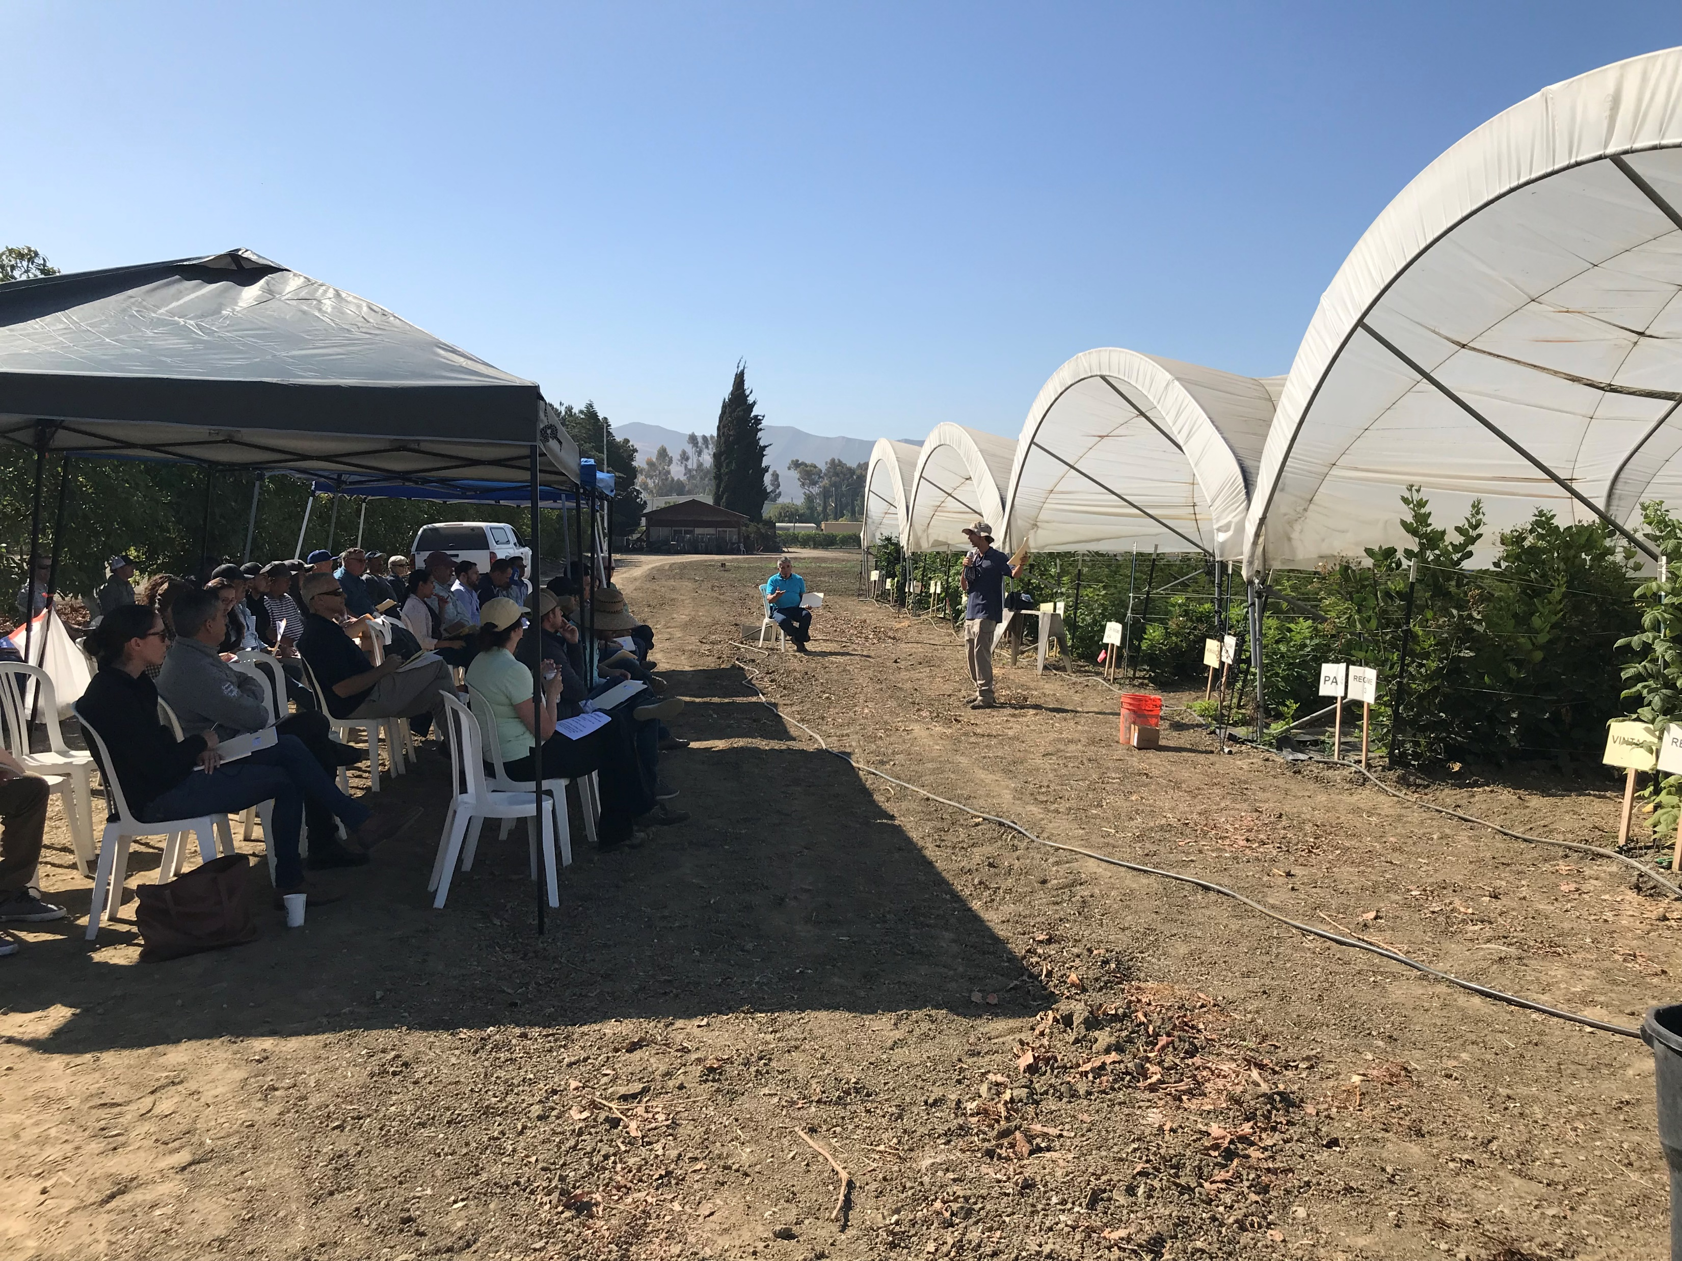
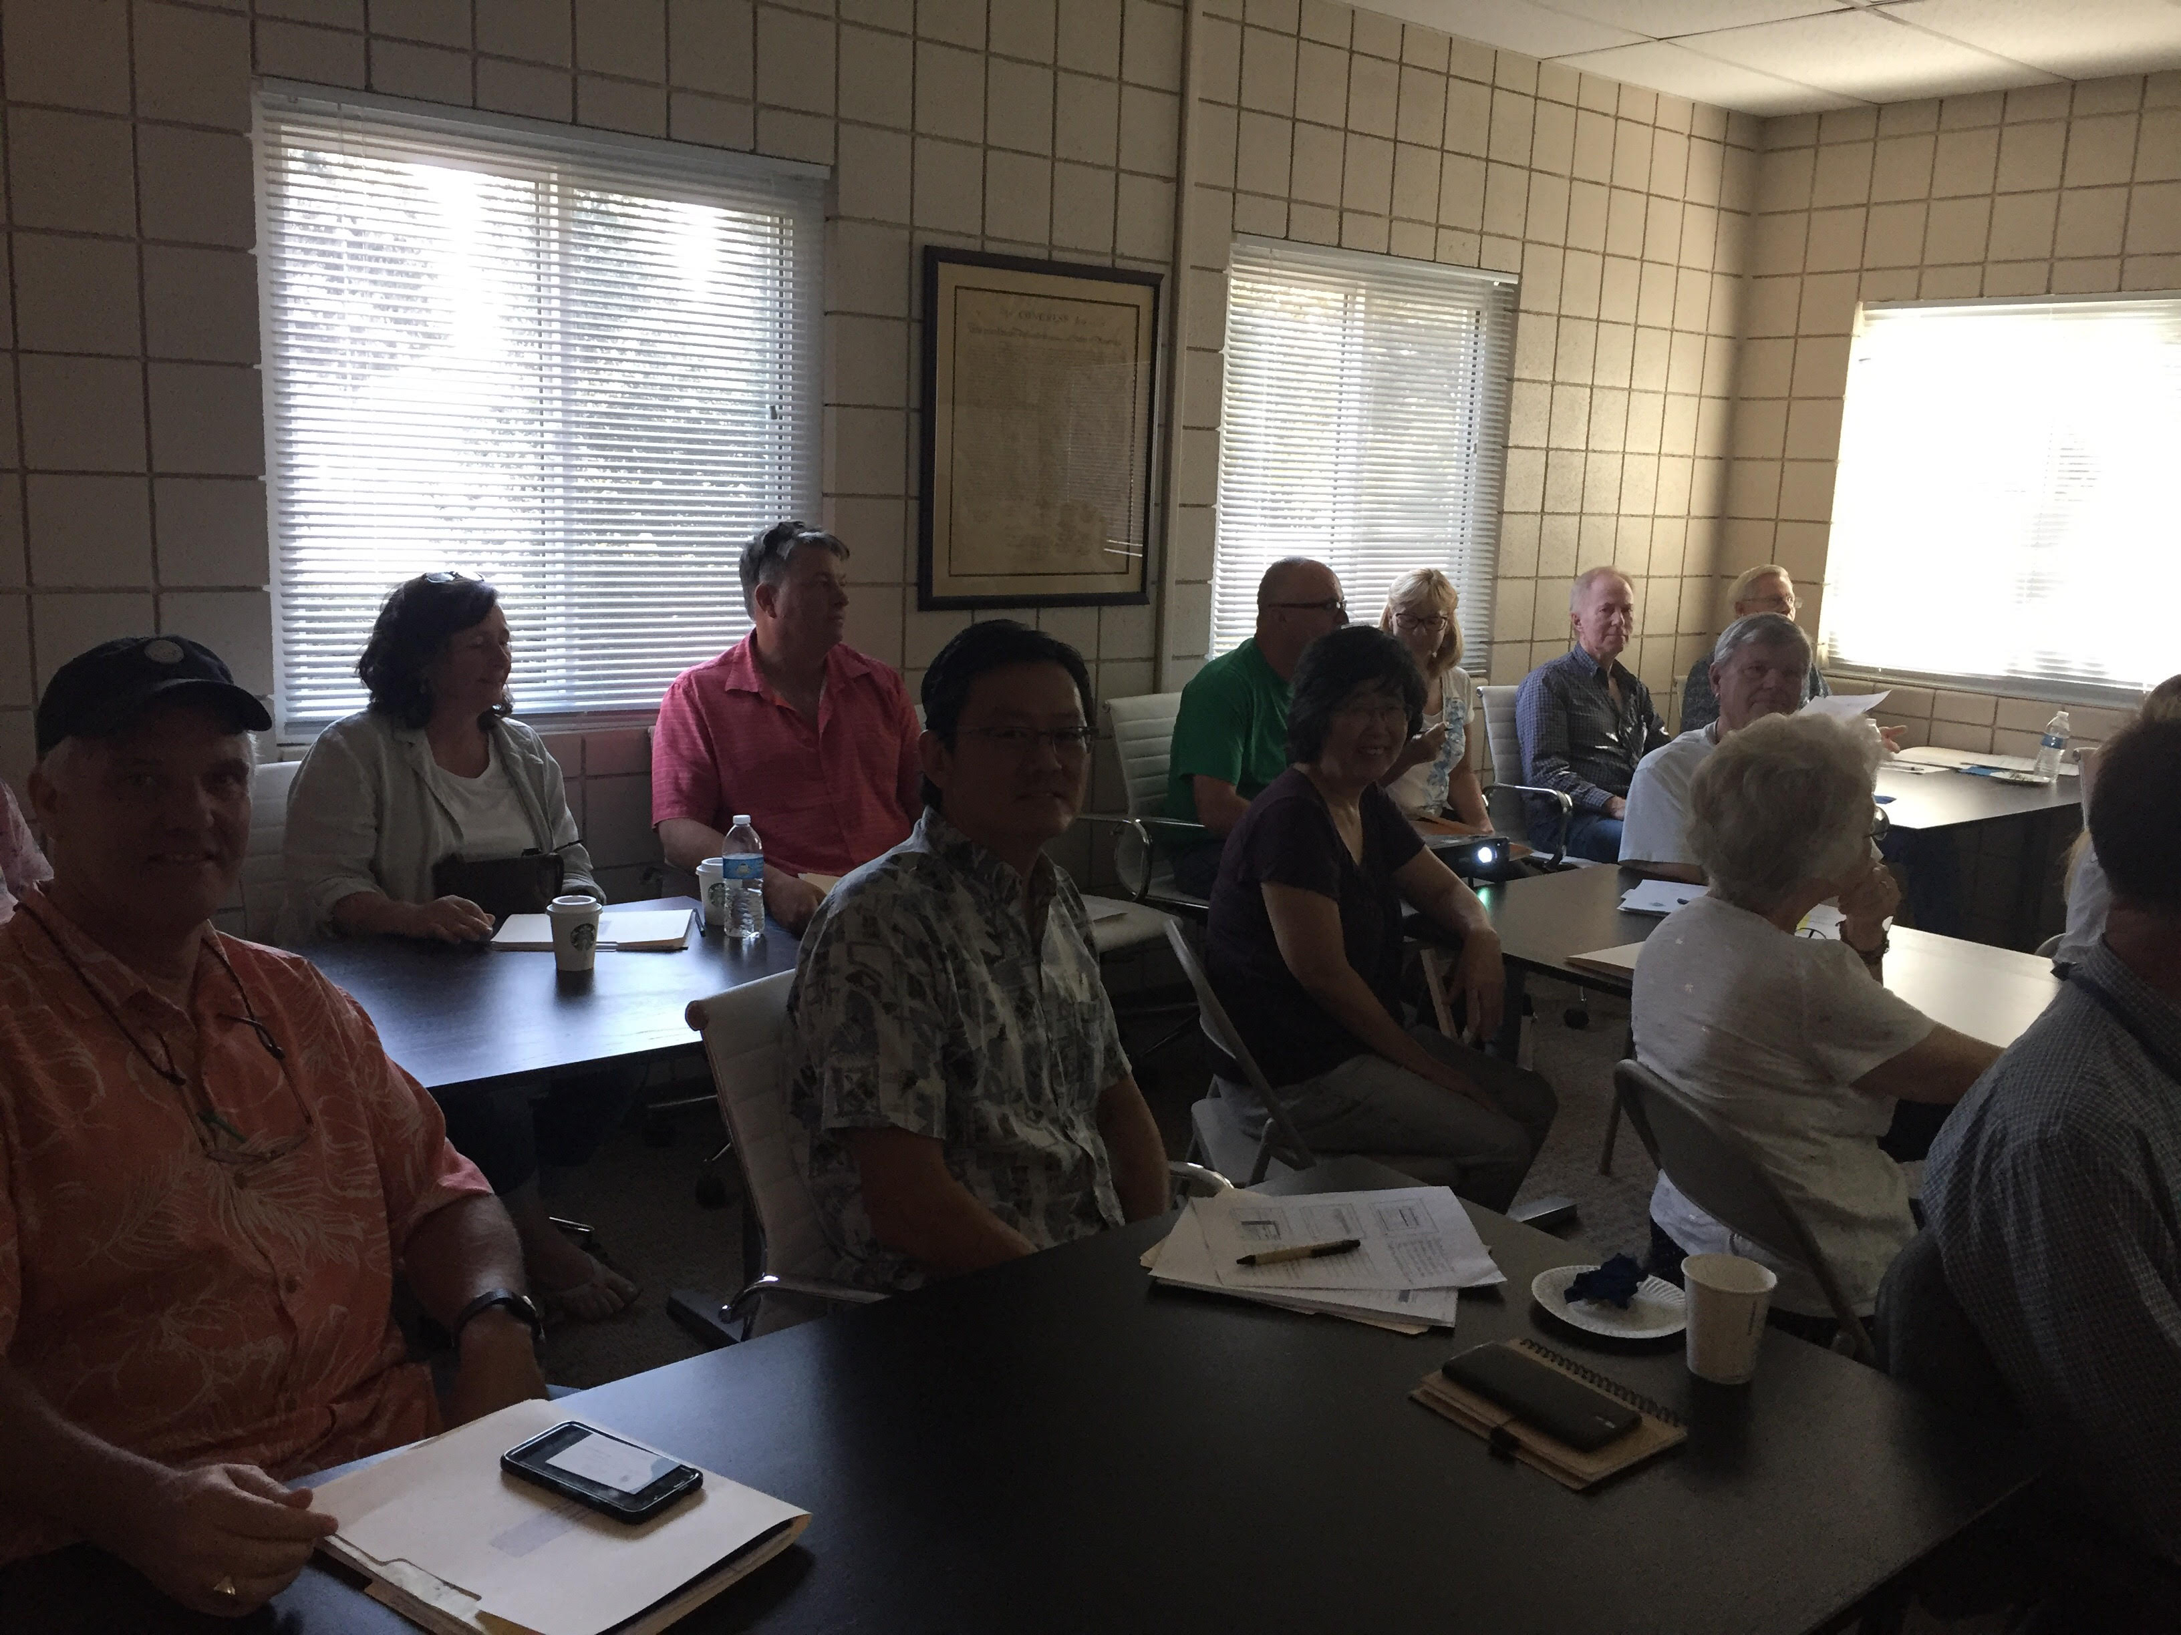
Why VCRCD??
RCDs are eligible to apply for many grants
We have a credible name in the resource conservation world
We’re so much more than agriculture!
We get to work with a variety of entities, ranging from non-profits to the federal government
Our mission is to conserve and protect VC’s resources – what’s cooler than that?!
RCDs are not politically based and don’t have an agenda – we exist to help both the landowner/user AND the environment
Working with landowners/users is valuable, challenging, dynamic, and fun!
We are NOT a regulatory agency, NOT an entity of Ventura County government, and CANNOT impose any authority on landowners/users – we’re here for the landowners, as an ally!
All About VCRCD
The job is a challenge... But it’s worth it!
Notes:
Explain photos – These are just a few...
Aerated composting demonstration at private Ojai horse property - 2016
Raspberry hoophouse stormwater runoff field day and demonstration at Hansen Agricultural Research and Extension Center managed by Ventura County UCCE - 2018
Landowners attending a workshop held at the RCD office for info on how to apply to CDFA’s Healthy Soils Program – 2017
Recall back – VCRCD is almost entirely grant based, which means we’re always hard at work finding the next opportunity!!

Slide 11
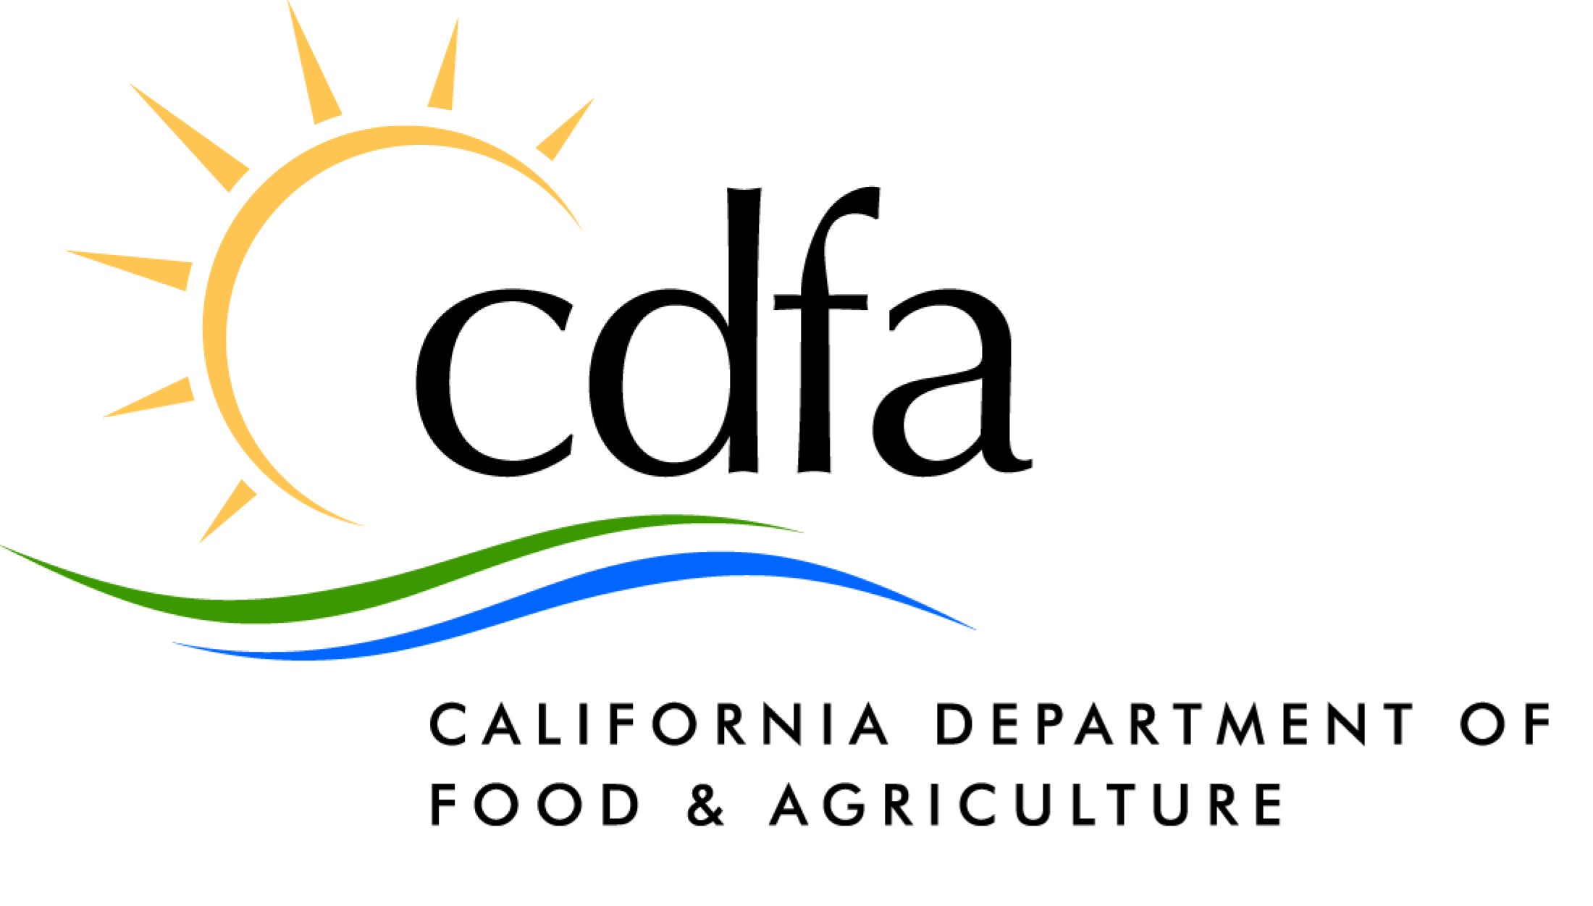
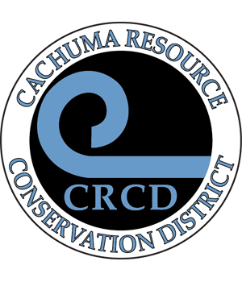
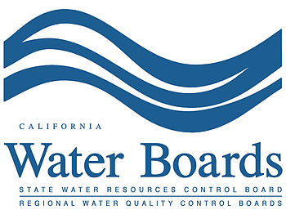
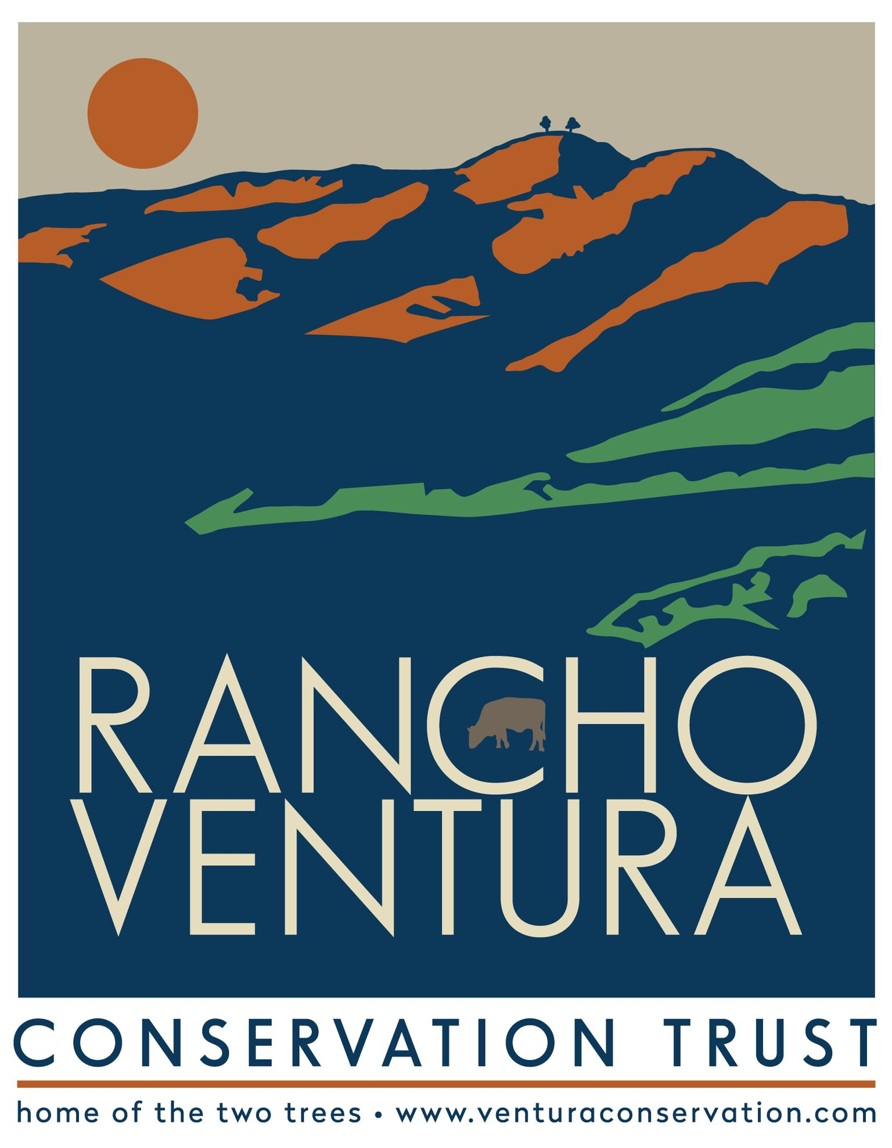
All About VCRCD
How do you see the RCD collaborating with your organization?

