Slide 1
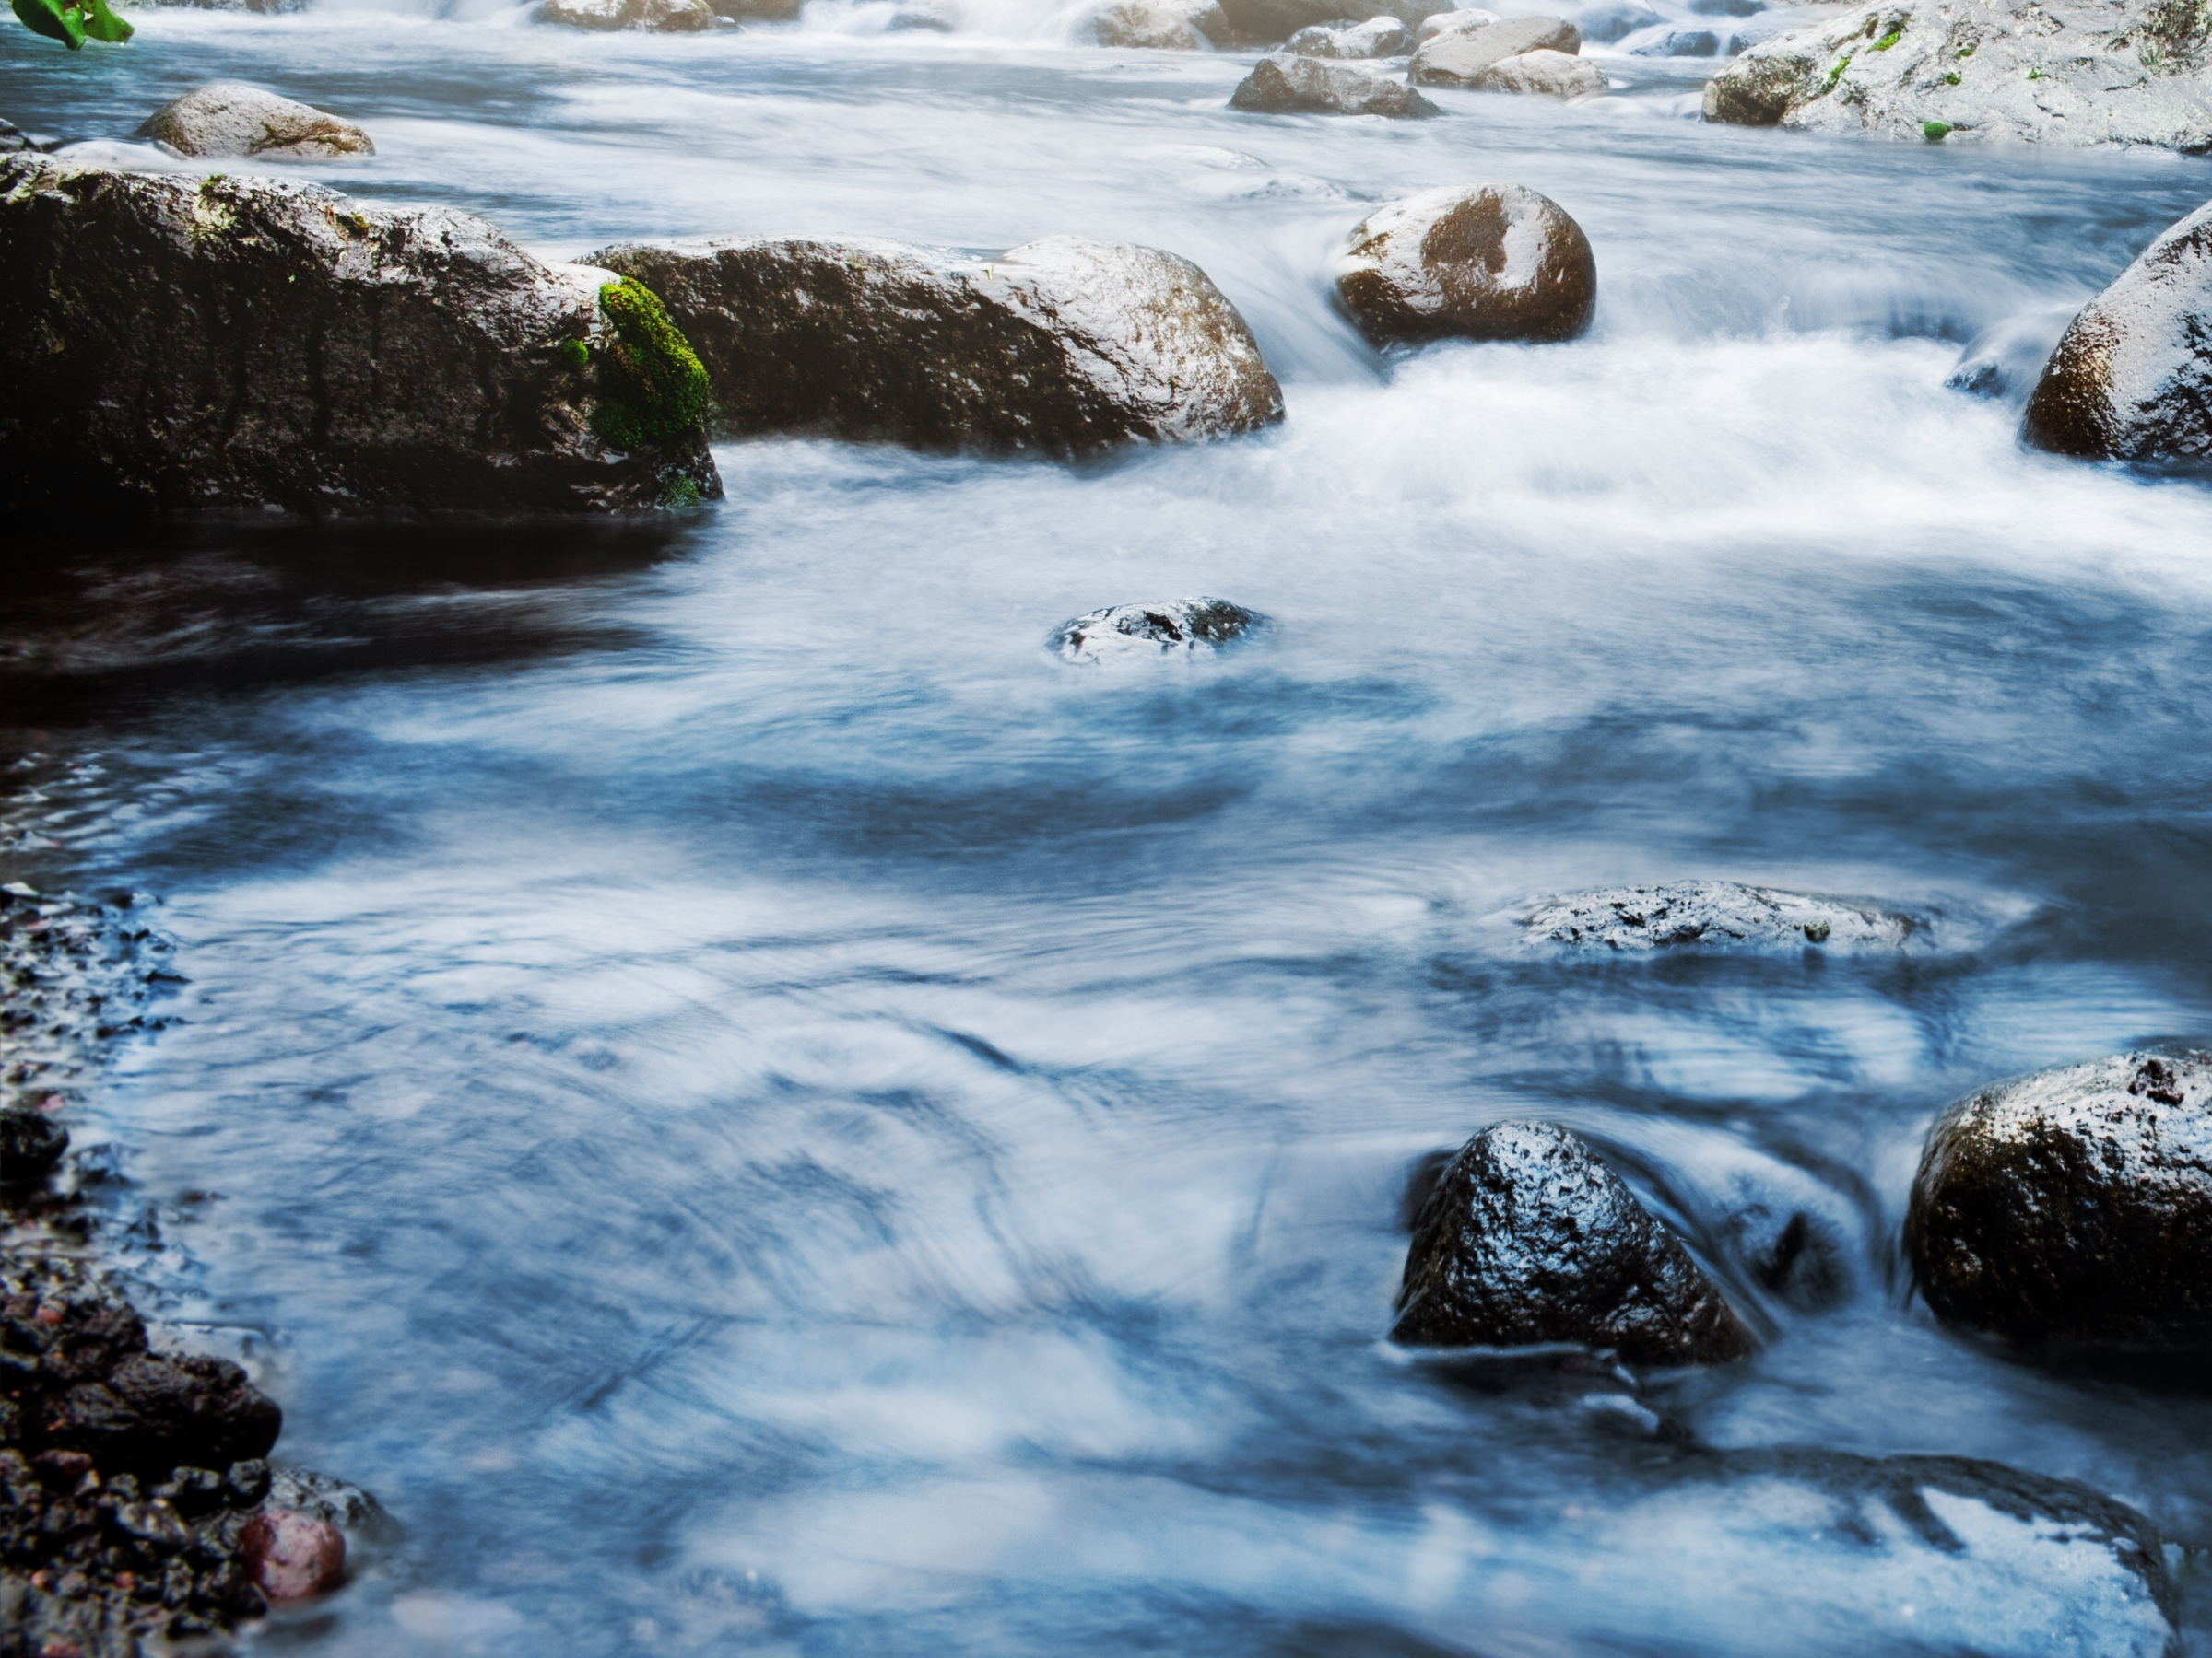
Update - Physical Solution for the Ventura River Watershed
Ventura River Watershed Council

Slide 2
Background
Importance of the Ventura River Watershed for consumptive and instream uses
2014 Channelkeeper lawsuit, state regulatory efforts and City’s cross-complaint
Physical Solution Released September 15, 2020
Meet and confer through January 2021.
2

Slide 3
Overview of Physical Solution
No determination of water rights or water allocations
Focus on specific improvements to Watershed
Protection of historical flows
Management Plan and Management Committee
Long-term implementation in three phases
3

Slide 4
Key Issues
Foster Park Flow Regime
Projects
Funding
Integration with GSA and other efforts
Continuing jurisdiction of the court
4

Slide 5
Projects
Foster Park Fish Passage Improvements
Fraser Street Road Crossing Passage Improvements
Gravel Enhancement in Matilija Creek
Boulder and Large Woody Material Augmentation in San Antonio Creek
Large Woody Material Augmentation in Ventura River at San Antonio Creek Confluence
Arundo Removal
Reduction of Predator and Non-Native Fish
5

Slide 6
Meet and Confer Summary
September 15, 2020 – January 29, 2021
5 formal sessions attended by 60 parties
Dozens of individual sessions
Meetings included SWRCB and CDFW
6

Slide 7
Meet and Confer Results
Possible revisions to Physical Solution
Clarification on monitoring and assessment of fish in good condition
Language on Operations, Maintenance, and Monitoring for Projects
Language on voluntary water management measures
GSA Coordination language
Management Committee Composition
7

Slide 8
Next Steps
February 9, 2021 status conference
Release revised Physical Solution – end of February
Continue to meet and confer
Proposed hearing on Physical Solution in November 2021
State agencies and some parties object to schedule
8

Slide 9
How to Learn More
City Website www.venturariver.com
Adjudication Website www.venturariverwatershedadjudication.com
9

Slide 10
Thank You!
33275130.1

